Slide 1
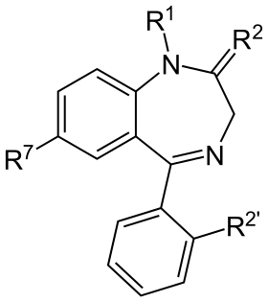
Introduction to Benzodiazepines
Wanjun Gu
PSPG 274 Presentation

Slide 2
Structure
Benzene ring + diazepine ring
Common modifications:
Halogenation at the R7 or R2’ position
Alkylation at the R1 position
Introduction of a fused ring system at R1 and R2 positions

Slide 3
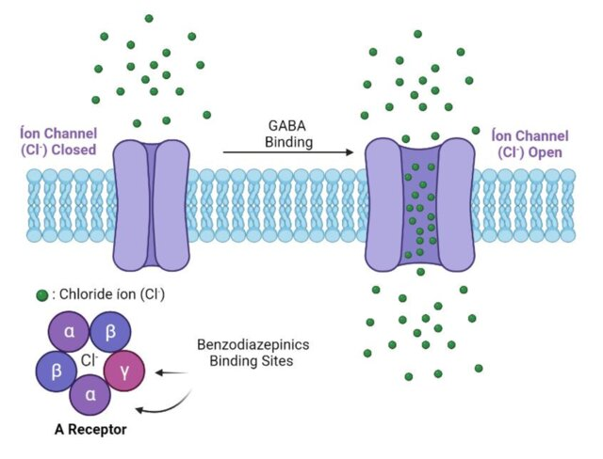
Mechanism
Benzodiazepines target the GABA receptor in the brain. Benzodiazepines target the α receptor by binding at the interface between the α and γ subunits.
Benzodiazepines increase the efficiency of GABAergic neurotransmission by enhancing the frequency or probability of the chloride channel opening in response to GABA. This leads to an increase in the influx of chloride ions into the neuron, making the neuron more negatively charged and less likely to fire.
GABA receptors are pentameric (five-part) ion channels composed of different subunits (e.g., α, β, γ, δ) arranged around a central pore.

Slide 4
Clinical Effects
Sedative and Hypnotic Effects: The overall inhibitory effect on the central nervous system (CNS) results in sedation and facilitates the onset of sleep.
Anxiolytic Effects: Benzodiazepines reduce the activity of neural circuits involved in anxiety, thereby exerting anxiolytic (anti-anxiety) effects.
Anticonvulsant Effects: By inhibiting excessive neural activity, benzodiazepines can prevent or stop seizures, making them effective anticonvulsants.
Muscle Relaxant Effects: They reduce the spinal cord's reflex activity, leading to muscle relaxation.

Slide 5
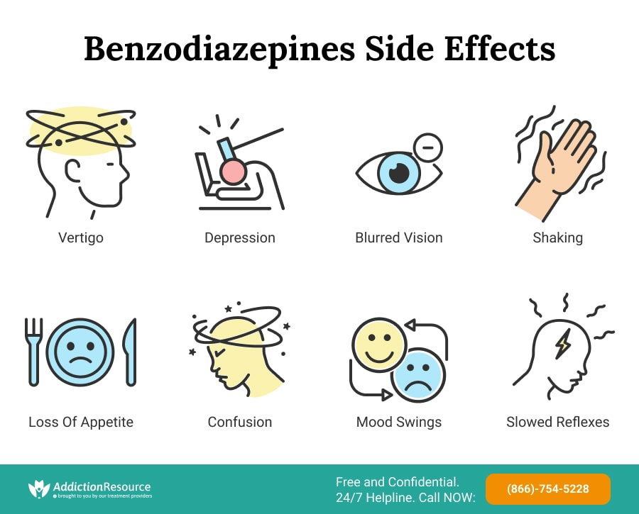
Side Effects
Cognitive and Motor Impairment: Impaired memory, drowsiness, and decreased motor coordination are common side effects.
Withdrawal and Addiction: The risk of dependence and withdrawal symptoms necessitates careful management of benzodiazepine use.

Slide 6
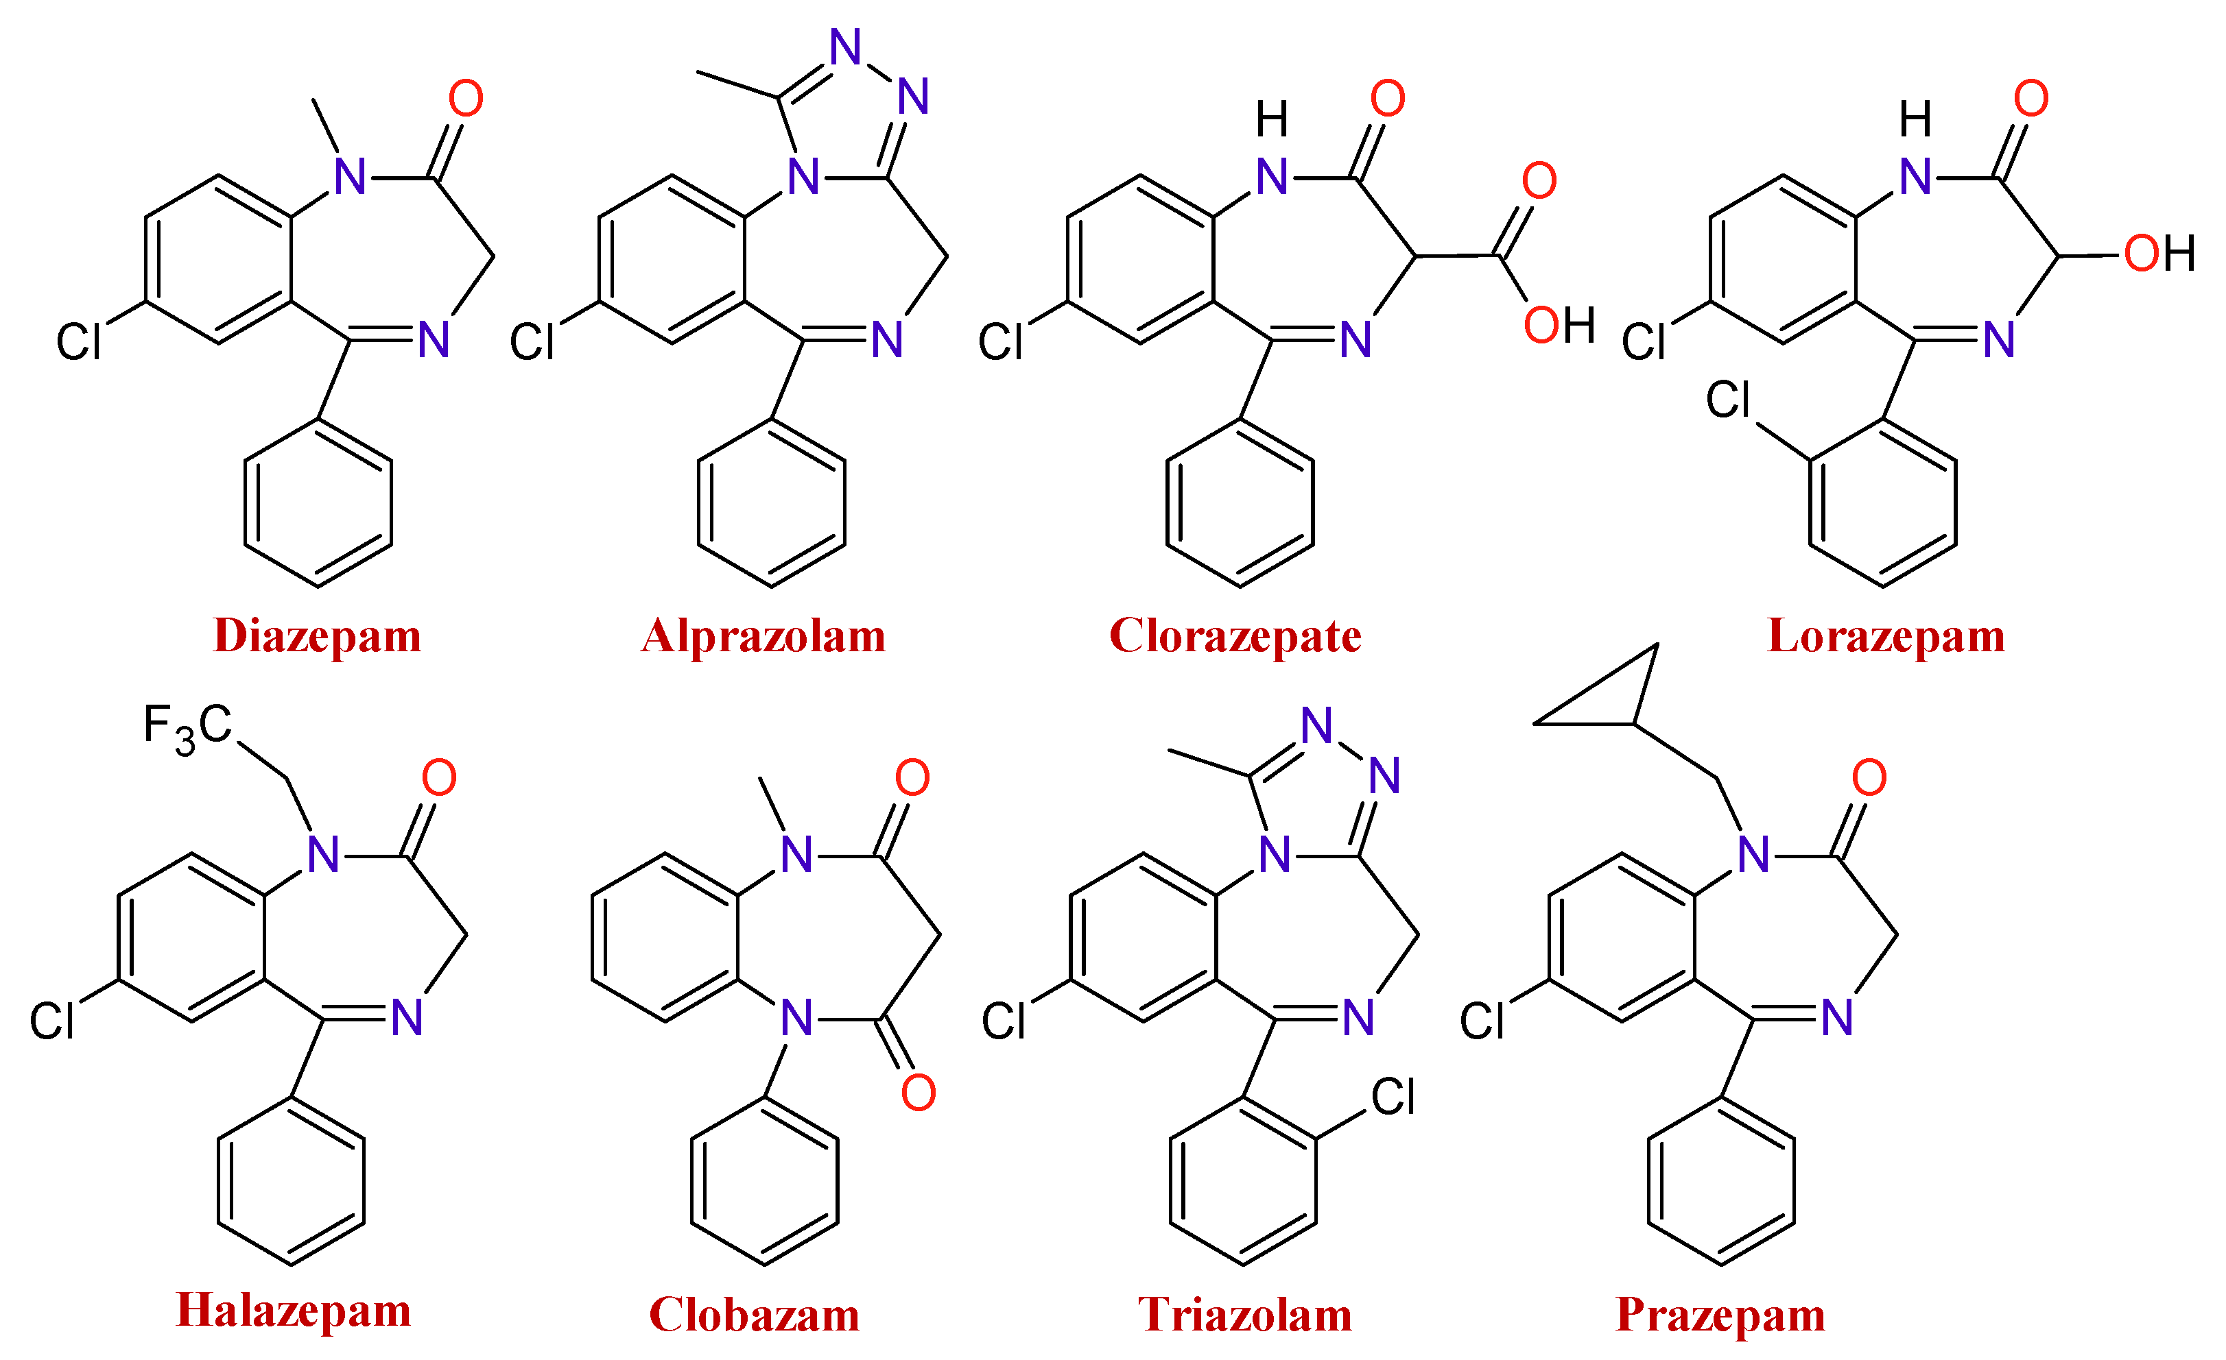
Types of benzodiazepines

Slide 7
Types of benzodiazepines
Diazepam:
Treats anxiety, muscle spasms and seizures
Brand name: Diastat and Valium
Alprazolam:
Treats anxiety and panic disorder
Brand name: Xanax

Slide 8
Types of benzodiazepines
Triazolam:
Treats insomnia, used for dental oral sedation
Brand name: Halcion

Slide 9
Types of benzodiazepines
Lorazepam:
Treats seizure disorders, such as epilepsy. Also used before surgery and medical procedures to relieve anxiety.
Brand name: Ativan

Slide 10
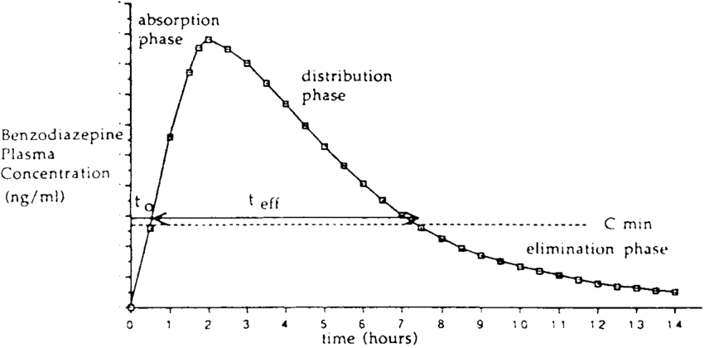
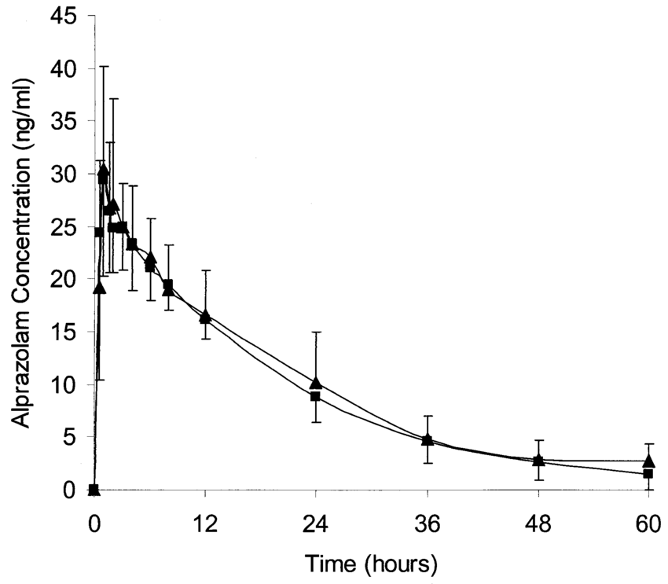
Pharmacokinetics
Concentration curve of Xanax (Alprazolam)
General concentration curve of benzodiazepines

Slide 11
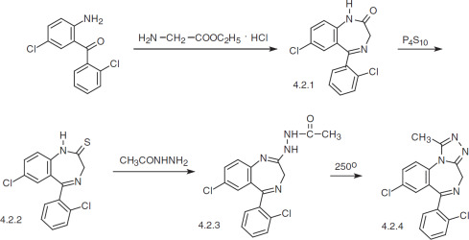
Synthesis
General synthesis process of many benzodiazepines
Reacting o-aminobenzophenones with α-amino acid derivatives
Transforming the carbonyl group into a thiocarbonyl group using phosphorus pentasulfide.
Synthesis of Xanax (Alprazolam)

Slide 12
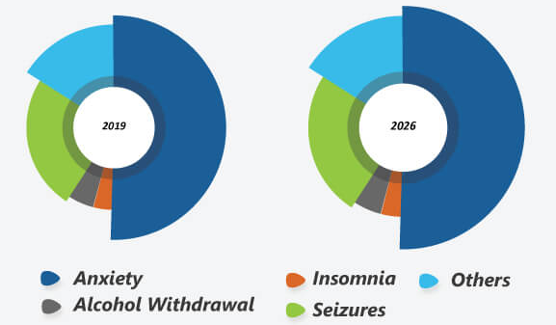
Market Segmentation of Benzodiazepines

Slide 13

Market Segmentation of Benzodiazepines

Slide 14
Summary
Benzodiazepines are a class of psychoactive drugs widely used against anxiety, insomnia and seizure.
Benzodiazepines target the GABA receptor to increase Cl- influx to reduce neuron firing.
Commonly seen benzodiazepines include alprazolam, midazolam, lorazepam, etc.
Benzodiazepines is fast-absorbing and takes a long time to metabolize.
Benzodiazepine addiction is a global epidemic.

