Slide 1
Determine DV Ratio Variation Across Strains
Wanjun Gu
Darquenne Lab
Nov. 11th 2019

Slide 2
Previously done
Determining DV Ratio
Determining Skewness of particle deposition distribution

Slide 3
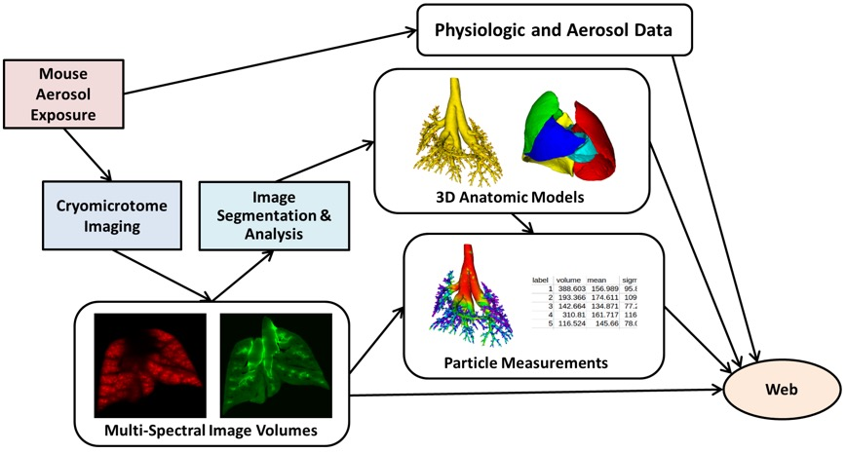
LAPD Experiment

Slide 4
LAPD Dataset
Particle Size | Strain and Sex |  |  |  |  |  |  |  | Total
 | B6C3F1 |  | BALB/c |  | CD-1 |  | C57BL/6
 | M | F | M | F | M | F | M | F
0.5 µm | - | - | 1 | 2 | - | - | - | - | 3
1.0 µm | 2 | 2 | 2 | 2 | 2 | 2 | 2 | 2 | 16
2.0 µm | 2 | 2 | 2 | 2 | 1 | 2 | 2 | 2 | 15
* One sample was omitted during the analysis due to bad quality |  |  |  |  |  |  |  |  | 34

Slide 5
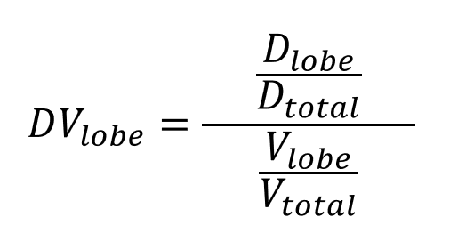
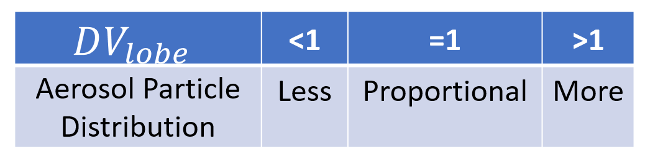
DV Ratio

Slide 6
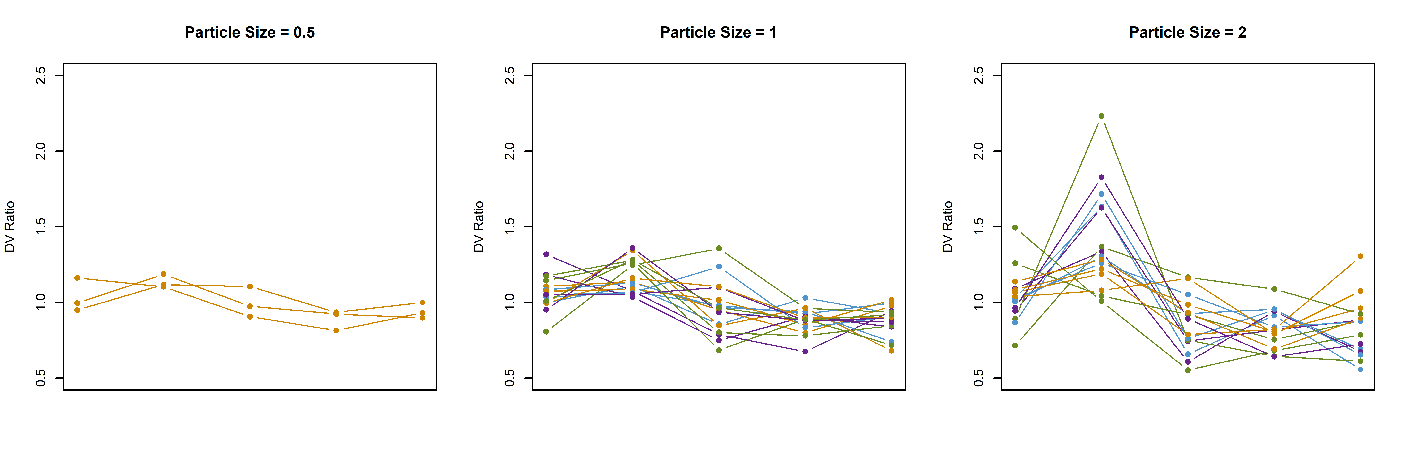





Left
Cranial
Middle
Caudal
Accessory
Left
Cranial
Middle
Caudal
Accessory
Left
Cranial
Middle
Caudal
Accessory

Slide 7
Particle Size | DV Ratio
 | Left | Cranial | Middle | Caudal | Accessory
1 Micron | 1.06±0.11 | 1.17±0.11 | 0.96±0.18 | 0.88±0.08 | 0.88±0.10
2 Micron | 1.04±0.18 | 1.42±0.34 | 0.86±0.19 | 0.82±0.13 | 0.80±0.15

Slide 8
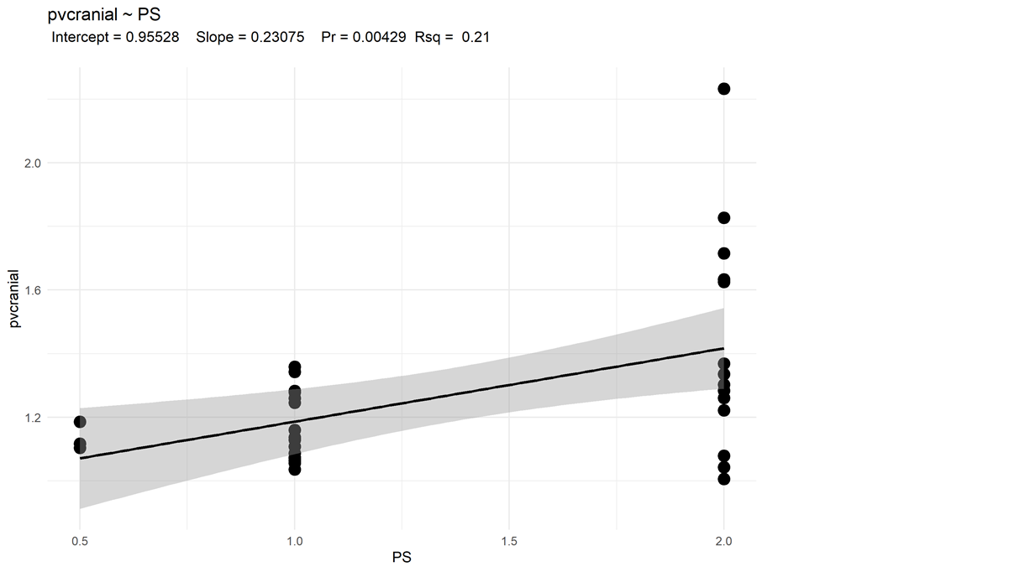
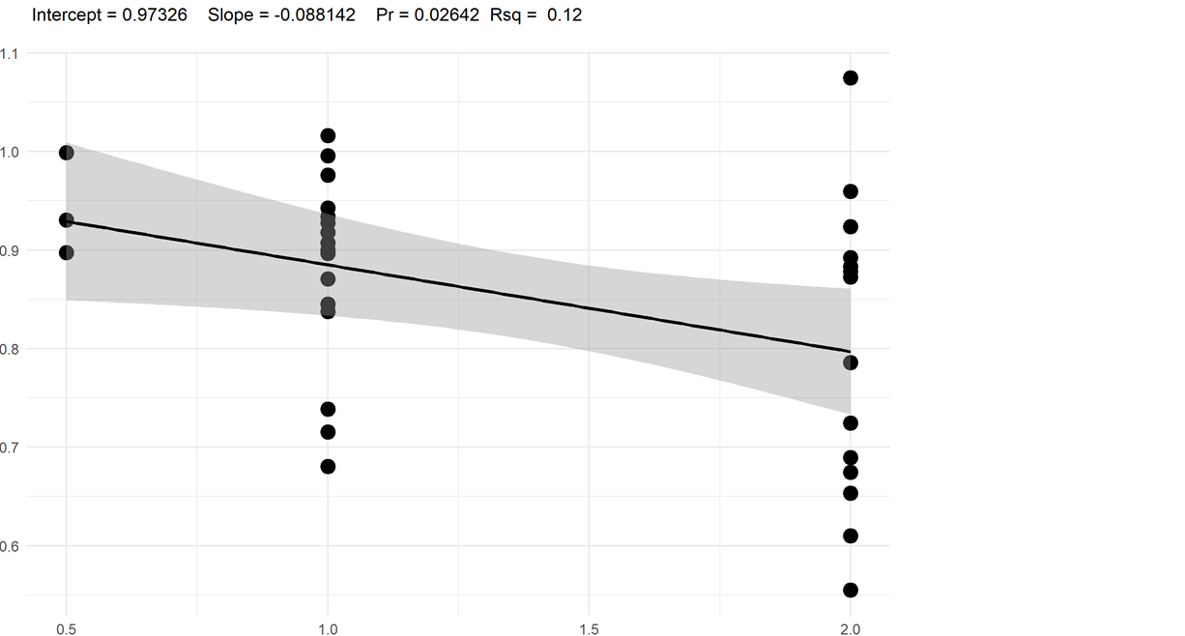


$$DV_{Cranial} Ratio$$
$$DV_{Accessory} Ratio$$
Particle Size
Particle Size

Slide 9
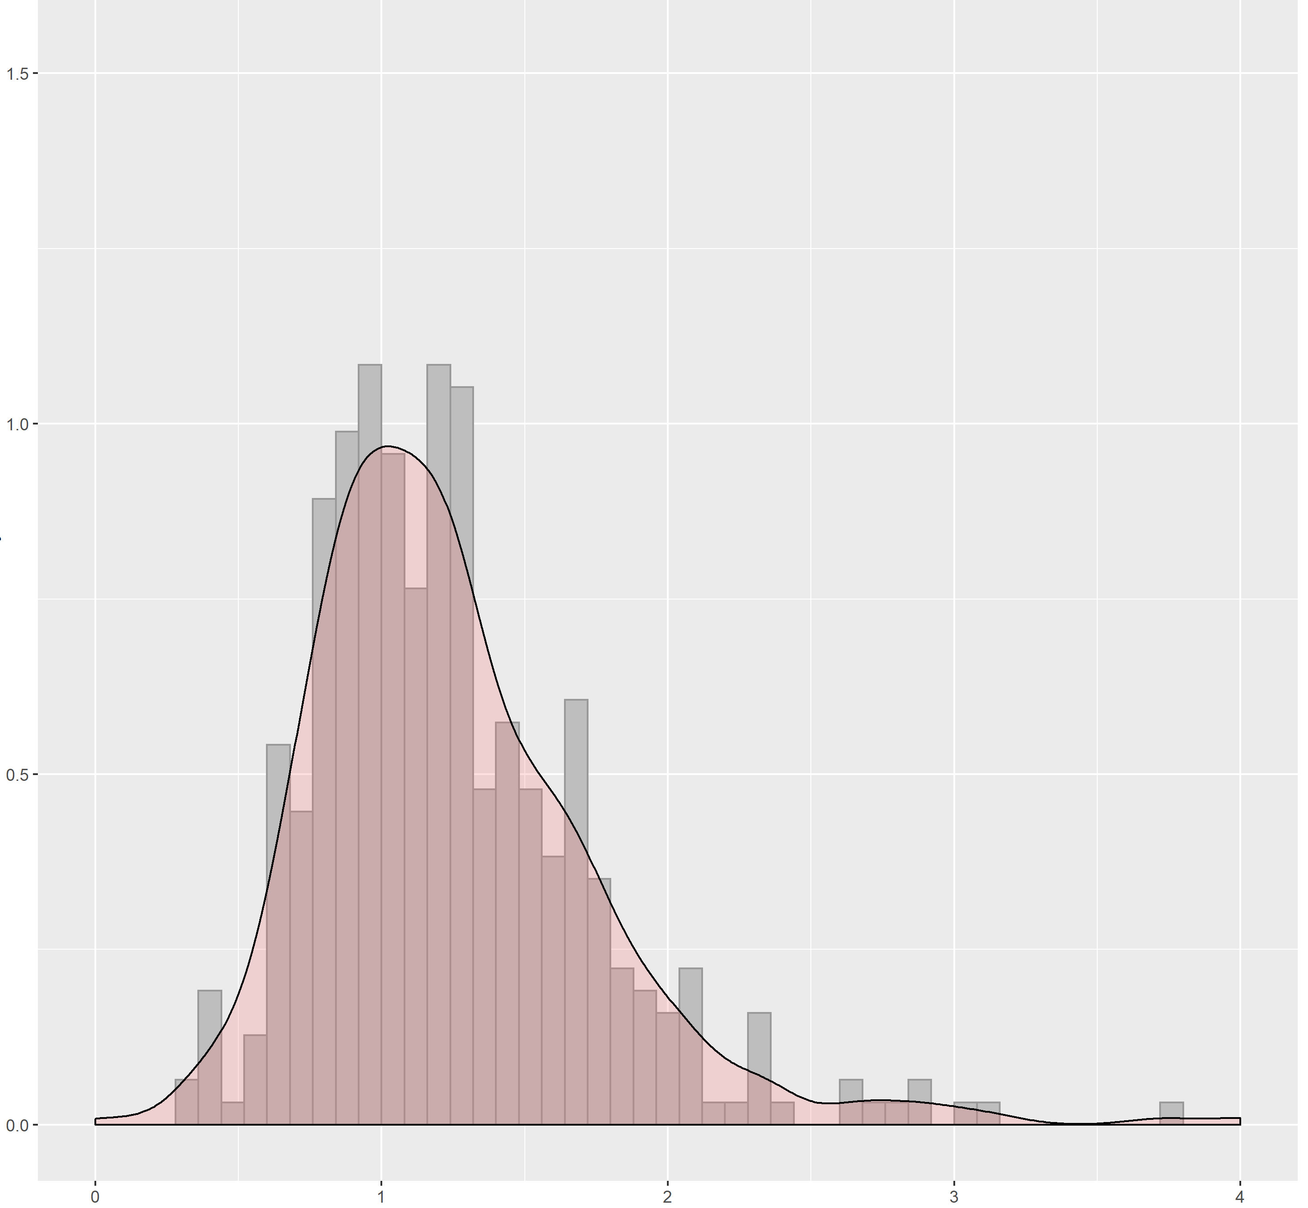
Skewness of Particle Deposition Distribution

Slide 10
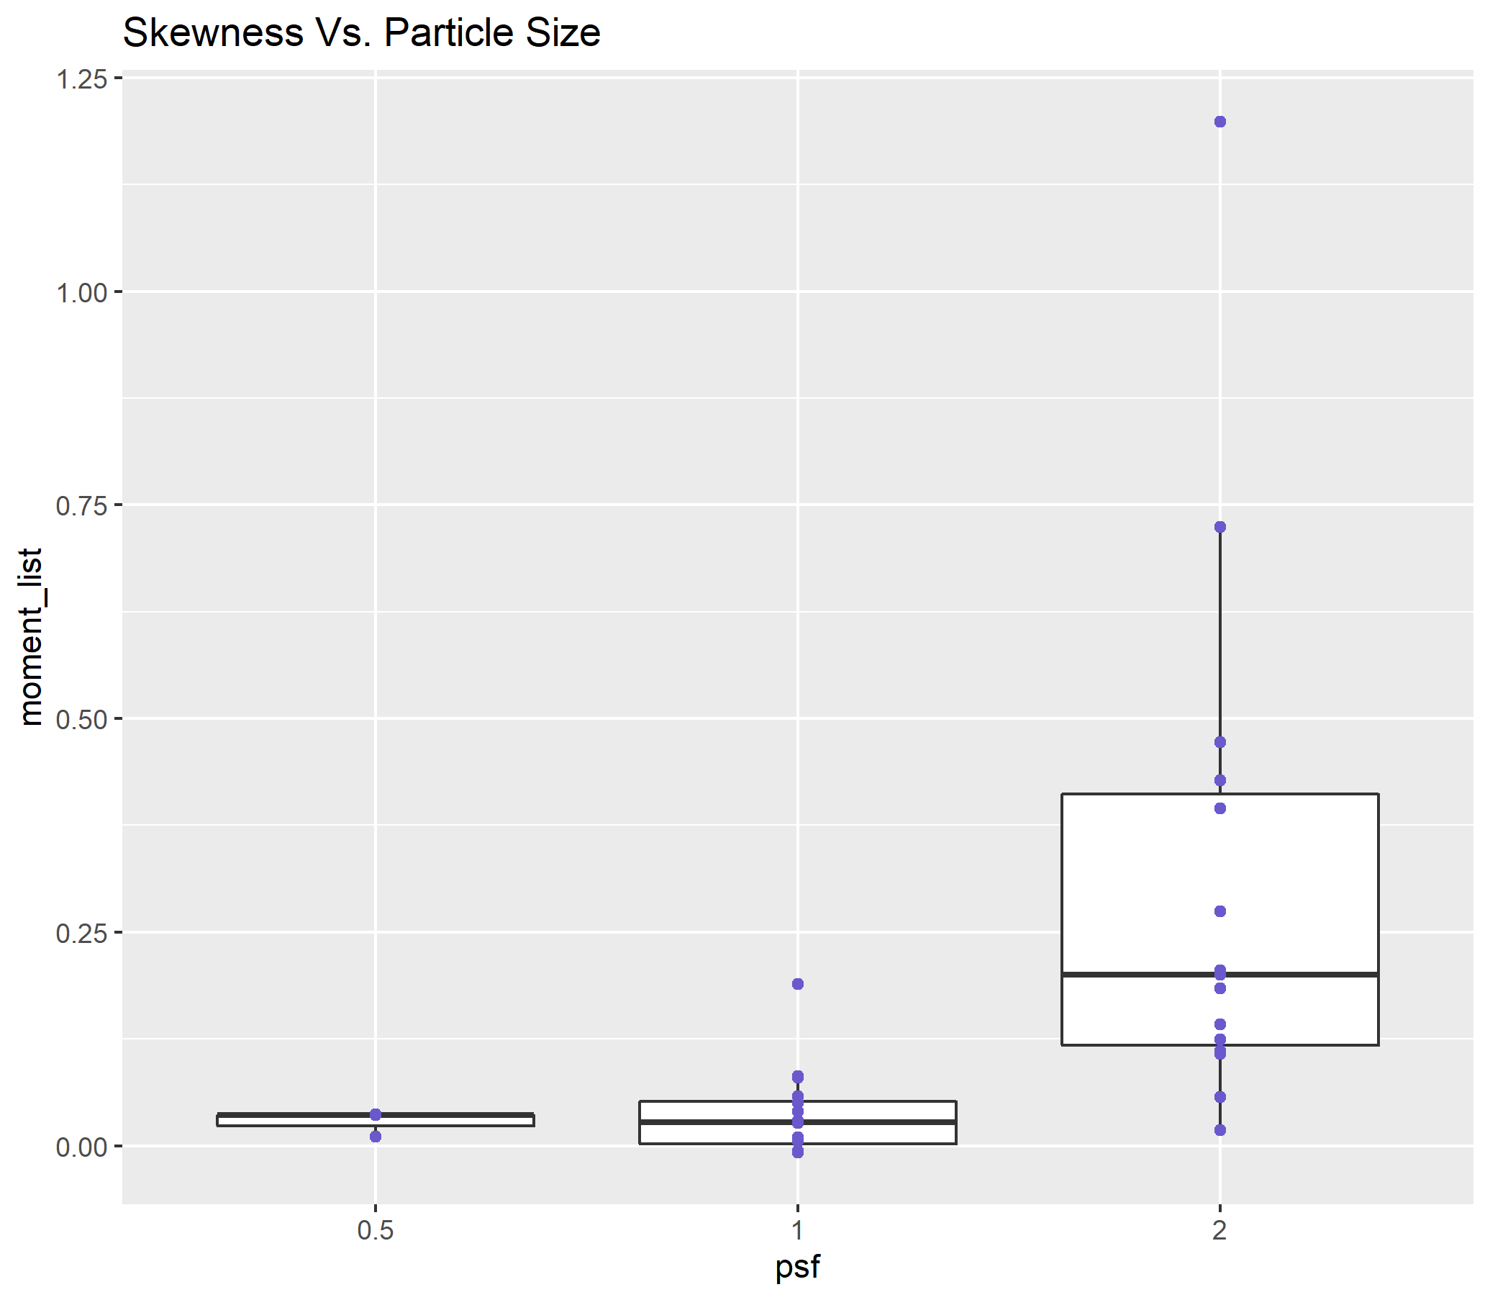
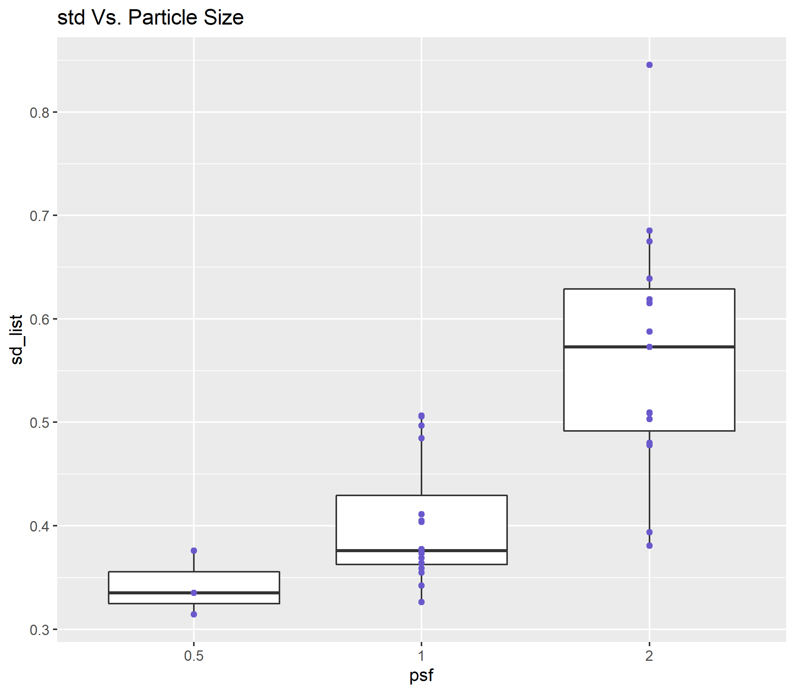
Standard Deviation
Vs. Particle Size
Skewness Vs. Particle Size
Skewness
Standard Deviation
Particle Size
Particle Size

Slide 11
Conclusion up to dosimetry conference
There was an uneven distribution of deposited particles among the lobes of the mouse lung. The unevenness increased with increasing particle size. Depending on the lobe, individual lobe analysis to determine overall deposition may either underestimate or overestimate total lung burden, at least for particles in the micron size range.
At near acini level, larger particle size was associated with higher likeness of formation of hot spots and a less uniform spatial distribution of particle deposition.

Slide 12
Finding Correlation between Particle Size and strain

Slide 13
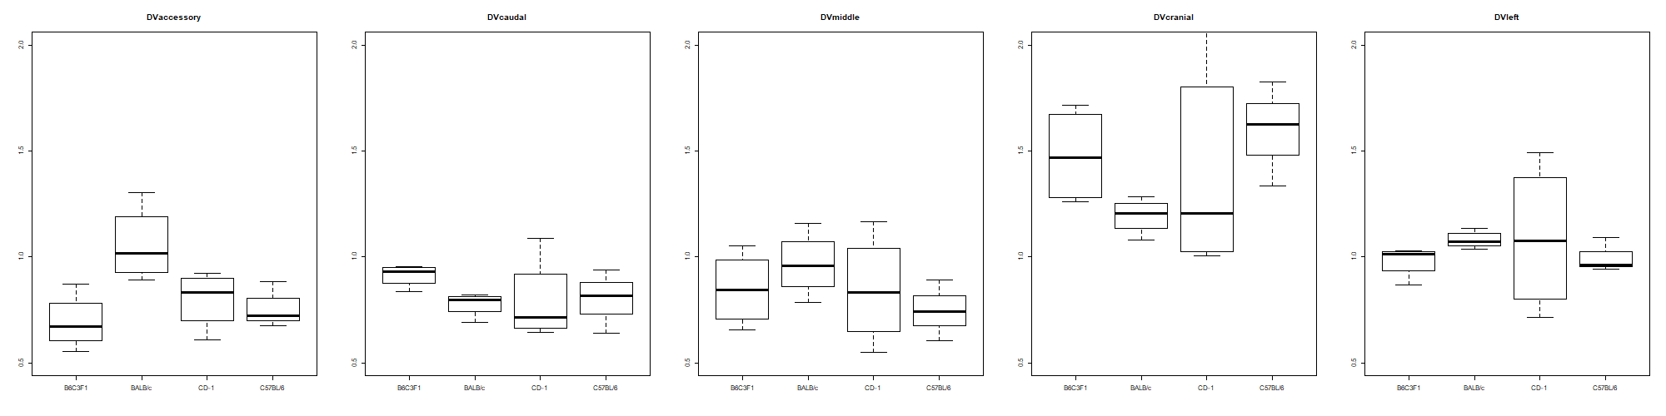

Slide 15
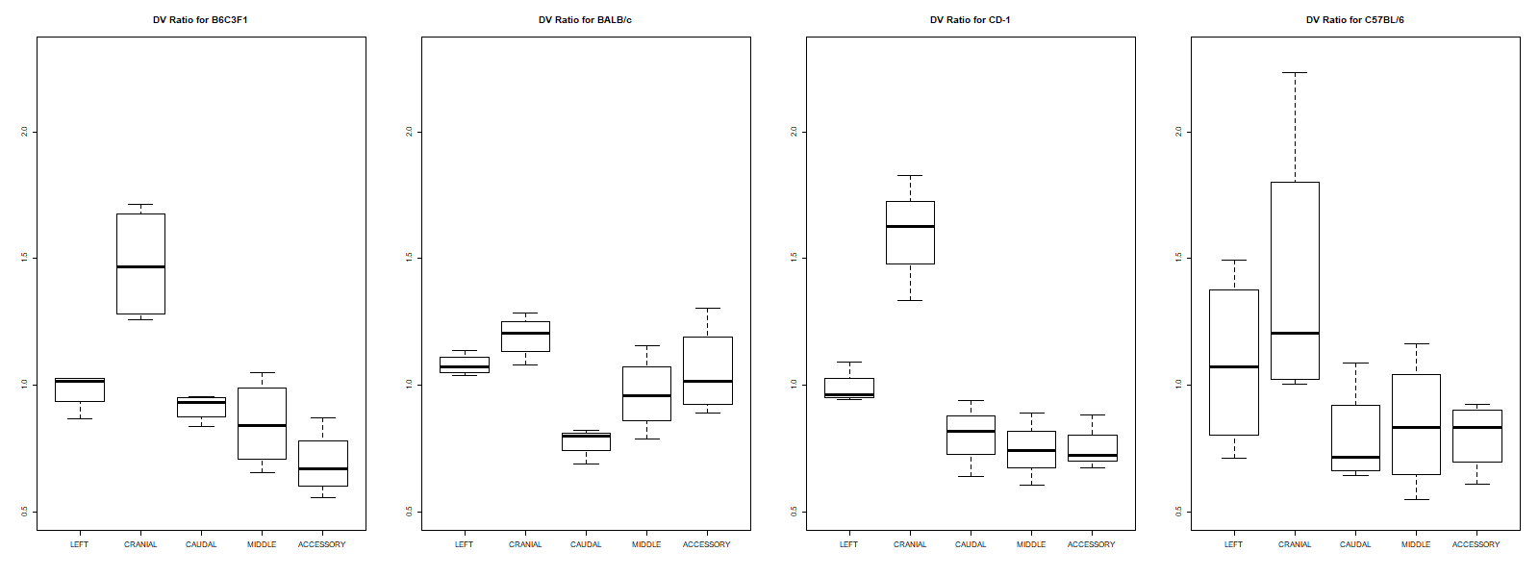

Slide 16
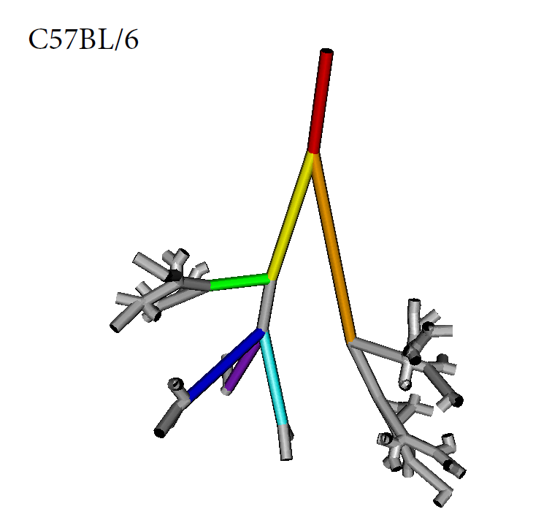
Explain the significantly lower DV accessory in BALB/c
Airway Entrance Angle

Slide 17
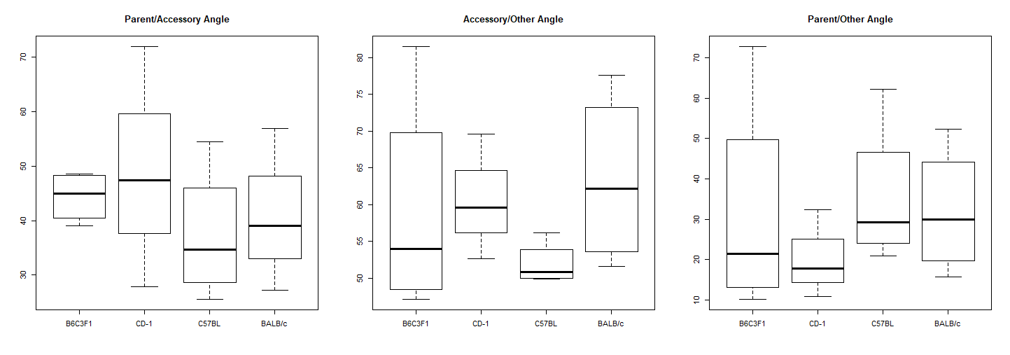

Slide 18
Notes

