Slide 1
LAPD Dataset Processing
Wanjun Gu
Update 052119

Slide 2
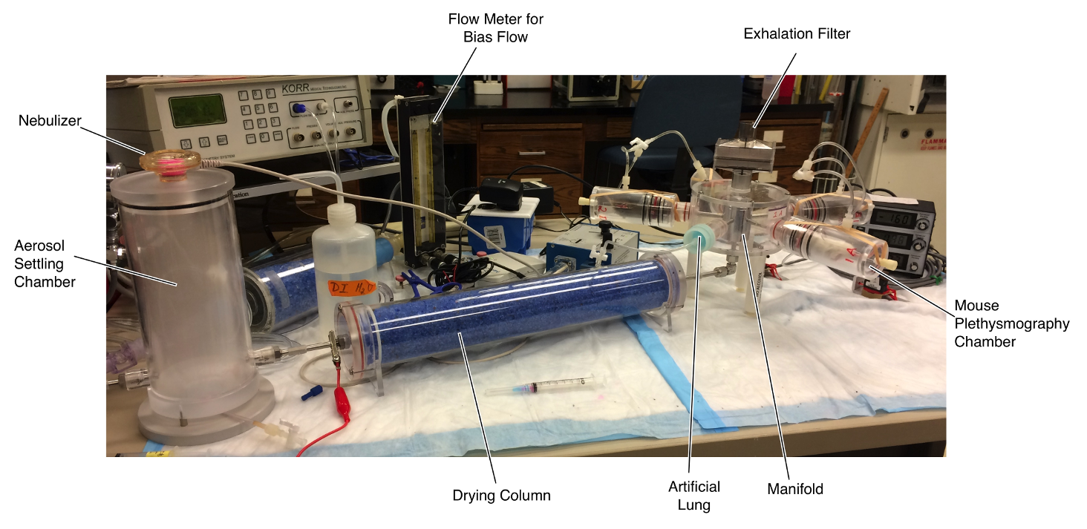
Experiment Setup

Slide 3
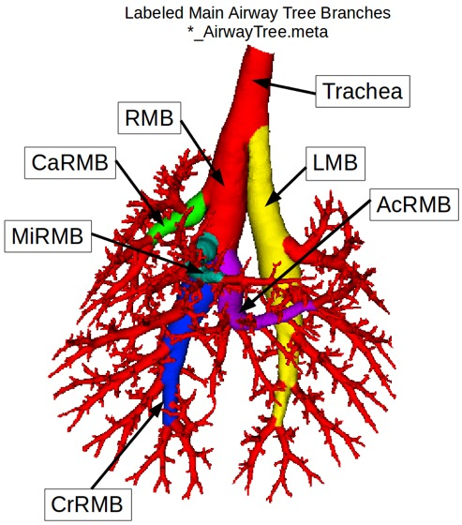
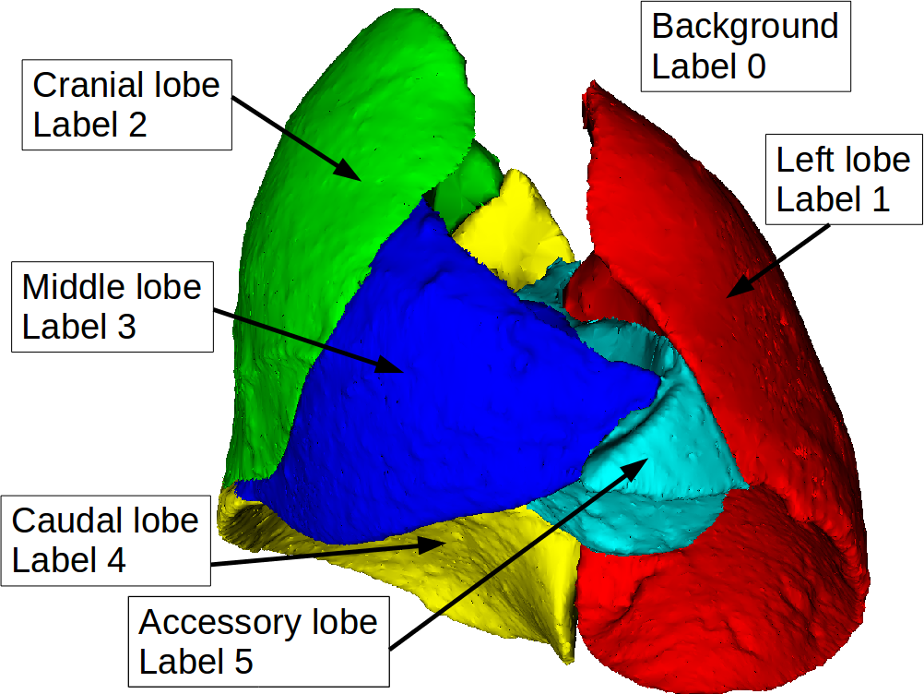
Lobe Level Labelling

Slide 4
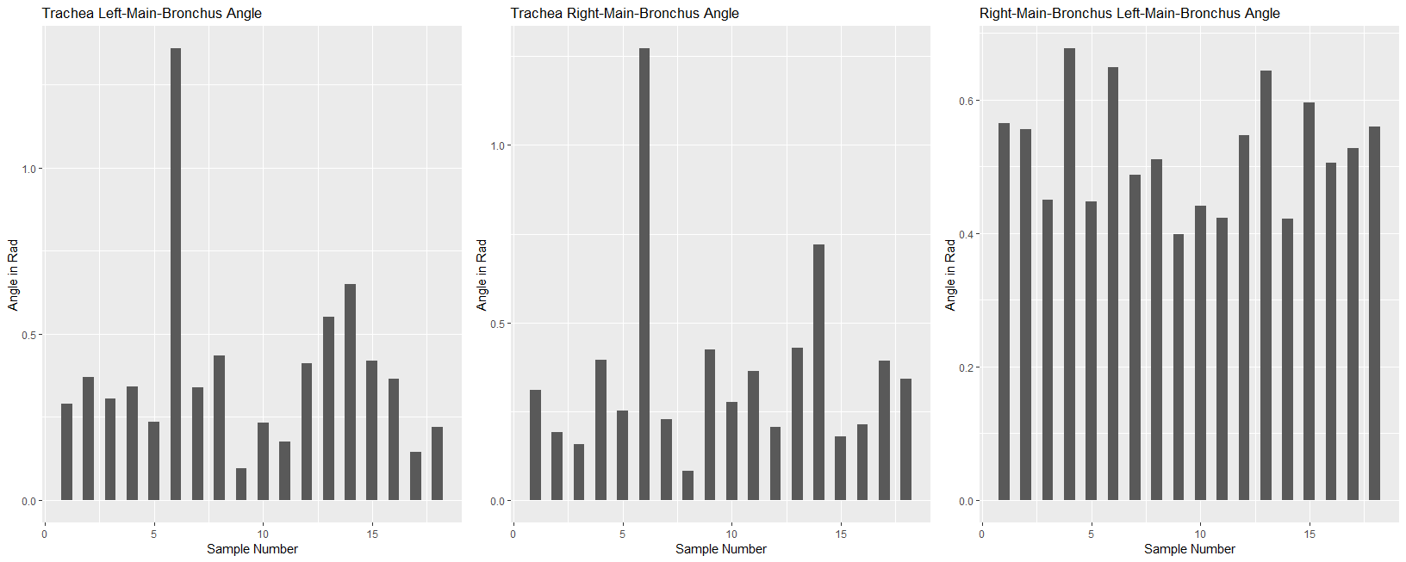
Trachea-Bronchi Angle Difference

Slide 5
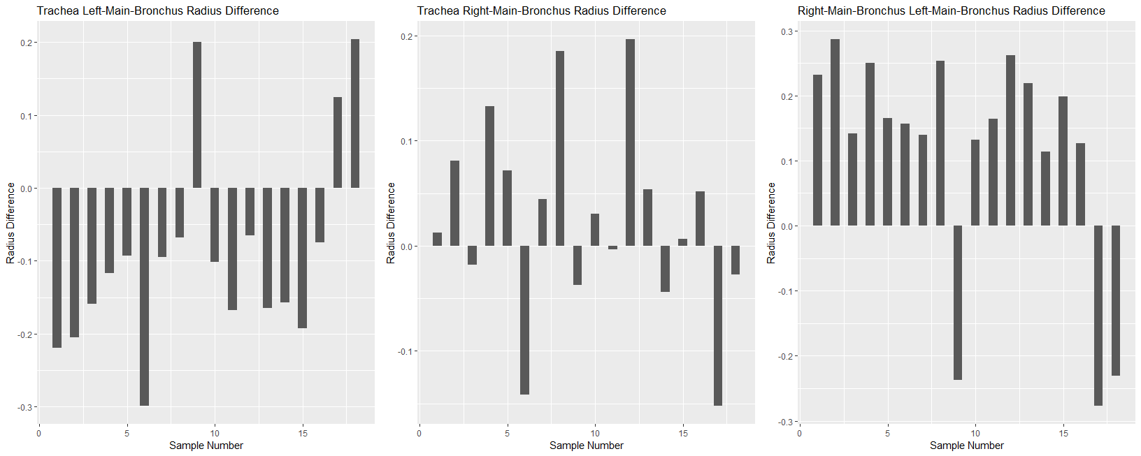
Trachea-Bronchi Radius Difference

Slide 6
Particle Size Comparison
Name | Strain | Gender | Weight | Particle_Size
m08 | C57BL/6 | F | 23 | 1
m07 | C57BL/6 | M | 24.1 | 1
m14 | C57Bl/6 | M | NaN | 1
m17 | C57BL/6 | F | NaN | 2
m16 | C57BL/6 | M | 22 | 2

Slide 7
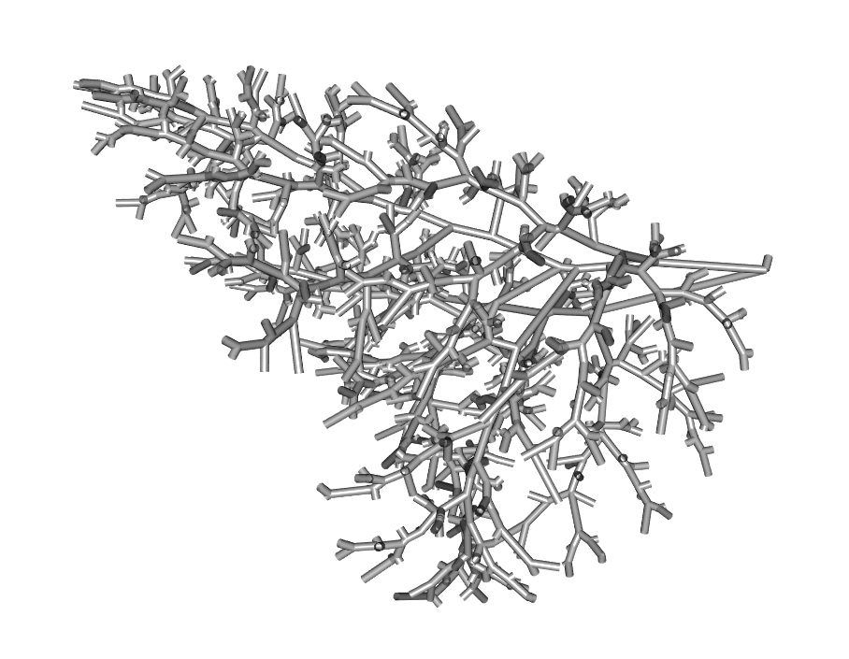
#6

Slide 8
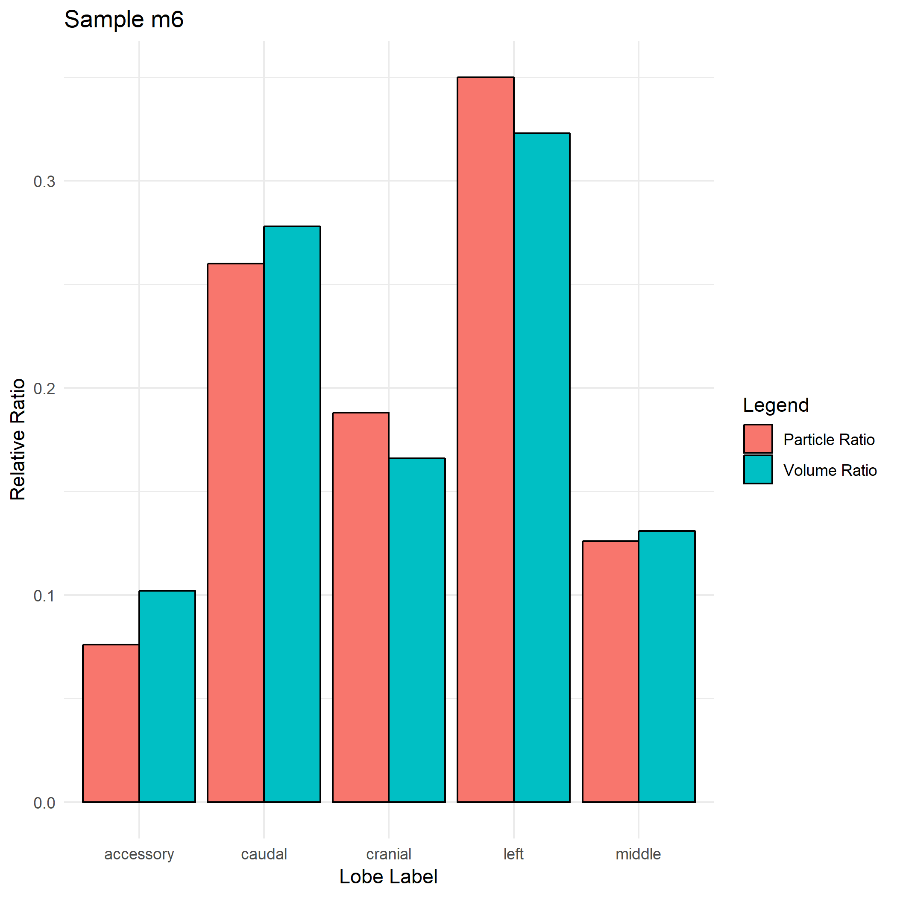

Slide 9
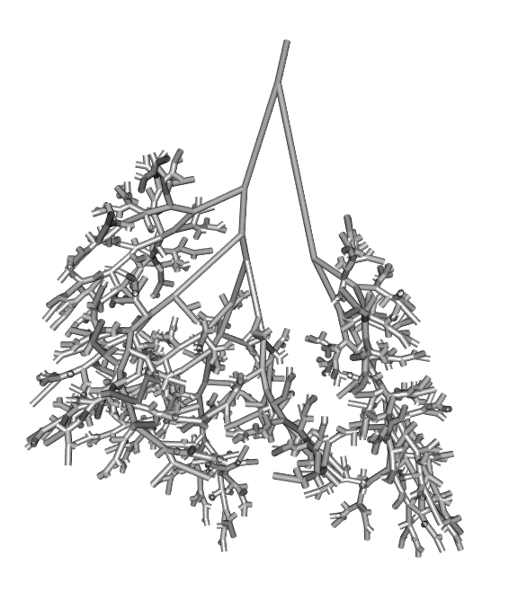
#8

Slide 10
