Slide 1

CDP Hemodilution Exercise Study
Cerro de Pasco, Peru (~4380 m)
Updates on the RNAseq Analysis
Simonson Lab 2020
Wanjun Gu
Eli Lawrence
Change Han
James Yu
Jack Zhang

Slide 2
Subject Condition:
CMS (N = 6)
Non-CMS (N = 8)
Isovolemic Hemodilution
Hemodilution
Non-Hemodilution
Non-Hemodilution
Post-Exercise
Post-Exercise
Post-Exercise
Fasting Rest
Pre-Exercise
Fasting Rest
Pre-Exercise
Fasting Rest
Pre-Exercise
Cardiopulmonary Exercise Testing

Slide 3
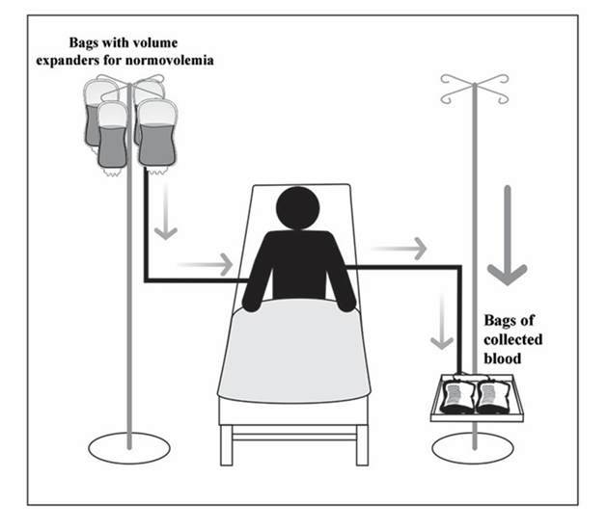
Isovolemic Hemodilution
Reduce hematocrit 20% from its initial value.
Up to four units of blood were removed during two consecutive days.
Each day the removed volume was replaced by an equal volume of colloid plasma replacement

Slide 4
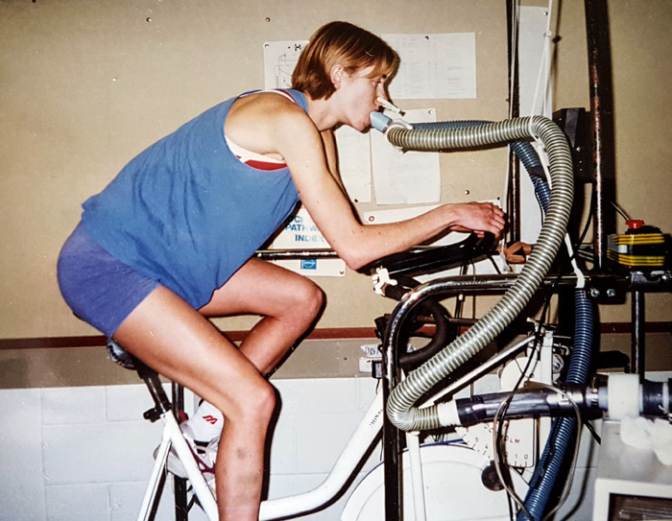
Cardiopulmonary Exercise Testing
A forehead oximeter probe was taped to the skin to obtain SpO2 measurements throughout the test
Six electrodes were taped onto cleansed skin in customary regions for impedance cardiography measurements
A tight-fitting silicone oro-nasal facemask was secured and connected to an ergoespirometer-metabolic system

Slide 5
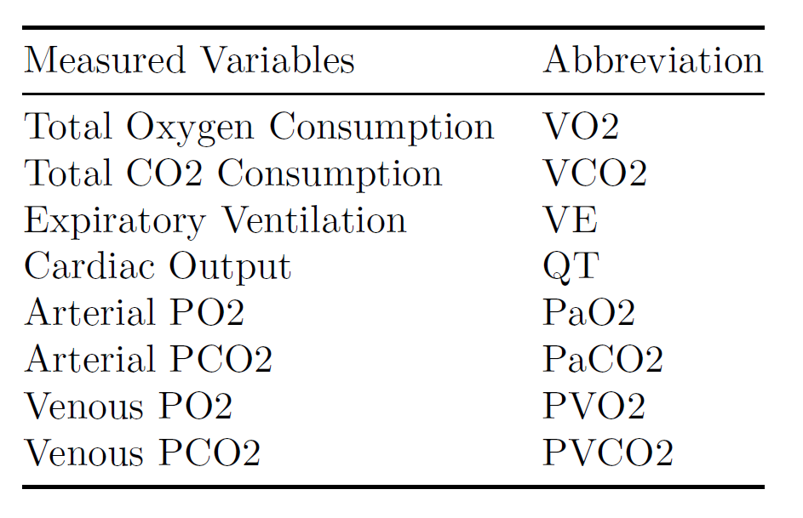
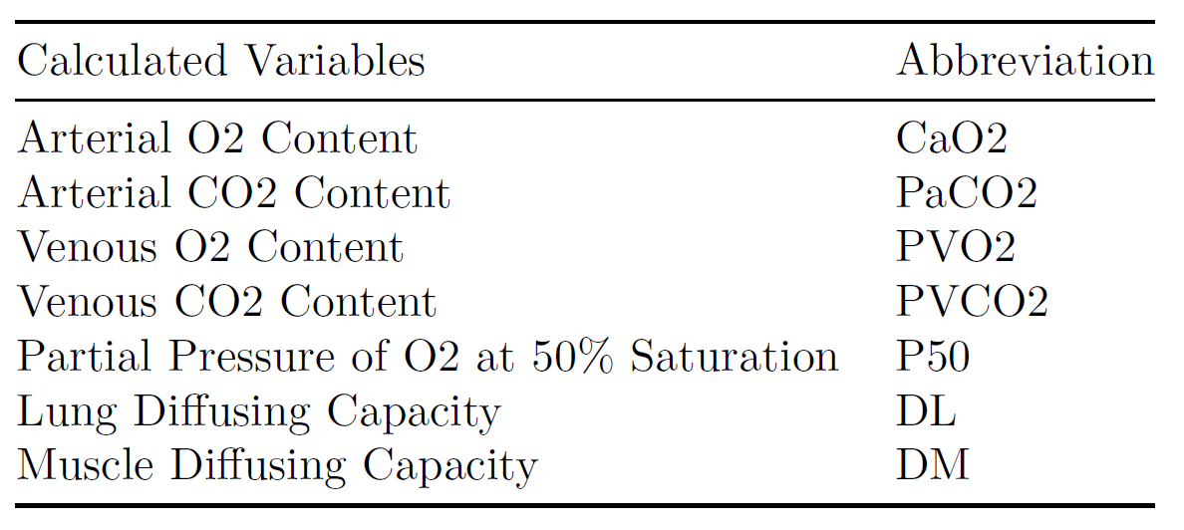
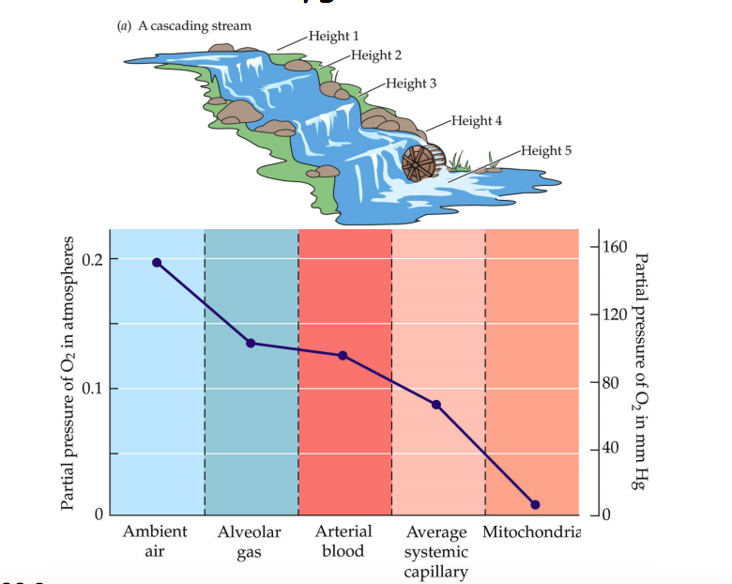
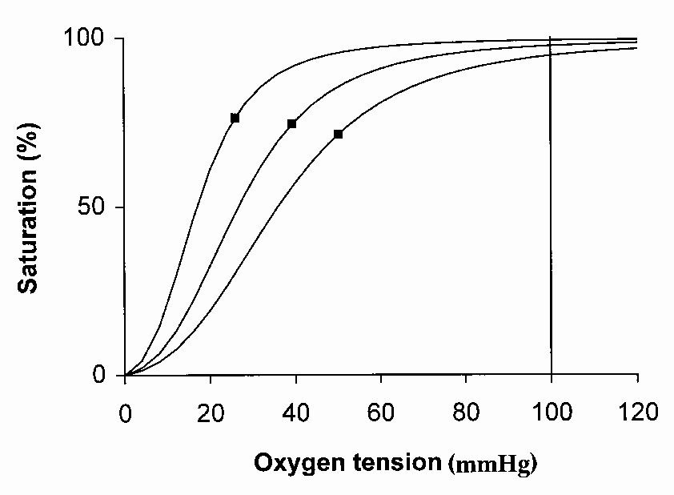
Variables Measured and Calculated

Slide 7
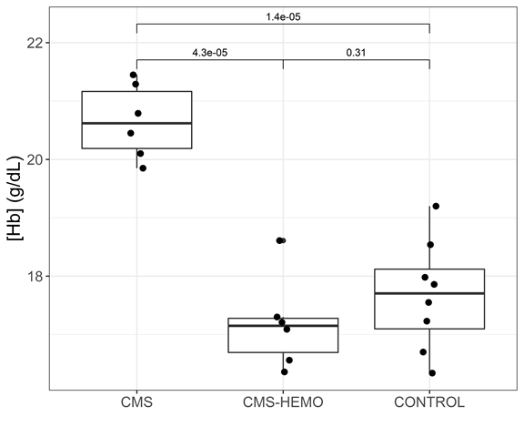
[Hb] decreased after hemodilution

Slide 8
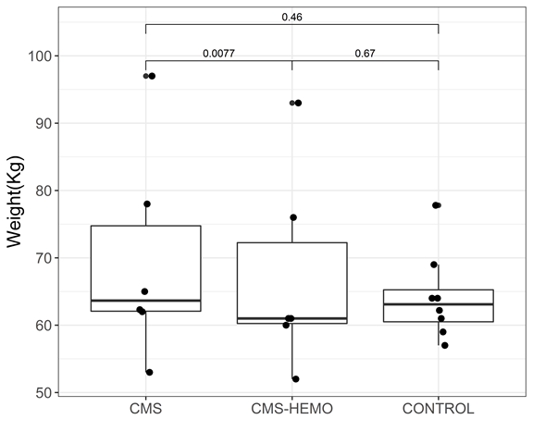
The weight of the subjects decreased after hemodilution

Slide 9
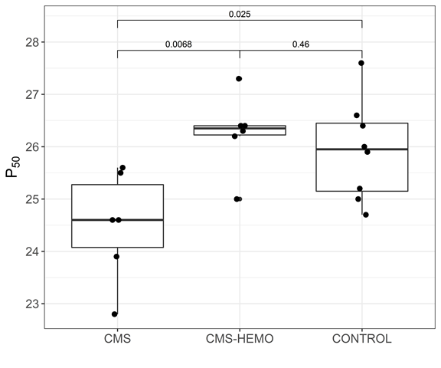
P50 went down after hemodilution

Slide 10
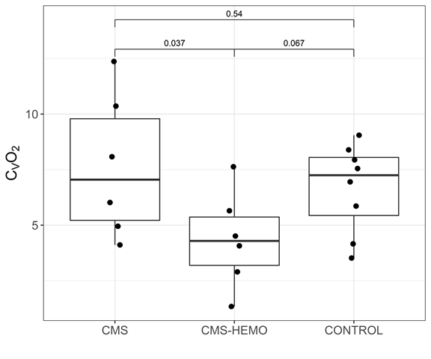
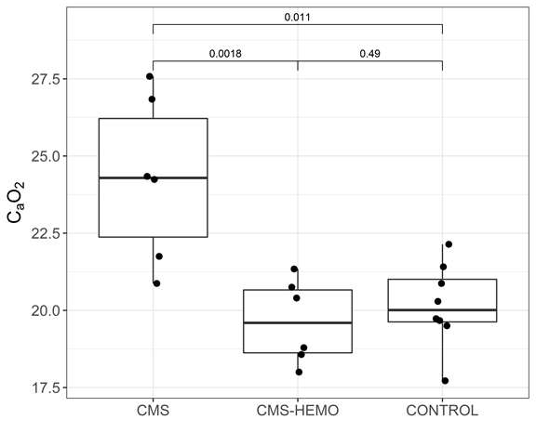
Arterial/Venous O2 content went down after hemodilution

Slide 11
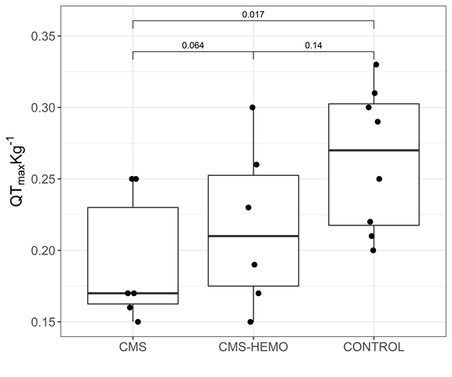
Cardiac output slightly went up after hemodilution

Slide 12
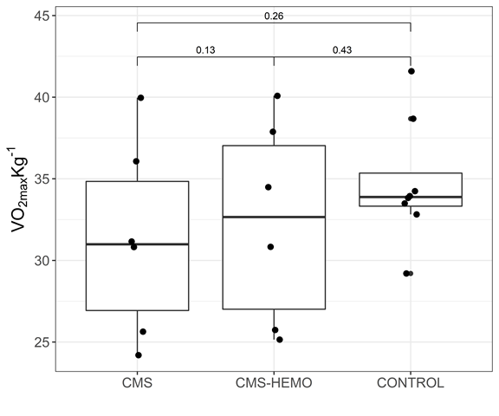
VO2max slightly went up after hemodilution

Slide 13
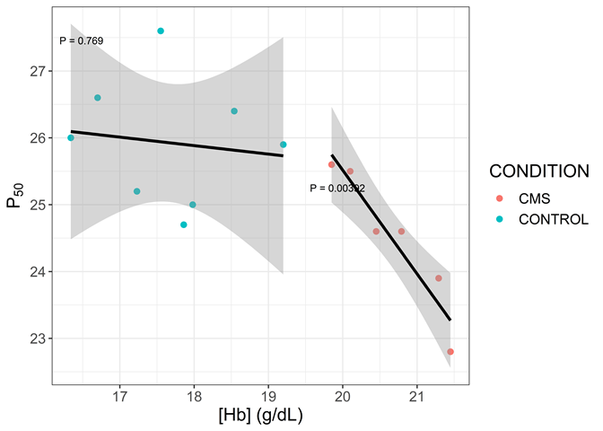
[Hb] is positively associated with P50 among subjects with CMS

Slide 14
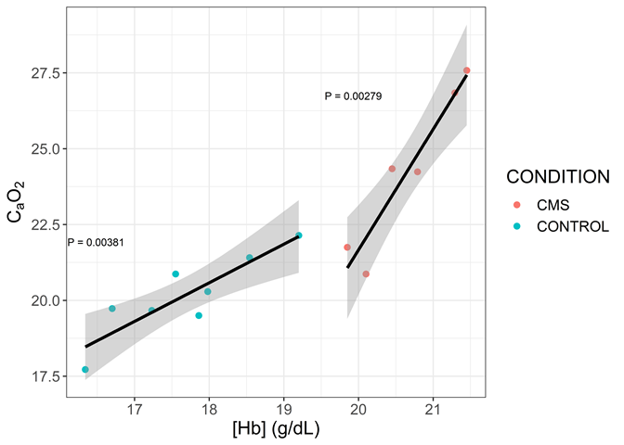
[Hb] is positively associated with O2 content

Slide 15
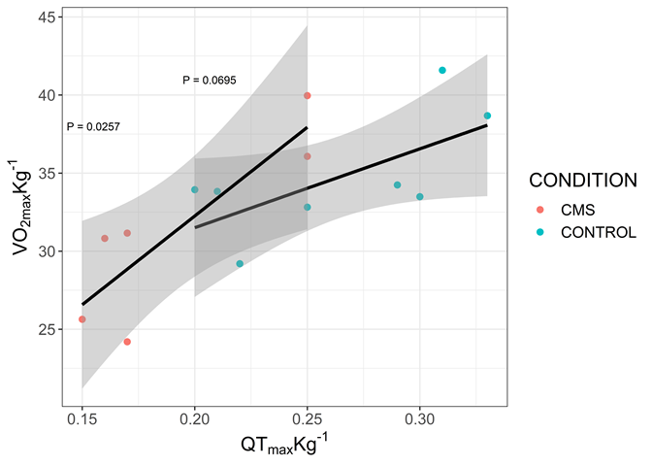
VO2max and QTmax are positively associated

Slide 16
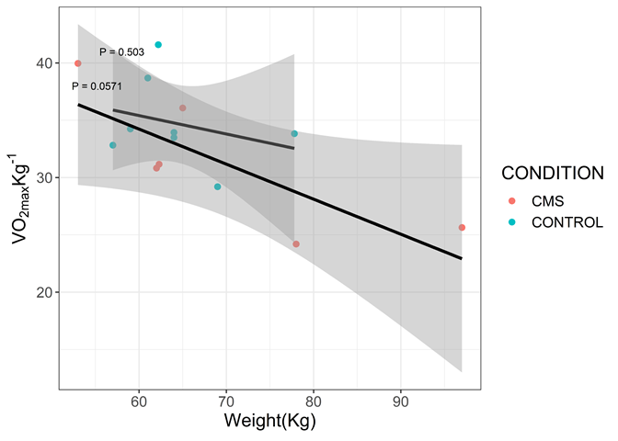
VO2max is negatively associated with body weight

Slide 17
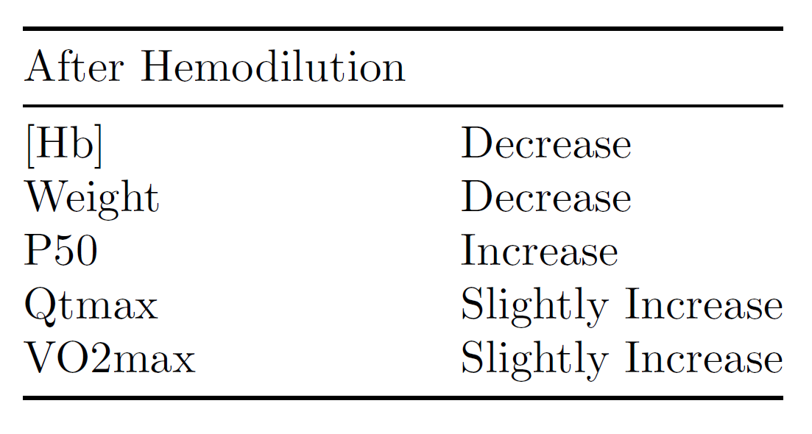
Research Findings
Research Questions：
Are people with CMS innately different from people without CMS in terms of gene expression levels?
Does hemodilution help alleviate symptoms of CMS? Do subjects after hemodilution show “healthy” markers of gene expression?
The next step is to understand the gene expression levels of the CDP subjects using RNAseq.

Slide 18
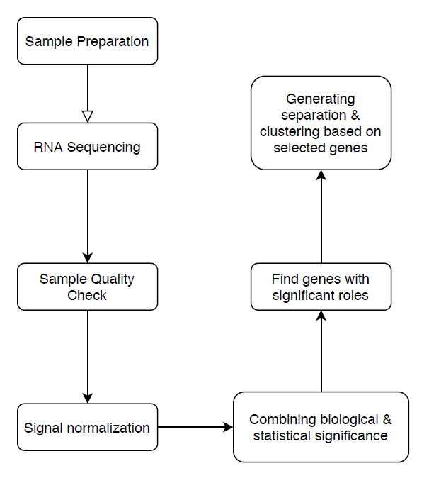
RNAseq Study schematic diagram

Slide 19
Sample Preparation and RNA Sequencing
Eli

Slide 20
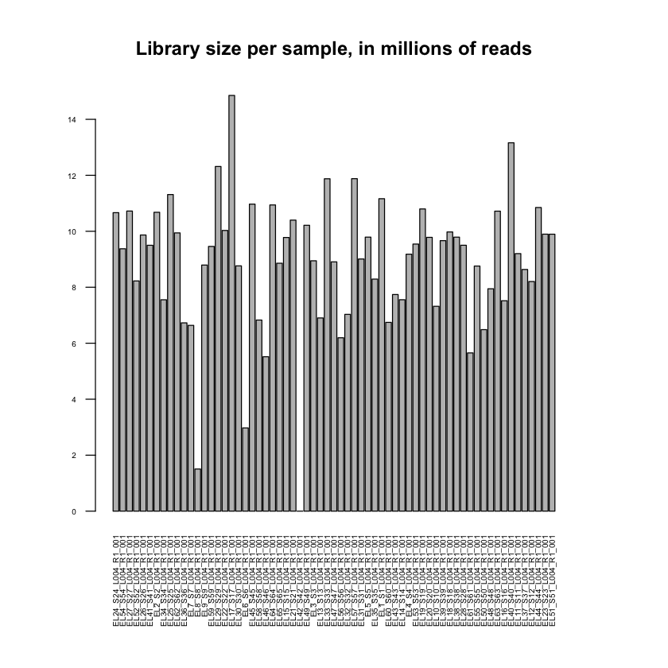
Sample Quality Check

Slide 21
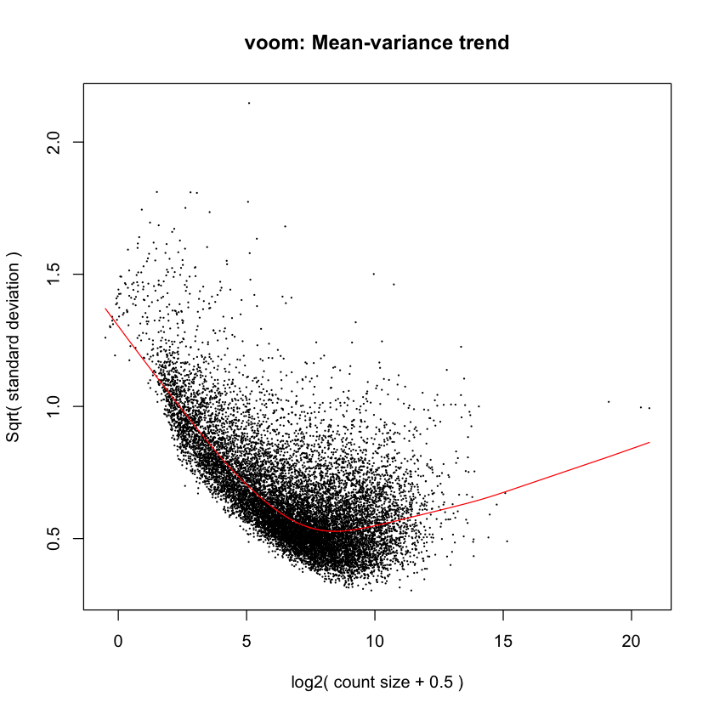
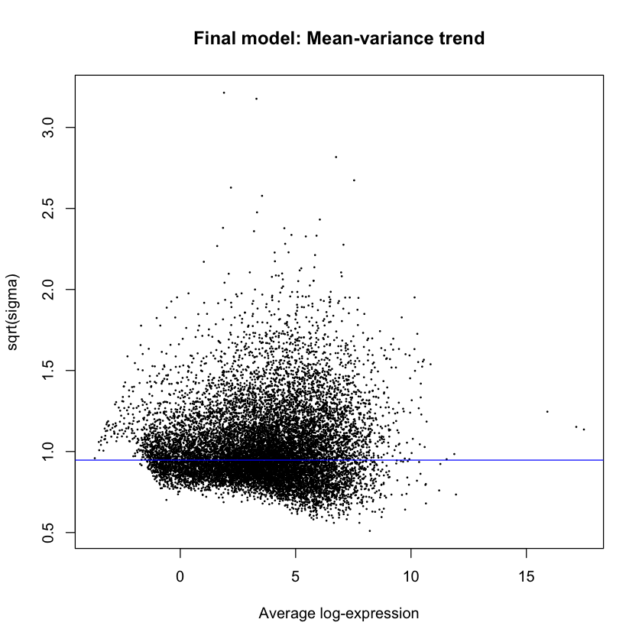
Signal Normalization

Slide 22
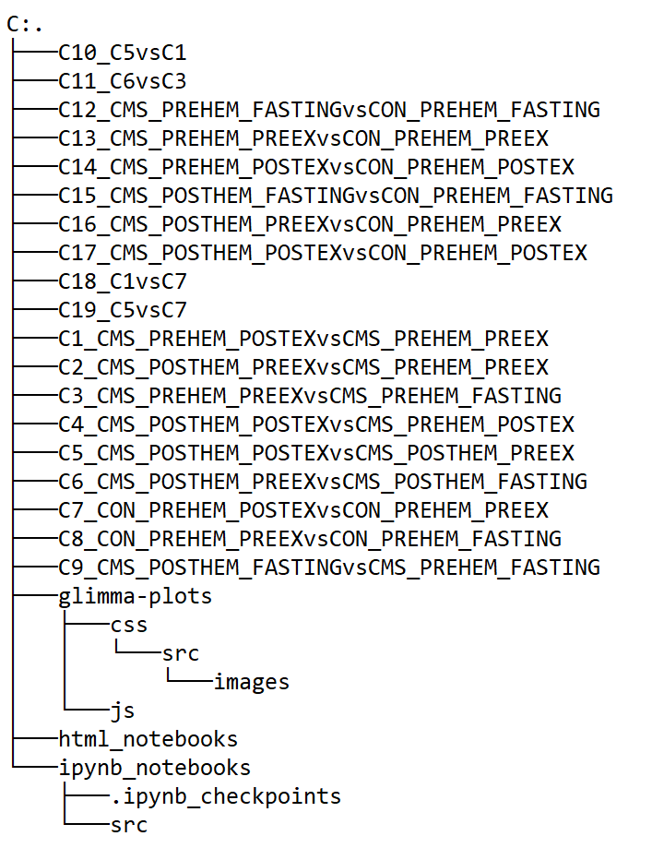
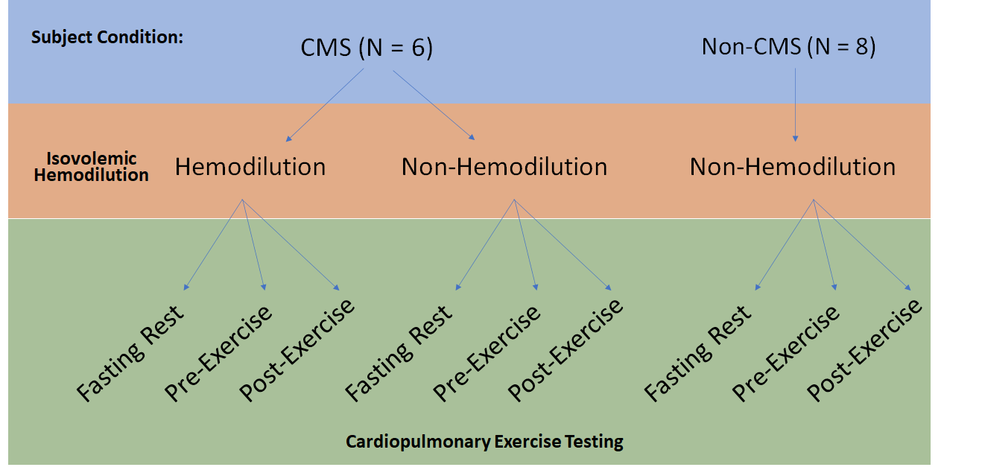

Slide 23
Combining biological & statistical significance
Chang

Slide 24
Pi-value for Gene Significance Evaluation
Incorporating and keeping a balance of both statistical significance and biological significance of differential expression.
1. Statistically speaking, genes showing systematic difference between two conditions are considered DE, usually measured by P-value.
2. Biologically speaking, DE means the difference in gene expression is sufficiently large.
Pi-value algorithm: fundamental formula: pi-value= FC *-(logP), where FC=log fold change, P is p value from t test.

Slide 25
Pi-value for Gene Significance Evaluation
Pi-value can address two issues regarding gene significance evaluation
1. The ‘small fold change, small variance’ (SFSV) issue. When a gene's variance is small, a slight expression level change may result in significant P-value and conclusion of statistical significance.
2. The ‘large fold change, large variance’ (LFLV) issue. In such a situation, a large expression change may be accompanied by a non-significant P-value
To see the effectiveness, pi-value = log(1/P^FC). If DE more than 2 fold change, FC is bigger, P^FC is smaller(0<P<1), 1/P^FC is larger. Thus, pi-value is larger. So original p value get enhanced in this way
If DE less than 2 fold. FC smaller, P^FC is larger(0<P<1), 1/P^FC is smaller. Thus, pi-value is smaller. Original p value get punished in this way.

Slide 26
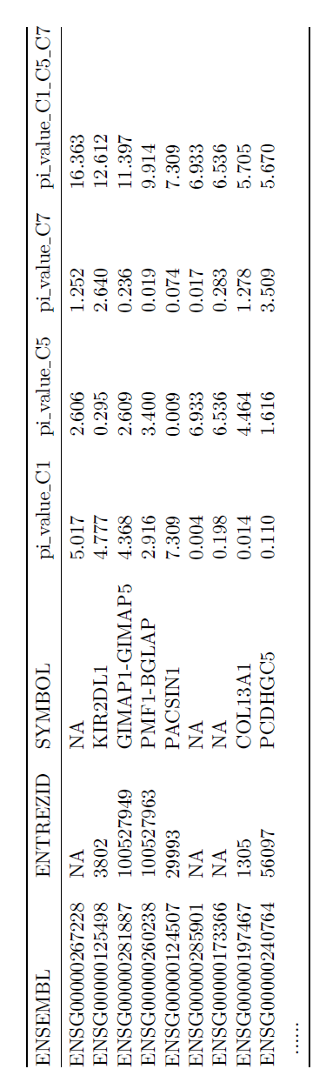

Slide 27
Find genes with significant roles

Slide 28
Introduction to Composite of Multiple Signals analysis and results of gene list comparison
James

Slide 29
Literature search on the significant genes
Eli

Slide 30
Generating separation & clustering based on selected genes

Slide 31
Introducing K Clustering
Jack

Slide 32
Introducing K Clustering
Clustering algorithms are used to group data instances according to some notion of similarity
K-means clustering specifically is a clustering method used to partition the dataset into k groups based on said notion of similarity
Traditionally viewed as an unsupervised method for data analysis but with enough background information, this algorithm can be useful in data analysis
We have different conditions in our dataset, for example resting vs exercise
Notes:
https://web.cse.msu.edu/~cse802/notes/ConstrainedKmeans.pdf

Slide 33
Algorithm that we will use
The specific algorithm that we will use is called Lloyd algorithm
It proceeds by selecting k initial cluster centers and then iteratively repeat:
Group each data point with the closest center
Recalculate new centers for each cluster using the mean of all points in the cluster
Group each data point with the new closest center
Each time this is performed, the points are left in a slightly more even distribution, closer to its final cluster
Notes:
https://web.cse.msu.edu/~cse802/notes/ConstrainedKmeans.pdf

Slide 34
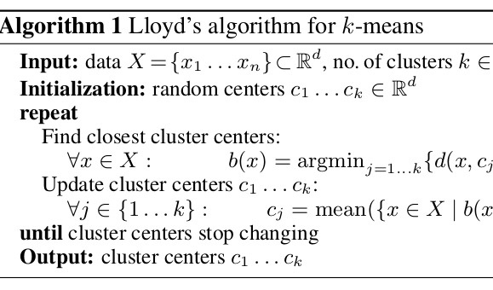
Function for clustering process
Notes:
https://avira.github.io/dsblog/2016-09-01-speeding-up-k-means.html

Slide 35
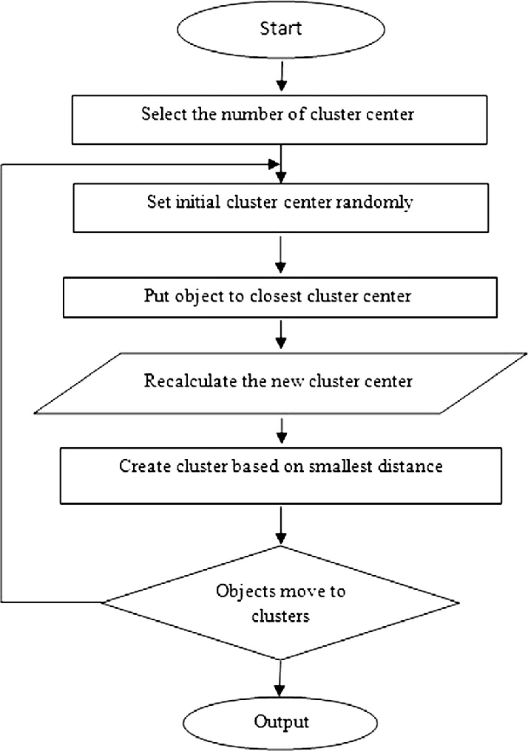
Pipeline

Slide 36
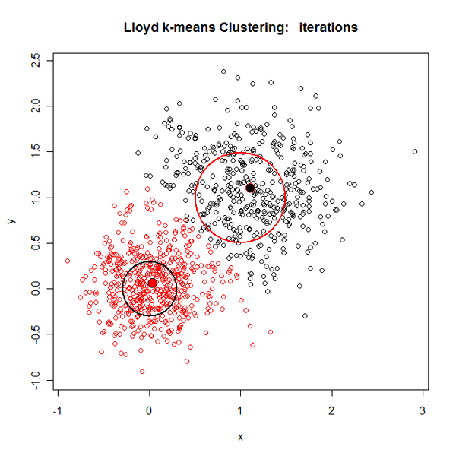
Example of clustering using 2 centers

Slide 37
Goal
Use clustering algorithms on our significant genes to visually
The goal is to use clusters as evidence to support significant gene up and down regulation
Similar to PCA, we expect to see obvious clusters

Slide 38
Clustering Analysis for this study
Chang

Slide 39
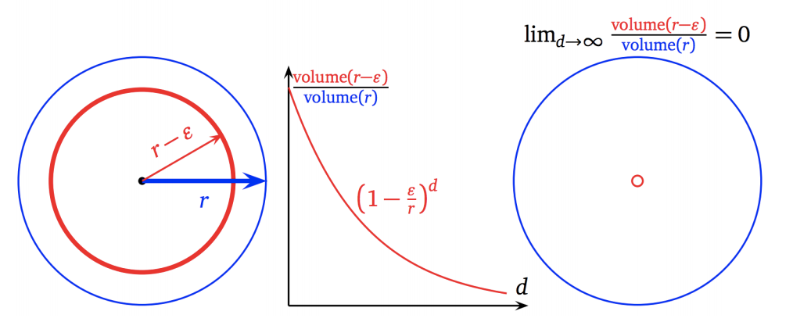
Clustering Analysis for this study
Example:
Purpose: After regrouping the data according to treatments and conditions, we want to use clustering analysis to see if there’s significant separations(aka differences) amongst groups.
Challenge: Curse of Dimensionality: Small sample(less than 100 patients) size but very high dimensionality(200 + significant genes).
In high dimension hyperspace, as features(dimensions) increase, even the most similar points tend to deviate from each other, thus resulting in high entropy within clusters or too many clusters.

Slide 40
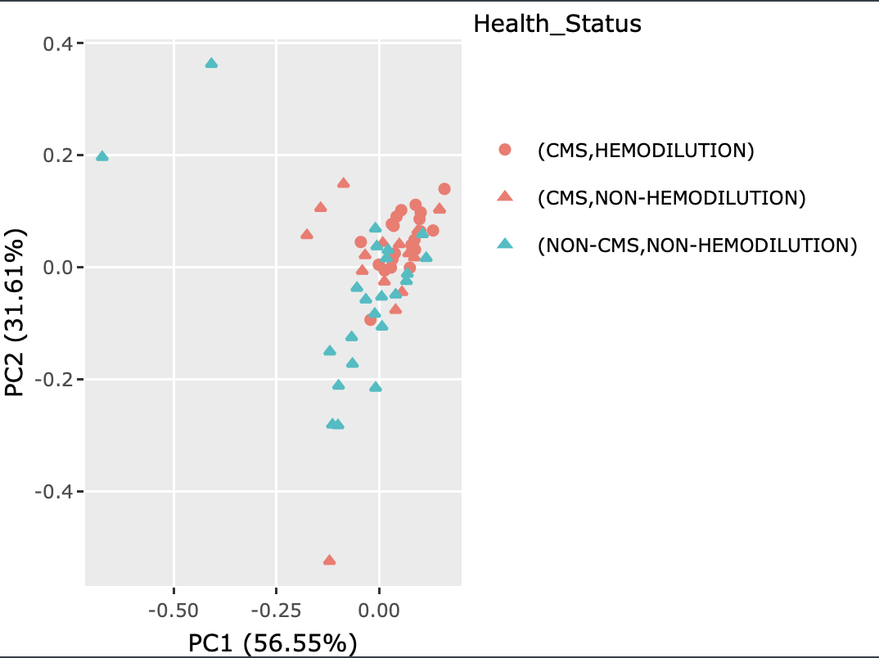
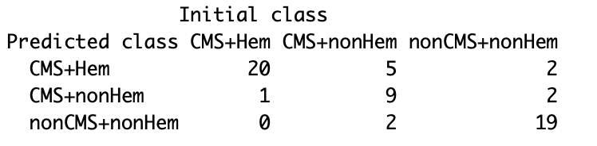
Clustering Analysis for this study
Using PCA and Discriminant Analysis.
PCA is a mainly a dimensionality reduction method but can also serve as a clustering visualization method. It finds the directions in hyperspace that capture most of information(variance).
Discriminant Analysis uses Expectation-Maximization Algorithm to build model that maximizes the conditional probability P(K|X), i.e Given the DE data, we categorize the sample(CMS, nonCMS etc.) as the one with highest probability.

Slide 41
Future Directions
Generate a list of well-binned genes to compare with existing selection lists to relevant studies.
Combining the physiology of the subjects with their gene expression levels to find correlations.
Group significant genes based on their functions, such as immuno-response, cardiovascular, hematology, etc.

Slide 42
Reference
1. C. W. Law, Y. Chen, W. Shi, G. K. Smyth, voom: Precision weights unlock linear model analysis tools for RNA-seq read counts. Genome Biol. 15, R29 (2014). 2. F. P. Carvalho, Mining industry and sustainable development: Time for change. 6, 61–77 (2017). 3. OPTIONS/ALTERNATIVES TO BLOOD TRANSFUSIONS, (available at http://bloodless.com.br/optionsalternatives-to-blood-transfusions/). 4. Cycle Ergometers, (available at https://www.topendsports.com/testing/products/cycle-ergometers.htm). 5. T. J. Morgan, The oxyhaemoglobin dissociation curve in critical illness. Crit. Care Resusc. 1, 93–100 (1999). 6. L. Bergé, C. Bouveyron, S. Girard, HDclassif: An R Package for Model-Based Clustering and Discriminant Analysis of High-Dimensional Data. Journal of Statistical Software, Articles. 46, 1–29 (2012). 7. Y. Xiao, T.-H. Hsiao, U. Suresh, H.-I. H. Chen, X. Wu, S. E. Wolf, Y. Chen, A novel significance score for gene selection and ranking. Bioinformatics. 30, 801–807 (2014). 8. S. R. Grossman, I. Shlyakhter, E. K. Karlsson, E. H. Byrne, S. Morales, G. Frieden, E. Hostetter, E. Angelino, M. Garber, O. Zuk, E. S. Lander, S. F. Schaffner, P. C. Sabeti, A composite of multiple signals distinguishes causal variants in regions of positive selection. Science. 327, 883–886 (2010).

Slide 43

Acknowledgements
Center for Computational Biology & Bioinformatics (CCBB)
Dr. Francisco C. Villafuerte
Simonson Lab

