Slide 1
CDP Hemodilution Exercise RNAseq Study
Presentation Aug 11, 2020

Slide 2
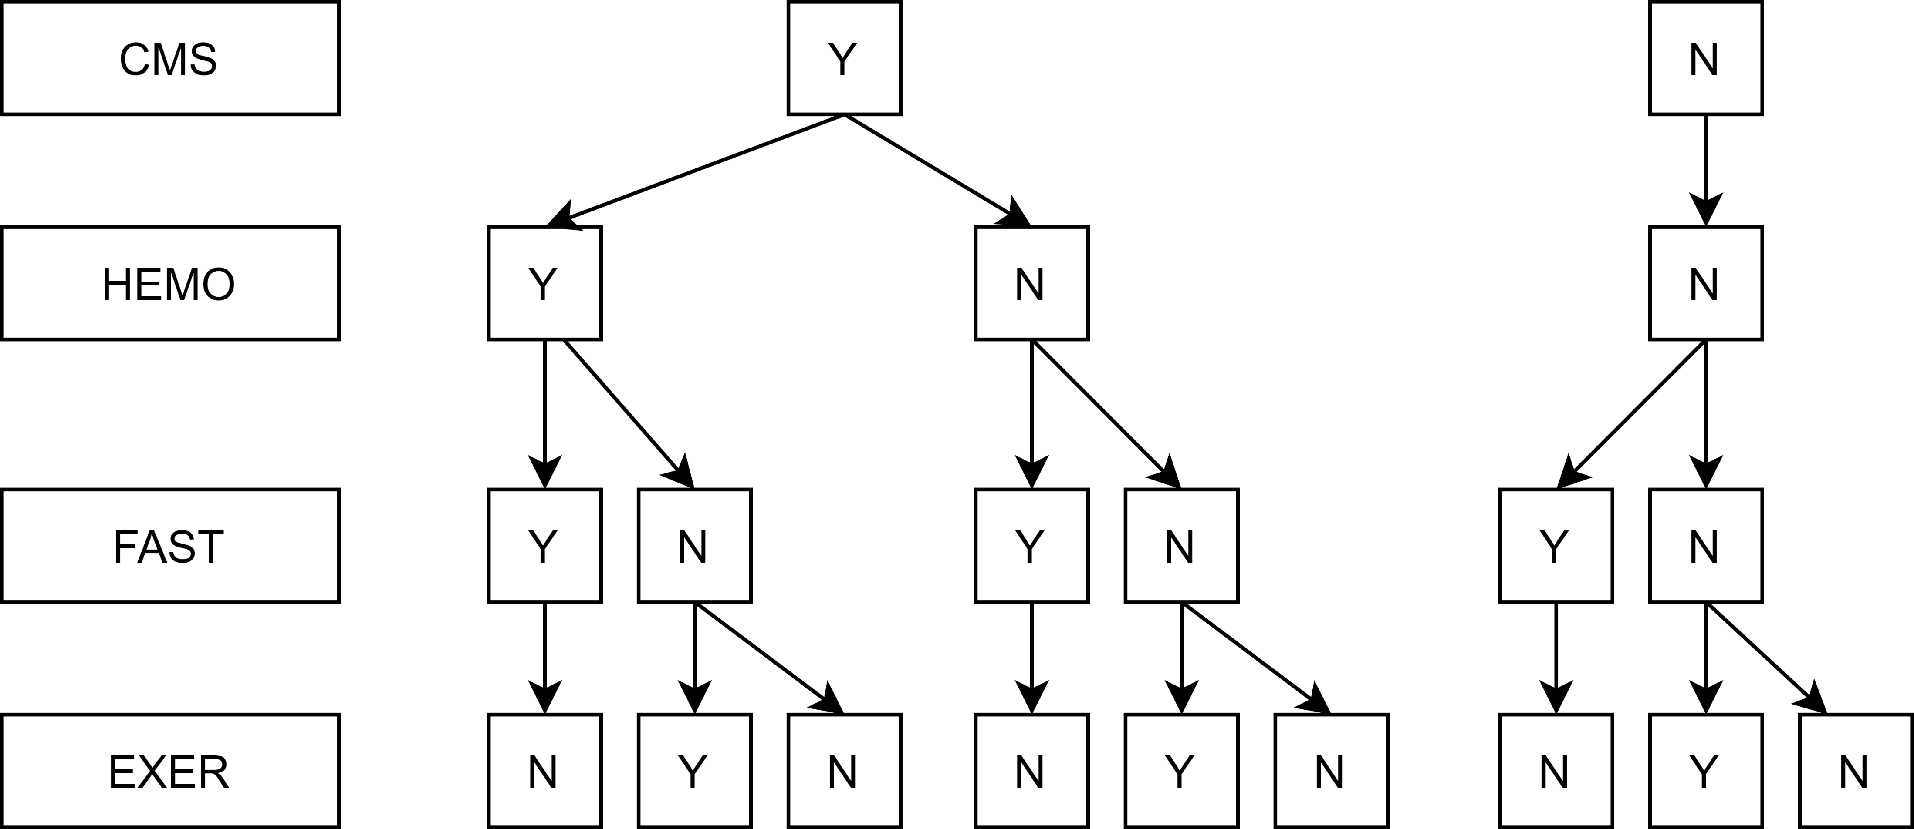

Slide 3
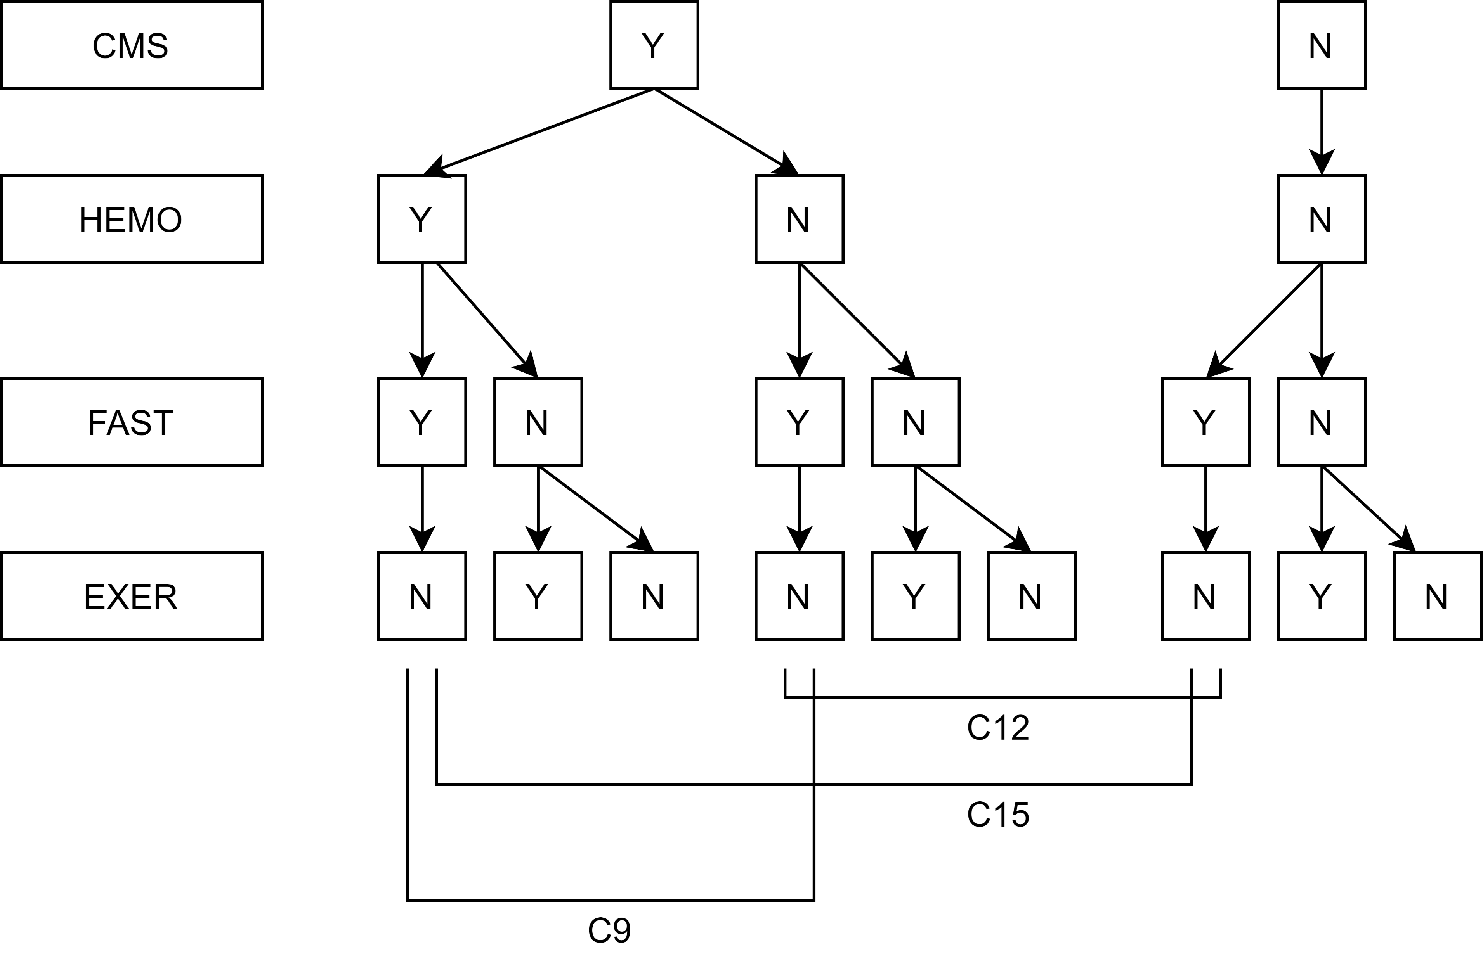

Slide 4
