Slide 1

High-altitude Natural Selection Near Transcription Factor Footprints
Wanjun Gu
Dec 14th, 2023

Slide 2
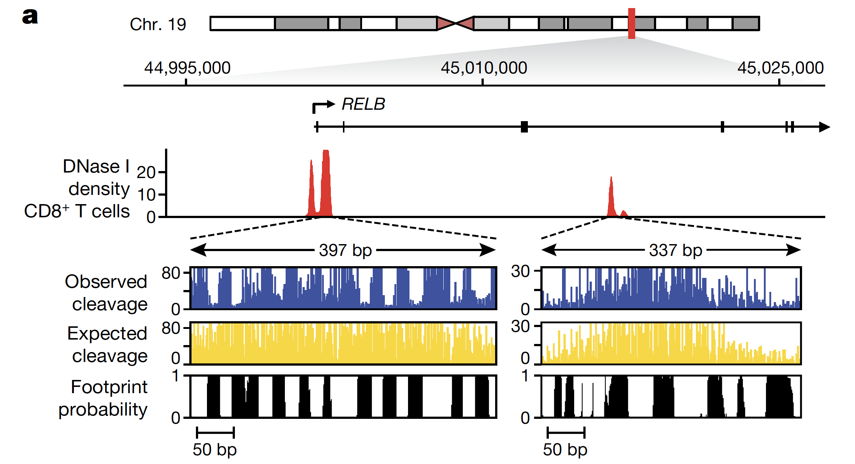

Background and Methods
Cerro de Pasco, Peru (~4315 m)
30x WGS of native highlanders (N = 40)
Characterizing the architecture of regulatory regions
- A comprehensive map of transcription factor (TF) footprints across the human genome
- TFs occupy regions of DNA that are more mutable and likely to associate with traits.
Testing for Natural Selection
- F_{ST}, ΔDAF, iHS, ΔiHH, and XP-EHH
- Composite of multiple selection signals (CMS_{BF})

Slide 3
Are there evident signals of natural selection near/within TF footprints
- Are strong signals of natural selection enriched near/within TF footprints?
- Does natural selection near/within TF footprints highlight:
- Any biological processes
- Any genes of interests

Slide 4
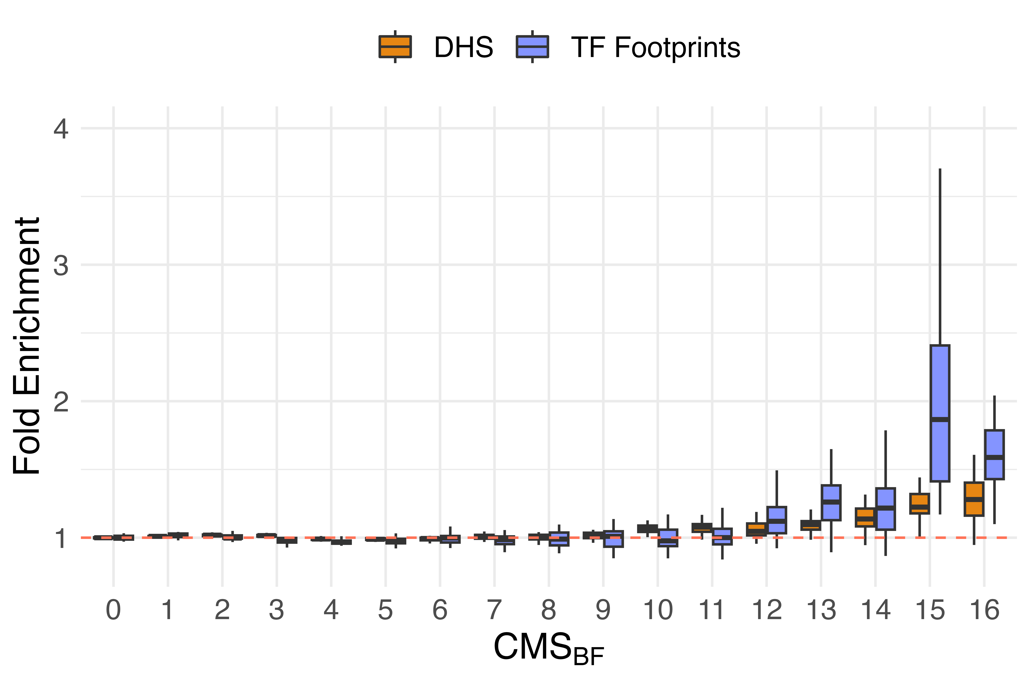
Natural selection signals are enriched near DHS and TF footprints
- Markers with stronger evidence of natural selection tend to be near/within DNase I hypersensitivity sites (DHS) and TF footprints
- Markers with CMS_{BF} greater than 12 are significantly enriched near TF footprints, compared to both baseline and DHS.
*
*
*
*

Slide 5
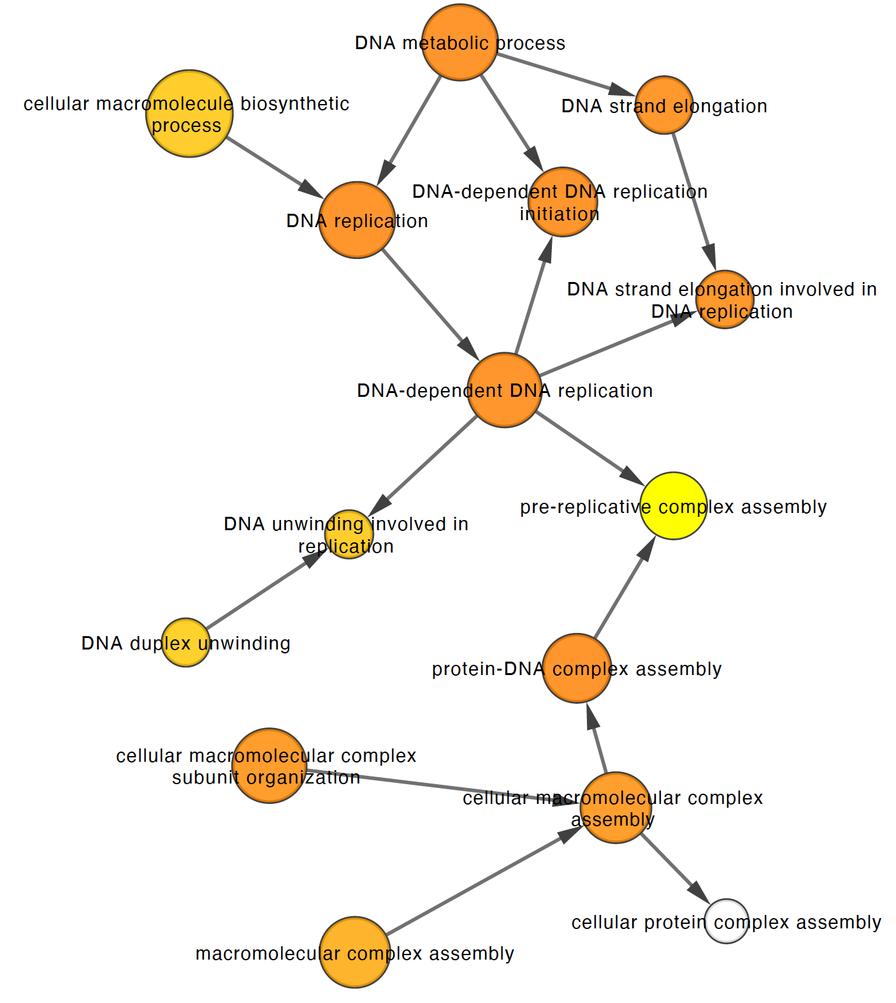
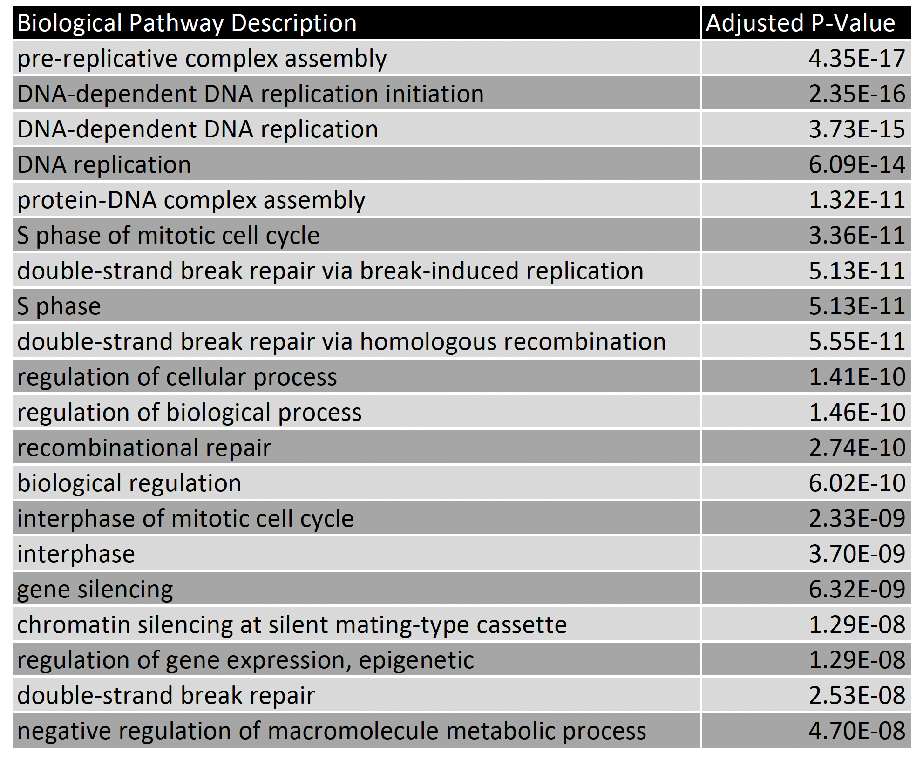
Evidently selected loci near TF footprints highlight DNA replication/repair pathways

Slide 6
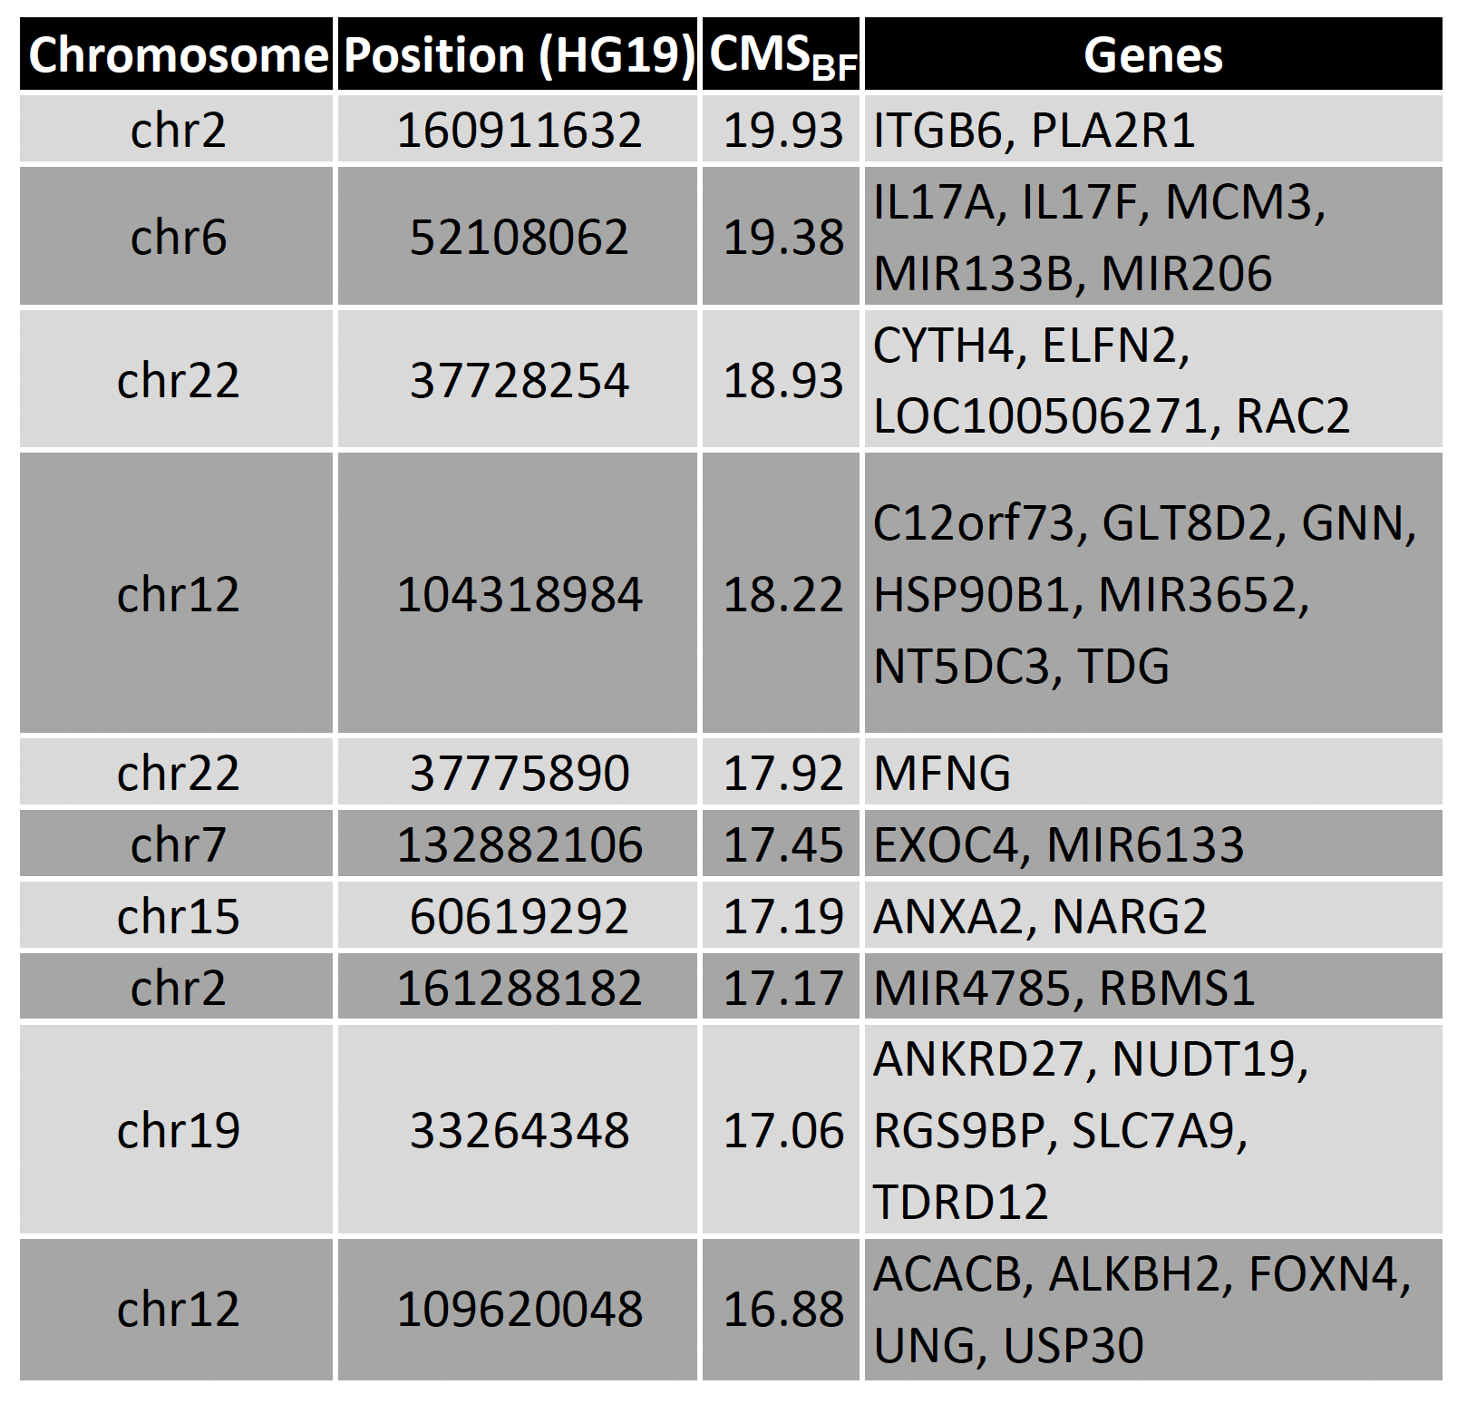
Selected loci near TF footprints colocalize around genes of biological relevance
Immune System and Inflammation: IL17A, IL17F
Cell Cycle and DNA Replication: MCM3 (Minichromosome Maintenance Complex Component 3)
DNA Repair and Maintenance: UNG (Uracil-DNA Glycosylase) and ALKBH2 (AlkB homolog 2)
…

Slide 7

Conclusion
- Strong signals of natural selection are enriched near/within TF footprints
- These selection signals near/within TF footprints are likely responsible for DNA replication, repair, and maintenance.
Reference and Acknowledgement

