Slide 1
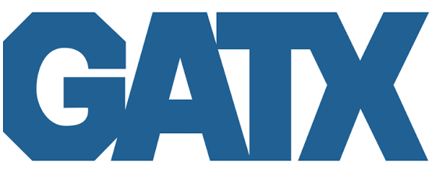
RECOMMENDATION: HOLD
Interest Cost
Renewal Pricing
Fleet Growth
Disposition Gains
Railcar Supply
Market Profile
Closing Price | $172.27
52-Week High / Low | $205.56 / $150.42
Insider Ownership | ~1.2%
Market Capitalization ($B) | 6.17
Enterprise Value ($B) | 17.7
P/E (TTM) | 16.5
EV/EBITDA | 15.1
Dividend Yield | 1.58%
Dividend Payout | 26.7%
Figure 1: GATX price and volume, one year (daily)
Financial Data | 2023 | 2024 | 2025 | 2026E | 2027E
Sales ($M) | 1,411 | 1,586 | 1,740 | 2,379 | 2,467
Sales Growth | 10.8% | 12.4% | 9.7% | 36.7% | 3.7%
EBIT Margin | 27.5% | 29.9% | 30.7% | 29.4% | 31.7%
BMG EPS | $7.07 | $7.89 | $8.75 | $10.53 | $10.47
Consensus |  |  |  | $10.23 | $11.27
ROE | 12.0% | 11.9% | 12.6% | 13.2% | 12.2%
ROA | 2.4% | 2.3% | 2.1% | 1.9% | 2.0%
LT Debt/Equity | 310% | 317% | 324%
FactSet, daily closes, trading days 2025-07-11 to 2026-10-05.
Price return | 5Y | 3Y | 2Y | LTM | YTD | 6M | 3M | 1M
 | 87.9% | 62.4% | 32.9% | -2.0% | 1.6% | -0.4% | -3.1% | -3.3%
Ticker: GATX
Analyst: Brock Gorzelanczyk
Contact at Gorzela2@uwm.edu
Current Price: $172.27
Target Price: $165.54
Short interest 5.9% of float, 11 days to cover. Beta 0.85 (3Y adjusted, vs S&P 500).
Price: 2026-10-05 close (FactSet); the call was SELL at $183.73 on 2026-09-25 (see Summary). 2026E and 2027E: BMG model (GATX-FSM-v32). Consensus: FactSet. 2023 to 2025 EPS non-GAAP.
1

Slide 2

Business Description
Drivers
Financial Analysis
Valuation
Risks
Key Highlights
Business Description
Revenue Segments
Cyclicality
2

Slide 3


Business Description
GATX Corporation (GATX), founded 1898 and headquartered in Chicago, IL, is a railcar lessor. It owns and manages about 278,000 railcars worldwide: 206,000 in North America after the January 2026 Wells Fargo deal doubled that fleet, 36,600 in Europe, 12,500 in India, plus aircraft engines through the RRPF joint venture with Rolls-Royce. Rail North America is about 77% of revenue.
Figure 1: Lease revenue by segment, Q2 2026 ($M)
Business model: buy railcars, lease them to shippers on multi-year full-service contracts with GATX handling maintenance, sell older cars for gains, then redeploy the capital. Revenue is cars times rate, and the rate resets at renewal.
Four reporting segments: Rail North America (dominant), Rail International (Europe via GATX Rail Europe, plus India), Engine Leasing (the RRPF joint venture with Rolls-Royce, leasing aircraft engines), and Other (Trifleet tank containers). Leases typically run four to five years.
Figure 2: Revenue and YoY growth, 2021 to 2027E
The GABX joint venture with Brookfield, 30% GATX and 70% Brookfield, closed on 2026-01-01 and doubled the consolidated fleet.
2026 revenue steps up 37% on the January GABX close. BMG models 2027 revenue growth of 3.7% and EPS of $10.47, against consensus $11.27.
Sources: Company filings, FactSet, BMG Capital
3

Slide 4
Revenue Segments
Rail North America
Rail International
Engine Leasing
$391.0M
$100.3M
$29.4M
Figure 3: Segment revenue, Q2 2026
Rail North America is the dominant segment: $391.0M of lease revenue in Q2 2026 across 192,638 railcars at 98.0% utilization, plus $67.7M of net disposition gains.
Rail International, Europe via GATX Rail Europe plus India, produced $100.3M of lease revenue in Q2 2026, with $27.9M of depreciation and $23.9M of interest expense.
Engine Leasing holds the RRPF joint venture with Rolls-Royce: $8.8M of lease revenue, $20.6M of non-dedicated engine revenue, and $49.6M share of affiliates pretax earnings.
Figure 4: Segment P&L, Q2 2026 ($M)
 | Rail North America | Rail International | Engine Leasing | Other
Lease revenue | 391.0 | 100.3 | 8.8 | 8.3
Other revenue | 44.0 | 5.3 | 20.6 | n/a
Maintenance expense | (131.8) | (19.2) | n/a | n/a
Depreciation | (124.0) | (27.9) | (10.6) | n/a
Other operating expense, incl. operating lease | (23.2) | (4.9) | (3.0) | n/a
Net gain on asset dispositions | 67.7 | 2.0 | n/a | n/a
Interest expense, net | (103.7) | (23.9) | (12.7) | n/a
Below segment, Q2 2026: SG&A $69.2M; taxes $38.4M; NCI $7.6M; net income to GATX $103.4M; 35.8M diluted shares.
Sources: Company filings, FactSet, BMG Capital
4

Slide 5
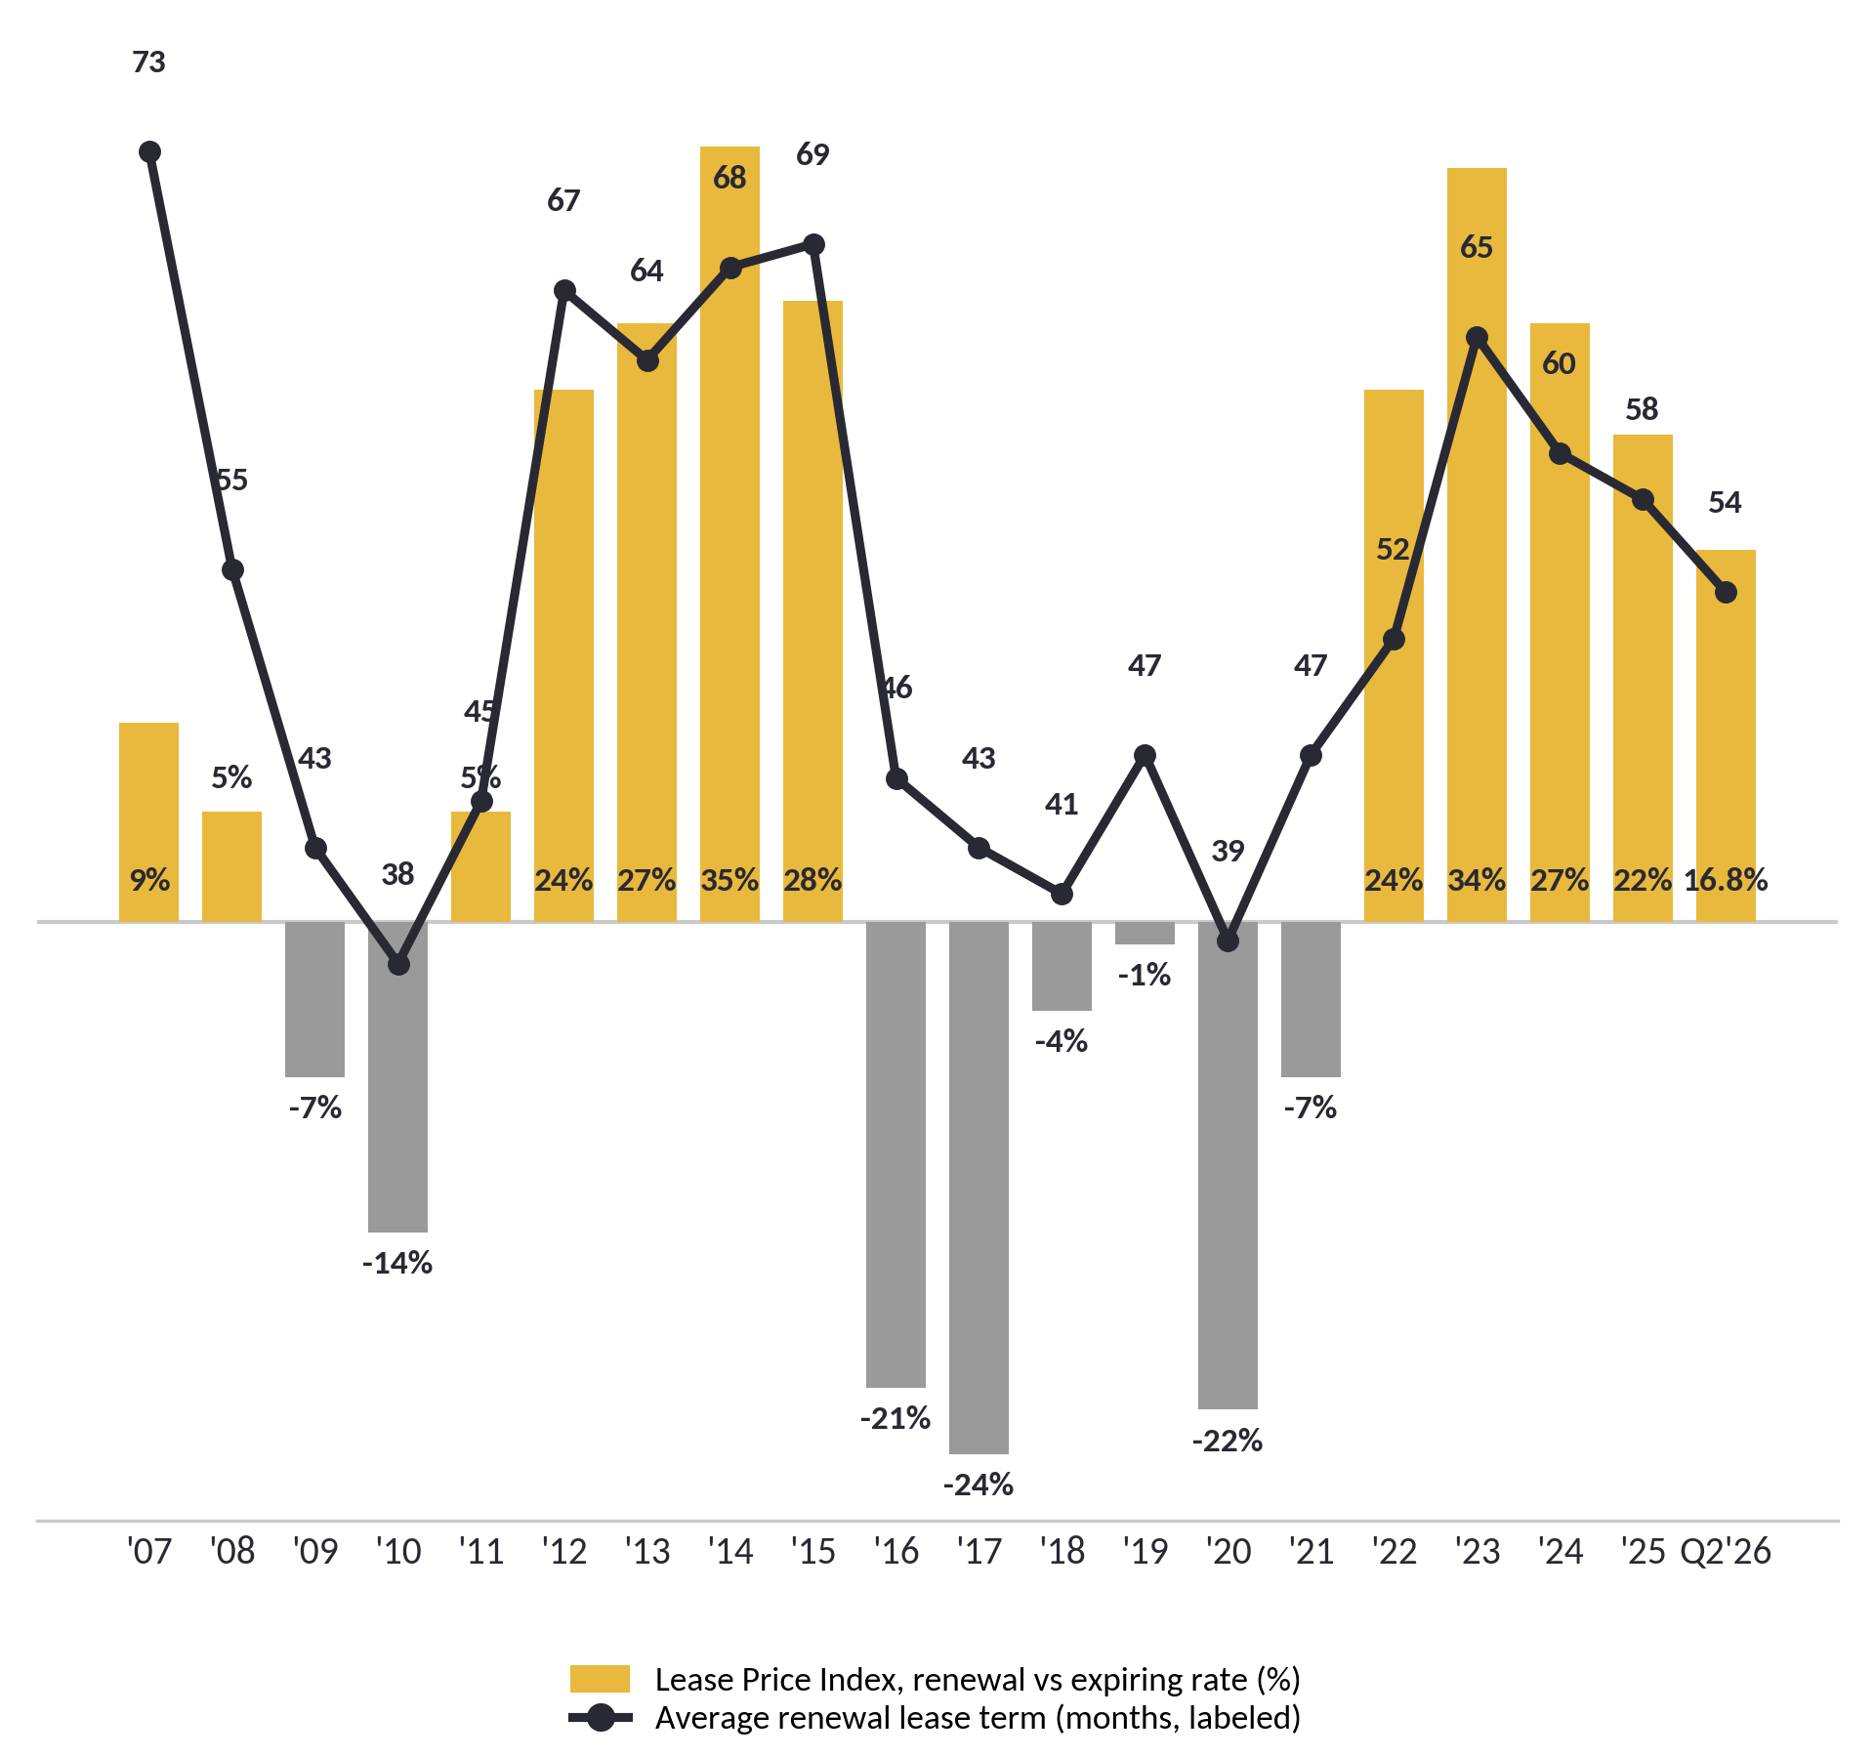
Cyclicality
Renewal pricing (LPI) sets the rate on about 12% of the fleet each year
Rate times cars on lease drives lease revenue
LPI is the cycle gauge: it decelerated to +16.8% in Q2 2026 from +22% in FY2025
Figure 5: LPI (bars, %) and average renewal term (line, months), 2007 to Q2 26
What the chart shows. Two full cycles. LPI peaked at +35% in 2014 and +34% in 2023; the trough was -24% in 2017, at the end of six straight negative years. Q2 2026 is +16.8%: strong, and past the peak of the up-leg.
Why it matters for the call. Only about 12% of the fleet renews in a year, so even a strong LPI is worth about $1 of EPS. The model's break-even LPI for 2027 is -29%, below the last trough. Repricing is not what makes or breaks this stock.
Read the line against the bars. GATX signs 65 to 73 month leases at the peaks and 38 to 43 at the troughs: it locks in the highs. The average term is 54 months now, down from 60, while renewal success fell from 87% to 79 to 83%. Customers are starting to push back on price. Those two are the leading indicators; LPI is the lagging one.
Sources: Company filings, FactSet, BMG Capital
5

Slide 6
Business Description
Drivers
Financial Analysis
Valuation
Risks
Key Highlights
Interest Cost
Renewal Pricing
Fleet Growth
Disposition Gains
Railcar Supply
6

Slide 7
Driver: Interest Cost
Figure 31: Debt maturity ladder ($M)
Figure 32: Floating-rate debt ($M)
Total debt $12,688M (FactSet balance sheet, includes revolver) against equity $2,751M at 2025-12-31, total debt to equity 461%.
Cash of $4,985M was pre-funded for the January GABX close, so year-end net debt was $7,703M. Consensus carries net debt of $11,277M for 2026.
Floating debt $3,830.5M at year-end 2025, of which $2,959M is the GABX term loan; $2,672.8M at June 30, 2026 after about $1.16B was termed out. 100bp is now about $0.20 net / $0.57 gross (was $0.45 / $0.81).
Net debt to EBITDA 7.65x in FY2025, the lowest in five years (range 7.65x to 8.91x).
Figure 33: Debt and rate-exposure detail
Figure 34: Cost of debt (%)
Item | Value | What it means
Total debt | $12.7B | Up from $8.2B a year earlier, mostly the Wells Fargo deal
Debt to equity | 4.6x | $4.61 of debt per $1 of equity: rate moves hit EPS hard
GABX term loan | $2.96B at 5.02% | Floating; due Dec 2030, the tall 2030 bar
Floating-rate debt | $2.67B | Resets with rates; $3.83B at YE2025 (Figure 32)
+1 point in rates | -$0.20 EPS | After hedges, June 30, 2026 ($0.57 before hedges)
Refinancing cost | 3.05% to 5.30% | 2026 maturities roll from 3.05% to new debt at 5.30%
Net debt / EBITDA | 7.65x | FY2025: years of cash earnings to repay net debt
Kill line: new 10-year debt at 6.00% or more fires an exit review. GATX's 2035 bond yields 5.95%.
Sources: Company filings, FactSet, BMG Capital
7

Slide 8
Driver: Renewal Pricing
Renewal pricing is the rate reset on about 12% of the fleet each year.
Figure 13: Renewal pricing inputs and the 2026 to 2027 bridge
Item | Value and period | Basis | Source | Comment
Lease Price Index | +16.8% (Q2 2026) | Renewal vs expiring rate | 10-Q | Decelerating
Lease Price Index | +22% (FY2025) | Renewal vs expiring rate | 10-Q | Prior print
FY2026 LPI guidance | High teens to low 20% (FY2026) | Company guidance | Q2 2026 call | Band
Legacy cars renewed | 21,500 (FY2025) | Legacy fleet | Company disclosure | About 22% of the FY2025 fleet of 99,560
Cars renewing annually | About 23,000 per year | Model assumption | Model | About 12% of the post-GABX fleet
Average expiring rate | $9,850 per car per year | Legacy cars | Model | Rate on leases ending now
Blended fleet rate | $8,205 per car per year | $391.0M x 4 / 190,587 cars | 10-Q | Average across all cars
Renewal bridge, 2026 to 2027 | +$45M pretax (2027E) | Rail NA $32M, GABX $9M, idle fill $4M | Model | Bridge
Kill criterion | LPI below +10% | Quarterly print | 10-Q | Exit review
Strong since 2022: +24% (FY2022), +34% (FY2023), +27% (FY2024), +22% (FY2025), +16.8% (Q2 2026).
FY2026 guidance is high teens to low 20%.
Sensitivity: halving the LPI from 16.8% to roughly 8% costs about 4% of EPS in year one, because only about 12% of the fleet renews in any year.
The reverse also holds: for repricing alone to make GATX a BUY under the rating rule, LPI would need to reach about +80%. Repricing cannot carry the call.
Kill criterion: an LPI print below +10% triggers an exit review.
Figure 13b: 2026 to 2027 renewal bridge, pretax ($M)
The 2026 to 2027 renewal bridge is about +$45M pretax: roughly $32M from Rail North America renewals, $9M from GABX joint-venture renewals at GATX's 30% share, and $4M from filling idle acquired cars.
Sources: Company filings, FactSet, BMG Capital
8

Slide 9
Driver: Renewal Pricing, Leading Indicators
Figure 14: Renewal success rate (%)
Figure 15: Customer strain signals
Renewal success fell from 87% in FY2025 to 79.1% in Q1 2026 and 82.6% in Q2 2026. Two prints below 85%; a third makes it a trend.
Customer strain signal
Renewal success, FY2025 | 87%
Renewal success, Q1 / Q2 2026 | 79.1% / 82.6%
Average renewal term, prior | 60 months
Average renewal term, now | 54 months
Lease Price Index, FY2025 | +22%
Lease Price Index, Q2 2026 | +16.8%
Cars renewing annually | About 23,000
Kill criterion | LPI below +10%
Average renewal term shortened from 60 months to 54 months.
Customers are pushing back on price at the margin.
Renewal success and term length are the leading indicators.
Both weakened before the LPI decelerated, the sequence you would expect if customers resist price.
Figure 16: Average renewal lease term (months)
Sources: Company filings, FactSet, BMG Capital
9

Slide 10
Driver: Fleet Growth, GABX
Figure 8: Consolidated active railcars, before and after GABX
Figure 24: Fleet utilization (%)
Figure 9: GABX ownership split (%)
The Wells Fargo acquisition doubled the consolidated fleet on 2026-01-01. GATX owns 30%, manages 100%, and earns fees on the whole fleet.
GATX manages the fleet and earns fees on top of its 30% economic share.
The acquired fleet closed at 97% utilization against 99% for the GATX legacy fleet, a gap of roughly 2,000 to 2,500 cars to fill.
Acquired cars sat on lower average lease rates, so there is re-lease upside as those contracts roll.
At the blended fleet rate of about $8,200 per car, filling 2,500 idle cars is roughly $20M of annual revenue on assets already paid for.
Sources: Company filings, FactSet, BMG Capital
10

Slide 11
Driver: Fleet Growth, Capex and Re-lease
GATX spends about $1.3B to $1.7B a year buying railcars. Fleet growth is the rate-base equivalent for a lessor: more cars, more lease revenue. GABX added 101,000 cars in a single transaction.
Figure 10: Return on capital vs cost of debt (%), FY2025
Figure 11: Capital spending on new railcars ($M)
ROIC 3.0% and return on total capital 3.9% (FactSet, FY2025, after tax) sit below the after-tax cost of debt, about 3.6%.
GATX gets a 12% ROE through leverage ($5.95 of assets per $1 of equity) and gains on car sales. That is why interest cost is driver 1.
Figure 12: GABX economics and the re-lease opportunity
Item | Value | Basis | Comparison | Source | Comment
Consolidated ROIC | 3.0% | FactSet FY2025, after-tax | After-tax cost of debt 3.6% | FactSet | Below cost of debt
GABX fleet economics at close | Below-market lease rates, 97% utilization | Acquired portfolio | GATX legacy 99% | Company disclosure | Re-lease and fill upside; segment ROIC not disclosed
Ownership | 30% GATX | JV with Brookfield | 70% Brookfield | 8-K, 2026-01-01 | GATX manages fleet
First call tranche | 1.56x book | Brookfield stake | Call rights over time | Company disclosure | Price paid
Acquired fleet | About 101,000 cars | From Wells Fargo | GATX legacy 99,560 | 8-K, 2026-01-01 | Fleet doubled
Acquired utilization | 97% | At close | GATX legacy 99% | Company disclosure | 2,000 to 2,500 cars to fill
Acquired lease rates | Below legacy | At close | Re-lease upside as rolls | Company disclosure | Upside driver
GABX term loan | $2,959M at 5.02% | Floating, due Dec 2030 | Guaranteed by GATX Corp | FY2025 10-K | Funds the deal
Renewal bridge, GABX share | About $9M pretax | 2027E | 30% economic share | Model | Part of +$45M bridge
Sources: Company filings, FactSet, BMG Capital
11

Slide 12
Driver: Disposition Gains
GATX sells older railcars every year and books the gains
Gains are a recurring part of the lessor model, not a one-off
H1 2026 booked 90% of the $130M legacy guide; BMG carries $155M.
Figure 17: Disposition gains, FY2026 guide and H1 2026 actual
Disposition gains are the recurring, not guaranteed line in the income statement.
Lease revenue is locked by multi-year contracts, typically four to five years.
Gains depend on what used railcars fetch in the secondary market, which is a cycle variable.
Disposition gains | Amount | Per share | Source
FY2026 guide, consolidated | $200.0M | $3.21 | $130M legacy + $70M GABX; GATX share $151M
H1 2026, Rail NA | $117.5M |  | 90% of the $130M legacy guide in six months
Q2 2026, Rail NA | $67.7M |  | 10-Q
Q2 2026, Rail Intl | $2.0M |  | 10-Q
Guided adj. EPS mid | $10.10 |  | Includes gains
BMG FY2026 legacy estimate | $155.0M | $3.29 | H1 actual plus H2 at a $37M pace; kill criterion $146M
Figure 18: FY2026 guide, legacy guide, H1 booked and BMG estimate ($M)
GATX's share of the $200M guide is $151M: its own $130M plus 30% of the $70M GABX gains (Brookfield keeps the rest). Taxed at 24% over 35.8M shares, that is $3.21 per share, about 32% of the $10.10 guided EPS midpoint.
At a 30% tax rate the share is about 29%.
Sensitivity: each $50M above or below the guide is roughly $1.06 per share. H1 legacy gains of $117.5M are 90% of the $130M legacy guide; BMG carries $155M, which is why BMG's 2026E EPS of $10.53 sits above the $9.90 to $10.30 guide. Below $146M (a kill criterion) the call moves toward SELL.
Sources: Company filings, FactSet, BMG Capital
12

Slide 13
Driver: Disposition Gains, What Moves It
Figure 19: Secondary-market drivers of the gains line
Figure 20: Gains pace vs guide ($M)
Secondary-market driver | Current read | Evidence | Source
Renewal rate environment | Positive, slowing | LPI +16.8% in Q2 2026 from +22% in FY2025 | 10-Q
Fleet utilization | Firm | 98.0% in Q2 2026 | 10-Q
Cycle position | Mixed | ISM PMI 54.5, up 5.6 points on a year ago; XLI/XLP peaked June 2026 | ISM, market data
Average renewal term | Shortening | 60 months to 54 months | Company disclosure
Renewal success rate | Softer | 87% FY2025; 79.1% Q1, 82.6% Q2 2026 | Company disclosure
Gains pace versus guide | Ahead | $117.5M of the $130M legacy guide booked in H1 | 10-Q
FY2026 gains ($M)
Guide, consolidated | 200.0
H1 2026 booked, legacy (Rail NA) | 117.5
Share of $130M legacy guide | 90%
Implied H2 to meet legacy guide | 12.5
H2 in BMG model (legacy $155M) | 37.5
Figure 21: Per-share translation
Per-share translation
GATX share, $151M of gains | $3.21
Tax rate assumed | 24%
Diluted shares | 35.8M
Guided adj. EPS midpoint | $10.10
Each $50M of gains | $1.06
Secondary-market railcar prices set the gain on every car sold
So the gains line, about a third of guided EPS, moves with the cycle rather than with contracts
Figure 22: Legacy gains: H1 booked, H2 to guide, H2 in BMG model ($M)
H1 legacy gains of $117.5M are 90% of the $130M legacy guide with two quarters left, which is why the guide is more likely to move up than down at Q3 on October 27. BMG carries $155M.
The same cyclicality cuts both ways: used railcar values fall when the cycle turns, and this is the line where that shows up first. Below $146M the call moves toward SELL; gains are the line holding up the HOLD.
Sources: Company filings, FactSet, BMG Capital
13

Slide 14
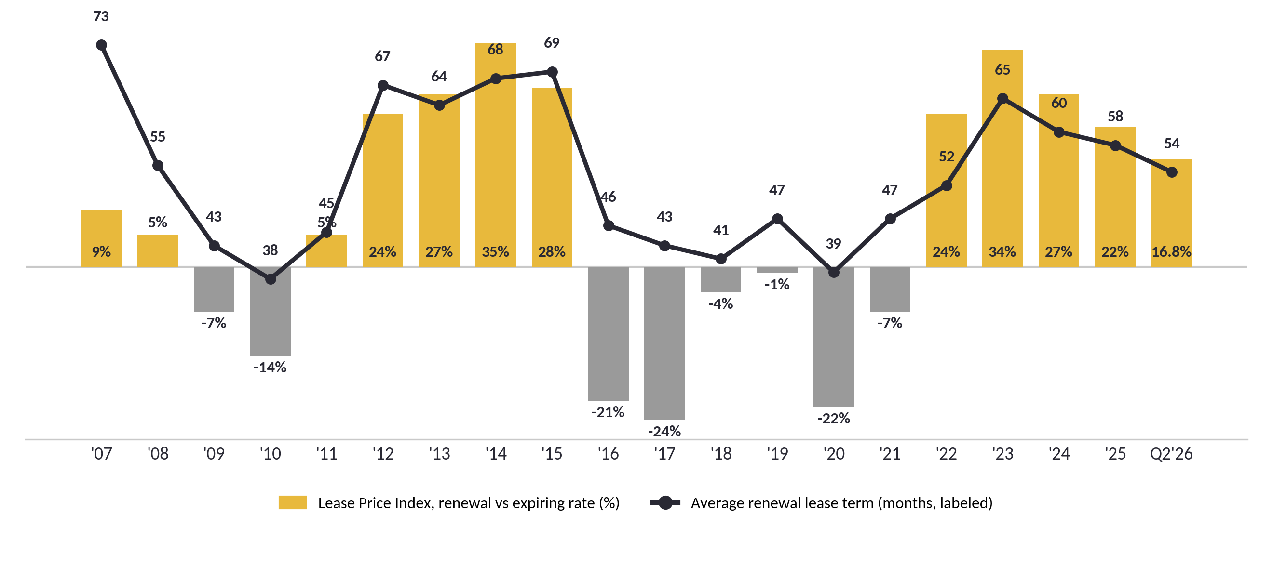
Driver: Railcar Supply Tightness
Figure 6: LPI (bars, %) and renewal term (line, months), 2007 to Q2 2026
Four consecutive years of renewal pricing above +20% means shippers are competing for railcars. Pricing power like this does not exist in a fleet with slack.
Fleet utilization 98.0% at Q2 2026. The North American fleet is effectively full.
GATX's own read, presented to the STB in March 2026: scrapping continues to outpace new builds, the North American fleet is shrinking despite 98% utilization, and builders are cutting production. Industry backlog is at a fifteen-year low. GATX describes the market as a supply-led recovery.
Figure 7: North American railcar deliveries vs orders, industry (cars)
Builders delivered 31,205 cars in 2025 but took orders for only 20,361, so the backlog fell to a fifteen-year low. Deliveries have since slowed to a 22,000-car pace. Fewer new cars while old ones are scrapped is why renewal pricing held above +20% for four years.
Backlog 23,431 cars at Q4 2025, the lowest since Q4 2010. Q2 2026 is 5,527 deliveries and 5,826 orders, times four. Source: RSI via GATX STB presentation, March 2026.
Sources: Company filings, FactSet, BMG Capital
14

Slide 15
Business Description
Drivers
Financial Analysis
Valuation
Risks
Key Highlights
EPS and Guidance
Estimate vs Consensus
Returns on Capital
15

Slide 16
EPS and Guidance
Lease revenue on 278K cars
Disposition gains
Interest cost
Adjusted EPS
Figure 26: FY2026 EPS guide ($)
Figure 27: 2027E EPS, BMG vs consensus ($)
Figure 28: Gains share of 2026 EPS ($)
Figure 29: Estimate versus consensus, FactSet pulled 2026-09-21
Figure 30: Q2 2026 net income ($M)
 | FY2026 |  | 2027E
 | Estimate | Consensus | Estimate | Consensus
Sales | 2,379 | 2,351 | 2,467 | 2,428
% Change | 36.7% | 35.1% | 3.7% | 3.3%
EPS - Diluted | $10.53 | $10.23 | $10.47 | $11.27
% Change | 20.3% | 16.9% | -0.6% | 10.2%
BMG builds its own EPS from the filings; consensus and guidance are checks, not inputs. Model: GATX-FSM-v25.
FY2026 guide $9.90 to $10.30 (raised 2026-07-30). BMG 2026E $10.53, above the range on legacy disposition gains of $155M vs the $130M guide; H1 was $117.5M.
2027E: BMG $10.47 vs consensus $11.27. The $0.80 gap is interest ($616M vs ~$590M, $0.55), a second year of Wells Fargo accretion the Street assumes ($0.30) and RRPF ($0.28), not repricing.
Q3 2026: BMG $2.67 vs consensus $2.48. A print at the guide midpoint is inside guidance and a miss against consensus.
Sources: Company filings, FactSet, BMG Capital
16

Slide 17
Returns on Capital
Figure 35: DuPont decomposition, FactSet
ROE decomposition | 2022 | 2023 | 2024 | 2025 | 2026E
Asset turnover | 0.127x | 0.129x | 0.131x | 0.113x
Pretax margin | 13.9% | 17.4% | 16.5% | 16.0%
Pretax ROA (excl. affiliates) | 1.76% | 2.24% | 2.16% | 1.81%
ROA | 1.55% | 2.37% | 2.31% | 2.12% | 1.94%
Equity multiplier | 4.96x | 5.09x | 5.13x | 5.95x
ROE | 7.70% | 12.05% | 11.86% | 12.63% | 11.89%
Net debt to EBITDA | 8.43x | 8.91x | 8.74x | 7.65x | 6.96x
ROIC 3.0% and return on total capital 3.9% (FactSet, FY2025, after-tax).
FactSet WACC 5.61% against ROIC 3.0%. On an asset basis GATX earns below its cost of capital; the return to equity comes through 5.95x leverage.
GATX paid 1.56x book for the first Brookfield call tranche.
Interest coverage 1.27x EBIT/interest, lowest in five years (1.54x in 2022). Normal for a lessor, where interest is the cost of the product.
2026E ROA, ROE and net debt/EBITDA are consensus; DuPont components are not forecast.
ROA includes after-tax equity-method affiliate earnings (RRPF joint venture) that sit below the pretax line, so pretax ROA times the tax complement does not reconcile to ROA. Each row is FactSet's reported value.
Figure 37: Price paid for the first call tranche
Figure 36: Return on equity, ten years (FactSet, ending equity)
1.56x
book value paid, first call tranche
2017 reflects the deferred-tax revaluation from the Tax Cuts and Jobs Act, not operations.
ROE troughed at 7.2% in 2021 and recovered to 12.6% by 2025. Consensus holds it near 11.5 to 12% through 2027. The multiple call rests on this level being sustained, not on it rising.
GATX holds call rights to buy up Brookfield's 70% stake over time.
Sources: Company filings, FactSet, BMG Capital
17

Slide 18
Business Description
Drivers
Financial Analysis
Valuation
Risks
Key Highlights
Historical Multiple
Non-Circular Inversion
Target and Four Methods
18

Slide 19
GATX Has Lessor Leverage and a Railroad Multiple
GATX's debt/EV of 69% matches AerCap (69%) and Trinity (72%). Its P/E of 17.6x sits between the lessor cluster (7 to 14x) and the Class I rails (22 to 27x). The market prices GATX's balance sheet as a lessor and its earnings as rail infrastructure.
AerCap earns an 18.7% ROE at 6.9x earnings and 1.2x book. GATX earns 13.3% at 17.6x and 2.3x book. The premium rests on railcar asset life (40+ years vs 25 for aircraft), residual-value stability, and domestic-only exposure. BMG holds the multiple at GATX's own median; the disagreement with the Street is the earnings.
GATX funds 13.4% of capital expenditure from operating cash flow, the lowest in the group (FactSet internal funding ratio). The rails fund over 100%. This is why free cash flow is negative and why the deck values on multiples.
Figure 38: Comparable companies, FactSet pulled 2026-09-21, prices as of 2026-09-18
Ticker | Price | Mkt Cap ($M) | EV ($M) | EV/EBITDA | P/E LTM | P/E FY1 | P/BV | ROE | ROA | Net Margin | Div Yield
GATX | 177.89 | 6,436 | 18,106 | 14.7x | 17.6x | 17.4x | 2.26x | 13.3% | 2.3% | 17.6% | 1.48%
Lessors
AER | 141.64 | 22,761 | 62,322 |  | 6.9x | 7.6x | 1.21x | 18.7% | 4.7% | 45.0% | 1.04%
WLFC | 54.32 | 1,621 | 3,614 | 9.6x | 13.6x | 8.8x | 1.75x | 12.6% | 2.4% | 13.2% | 0.98%
Manufacturers
TRN | 28.00 | 2,313 | 7,245 | 11.1x | 6.7x | 12.6x | 1.95x | 32.4% | 4.1% | 17.1% | 4.43%
GBX | 41.82 | 1,294 | 2,835 | 6.8x | 12.3x | 13.8x | 0.82x | 7.0% | 2.5% | 4.1% | 3.25%
Rental and rails
URI | 1,013.91 | 63,297 | 77,415 |  | 24.4x | 20.5x | 6.85x | 28.9% | 8.7% | 15.7% | 0.76%
UNP | 279.37 | 166,472 | 194,683 | 13.7x | 22.6x | 21.4x | 8.03x | 39.7% | 10.5% | 28.8% | 2.03%
CSX | 47.10 | 87,531 | 102,336 | 13.4x | 27.2x | 23.5x | 6.20x | 24.4% | 7.4% | 22.2% | 1.19%
NSC | 314.16 | 70,804 | 84,451 | 15.2x | 26.8x | 24.2x | 4.34x | 17.0% | 5.9% | 21.0% | 1.72%
Median |  |  |  |  | 17.6x | 17.4x | 2.26x | 18.7% | 4.7% | 17.6% | 1.48%
EV/EBITDA is FactSet's comps-page figure (GATX EV $14,677M); the EV column uses the enterprise value bridge on the same date, $18,106M. The two differ on unconsolidated investments and non-controlling interest.
Sources: Company filings, FactSet, BMG Capital
19

Slide 20
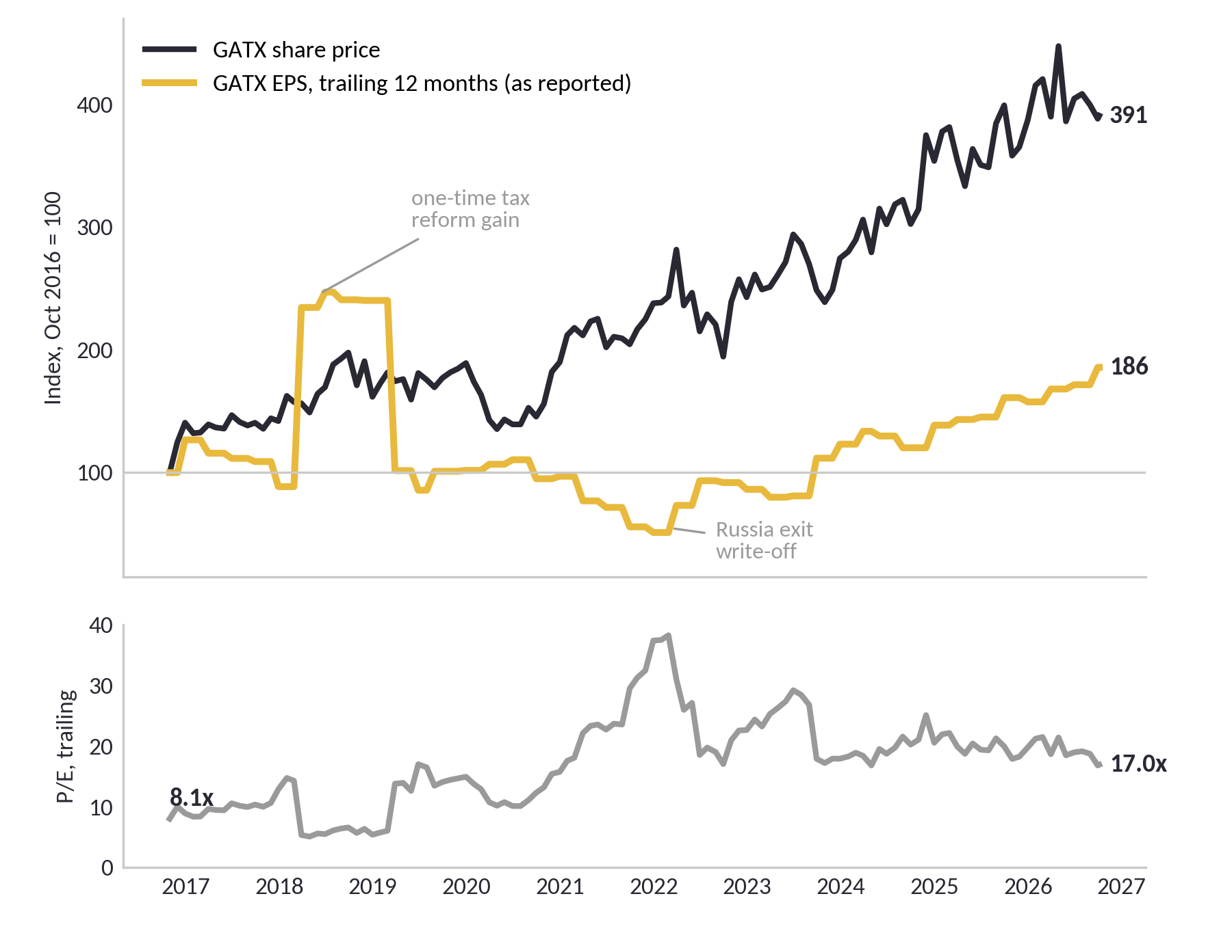
What Drove Ten Years of Returns
Figure 38a: GATX share price vs trailing EPS (index, Oct 2016 = 100) and trailing P/E, monthly
Figure 38b: Ten years in three numbers
 | Oct 2016 | Oct 2026 | Change
Share price | $43.77 | $171.12 | x3.9
EPS, trailing | $5.43 | $10.09 | x1.9
P/E, trailing | 8.1x | 17.0x | x2.1
Share of return |  |  | 45% EPS / 55% P/E
Figure 38c: What it means for the call
Two engines, about half each.
The stock rose 3.9 times in ten years; earnings per share rose 1.9 times. The rest came from the multiple, which doubled from 8x to 17x. In log terms, 45% of the return was earnings growth and 55% was re-rating.
The re-rating is the part least likely to repeat. From here the return has to come from earnings, which is exactly where this deck disagrees with the Street: $10.47 vs $11.27 for 2027.
Trailing EPS is as reported, so it includes one-time items (the 2017 tax reform gain, the 2022 Russia exit). Price return excludes dividends.
Sources: FactSet Interactive Charting (daily, 2016-10-11 to 2026-10-06), BMG Capital
20

Slide 21
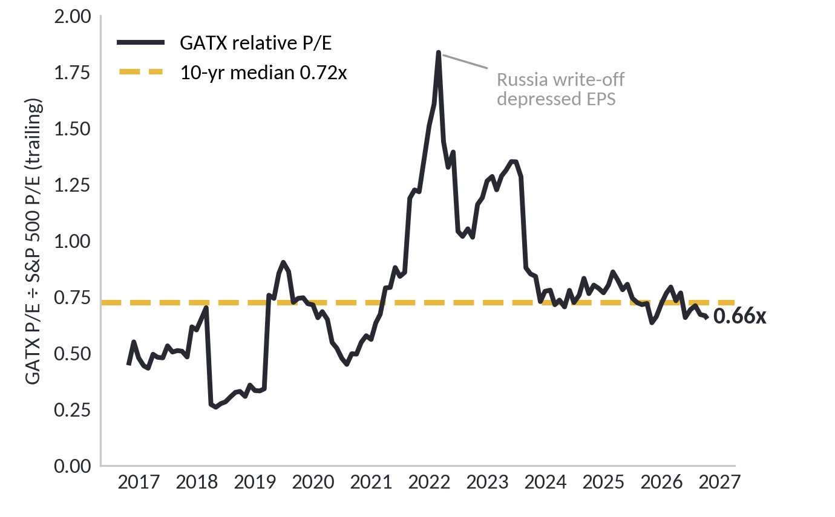
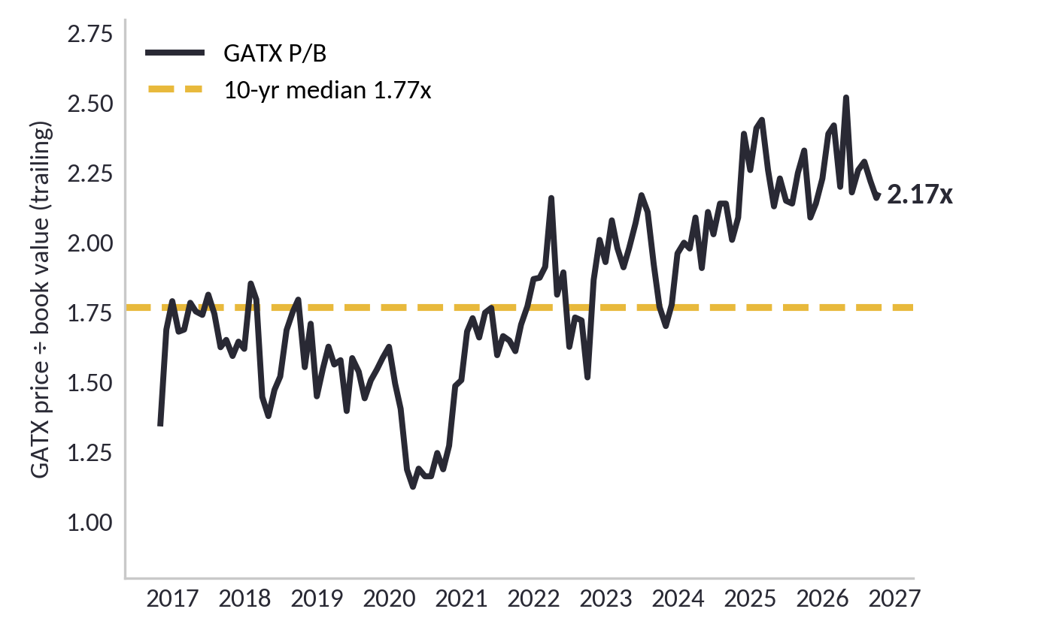
Relative Value: GATX vs the Market
Figure 38d: GATX P/E relative to the S&P 500, trailing, monthly
Figure 38e: GATX price to book value, trailing, monthly
Against the market, cheap on earnings.
GATX trades at 0.66x the S&P 500's P/E, below its ten-year median of 0.72x (36th percentile). That is the bull's best chart. Two cautions: the S&P's own P/E has expanded, so part of 'cheap vs the market' is the market getting expensive; and trailing EPS includes one-time items. The 2022 spike is the Russia write-off shrinking earnings, not an expensive stock.
Against its own history, rich on book.
At 2.17x book GATX is in the top 15% of the last ten years (median 1.77x). For a lessor, book value is the fleet the earnings come from, which is why this deck weights justified P/B and NAV at 70% of the target. The buy-side question is whether a 12% return on equity earns 2.17x book. The model's answer is about 1.8x.
Sources: FactSet Interactive Charting (monthly, Oct 2016 to Oct 6, 2026), BMG Capital
21

Slide 22
Historical Multiple Distribution
BMG's target multiple is the ten-year median, 16.34x. At $172.27 the stock trades at 16.45x BMG's 2027E of $10.47, right at that median, and 15.3x consensus $11.27. On Sept 25, at $183.73, it was 17.5x BMG's earnings. There is no multiple-expansion case on BMG's earnings.
Figure 39: GATX NTM P/E, ten years; median and current on BMG EPS
FactSet daily NTM P/E, month-end values, 2016-09 to 2026-09. Daily series n=2,606.
On BMG's earnings the stock now trades at its ten-year median multiple. The call is on the earnings, not the multiple.
Figure 40: GATX NTM P/E distribution
Figure 41: Median NTM P/E and days at or above 17.8x, by year
Statistic | Multiple | Implied price
10-year median NTM P/E | 16.34x | $171.08
5-year median NTM P/E | 17.08x | $178.83
5-year 75th percentile | 18.11x | $189.61
Current, 2027 consensus / BMG EPS | 15.3x / 16.45x | n/a
P/E leg: 10-yr median, probability-weighted | 16.34x | $169.76
2027E EPS used (BMG) | $10.47 | n/a
Conviction | 3 of 5 | n/a
Period | Median NTM P/E | Days at or above 17.8x
2016 to 2019 | 10.8x to 15.2x | 0%
2020 | 15.1x | 15%
2021 | 20.3x | 95%
2022 | 16.9x | 32%
2023 | 16.5x | 15%
2024 | 17.2x | 23%
2025 | 17.3x | 35%
2026 YTD | 16.8x | 33%
On Sept 25 GATX traded at 17.5x BMG's $10.47, the 76th percentile of its ten-year daily distribution. After the 6.2% drop to $172.27 it trades at 16.45x, essentially the ten-year median. On 2027 consensus of $11.27, which BMG's model does not support, it is 15.3x. The price has come down to the multiple BMG uses; what is left is the earnings gap. BMG does not pay above the ten-year median for earnings that depend on asset sales, so the target multiple is the median.
Sources: Company filings, FactSet, BMG Capital
22

Slide 23
Why Multiples, Not DCF
Figure 42: Why a multiple, not a DCF
Figure 43: Inversion at the 10-year median
Three reasons a multiple is the right tool for GATX, and an unlevered DCF is not:
One: as a lessor with about $12.5B of debt, equity is a thin slice on a large asset base; BMG built the DCF anyway and 75 to 87% of the value sits in the terminal year, with the answer swinging from $97 to $477 a share depending on the terminal method. It is a diagnostic, weighted zero.
Two: earnings are contractual and visible, four to five year leases on a 278,000 car fleet, so the work is in the earnings and the multiple is anchored to history.
Three: lessors are valued on what the assets are worth. BMG's net asset value, marking the fleet by vintage, gives $169 a share, which agrees with the P/E target from an independent direction (next slide).
Inversion check
Price, 2026-10-05 close | $172.27
10-yr median multiple | 16.34x
Implied 2027 EPS | $10.54
2027E consensus / BMG | $11.27 / $10.47
Priced for | BMG's earnings
Figure 44: Target math
Target math
2027E EPS (BMG) |  | $10.47
Target multiple (10-yr median, base) |  | 16.34x
P/E leg (prob-weighted) |  | $169.76
I did not choose the median. The market's own history did.
At the ten-year median of 16.34x, $172.27 implies 2027 EPS of $10.54: close to BMG's $10.47 and $0.73 below consensus $11.27. On Sept 25, at $183.73, the same test implied $11.24, the Street's number.
The honest test now says the stock is priced near BMG's earnings, not the Street's. That is why the call is HOLD, not SELL.
Sources: Company filings, FactSet, BMG Capital
23

Slide 24
Justifying 16.34x
Figure 45: Target math, 2027E EPS times target multiple
Figure 46: Target price by multiple on BMG 2027E EPS ($)
Target math
2027E BMG EPS | $10.47
P/E leg, 16.34x (10-yr median), 30% weight | $169.76
Price target, weighted: P/E 30% / NAV 35% / justified P/B 35% | $165.54
Expected 12-month total return | -2.4% (incl. $2.61 dividend)
Figure 47: Target price and return at alternative multiples
Multiple | Target price | Return
16.34x (10-yr median) | $171.08 | -1%
16.45x, current on BMG EPS | $172.27 | 0%
17.08x (5-yr median) | $178.83 | +4%
18.11x (5-yr 75th pct) | $189.61 | +10%
At the ten-year median the P/E value is $171, about today's price: the market is now paying the median multiple on BMG's earnings. At the five-year median of 17.08x it is $179, +4%. At the five-year 75th percentile of 18.11x it is $190, +10%. No multiple in GATX's own ten-year range gets to a BUY (+15%) on BMG's earnings.
Why 16.34x: it is the multiple GATX's own ten-year history set, and BMG does not pay above it for earnings where roughly 40% of pretax income is disposition gains. The P/E leg weights three full-model scenarios: bear 25% ($10.12 at the 25th percentile 14.78x), base 50% ($10.43 at 16.34x), bull 25% ($10.66 at the 75th percentile 17.69x), which gives $169.76. That leg is 30% of the target; NAV and justified P/B are the rest (next slide).
Sources: Company filings, FactSet, BMG Capital
24

Slide 25
Four Ways to Value a Lessor
Figure 48: Four ways to value a lessor, $ per share, GATX-FSM-v32 (weights: justified P/B 35%, NAV 35%, P/E 30%)
Method | Value / share | vs $172.27 | What it says
P/E, probability-weighted (bear 25 / base 50 / bull 25), weight 30% | $169.76 | -1% | Ten-year median on BMG 2027E EPS $10.47. The market's own pricing of GATX.
Net asset value, fleet marked by vintage, after deferred tax, weight 35% | $169.91 | -1% | Vintage marks 1.02x to 1.27x; fleet-wide 1.04x. At a 1.14x mark the target is $177, +4% with the dividend: still HOLD.
Justified P/B x 2027E book: (12.2% - 5.0%) / (9.0% - 5.0%) = 1.80x, weight 35% | $157.56 | -9% | The buy-side lens. g = sustainable growth (retention x ROE, capped). At g 2% this leg is $127; at 4%, $143.
Residual income, ROE minus cost of equity, 10-year fade, weight 0% | $99.17 | -42% | Same math as justified P/B; shown, not weighted, to avoid double counting.
Peer P/B on ROE, nine lessors, filings-sourced, weight 0% | $161.97 | -6% | R-squared 0.03: noise. Shown, not weighted.
Unlevered DCF, Gordon / exit multiple, weight 0% | $470 / $97 | n/a | 75 to 87% of value in the terminal year. Wrong tool for a lessor.
Weighted target | $165.54 | -4% | 0.30 x 169.76 + 0.35 x 169.91 + 0.35 x 157.56. Return -2.4% with the $2.61 dividend. Weights set 2026-10-01; growth input corrected 2026-10-02.
Figure 49: Earnings quality, 2027E
Figure 50: What the four methods say together
Diluted EPS (BMG) | $10.47
Core EPS ex-disposition gains (floor) | $5.57
EPS at normalized gains (6-yr avg $105M) | $7.81
P/E on normalized-gains EPS at $172.27 | 22.1x
Disposition gains as % of pretax income | ~40%
Every method that does not start from "the market is right" lands at or below $172.27. P/E and NAV agree near $170. Justified P/B at $158 is the buy-side lens: at 2.0x 2027E book the price needs a 12.9% ROE; the model has 12.2%.
The bull's best argument is the fleet mark. GATX sells its oldest cars at 1.76x book, so book understates the fleet. The model marks it at 1.04x; at 1.14x the target is $177, +4% with the dividend, still a HOLD. That is the assumption to attack, and it is on the page.
Gains are a real business line (about $105M a year), so core EPS ex-gains is a floor, not a base. On normalized gains the stock trades at 22.1x.
Sources: Company filings, FactSet, BMG Capital
25

Slide 26
Business Description
Drivers
Financial Analysis
Valuation
Risks
Key Highlights
Industry Framework
Rate Exposure
Cycle Position
Heat Map and SWOT
Kill Criteria
26

Slide 27
Industry Framework: Cyclical, Mature, Supply-Constrained
Sector classification
Industrials, transportation equipment leasing. Cyclical. Industrial equipment demand runs at roughly 2x GDP growth less 2% (Spellman). GATX's beta is 0.85 to the S&P 500 and 0.93 to XLI, lower than the sector because four-to-five-year leases contract the revenue.
Life cycle stage
Mature. FY2025 EBIT margin of 30.7% is the highest in GATX's 25-year record, which is what margins do at the top of the mature phase. Growth comes from consolidation (GABX doubled the fleet) rather than organic expansion. Free cash flow is negative because GATX chooses expansion capex, not because the business cannot generate cash.
Supply dynamics
Capacity is not being added at the peak. Industry backlog of 23,431 cars at 12/31/2025 is the lowest since Q4 2010. Builders are cutting production and scrapping outpaces new builds (GATX to the STB, March 2026). This is the opposite of the overbuild that ends most industrial cycles.
Figure 48: Porter's Five Forces, GATX (1 = weak force, 5 = strong)
Figure 49: Five forces, one-line read
Force | Read
New entrants (2) | $12B+ balance sheet and investment-grade funding required; PE-backed lessors cannot match GATX's cost of debt.
Suppliers (3) | Two dominant builders, Trinity and Greenbrier; low production gives them pricing power, but GATX is a top buyer.
Buyers (3) | Shippers can walk at renewal (success rate 79%); the tight fleet limits their alternatives.
Substitutes (2) | Truck for short-haul, pipeline for liquids; rail stays structurally cheaper for bulk.
Rivalry (3) | GATX, Trinity's leasing arm, Union Tank Car, PE lessors; fleet tightness mutes price competition.
Average 2.6 of 5. All five forces relate negatively to prices and profits; a moderate reading in a supply-constrained market is the structural reason renewal pricing has held above +20% for four years.
27

Slide 28
Risk: Interest Rate Exposure
Figure 50: Floating-rate debt at 2025-12-31 ($M)
Figure 51: Debt maturity ladder ($M)
$0.20
Figure 52: Fixed average coupon on maturing debt (%)
per share, per 100bp, net of hedges, June 30 ($0.45 at YE25).
$26.7M pretax gross on $2,672.8M floating at June 30, 2026, of which $1,754M is swapped to fixed.
Two exposures. $3.8B floated at year-end and $2.7B at June 30, after about $1.16B was termed out into fixed debt: 100bp is now about $0.20 per share net of $1,754M in swaps (was $0.45), immediate, either direction; $0.57 gross. $8.9B is fixed until maturity, but the 2026 tranche was borrowed at about 1% and refinances near 5.3%. Kill criterion: 6.00% on new 10-year issuance.
Sources: Company filings, FactSet, BMG Capital
28

Slide 29
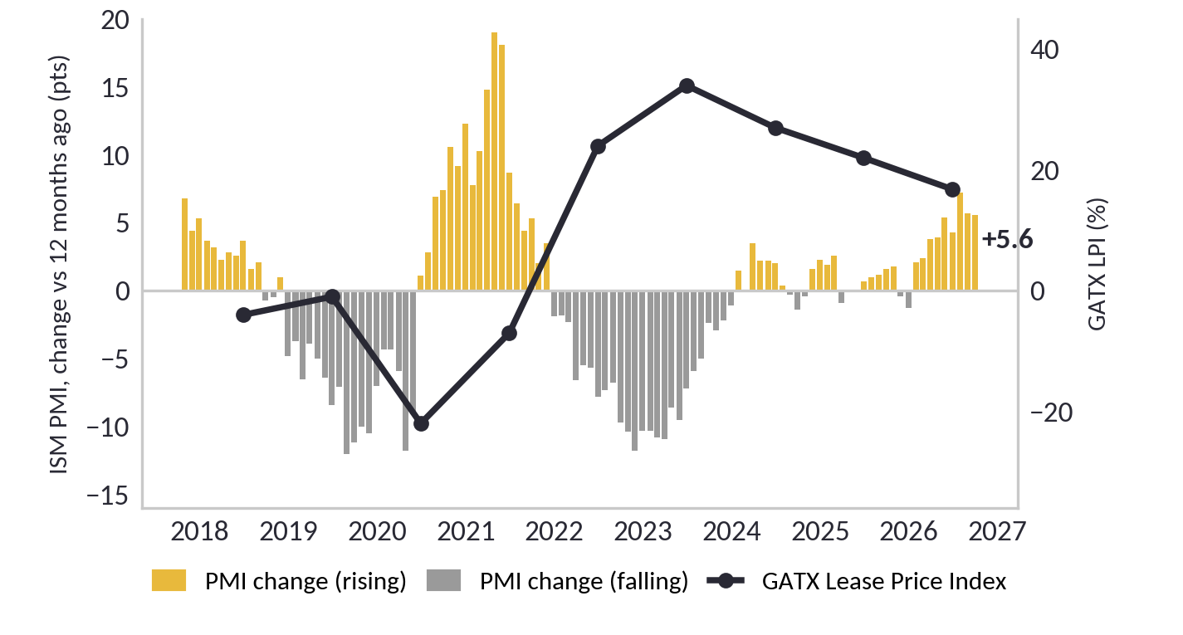
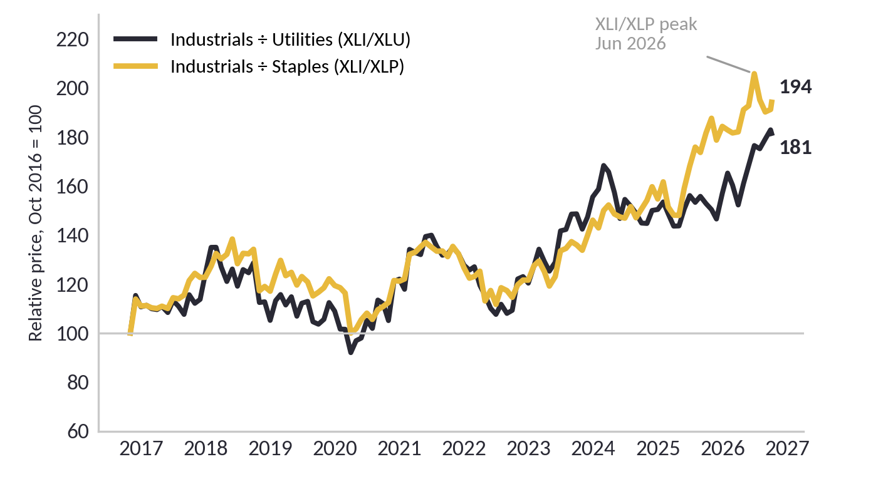
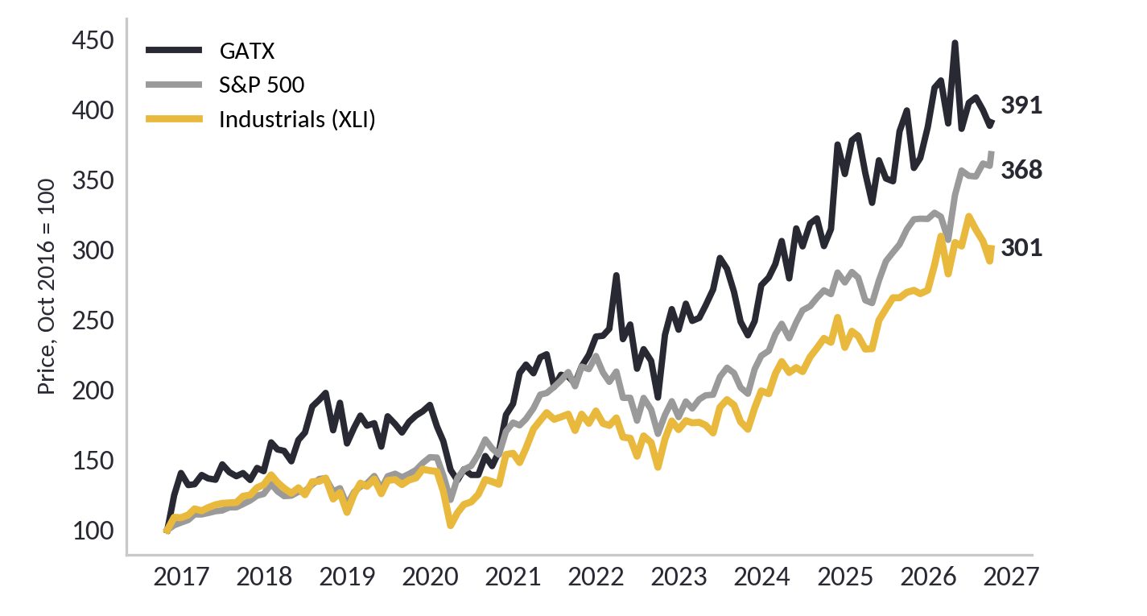
Macro Drivers: PMI and Sector Rotation
Figure 52a: Change in ISM Manufacturing PMI vs GATX Lease Price Index
Figure 52b: Cyclicals vs defensives, relative price
Figure 52c: GATX vs S&P 500 vs industrials, price, Oct 2016 = 100
What the macro says:
The PMI is 54.5, 5.6 points above a year ago. New orders, which lead the headline, are 55.3, up from 48.7 a year ago. The industrial economy is accelerating, not rolling over.
Industrials vs utilities is at a ten-year high. Only industrials vs staples and the July PMI print (55.6) have turned.
The PMI change led GATX's LPI by about a year in 2019 to 2022. Since 2022 the railcar shortage kept LPI high even while the PMI fell.
What it means for the call:
The call rests on interest cost and valuation, not on a downturn. A rising PMI is the main upside risk: if it lifts 2027 renewal pricing above the modeled +15%, 2027 earnings beat the model.
Sources: FactSet (ISM Manufacturing PMI; XLI, XLU, XLP, S&P 500 and GATX monthly prices, Oct 2016 to Oct 6, 2026), company filings (LPI), BMG Capital
29

Slide 30
Risk: Cycle Position
Figure 53: GATX Lease Price Index, the company's own instrument (%)
Cycle read: LATE_CYCLE
XLI/XLP ratio peaked in June 2026
One observation, n = 1
All three instruments turned before the call opened on 2026-09-11.
Figure 54: Cycle instruments and turn dates
Cycle instrument
GATX Lease Price Index | +16.8% in Q2 2026, down from +22% in FY2025
Turn date | Q2 2026 print, late July
ISM Manufacturing PMI | Turned down
Turn date | July 2026
XLI/XLP ratio, cyclicals vs defensives | Peaked
Turn date | June 2026
Classification | LATE_CYCLE
Call opened | 2026-09-11
Observations | One, n = 1
Not a driver | Utilization, 98% to 99% for years
Not a driver | PMI on its own, only alongside LPI and XLI/XLP
ISM Manufacturing PMI turned down in July 2026
Equities turned first in June, then the PMI in July, then the company's own pricing in late July.
I opened the call on 2026-09-11, after all three had rolled over.
GATX LPI decelerated to +16.8% in the Q2 2026 print, late July
One observation, not a pattern. Update Oct 6 (slide 29): the PMI is still 5.6 points above a year ago and industrials vs utilities is at a ten-year high. The read is mixed, not late. A rising PMI is the main risk to this call.
Sources: Company filings, FactSet, BMG Capital
30

Slide 31
Risk Heat Map and SWOT
Figure 55: Risk assessment matrix, probability vs impact (0 to 100)
Figure 56: SWOT analysis
Strengths | Weaknesses
278,000 railcars worldwide; North America doubled via GABX on 2026-01-01 | ROIC 3.0% below 4.8% cost of debt on an asset basis
98% utilization; fleet effectively full | Debt/equity 461%; net debt/EBITDA 7.65x
Four-to-five-year contracted lease revenue | Free cash flow negative every year on record
Investment grade: S&P BBB, Moody's Baa2, Fitch BBB+ | Interest coverage 1.27x, lowest in five years
Full-service model creates switching costs | About a third of guided EPS from non-contractual disposition gains
$1.75B of interest rate swaps on the floating book | GATX guarantees 100% of GABX debt while owning 30%
Opportunities | Threats
2,000 to 2,500 idle acquired cars to fill at ~$8,200 per car | Fed hiking cycle; 10-year Treasury above 5%
Below-market GABX leases re-price upward as they roll | Three cycle instruments turned before the call opened
Industry backlog at a 15-year low; scrapping outpaces builds | Renewal success 87% to 79%; term 60 to 54 months
Rail International and Engine Leasing growing 6% to 14% | Multiple compression as rates rise; 17.8x target set at lower rates
Call rights to buy up Brookfield's 70% of GABX over time | Secondary-market railcar prices fall when the cycle turns
Possible guide raise on disposition gains at Q3 2026 | Class I rail consolidation (UP-NS merger) could shift shipper leverage
# | Risk | Prob. | Impact | Score
1 | Fed hiking cycle, floating-rate repricing | 85 | 60 | 5,100
2 | Multiple compression in a higher-rate regime | 50 | 70 | 3,500
3 | Cycle turn, late-cycle read confirmed | 40 | 80 | 3,200
4 | 2026 refinancing step-up, 1% Europe debt to 5%+ | 95 | 30 | 2,850
5 | GABX re-lease and idle-fill slower than modeled | 35 | 40 | 1,400
6 | Disposition gains miss the $200M guide | 25 | 55 | 1,375
7 | LPI prints below +10% (kill criterion) | 25 | 50 | 1,250
8 | Credit downgrade below BBB- (kill criterion) | 10 | 90 | 900
The two highest-scored risks, rates and multiple compression, are the same risk from two directions. Both are new since the September Fed hike. The pre-registered kill criteria on the next slide are the thresholds for risks 7 and 8; risks 1 through 4 are watched through the macro feed.
31

Slide 32
Pre-Registered Kill Criteria and Risks
Figure 57: Pre-registered kill criteria, any one fires an exit review
Criterion | Threshold | Current | Source
Cost of debt, new 10-yr | 6.00% or higher | 5.95% (GATX 2035 bond, Sep 2026) | Bond yield; 8-K for new issues
NA fleet utilization | Below 96% | 98.0% (Q2 2026) | 10-Q
Lease Price Index | Below +10% | +16.8% (Q2 2026) | 10-Q
Credit rating | Below BBB- | S&P BBB stable, Moody's Baa2 positive outlook, Fitch BBB+ stable; one notch above the trigger (Fitch two) | S&P / GATX IR
Legacy disposition gains, FY2026 | Below $146M | BMG $155M; guide $130M; H1 $117.5M | 10-Q; BMG model Rating sheet
What would make me wrong
GATX's own 2035 bond yields 5.95%, 5bp from the 6.00% trigger. Any 10-year issuance at or above 6.00% fires the criterion regardless of the tape.
At $172.27 the expected 12-month return is -2.4%, inside the HOLD band. Above about $177 the rule flips to SELL; below about $146 it flips to BUY. The rule is mechanical; I do not get to argue with it.
Disposition gains are about 40% of pretax income and depend on secondary-market railcar pricing, which is cyclical. Below $146M of legacy gains the target falls and the call moves toward SELL.
The cushion in the earnings is asset sales and RRPF dividends, not repricing: repricing adds about $45M in 2027 falling to $17M by 2029, against $224M of added interest.
Break-even LPI in 2027 is -29%; the 2017 trough was -24%. The thesis survives a normal down-cycle only with dispositions intact.
Figure 58: Signposts, watch not kill
Signpost | Latest reading
Renewal success rate | 87% FY2025, 79.1% Q1, 82.6% Q2 2026
Average renewal term | 60 months to 54 months
Rail carloads, chemicals and petroleum | AAR weekly, monitored
Disposition gains pace | $117.5M H1 legacy vs $130M legacy guide (90%)
Every risk carries a threshold and a source
Each criterion is registered before the fact, with the disclosure that reports it. Any one firing triggers an exit review before the 2027-09-13 evaluation. Opened BUY 2026-09-11, SELL 2026-09-28 after the model build, HOLD 2026-10-06 after a 6.2% decline.
32

Slide 33
Summary
RECOMMENDATION: HOLD
Interest Cost
Renewal Pricing
Fleet Growth
Disposition Gains
Railcar Supply
Figure 1: GATX price and volume, one year (weekly)
GATX is a railcar lessor in a structurally tight market with a fleet that doubled in January. Those are real. But the earnings cushion is asset sales and RRPF dividends, not repricing, and BMG's model, built from the 10-K and Q2 10-Q, gets 2027 EPS of $10.47 against a Street at $11.27: the gap is interest, a second year of Wells Fargo accretion, and RRPF. Weighting three methods, justified P/B 35%, vintage-marked NAV 35% and P/E 30%, gives a $166 target against $172.27: expected return -2.4% with the dividend, inside the HOLD band. The P/E and NAV legs sit near $170, about where the stock trades; justified P/B at $158 says 2.0x book needs a 12.9% ROE, above the 12.2% the model has for 2027. Fairly priced to slightly rich, not cheap: above about $177 the same rule says SELL, below about $146 BUY.
Kill criteria: new 10-year debt at or above 6.00% (2035 bond: 5.95%), legacy disposition gains below $146M, utilization below 96%, LPI below +10%, rating below BBB-.
Mechanics: opened BUY at $178.53 on 2026-09-11; revised to SELL at $183.73 on 2026-09-28 after the model build; target method revised to weighted P/B, NAV and P/E on 2026-10-01 and the growth input corrected 2026-10-02 (v32). Moved to HOLD 2026-10-06: the stock fell 6.2% to $172.27 with the target unchanged. Evaluation 2027-09-13, benchmark XLI. Next test: Q3 on 2026-10-27, BMG $2.67 vs consensus $2.48.
FactSet, daily closes aggregated to weekly, 2025-07-11 to 2026-10-05.
Current Price: $172.27
Target Price: $165.54
FactSet consensus target is $219.75 on an average rating of Buy from 4 brokers. BMG's target of $166 is 25% below consensus. The HOLD says the Street's 2027 earnings are $0.80 too high, and that after a 6.2% drop the price now sits close to what the filings support.
33

Slide 34
Appendix
Definitions:
LPI (Lease Price Index): GATX's weighted-average change in renewal lease rate versus the expiring rate, for cars renewed in the period.
Utilization: Railcars on lease divided by total railcars in the fleet, at period end.
Disposition gains: Net gain on sale of railcars and other operating assets, a recurring line for a lessor.
GABX: The 30/70 GATX/Brookfield joint venture that acquired Wells Fargo's rail portfolio on January 1, 2026.
RRPF: Rolls-Royce & Partners Finance, the aircraft engine leasing joint venture inside the Engine Leasing segment.
NTM P/E: Price divided by next-twelve-months consensus EPS.
SIP consolidated close: The official consolidated closing price across all exchanges, used for every entry and price reference in this deck.
34

Slide 35
Appendix: Segment P&L, Q2 2026
Figure 59: Segment P&L, Q2 2026 ($M). Parentheses are expenses. Source: Q2 2026 10-Q segment note and income statement.
Line item ($M) | Rail NA | Rail Intl | Engine Leasing | Other | Total
Lease revenue | 390.9 | 100.3 | 8.8 | 8.3 | 508.3
Non-dedicated engine revenue |  |  | 20.6 |  | 20.6
Other revenue | 44.0 | 5.3 |  | 1.8 | 51.1
Total revenue | 434.9 | 105.6 | 29.4 | 10.1 | 580.0
Maintenance expense | (131.8) | (19.2) |  | (0.8) | (151.8)
Depreciation | (124.0) | (27.9) | (10.6) | (4.0) | (166.5)
Operating lease expense | (7.4) |  |  |  | (7.4)
Other operating expense | (15.8) | (4.9) | (3.0) | (1.1) | (24.8)
Net gain on asset dispositions | 67.7 | 2.0 |  |  | 69.7
Interest expense, net | (103.7) | (23.9) | (12.7) | (2.7) | (143.0)
Other income (expense) | (1.5) | (0.1) | 13.7 | 0.6 | 12.7
Share of affiliates' pretax earnings |  |  | 49.6 |  | 49.6
Segment profit | 118.4 | 31.6 | 66.4 | 2.1 | 218.5
Less: SG&A |  |  |  |  | (69.2)
Less: Income taxes |  |  |  |  | (38.4)
Less: Non-controlling interest |  |  |  |  | (7.6)
Net income attributable to GATX |  |  |  |  | 103.4
Adjustment to common |  |  |  |  | (1.9)
Net income available to common |  |  |  |  | 101.5
Diluted shares (M) |  |  |  |  | 35.8
Diluted EPS |  |  |  |  | $2.83
Rail NA lease revenue is segment revenue of $434.9M less other revenue of $44.0M, both disclosed. Segment profit sums to $103.3M after SG&A, taxes and NCI; the reported figure is $103.4M, the difference is rounding. Engine Leasing includes $49.6M of pretax affiliate earnings from the RRPF joint venture with Rolls-Royce.
35

Slide 36
Appendix: Debt by Maturity and Rate Type
Figure 60: Debt maturity ladder with fixed and floating split ($M). Source: FY2025 10-K Note 8.
Maturity | Fixed ($M) | Fixed avg coupon | Floating ($M) | Total ($M) | Note
2026 | 520.5 | 3.05% | 132.7 | 653.2 | Mostly European bonds at 0.90% to 1.07%
2027 | 725.3 | 4.85% | 129.2 | 854.5
2028 | 774.8 | 3.85% | 50.0 | 824.8
2029 | 544.5 | 5.03% | 362.9 | 907.4
2030 | 657.4 | 3.99% | 3,003.0 | 3,660.4 | Includes GABX term loan $2,959.0M at 5.02%, SOFR-based, GATX-guaranteed
Thereafter | ~5,452 | not disclosed | ~152.7 | 5,605.0 | Aggregate only in Note 8; split is derived
Total | ~8,675 |  | 3,830.5 | 12,505.3
Floating-rate exposure, net of hedges
Item | $M
Gross floating-rate debt | 3,830.5
Less: cash flow hedges (floating to fixed swaps) | (1,754.4)
Plus: fair value hedges (fixed to floating) | 50.0
Net floating exposure | 2,126.1
100bp sensitivity, pretax | 21.3
100bp sensitivity, per share | $0.45
Fixed weighted coupons are derived from the individual tranche coupons in Note 8. The thereafter split is derived: total floating of $3,830.5M less 2026 to 2030 floating of $3,677.8M leaves $152.7M; fixed is the residual. The GABX term loan is 77% of the total floating book. Hedge figures from the Q2 2026 10-Q derivatives note; confirmation that the $1,754.4M is interest-rate swaps only, excluding currency hedges, is pending.
36

Slide 37
Appendix: International and Engine Leasing
Figure 23: Rail International revenue, Europe and India.
Rail International grew 10.7% in 2025 and consensus has 6% to 10% through 2027. India is the growth market; Europe is the base.
Engine Leasing is 7% of revenue but its RRPF joint venture with Rolls-Royce contributed $49.6M of pretax affiliate earnings in Q2 2026 alone. Consensus 2027 revenue growth is 13.6%, the fastest in the company.
Figure 24: Engine Leasing revenue, RRPF joint venture with Rolls-Royce.
Both segments are small against Rail North America. Both are growing faster than it. Consensus 2027 Rail NA growth is 2.2%.
Figure 25: Segment revenue, 2025 actual and consensus ($M)
Segment | 2025A | 2026E | 2027E
Rail NA | $1,186M | $1,734M | $1,772M
Rail International | $388M | $425M | $452M
Engine Leasing | $125M | $132M | $150M
Sources: Company filings, FactSet, BMG Capital
37

