Slide 1
Cleaning Data
Sean McMinn
Digital frameworks
Northwestern University – Summer 2018
Github.com/shmcminn/digitalframeworks-summer18

Slide 2
Data stories?

Slide 3
Steps to a data story
Find data
Clean data
Analyze data
Present data

Slide 4
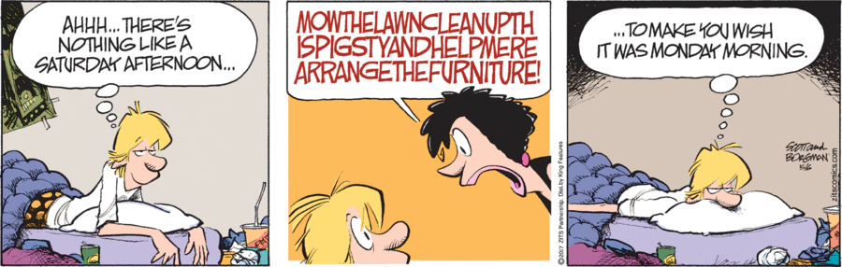
Data cleaning

Slide 5
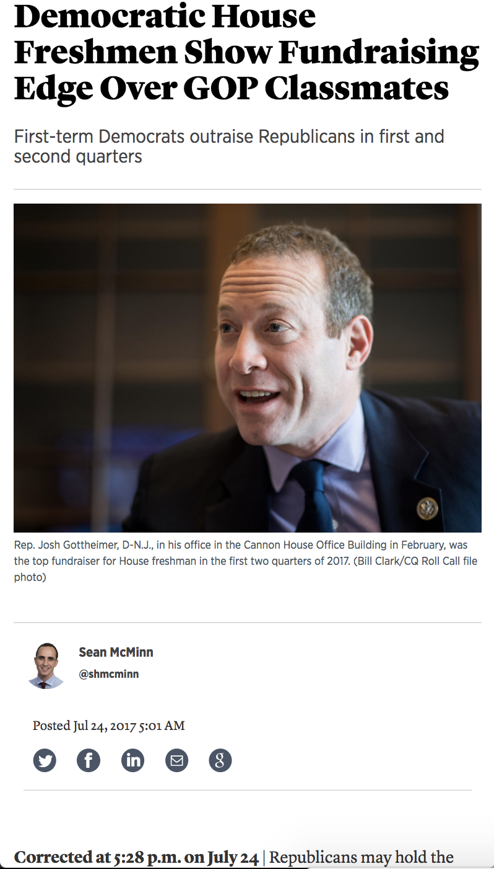
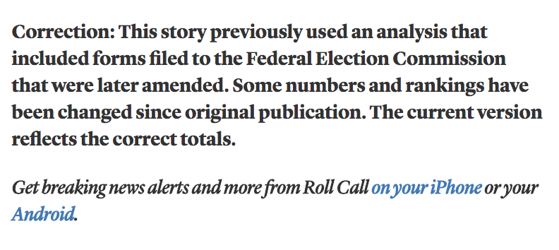
Data cleaning
Prevents this

Slide 6
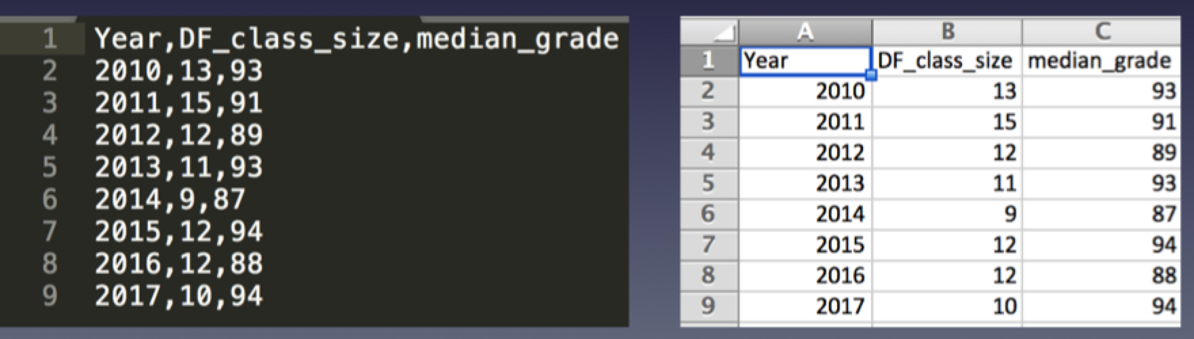
CSV => Excel
Excel can easily interpret most CSV files
But not always in the way you want
This is going to focus on spreadsheets, but many of the same principles apply to other data formats

Slide 7
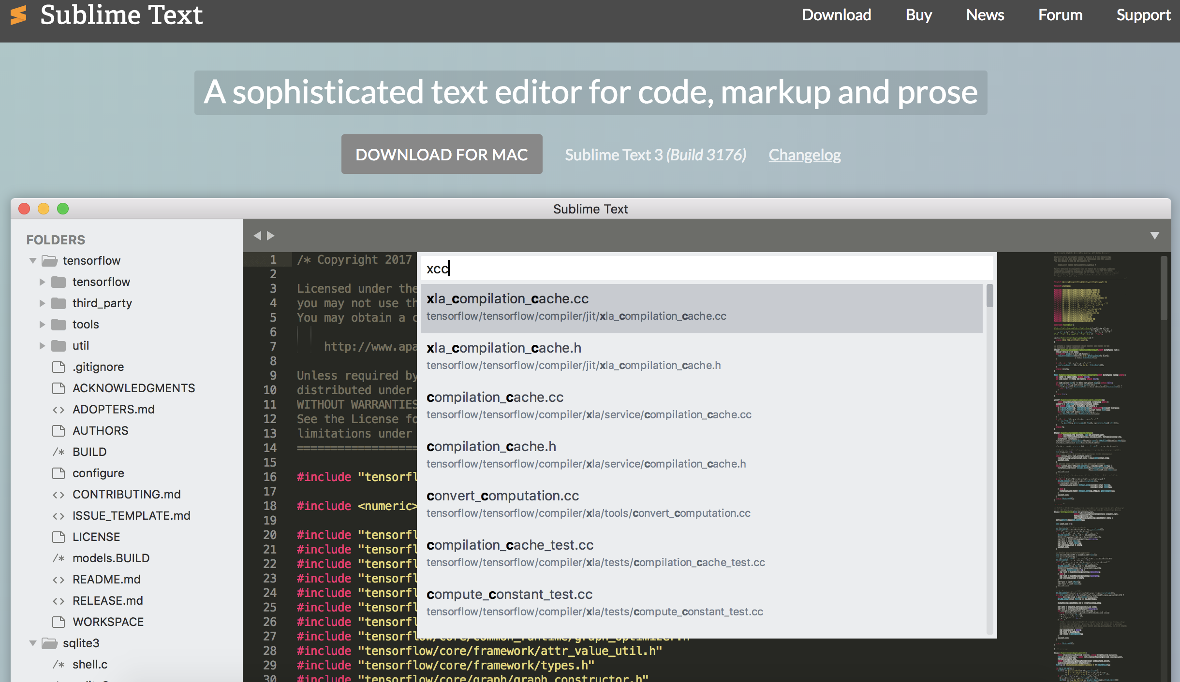
First …
Download text editor
sublimetext.com/3

Slide 8
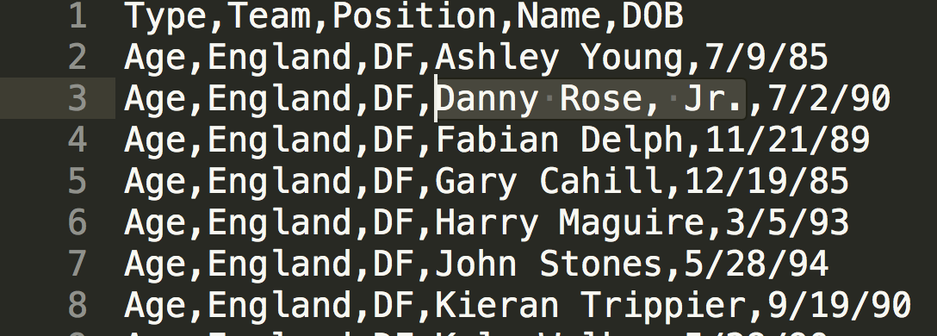
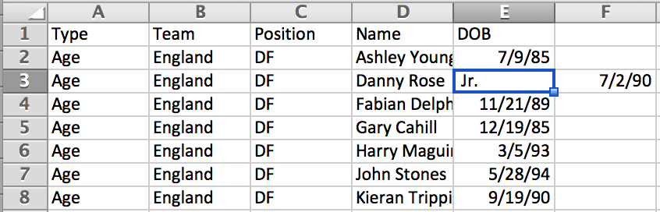
What to watch out for
Extra comma
(not actually a Jr.)
¯\_(ツ)_/¯

Slide 9
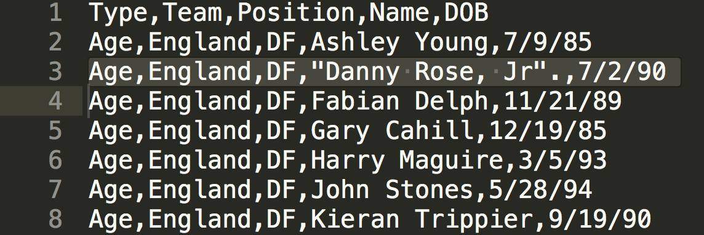
What to watch out for
Fix with quotes

Slide 10
What to watch out for
In pairs, fix this spreadsheet
{{DOWNLOAD }}

Slide 11
What to watch out for
Leading zeroes

Slide 12
What to watch out for
Cell data types

Slide 13
What to watch out for
Missing data
{DATA DOWNLOAD}

Slide 14
What to watch out for
Typos and/or data input inconsistency

Slide 15
What to watch out for
Duplicates/amendments
{DATA DOWNLOAD}

Slide 16
What to watch out for
Data broken into sections
{DATA DOWNLOAD}

Slide 17
What to watch out for
Merged cells

Slide 18
What to watch out for
Columns that should be split into two
{DATA DOWNLOAD}

Slide 19
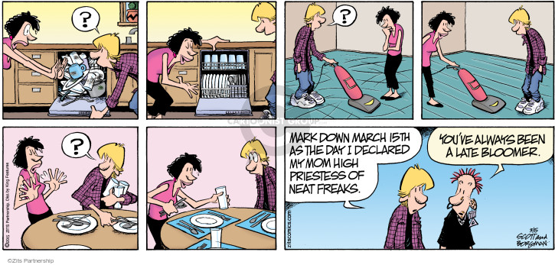
Cleaning techniques

Slide 20
Cleaning techniques
You can do everything by hand, one at a time, but UGH

Slide 21
Cleaning techniques
Find and replace
{DOWNLOAD FILE}

Slide 22
Cleaning techniques
ADVANCED find and replace
a.k.a. regular expressions
a.k.a. regex
a.k.a. misleadingly intimidating garbage
^".*" or \n[A-Za-z]*\t or : "\d*"
{DOWNLOAD FILE}

Slide 23
Cleaning techniques
Find and replace in Sublime using regex

