Slide 1
Analyzing Data
Sean McMinn
Digital frameworks
Northwestern University – Summer 2018
Github.com/shmcminn/digitalframeworks-summer18

Slide 2
Data stories?

Slide 3
Steps to a data story
Find data
Clean data
Analyze data
Present data

Slide 4
Agenda
Interviewing data
Guest: David Eads, Propublica Illinois
Data anlaysis in Excel

Slide 5
“Interviewing” Data
Questions you might ask a human source (let’s say a cop):
“Are there any interesting stories from your time on the force?”
Which college in town gives you guys the most trouble?
What’s the busiest shift to work on?

Slide 6
“Interviewing” Data
“Are there any interesting stories from your time on the force?”
Look for unusual data. For example:
Filter police reports to drunk and disorderlies
Filter time 0800 – 1200
Map XY data, and look for any unexpected locations

Slide 7
“Interviewing” Data
“Which college in town gives you guys the most trouble?”
Use XY coordinates to determine if police report is within a mile of a college
Group police reports by month
Sum up the number of monthly police reports for each college

Slide 8
“Interviewing” Data
“What’s the busiest shift to work on?”
Group police reports by shift
Group reports by month
Calculate average number of reports per month for each shift

Slide 9





“Interviewing” Data
Tips for “regular” interviews:
Ask direct, but open ended, questions
Be willing to go where answers lead you
Ask newsworthy questions
Get the name of the dog
Be aware your source may be dishonest or have an agenda

Slide 10
“Interviewing” Data
Tips for data interviews:
Phrase specific questions in your head before you begin using the computer
If you find an interesting trend, keep exploring it
Find the newsworthy trends/stories in the data
See if there’s any color you can track down either in the data or through external sources
Think about what your data may be missing and who published it

Slide 11

Guest speaker
David Eads
News applications developer, ProPublica

Slide 12
Chicago city salaries
Name
Job Titles
Department
Full or Part-Time
Salary or Hourly
Typical Hours
Annual Salary
Hourly Rate

Slide 13
Chicago city salaries
Exploring new data:
Sort/look for outliers
Filter
Group with pivot tables
Notes:
Sort by wage (min), filter by office (mayor), group and look at highest average (DOIT)

Slide 14
Chicago city salaries
WARNINGS: Exploring new data:
Sort/look for outliers
Make sure entire sheet gets sorted
Filter
Remember this is only part of your data: calculations only apply to that subset
Group
ALWAYS make a copy of your data
Notes:
Sort by wage (min), filter by office (mayor), group and look at highest average (DOIT)

Slide 15
Chicago city salaries
Standardize data using a formula
Examples:
= a2 + b2
= a2 / 50
=sum(a2:a10)
=average(b2:b10)
=year(b3)
=weekday(b3)
Cheat sheet:
https://www.dummies.com/software/microsoft-office/excel/excel-formulas-and-functions-for-dummies-cheat-sheet/
Notes:
Sort by wage (min), filter by office (mayor), group and look at highest average (DOIT)

Slide 16
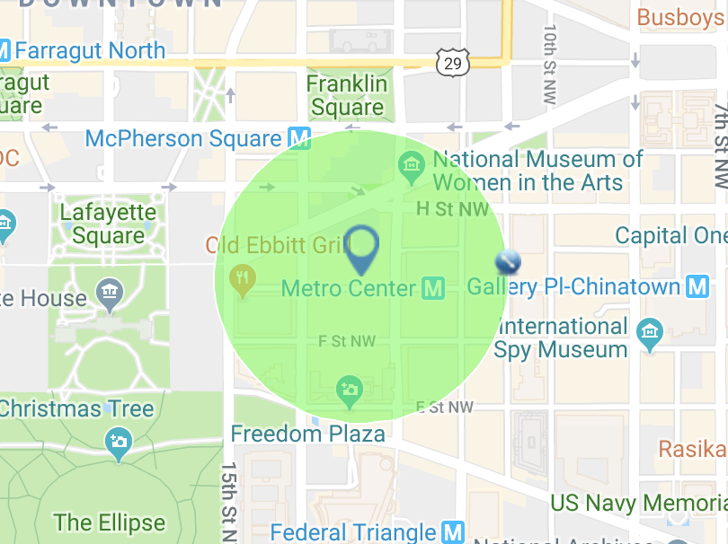
Crime data
Download medill_crime_data_1000ft_1yr.csv

Slide 17
Crime data
Fields
REPORT_DAT
SHIFT
OFFENSE
METHOD
BLOCK
DISTRICT
PSA
WARD
ANC
NEIGHBORHOOD_CLUSTER
BLOCK_GROUP
CENSUS_TRACT
VOTING_PRECINCT
CCN
XBLOCK
YBLOCK
START_DATE
END_DATE

Slide 18
Crime data
Questions for PIVOT TABLES!
What is the most common type of crime in our area?
What block has the most/least crimes on it?
What time of day has most/least crimes?
What day of week has most/least crimes?

Slide 19
Crime data
Find something interesting in the 1,000-foot radius around somewhere else in DC (could be your home, your internship office, a landmark, etc) using data from the last year
http://crimemap.dc.gov/CrimeMapSearch.aspx

Slide 20
Combining datasets
We can use Goolge Fusion tables to “merge” datasets that have a common key.
Download all_dc_30_days_crime.csv and comp_table_wd12.csv
Go to drive.google.com

