Slide 1
Statistics for Reporters
Sean McMinn
Digital frameworks
Northwestern University – Summer 2018
Github.com/shmcminn/digitalframeworks-summer18

Slide 2
Data stories?

Slide 3
Steps to a data story
Find data
Clean data
Analyze data
Present data

Slide 4
Agenda
Examples
Guest:
Statistical concepts you should know

Slide 5
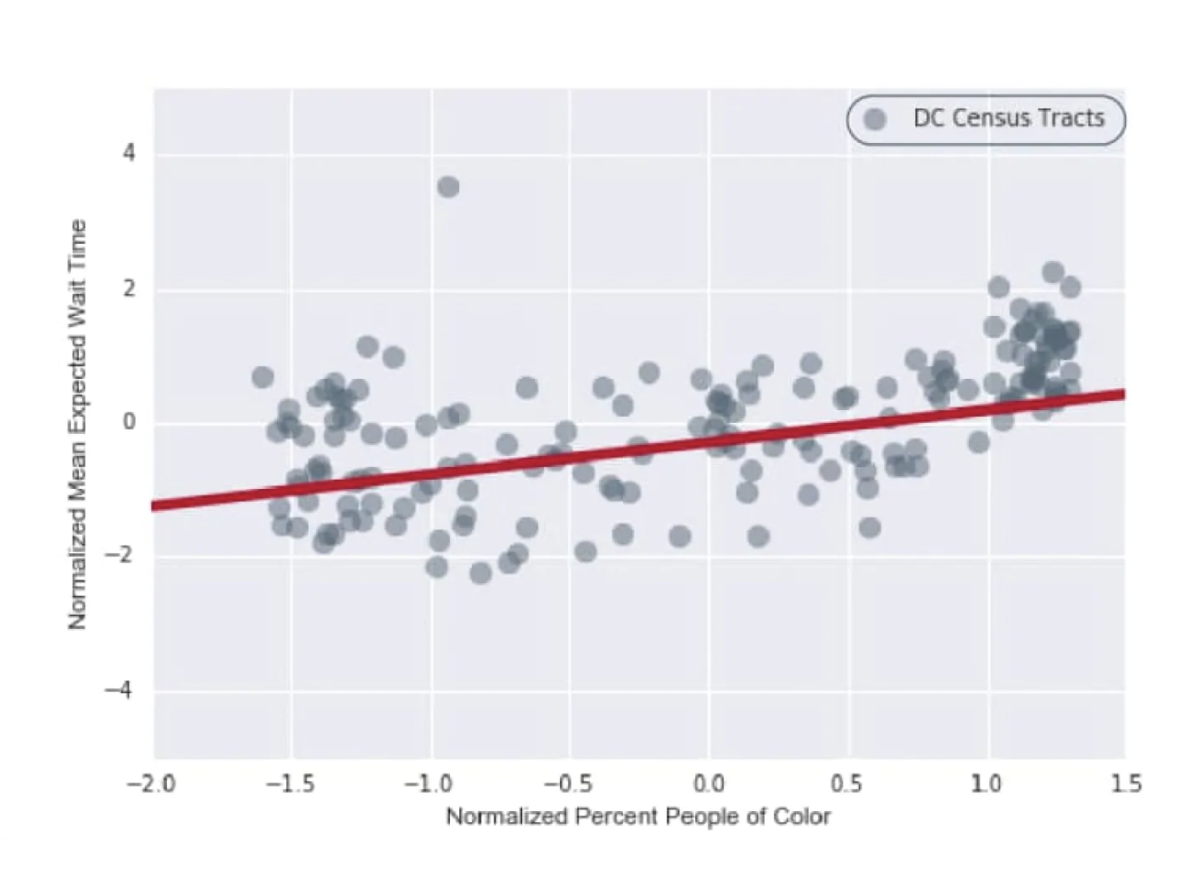
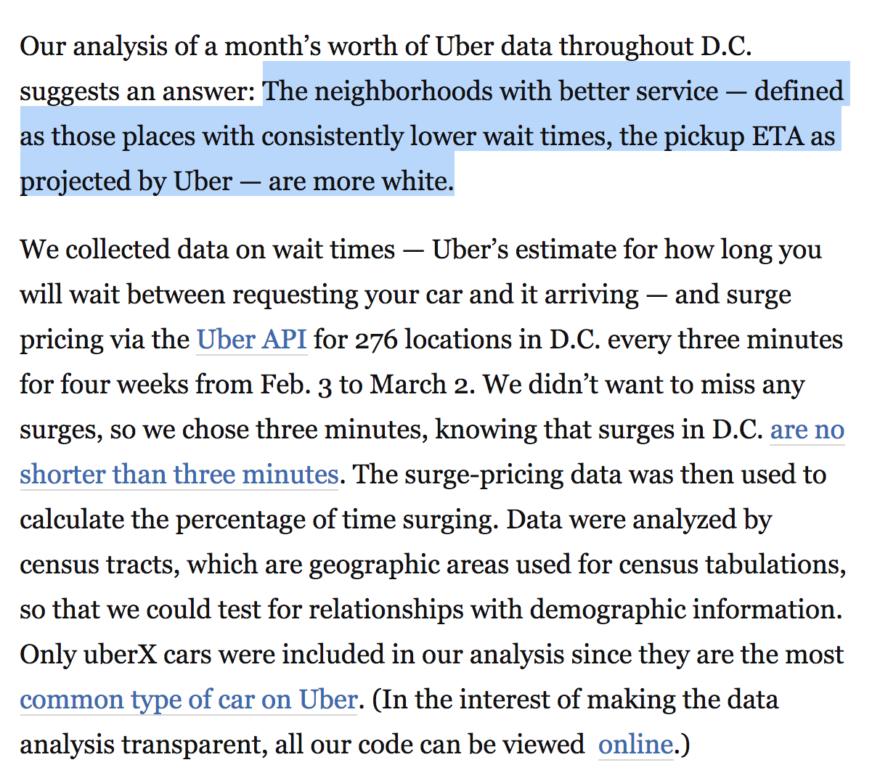
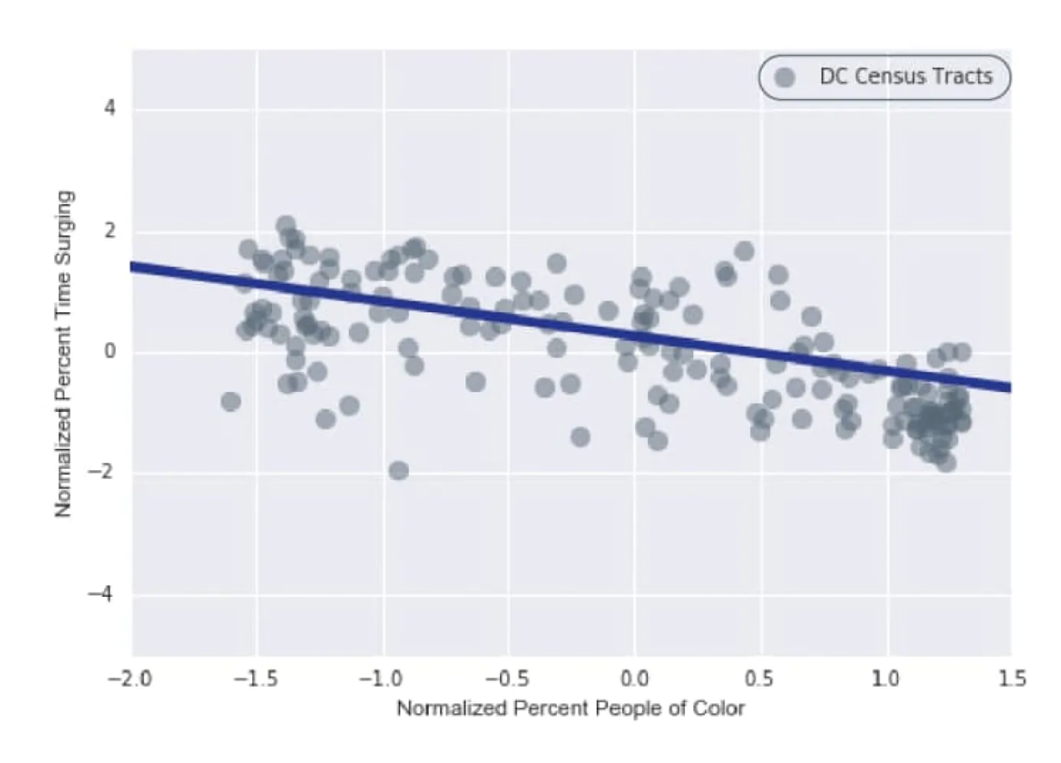
Stories with statistics
https://www.washingtonpost.com/news/wonk/wp/2016/03/10/uber-seems-to-offer-better-service-in-areas-with-more-white-people-that-raises-some-tough-questions/

Slide 6
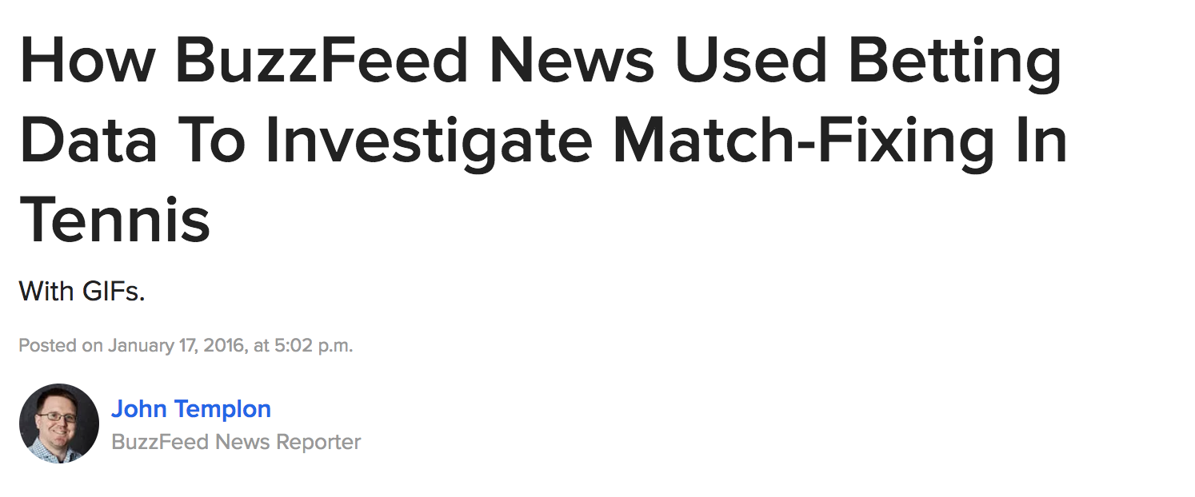
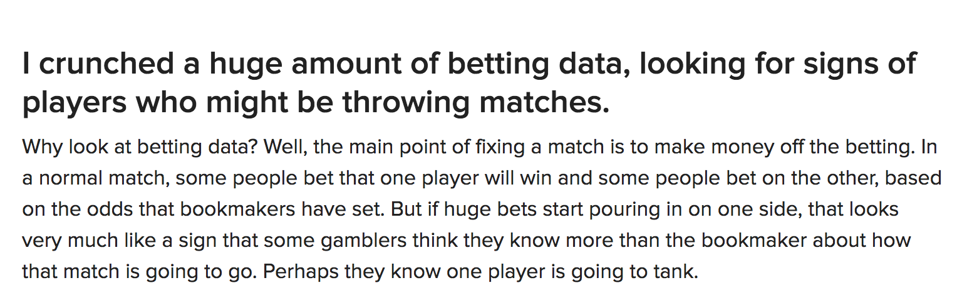
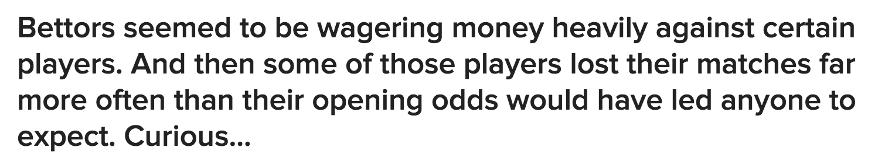
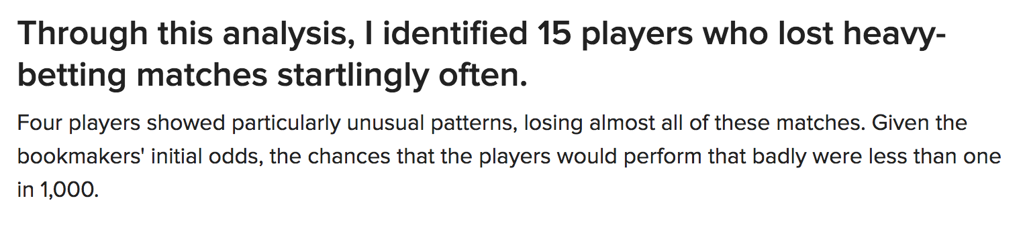
Stories with statistics
https://www.buzzfeed.com/heidiblake/the-tennis-racket?utm_term=.koRMg78M4#.fiob6VAbE

Slide 7
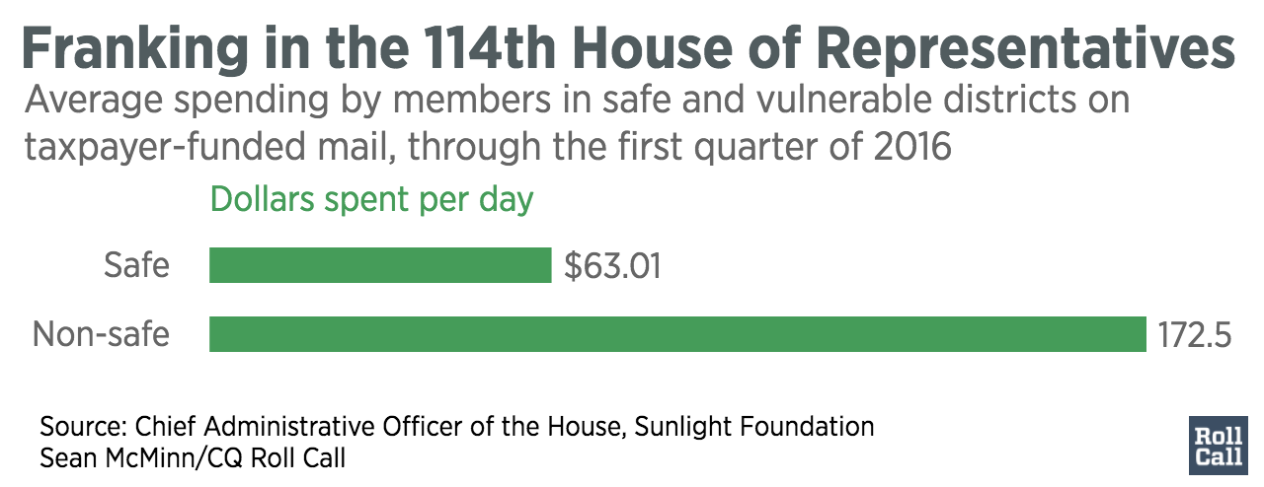
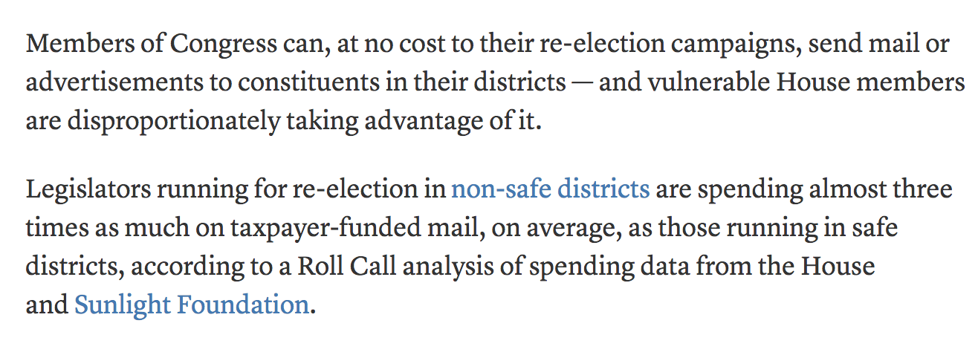
Stories with statistics
http://www.rollcall.com/news/house-members-can-send-mail-taxpayers-dime-vulnerable-ones-much-much

