Slide 1

All Our Yesterdays: A toolkit to explore web archives in Colab
Tim Ribaric
Sam Langdon

Slide 2
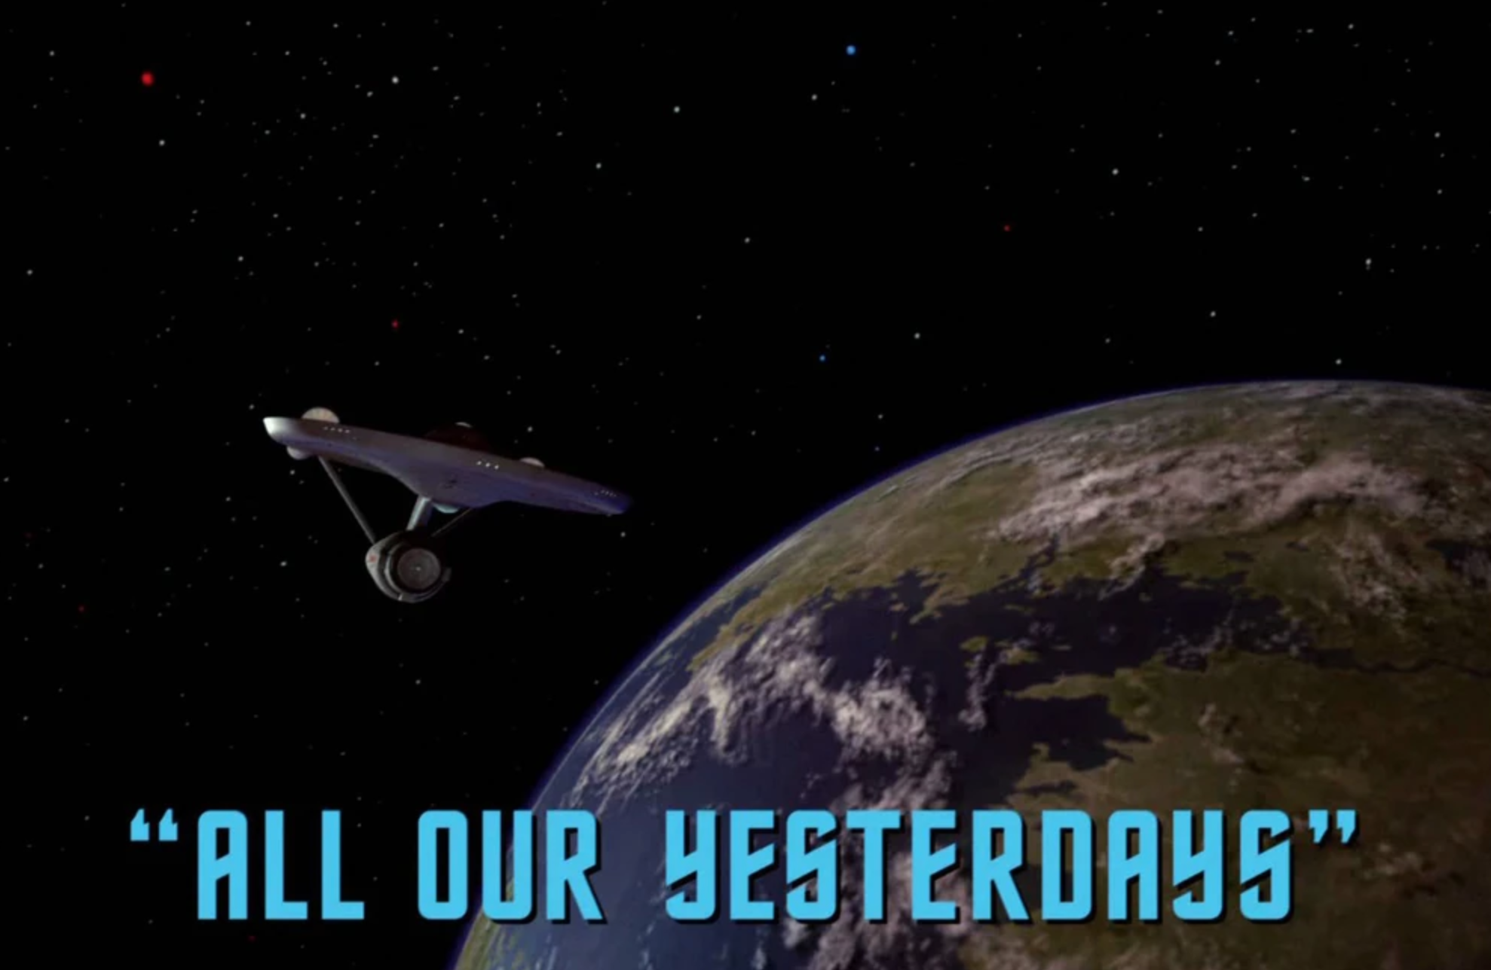
Motivation?
WARCs are difficult to work with directly (especially if they are gigabytes in size)
No standard desktop tool is suitable to explore them
Often you don’t want to look at the whole archive anyway
Notes:
https://memory-alpha.fandom.com/wiki/All_Our_Yesterdays_(episode)

Slide 3
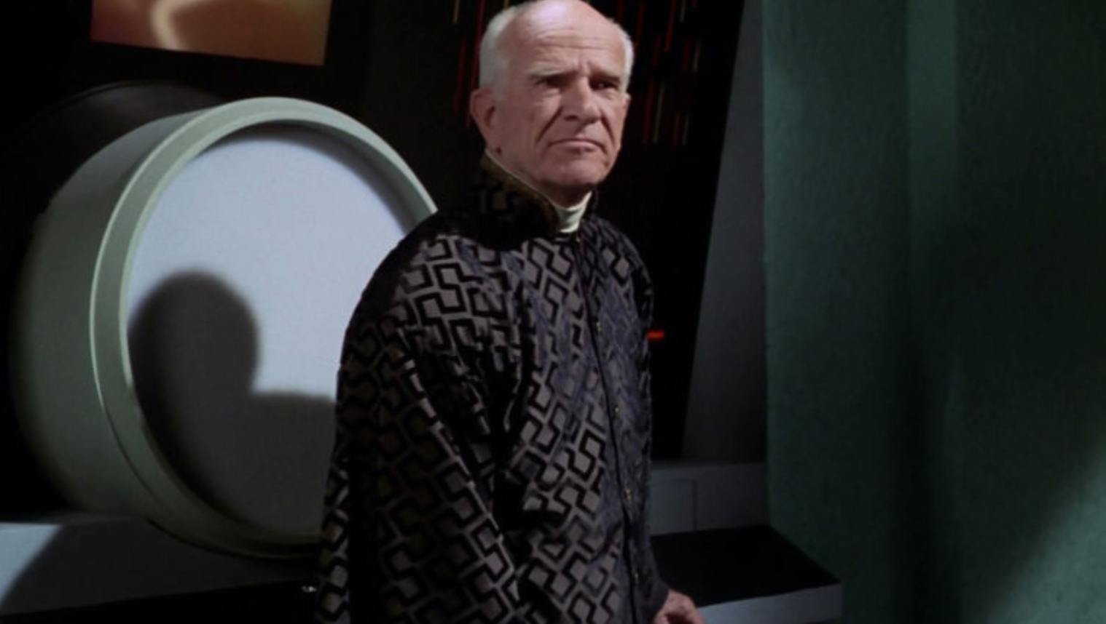
Motivation?
Looking to make a toolkit that scaffolds up an environment that will create the derivatives and plot out basic analysis steps
Build on the new additions to the ARCH tool that is being developed as part of ARCHIVE-IT

Slide 4
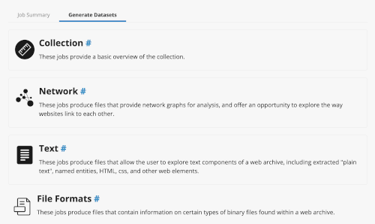
Motivation?
One of the things Archives Unleashed has been working on
An integrated derivative generator
Used these derivatives to perform some in-depth analysis

Slide 5
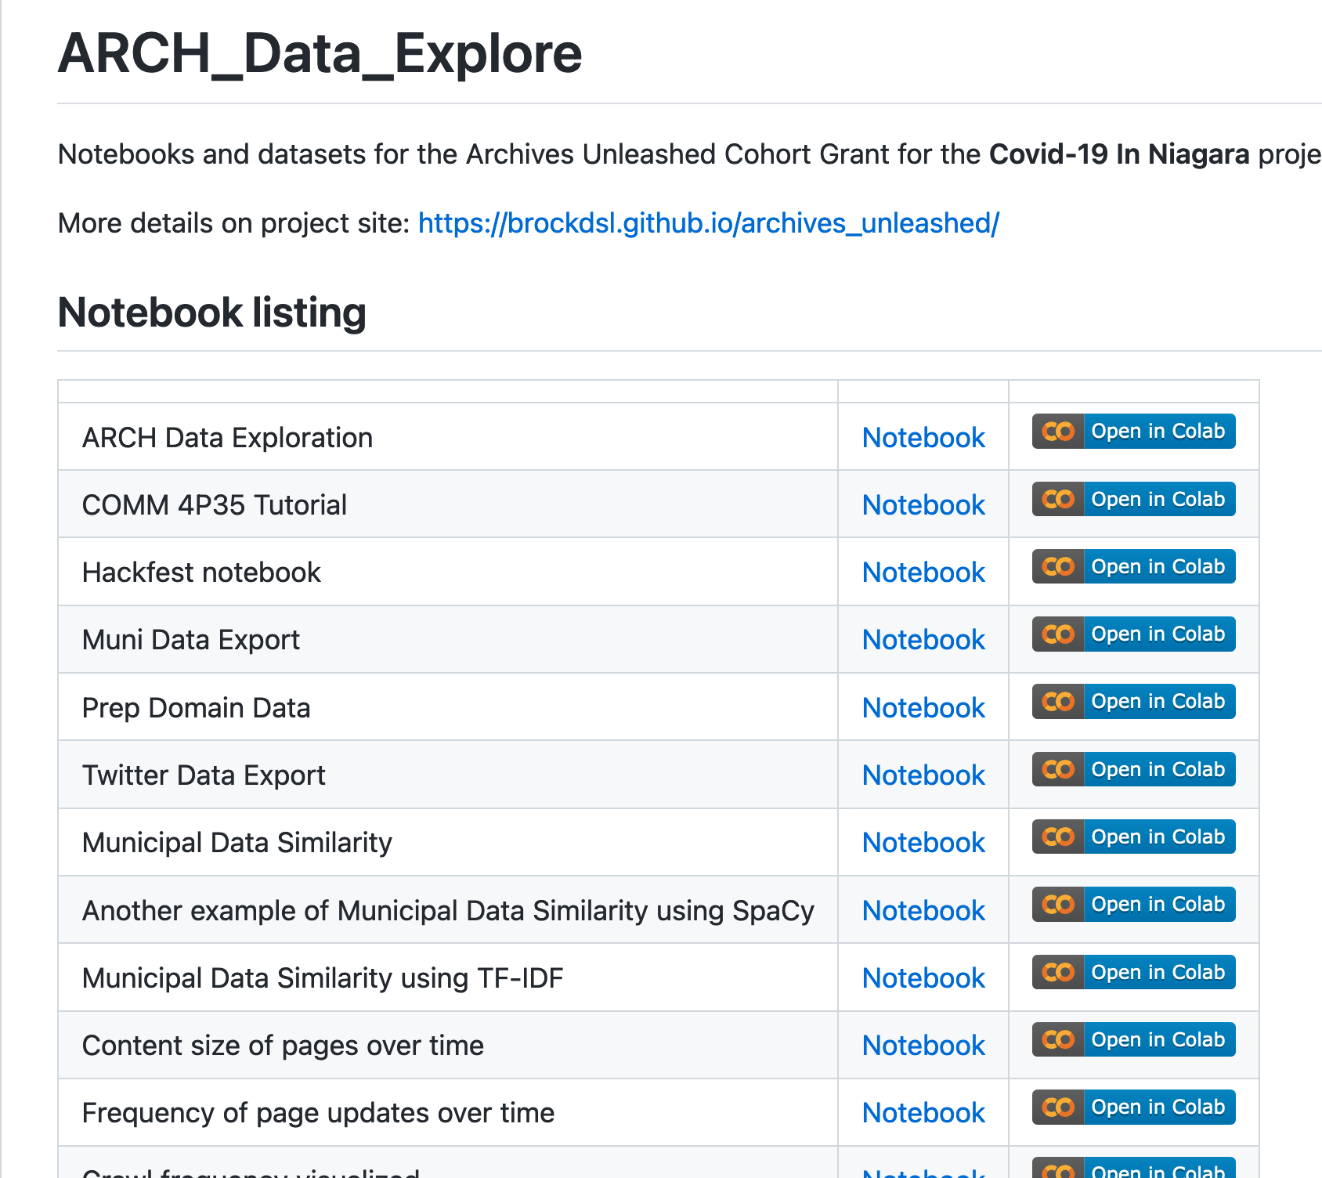
Motivation
What do you do with your derivative? Particularly if you don’t have much background / experience working with CSV Files
Google Colab is a great place to start
Notes:
https://github.com/BrockDSL/ARCH_Data_Explore

Slide 6
Demo
Derivative Generation

Slide 7
Demo
Analysis of a derivative

Slide 8
Roadmap
Archives Unleashed Grant for ‘Niagara COVID Archive’
Prototype of notebooks created for analysis
Match of Mind Grant to develop AOYTK software
…
Further Match of Mind Grant to do User Testing on user notebooks

Slide 9
More info
Project is available on GitHub:
https://brockdsl.github.io/AOYTK/
Looking for collaborators to test? dsl@brocku.ca

