Slide 1


Slide 2

Welcome to The Digital Scholarship Lab
Lots of workshops on Experience BU
https://brocku.ca/library/dsl

Slide 3

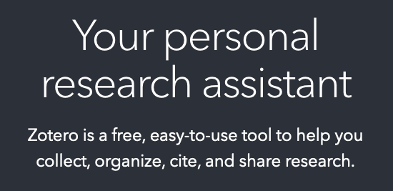
Agenda
Why?
Setup
The Three Phase!
Killer Features
Here to Help

Slide 4
Quick Questions about Citations
What citation style do you use?
How do you keep track of citations presently? (OR, Tim I have no idea what you’re talking about)
Have you heard of Zotero before?

Slide 5
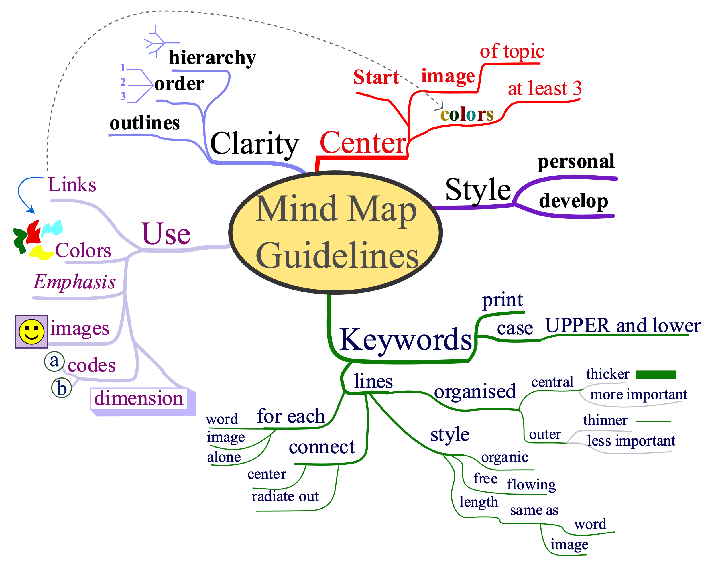
Mind Map your Research!

Slide 6
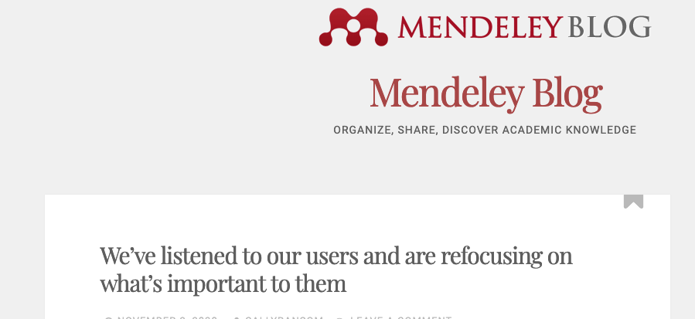
Why Zotero?

Slide 7
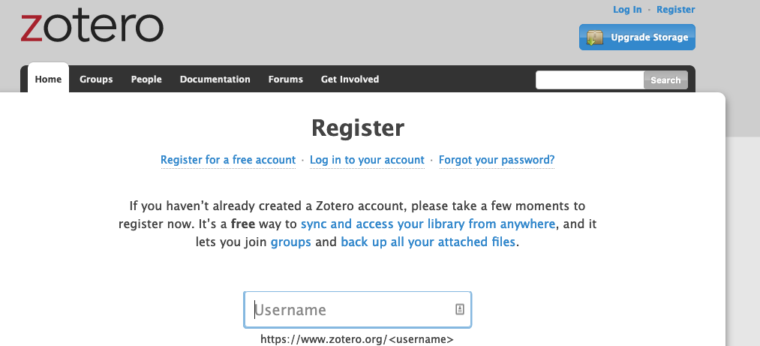
Setup Zotero
Free as in beer & speech
No direct cost to you
Notes:
https://www.zotero.org/user/register/

Slide 8
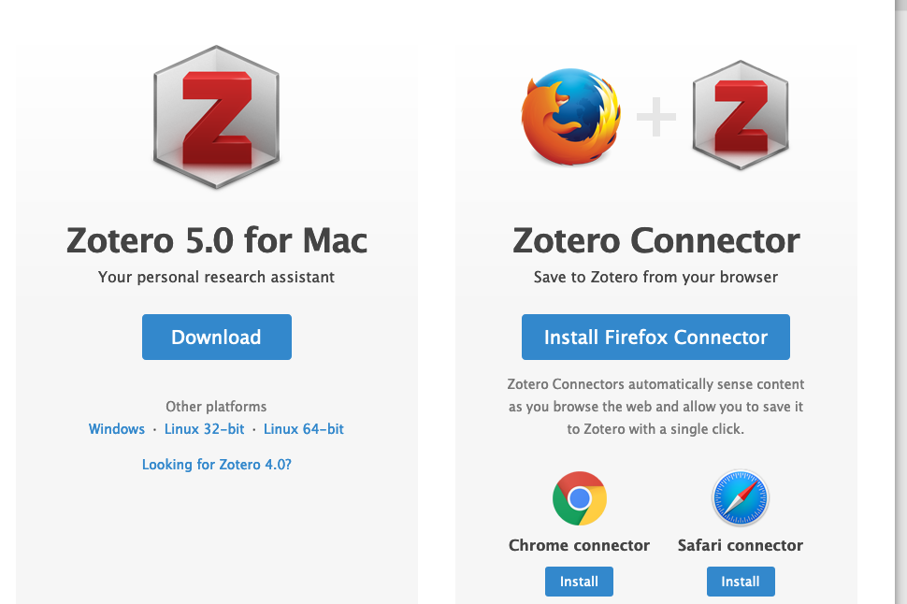
Setup Zotero
You’ll need 3 pieces
Client
Connector
Processor Plugin
Notes:
https://www.zotero.org/download/

Slide 9
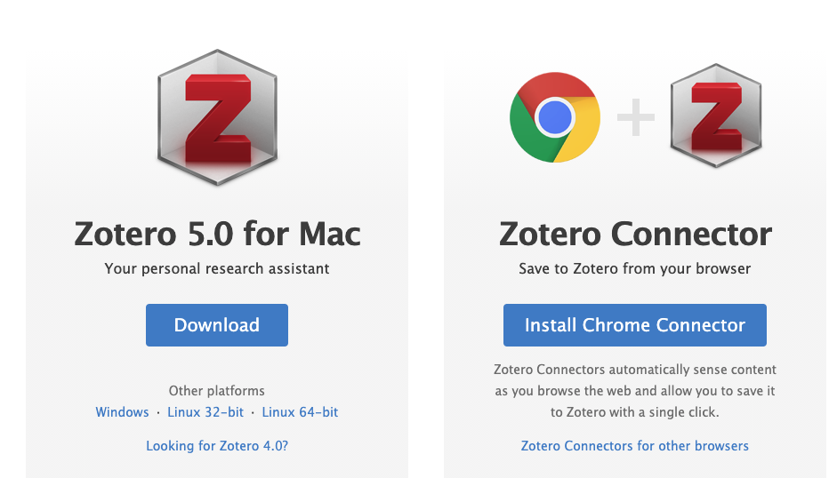
Setup Zotero
You’ll need 3 pieces
Client
Connector
Processor Plugin
Notes:
https://www.zotero.org/download/

Slide 10
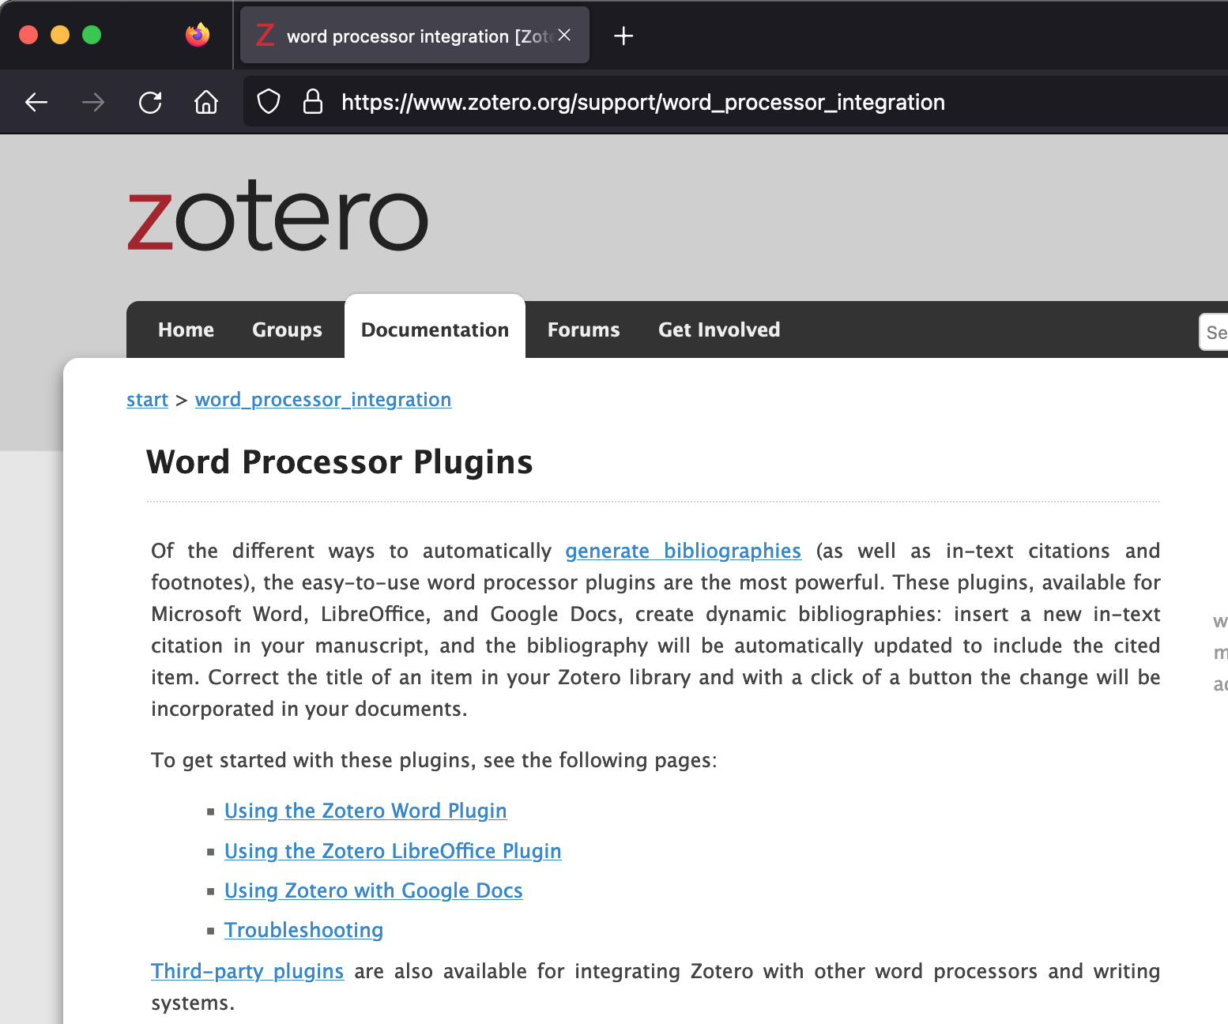
Setup Zotero
You’ll need 3 pieces
Client
Connector
Processor Plugin
Notes:
https://www.zotero.org/support/word_processor_integration

Slide 11
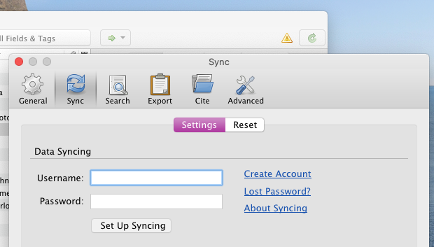
Setup Zotero
Start the Client
Click the green arrow
Add in your dets

Slide 12
The Three Phases!
Gathering Research
Reviewing Research
Reusing Research

Slide 13
Gathering Research
Or how do we get stuff into Zotero
Manually
With ‘Magic’ numbers
Using the Extension

Slide 14
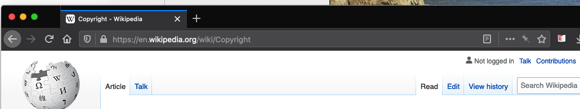
Gathering Research

Slide 15
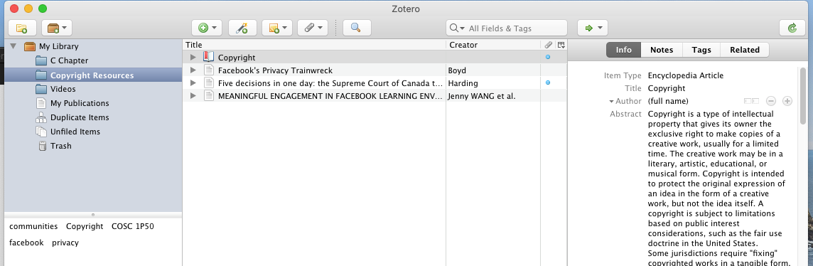
Gathering Research

Slide 16
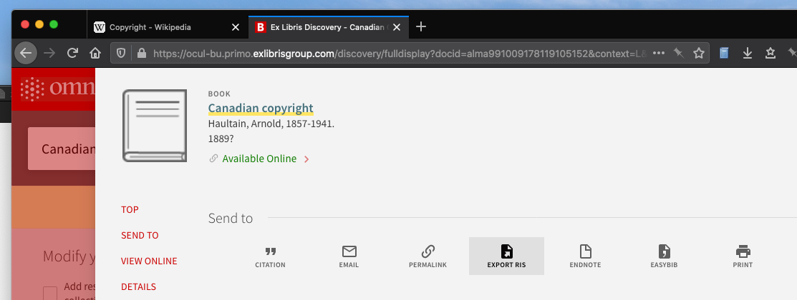
Gathering Research

Slide 17
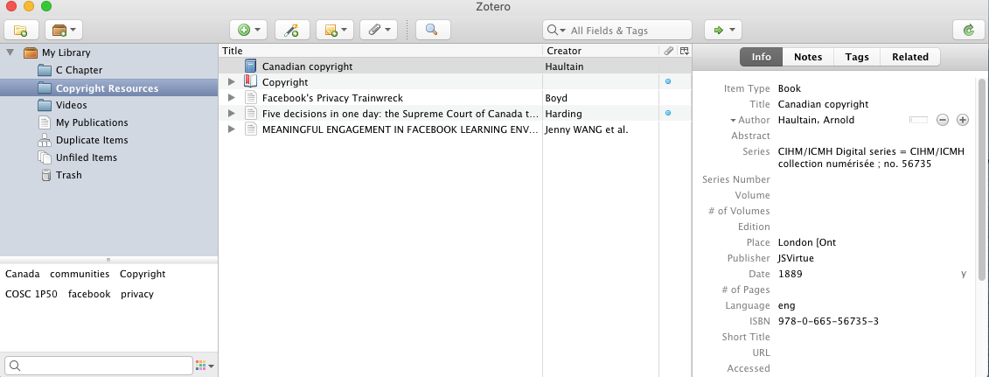
Gathering Research

Slide 18
Reviewing Research
Or what do we do with things once they are in Zotero
Tags & Notes
Collections
PDFs

Slide 19
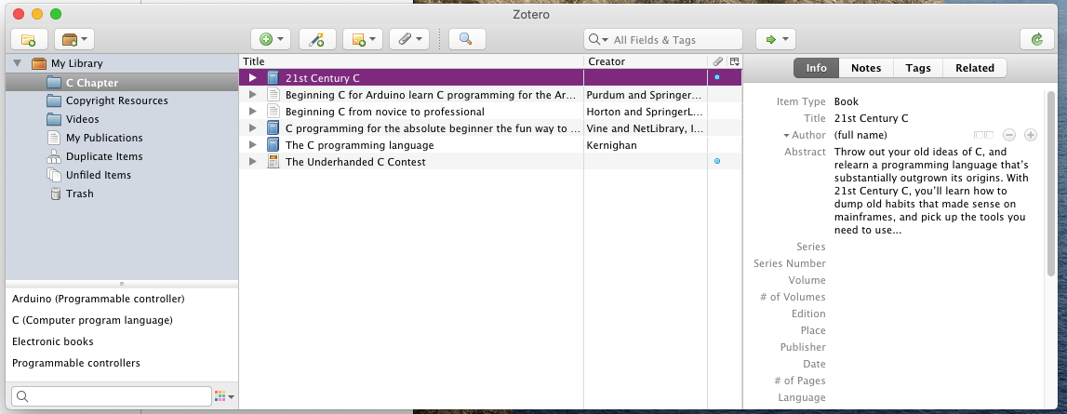
Reviewing Research

Slide 20
Reusing Research
OR How we can put citations into your papers

Slide 21
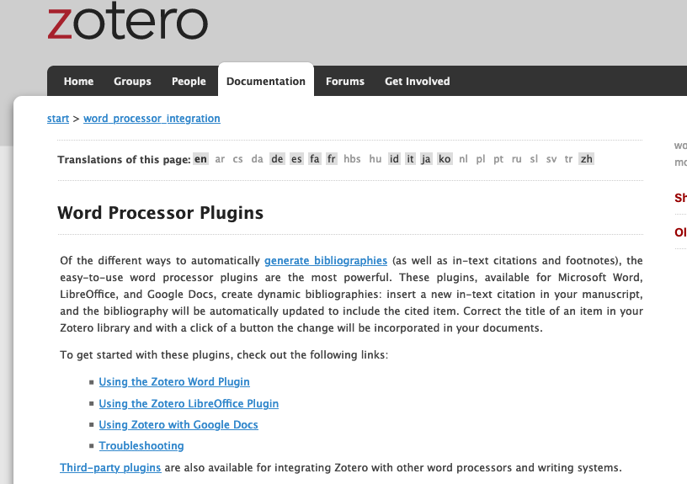
Reusing Research
Notes:
https://www.zotero.org/support/word_processor_integration

Slide 22
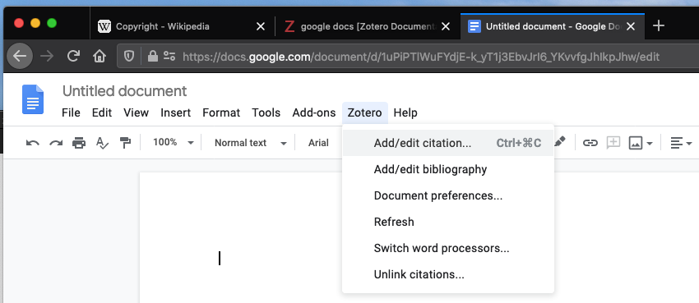
Reusing Research
Notes:
https://www.zotero.org/support/word_processor_integration

Slide 23
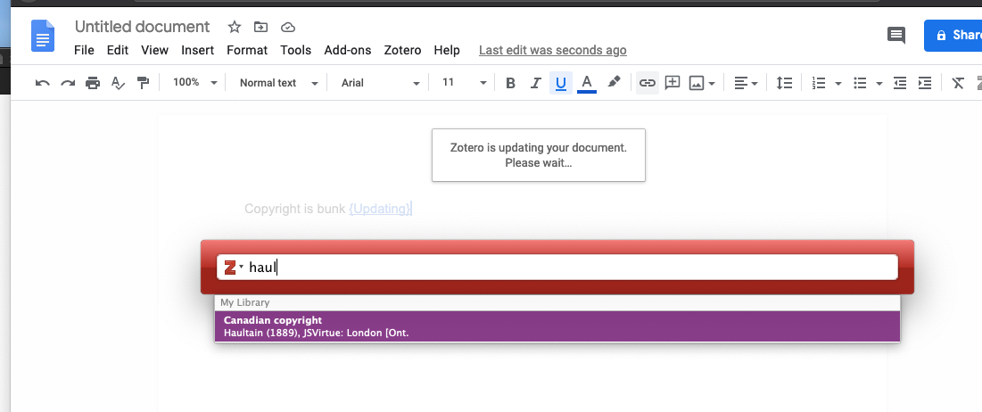
Reusing Research
Notes:
https://www.zotero.org/support/word_processor_integration

Slide 24
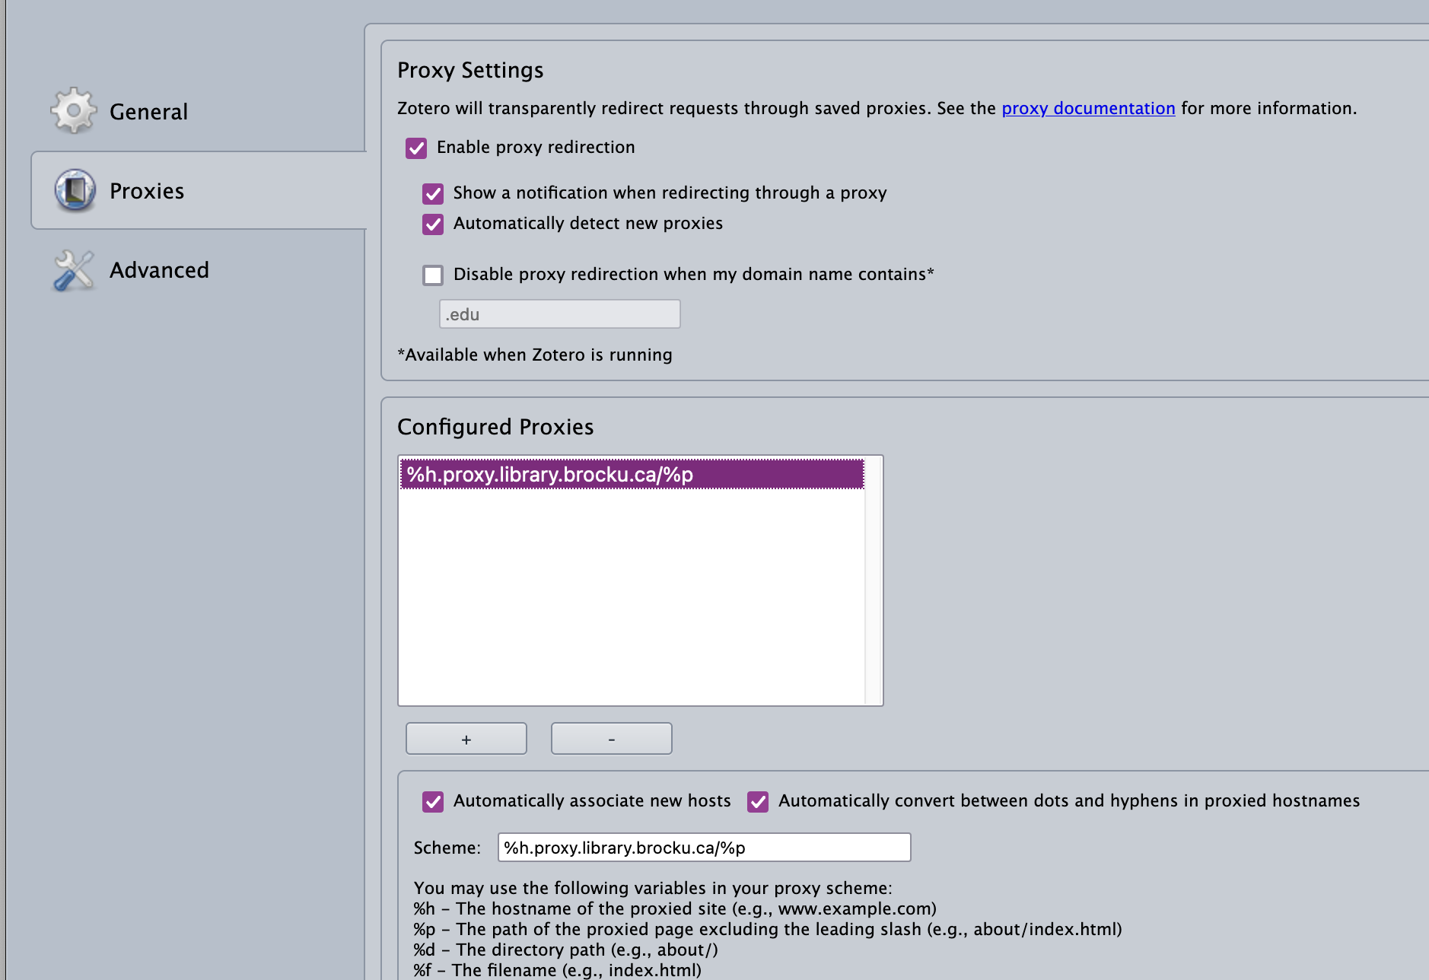
Killer Features
Working off-site?
Extension Settings
Zotero
Proxies
‘Enable proxy redirection’
%h.proxy.library.brocku.ca/%p

Slide 25
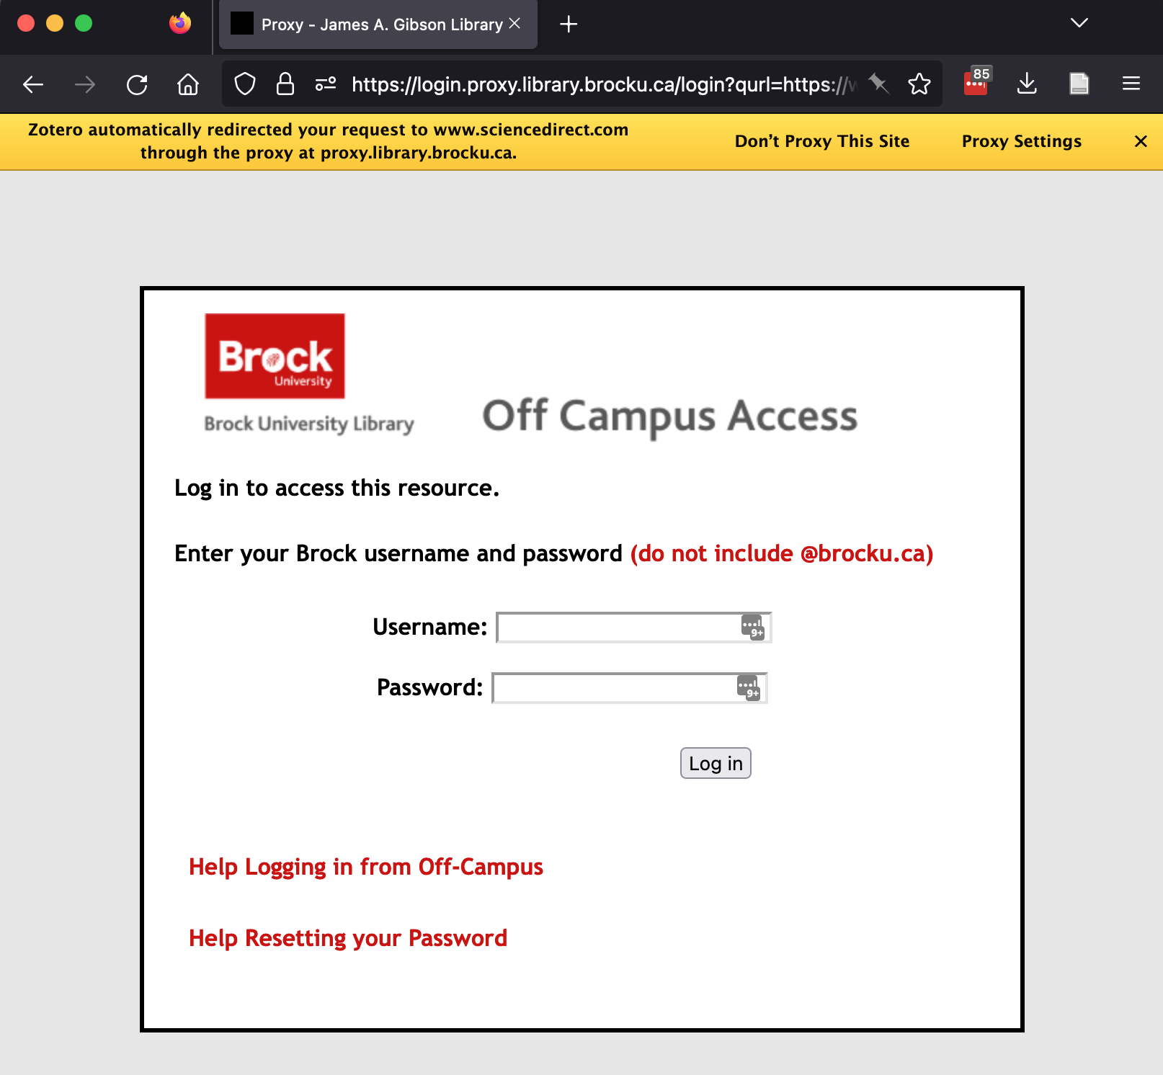
Killer Features
Working off-site?
Extension Settings
Zotero
Proxies
‘Enable proxy redirection’
%h.proxy.library.brocku.ca%p

Slide 26
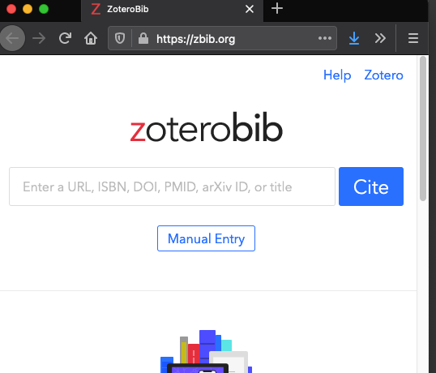
I don’t have time for Zotero right now!
Need a quick bibliography? Try zbib.org

Slide 27
Try it yourself?
Go ahead I’ll wait
Sign up for Account
Download Install
Sync
Add citation from Wikipedia & tag it
Add citation from OMNI & tag it
Generate a paper with a citation
Email it to dsl@brocku.ca

Slide 28
Thanks!
To appreciate it you need to try it.
Start now so it’ll follow you during your whole career
More help at our tutorial: https://brockdsl.github.io/A-Step-by-Step-Guide-to-Zotero/

