Slide 1
RDM in Jupyter
The Importance of Keeping your Data Reproducible

Slide 2
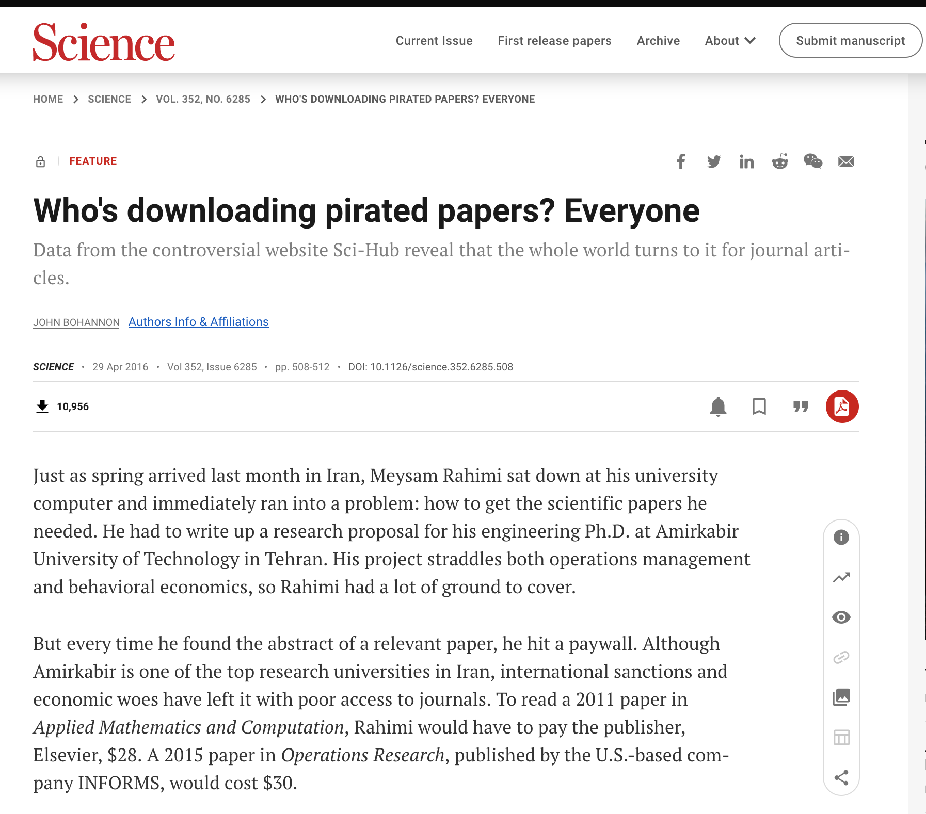
My Origin Story…
Was lookup up Sci-Hub shenanigans
Came across ‘legitimate’ research on it
Notes:
https://www.science.org/doi/10.1126/science.352.6285.508

Slide 3
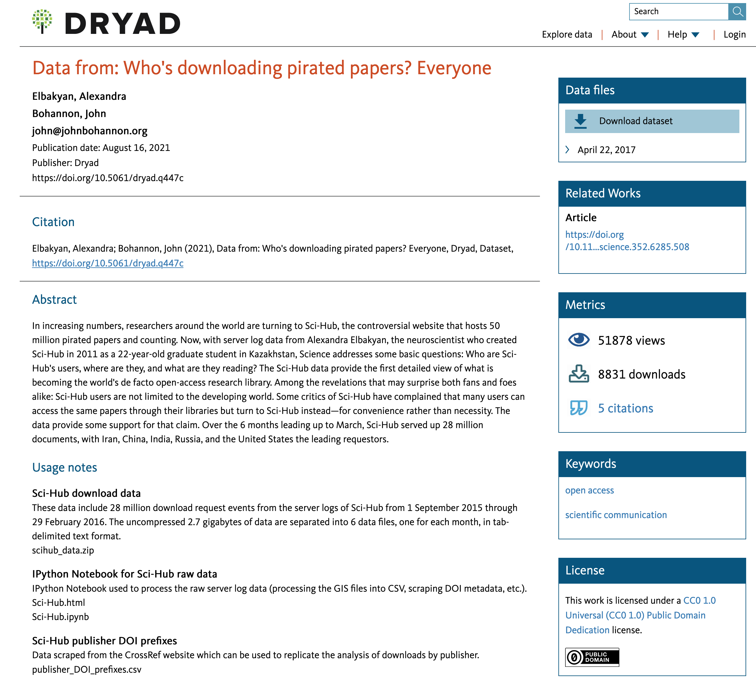
My Origin Story…
Found a link to a data record
Some files!
I could re-use those!

Slide 4
Jupyter!
You’ll quickly learn that I am huge fan of Jupyter in all of it’s different flavours
Works really good as both a teaching and research environment

Slide 5
Jupyter! – Use Cases
Teaching
Provides a structured code environment that you can share with learners
For example, can provide half completed code and ask them to fill in the details. (*ahem*)
Research
You can do your analysis in a self-documenting process
Mix of Markdown and Code creates a very readable end product.

Slide 6
Jupyter! – Home Machine
- Using something like Anaconda Navigator
CPU
Disk
Data
.
.
.
.
Code
.
.
.
.

Slide 7
Jupyter! – Hosted
- Using something like myBinder or Google Colab
CPU
Disk
Data
.
.
.
.
Code
.
.
.
.

Slide 8
Usability & Jupyter
Our goal then is to save:
Code
Data
Anything else specific to our runtime
So that data reusability is possible:
For verification
Further research
Long term preservation

