Slide 1

Github for Researchers

Slide 2
But First!
What compels you to be here today?
What do you know about github?

Slide 3

Tip of the iceberg

Slide 4
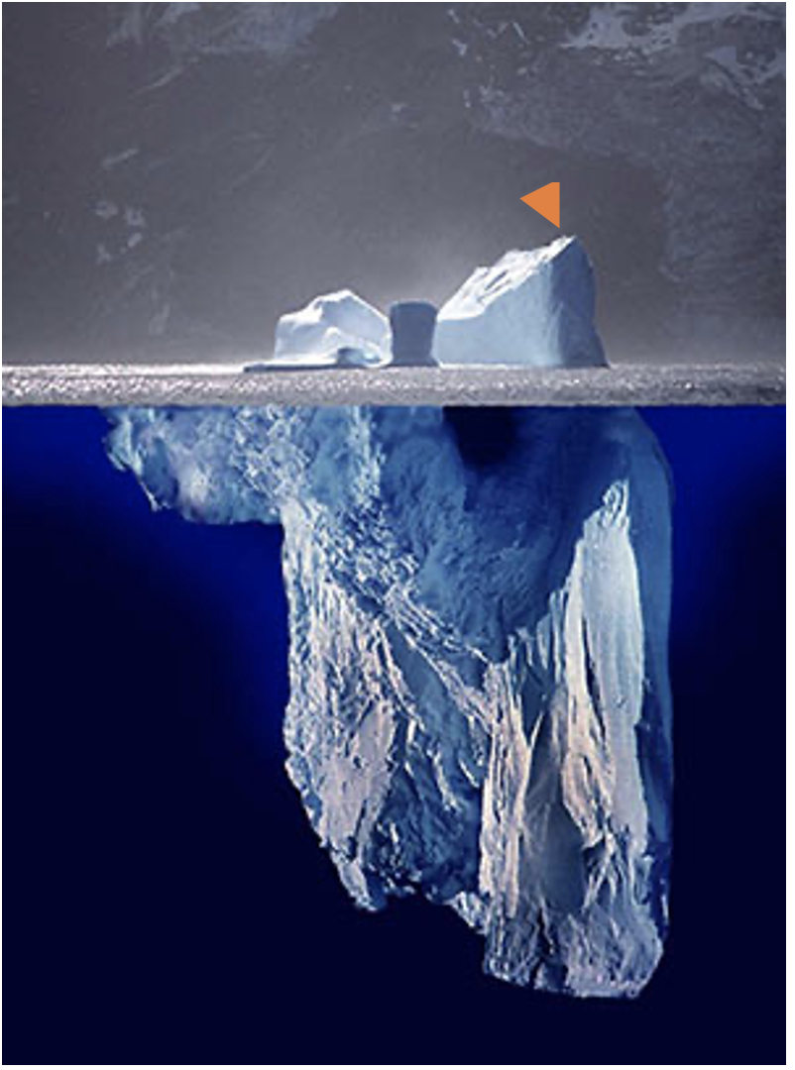
Tip of the iceberg

Slide 5
Please Note!
git != github
Same way Kleenex is not Facial Tissue

Slide 6
What we’ll attempt
Basics of repository
Modifying code
Using github to publish to the web
Basic forking
This is already very ambitious!

Slide 7
What we won’t attempt!
Branching
Conflict resolution
Cloning
Any other bells and whistles…

Slide 8
Onto Github
Please login to the site!

Slide 9
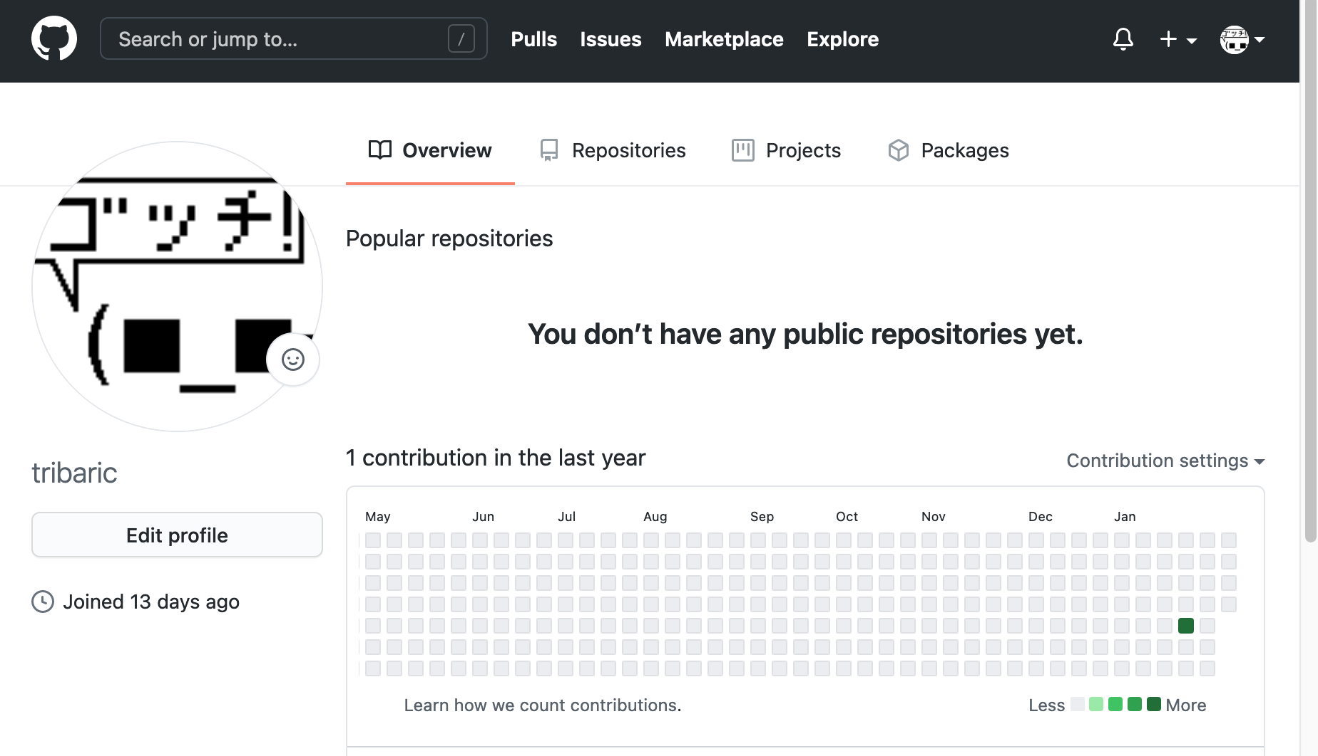
Notes:
https://github.com/settings/profile

Slide 10
The Scenario P1.
You are a researcher who has put together 2 things:
A bit of code that does some analysis
A dataset
You’d like to put this online and get feedback from your colleagues, establish connections around this
Notes:
https://raw.githubusercontent.com/BrockDSL/github_for_researchers/master/p1.pdf

Slide 11
The Scenario P2.
A collaborator has added some changes to your code!
Let’s load up those changes
Notes:
https://raw.githubusercontent.com/BrockDSL/github_for_researchers/master/p2.pdf

Slide 12
A brief interlude
How do researchers use git?
Glad you asked!
Research Project: Investigating & Archiving the Scholarly Git Experience (IASGE)
https://investigating-archiving-git.gitlab.io/about/
Notes:
https://investigating-archiving-git.gitlab.io/about/

Slide 13
The Scenario P.3
You are applying for a grant and you need to make a web presence for your project so that it can be accessed by people not familiar with code
Notes:
https://raw.githubusercontent.com/BrockDSL/github_for_researchers/master/p3.pdf

Slide 14
The Scenario P.4
Our lab has generated some more data, let’s update our repository for it.
Notes:
https://raw.githubusercontent.com/BrockDSL/github_for_researchers/master/p4.pdf

Slide 15
The Scenario P.5
Our lab is going to ‘fork’ a successful project to make it our own.
Notes:
https://raw.githubusercontent.com/BrockDSL/github_for_researchers/master/p5.pdf

Slide 16
What comes next?
GitHub is social
Follow your progress
Collaborate with others
Private Repositories

Slide 17
Thanks!
More questions / follow up?
dsl@brocku.ca

