Slide 1
Diagrams only

Slide 2
Pivotal Cloud Foundry Architecture
Platform Runtime (Elastic Runtime)
Services
Routing
Container Scheduling
Service Discovery
Configuration
Database
Application Framework
Big Data
12 Factor Apps
Microservices
RESTful Services
Circuit Breakers
Object Storage
Mobile
Spring Boot
Ruby on Rails
Node.js
.NET
Build CI
Logging & Metrics
Messaging
User Provided
Operations
Zero Downtime Deployments
Failover & Recovery
Scaling
Security Patching
Platform
Upgrades

Slide 3
Container image
application layer
PCF buildpacks provide full support and maintenance for 3 of the 4 layers of the container stack
Devs can focus on just the app code
PCF creates the container image for you
runtime layer*
Dev Supported
PCF Supported
OS image
App container
Ops Supported
linux host & kernel
* Devs may bring a custom buildpack

Slide 4

Diego for PCF SSH access to containers
> cf ssh my-awesome-app
SSH Proxy Server
✓ Authenticate
✓ Locate target container
✓ Connect to the ssh daemon
✓ Manage communication
DEA /CELL
App
App
App
App

Slide 5
Blue-Green Deployments
Blue-Green deployment is an approach to upgrading application with minimal downtime.
It also enables easy rollback to the old version if the new version experiences problems
It works by keeping both versions online, and switching from the old version to the new version
live
traffic
app 1.0
app 1.0
live
traffic
app 1.1
app 1.1
Before
After
Notes:
https://docs.pivotal.io/pivotalcf/devguide/services/migrate-db.html
IMAGE FOUND ON GOOGLE – check

Slide 6
Blue-Green Deployments using Routes
Main idea: you always want myapp.cfapps.io to be good
Use routes to achieve this
Because you are in a single space, multiple application can use the same routes
myapp.cfapps.io
myapp.cfapps.io
app 1.0
app 1.0
app 1.0
myappdev.cfapps.io
app 1.1
myapp.cfapps.io
app 1.1
myapp.cfapps.io
app 1.1
Before
(working on version 1.1)
During
(version 1.1 is ready)
After
(done with version 1.0)
Notes:
https://docs.pivotal.io/pivotalcf/devguide/services/migrate-db.html
IMAGE FOUND ON GOOGLE – check

Slide 7
Slowly Turning on Traffic using Instances
Start with four instance of blue, one instance of green
80% of traffic will use version 1.0
Decrease blue instance, increase green instances as confidence builds
app 1.0
myapp.cfapps.io
app 1.0
app 1.0
app 1.0
app 1.1
app 1.1
myapp.cfapps.io
app 1.1
myapp.cfapps.io
app 1.1
app 1.1
Notes:
https://docs.pivotal.io/pivotalcf/devguide/services/migrate-db.html
IMAGE FOUND ON GOOGLE – check

Slide 8
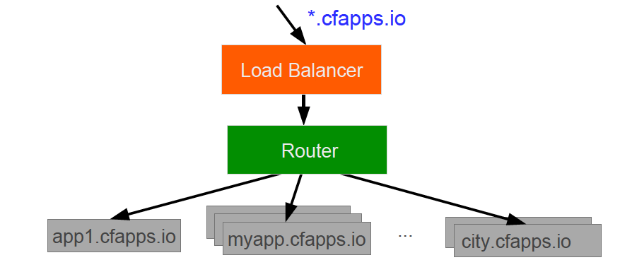
Domains – Behind the Scenes
A wildcard entry (*) is added to the DNS for the app domain
That DNS entry points to a load balancer (or Cloud Foundry’s HA Proxy), which points to the Cloud Foundry’s Router
The Router uses the subdomain to map to application instance(s)
Notes:
https://docs.pivotal.io/pivotalcf/devguide/deploy-apps/routes-domains.html
Picture of PCF architecture HAProxy and Router using domain namesdns

Slide 9
*.cfapps.io
Load Balancer
Pivotal Elastic Runtime
Router
BLOB store
Cloud Controller
metadata
Health Manager
Runtime VMs
attendees.cfapps.io
attendees-blue.cfapps.io
attendees-green.cfapps.io
attendees-blue.cfapps.io
attendees-green.cfapps.io
attendees-blue.cfapps.io
attendees-blue.cfapps.io

Slide 10
client
microservice
UI
(thymeleaf / bootstrap / Spring Boot, MVC and Cloud Connectors)
Model
Service
(feign / Ribbon)
attendees
(spring boot, Data, Cloud Connectors)
REST
(http/json)

Slide 11


Pivotal Cloud Foundry Architecture Recap
Ops Manager UI
Dynamic Router
Provision
and Manages
Ops Manager Director
Cloud Controller
Health Manager
Operations Manager – Infrastructure Automation
UAA
Login Server
Provision
and Manages
Distributed Containerized Runtime
Apps Container
Apps Container
Service Broker*
Service Broker*
Messaging (NATS)
Service Nodes
Service Nodes
Metrics Collection
App Log Aggregator
Service
Service
Elastic Runtime – Application Management
Service Broker*
User Provided Service
* Service Brokers are registered with PCF ERS marketplace

