Slide 1
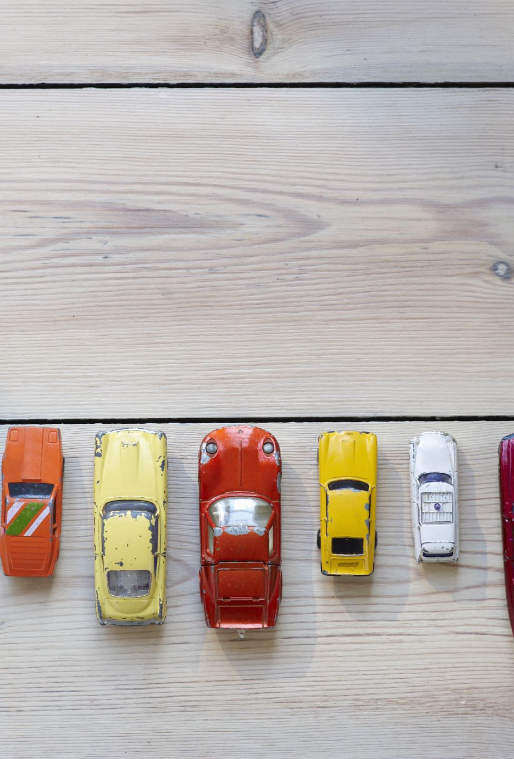

Lariat
Financial Analysis
2019 Projection
Brock Franz
Notes:
-Hello, my name is Brock Franz and I’m a data analyst from Gilbert, AZ
-A little background on me, I spent 25 years in retail management in various positions but felt I could do more from behind the scenes, so I enrolled in a data bootcamp with Thinkful where I was educated and certified In analyzing data with numerous programs
-I have been hired to analyze the financial information from 2018 and make recommendations to lower operational costs and increase revenue and profits for 2019
-First let’s take a look at the recap of 2018

Slide 2

2018 Results
4,000 vehicles in fleet
50 locations nationwide
325,608 customer transactions
$45,452,780 in total revenue
$17,208,474 in profit
Notes:
This is probably common knowledge to all of you but in case it isn’t, let’s set the baseline from which we’re starting
In 2018, Lariat had 4,000 vehicles in the fleet that serviced the 50 locations nationwide
Over 325,000 consumers rented a car from Lariat last year
That led to 45 ½ million dollars in annual revenue with just north of 17 million in bottom line profits

Slide 3

2019 Objective
Maximize total revenue
Increase bottom line profits
Minimize overall costs
Make More Money!
Notes:
-The objective of my research and this presentation is obviously to
maximize revenue while minimizing costs,
Increase the overall profitability of the fleet,
And in all reality, help you MAKE MORE MONEY

Slide 4
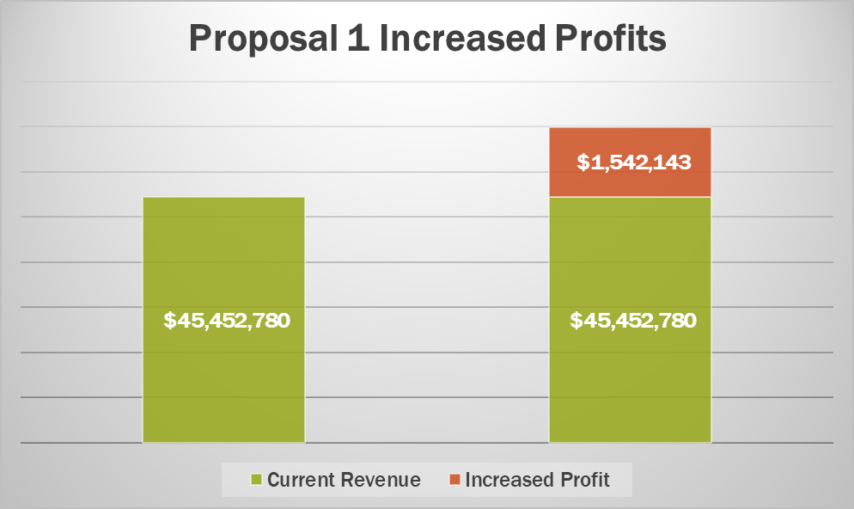
Strategy one
+3.39%
Top 5% of the fleet generates $16,809 annual revenue vs the bottom 10% at $7,239
Liquidate bottom 10% of fleet based on yearly revenue
Invest estimated almost $10 million into newer vehicles modeled after the top 5% revenue generators
Purchase 266 new vehicles
2019 projected revenue of almost $47 million
Increased profit YOY of $1,542,143
Depreciation values from Edmunds.com
Average new vehicle by year values from Statista.com
Notes:
-The first strategy that I am proposing involves the total revenue contributed by each individual vehicle on an annual basis.
-I propose the liquidation of the bottom 10% of revenue generating vehicles
-The bottom 10% of these cars only generate $7,000 of annual revenue vs the almost $17,000 provided by the top 5% of the fleet
-The bottom 10% consists of 400 cars that will provide nearly $10 million dollars to invest in roughly 266 newer, more desirable, more profitable vehicles
-By replacing these under performers with top performers, revenues will increase by over $1.5 million along with profits increasing by a similar number under current operating costs
-newer cars, streamlined fleet, over $18.7 million in annual profit?
Sounds great don’t you think?

Slide 5
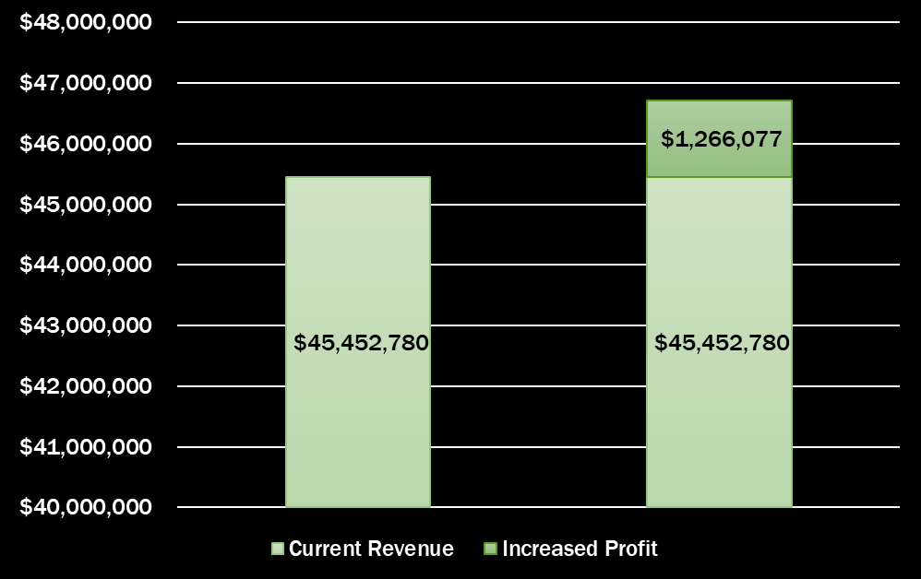

Strategy two
Top 5% of vehicles rented average 116 days per year
Bottom 10% only average 54
Liquidate bottom 10% and invest in the top 5%
Purchase 267 new vehicles
New projected revenue of $46,718,857
Increased profit YOY of $1,266,077
Notes:
-The second strategy is a similar one but based on different statistics
-Here, I have identified the total annual number of days each vehicle has been rented. This is an easy figure to tell you how much your customers like each of your cars.
-The top 5% of vehicles were rented 116 days out of the year on average while the bottom 10%, less than half at a measly 54 days
-Again in similar fashion, if the bottom 10% were liquidated and the proceeds used to buy the cars that your customers are TELLING YOU THEY WANT, 267 desirable and much more rentable cars will join the fleet,
-This would increase revenues and profits by almost $1.3 million dollars for the year and delight your patrons by giving them the cars they want to drive!

Slide 6

questions
Notes:
As you can see I have presented 2 similarly structured plans with 2 different results,
Both being very advantageous to your business,
Any questions??

Slide 7

Either route taken leads to success
Investing in the top performing vehicles is a win
“Don’t be afraid to give up the good to go for the great.”
-John D. Rockefeller
Brock Franz
Brockfranz66@gmail.com
(480)729-0821
Notes:
-I want to thank you for your time today, I really do appreciate the opportunity to assist in helping Lariat grow
-If you have any other questions, comments, or further insights, my information is at the bottom of this slide and I will be emailing this deck to you this afternoon
Thank you again,
Have a wonderful day

