Slide 1
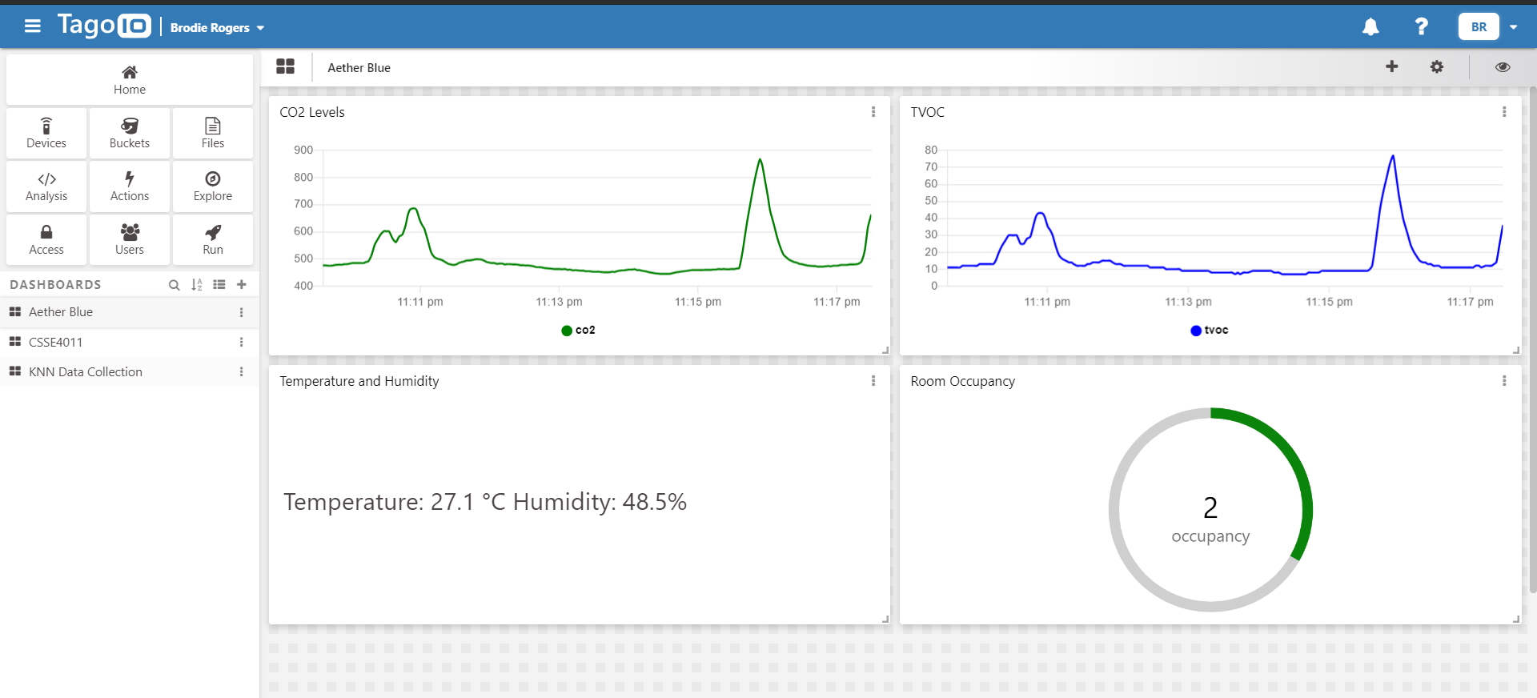
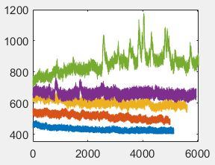
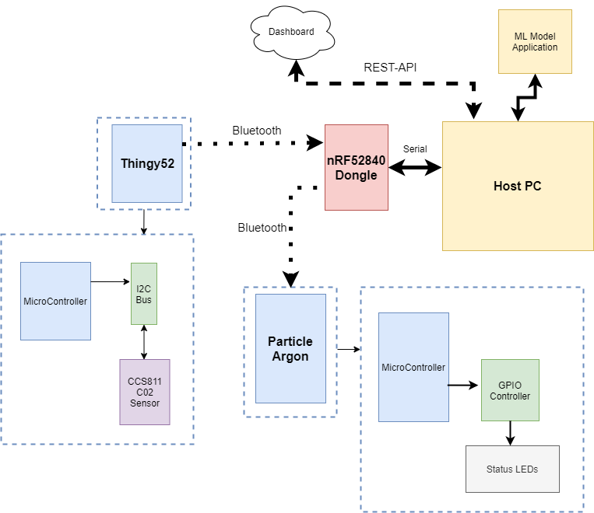
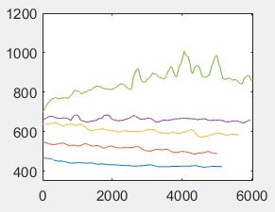
B3 - Air Quality and Room Occupancy Sensing Network
Aether-Blue (Riley Norris and Brodie Rogers)
AIMS (KPIs)
Reliable Bluetooth Network (Stable Communication)
Reliable Sensor Data Retrieval (Stable 4hz reading)
Model can be easily adapted to various room sizes (< +20% training room size)
Model can correctly determine room occupancy count (up to 20% error)
System can alert room occupants of possible breach of room capacity (blink red LED on sensor nodes and display red LED at door)
SYSTEM OVERVIEW
System uses two Thingy52 devices as sensor nodes which reads CO2, TVOC, Temperature and Humidity levels.
Sensor data is broadcasted to a nRF52840 Dongle over BLE.
Data is serialized and transmitted to the host PC over UART which is read by the python script.
Python script uses ML model to determine room occupancy and pushes data to a web dashboard (Tag-io) using a RESTful API.
Host PC commands Dongle to notify sensor nodes and Particle Argon if maximum room occupancy is reached.
ROOM TESTING CONDITION
Project was tested in room 50-L303E which had a measured dimension of 3.3 x 3.5 x 2.6m (30m² volume).
Room was ventilated with ducted air-conditioning at all stages of testing.
The room was tested with the door closed.
Thingy52 sensor nodes were spaced 1.5m apart on a table at a height of 1m.
DATA COLLECTION RESULT
Data was collected using a python script and examined in Matlab. CO2 and TVOC data was quite distinguishable which different sensor levels for different numbers of room occupants.
Raw CO2 data example is graphed below.
Moving Average smoothed CO2 data example is graphed below.
WEB DASHBOARD
The project used a Tag-io web dashboard to display periodic (2s) CO2, TVOC, temperature and humidity data along with the predicted occupancy of the room.
Example of the dashboard interface is below.
MACHINE LEARNING
Project used a Support Vector Machines (SVM) model from the sklearn python library and also a Gradient Boosted Decision Trees (GBDT) model from the xgboost python library.
The model uses CO2 and TVOC data for predictions since temperature and humidity were affected by the air-conditioning system too much.
FIELD DEPLOYMENT
Current system setup is dependent on similar room conditions to those tested.
For effective field deployment, users will be required to collect data which is unique to their room conditions.
This data can be collected using the data collection python script and needs to be stored a .csv file located in the accompanying folder.
Further sensor nodes can be added to the system for large rooms with a recommended sensor for each 20m² volume of room. Each sensor will need to be programmed with a unique sensor ID.
TESTING RESULTS
The testing of the models showed that GBDT was the better model and provided smoother predictions.
Bluetooth Stability:
BLE was stable and no issues were encountered during data collection or testing.
Sensor Data Reliability:
CCS811 data was retrieved at 4Hz and reliable after ~30 minutes warm-up time.
Room accuracy achieved:
+- 1 person with ~80% accuracy once CO2 and TVOC levels had a chance to settle.
Larger Room Capability:
System was tested in 50-L304 with an estimated volume of (50m² volume) with ~70% accuracy.
CONCLUSION
The project outcome was deemed successful and was able to satisfy each of the KPI goals. The work was interesting and built on previous sensor and BLE work from the practicals.
Problems Encountered
CCS811 required a 48-hour burn period and minimum 20-minute warm-up time as per the datasheet.
Thingy52 would automatically change baseline register of CCS811 to continuously adjust to environment. This affects the consistency of the data for the ML model.
Future Improvements
Complete further data testing in various room sizes.
Implement seven-segment display at door entry of room occupancy.

