Slide 1
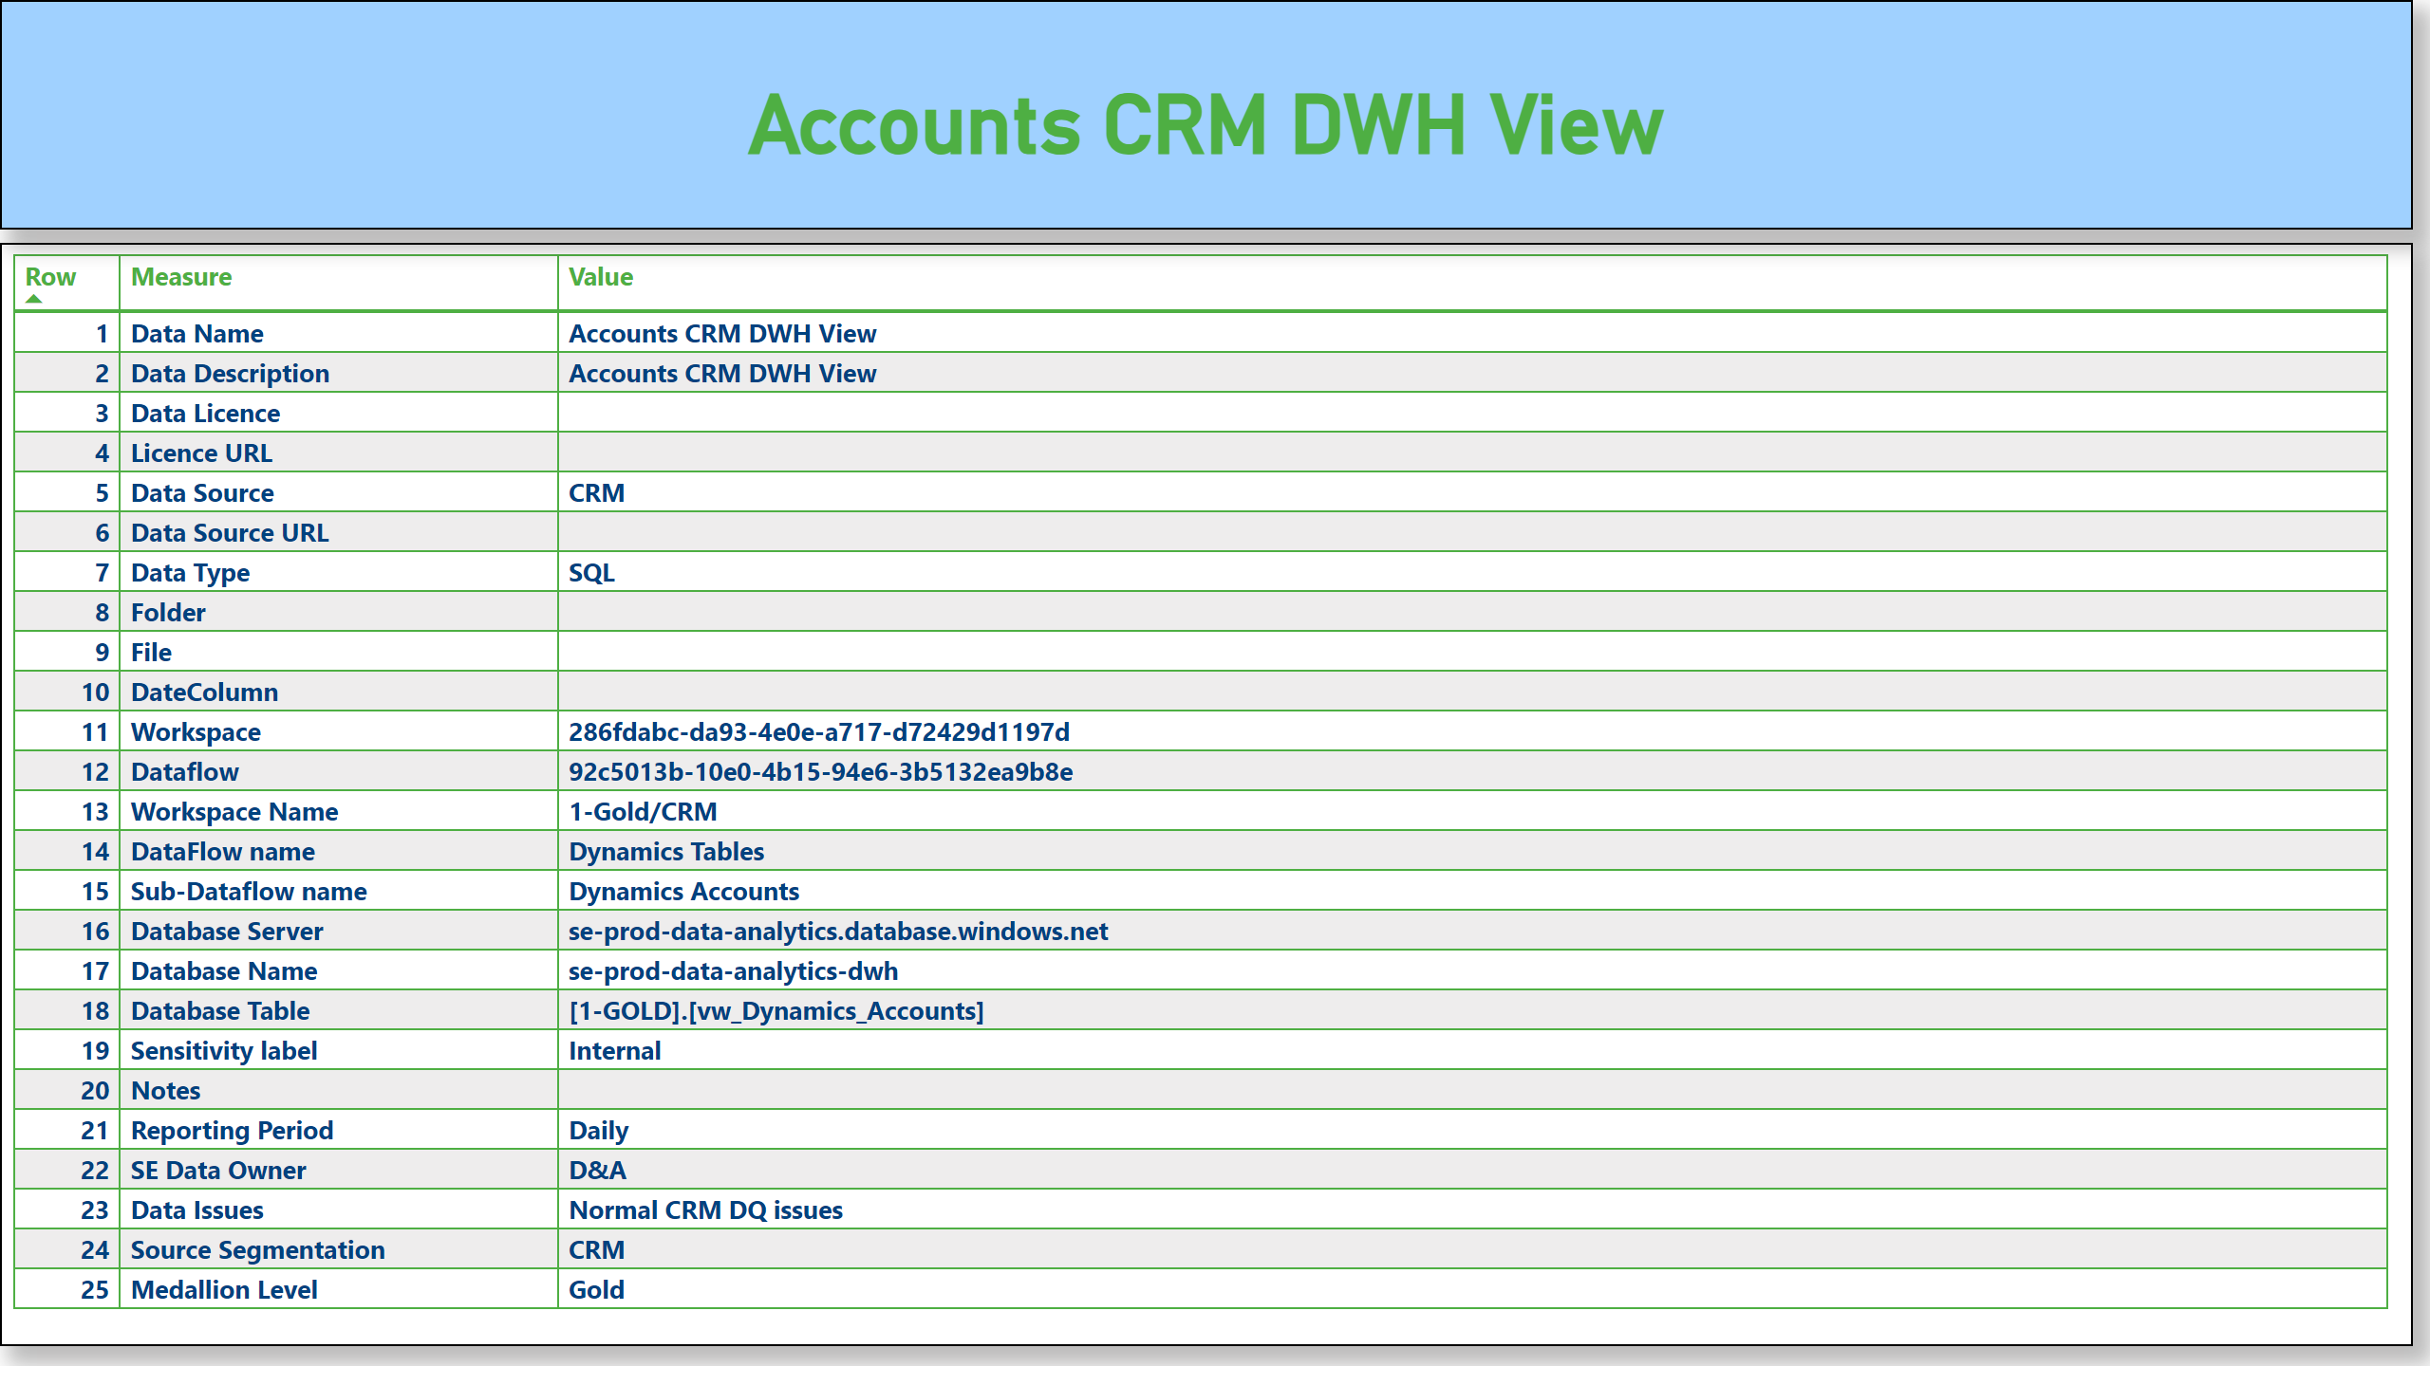
MetaData
Notes:
tableEx
No alt text provided
card
No alt text provided

