Slide 1
HART & SANA
Paper Presentation
ECEN-689 | Spring 2026
Brody Jordan
Notes:
I will be presenting two papers today, both published in 2024

Slide 2
Image Synthesis
In text-to-image synthesis, there are two dominant models: autoregressive and diffusion, each with their own pros and cons
HART & SANA both released in 2024 (MIT & NVIDIA), aim to improve both models, with HART targeting autoregression and SANA targeting diffusion
Notes:
Left Side (HART): "Fixing Autoregression." Key bullets: Hybrid tokens, continuous details.
Right Side (SANA): "Fixing Diffusion." Key bullets: 32x compression, Linear attention.

Slide 3
HART EFFICIENT VISUAL GENERATION WITH HYBRID AUTOREGRESSIVE TRANSFORMER
Notes:
I will be presenting two papers today, both published at ICLR 2025

Slide 4
HART – Overview
The discrete tokenizers used in autoregressive models lack the fine detail reconstruction capabilities of continuous tokenizers used in diffusion models
Compared to autoregressive models, diffusion models achieve higher quality outputs at the cost of increased computational requirements
HART seeks to find an autoregressive model that can produce outputs with quality rivaling diffusion models while significantly reducing cost

Slide 5
HART – Method
To address these issues, the authors proposed a hybrid tokenizer where the continuous latents are split into a sum of discrete latents and a continuous residual
Discrete latents: big picture; global structure and layout
Continuous latents: fine detail; edges, micro-textures
Notes:
sum of discrete latents derived from a VAR (Visual AutoRegressive modeling) tokenizer
These two latents are then modeled by our hybrid transformer: the discrete latentsare handled by a scalable-resolution VAR transformer, while the continuous latents are predicted bya lightweight residual diffusion module with 5% parameter and 10% runtime overhead.

Slide 6
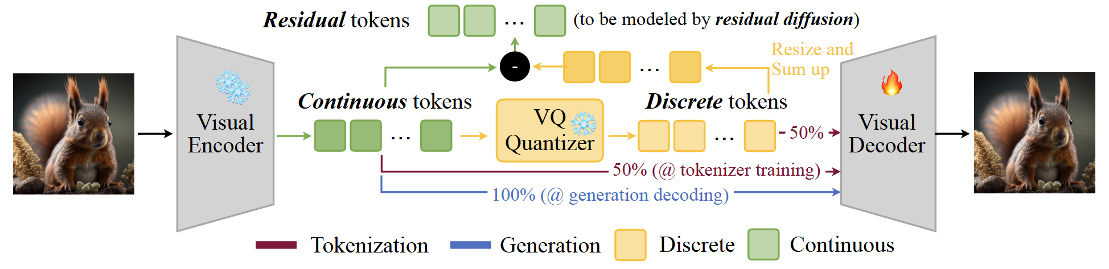
HART – Method
Notes:
Unlike conventional image tokenizers that decode either continuous or discrete latents, thehybrid tokenizer in HART is trained to decode both continuous and discrete tokens. At inferencetime, we only decode continuous tokens, which are the sum of discrete tokens and residual tokens.The residual tokens will be modeled by residual diffusion

Slide 7
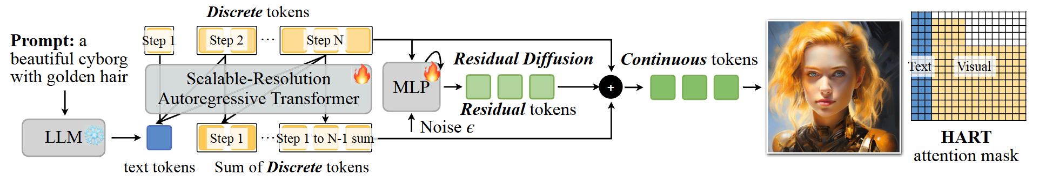
HART – Method
Notes:
Unlike conventional image tokenizers that decode either continuous or discrete latents, thehybrid tokenizer in HART is trained to decode both continuous and discrete tokens. At inferencetime, we only decode continuous tokens, which are the sum of discrete tokens and residual tokens.The residual tokens will be modeled by residual diffusion

Slide 8
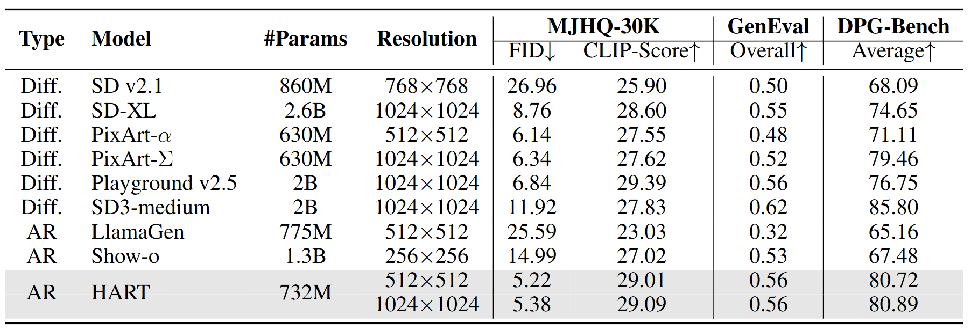
HART – Experiments
Notes:
he performance of HART on MJHQ-30K, GenEval and DPG-Bench benchmarks. Wecompare HART with open-source diffusion models and autoregressive models. Results demonstratethat HART can achieve comparable performance to state-of-the-art diffusion models with <1B parameters, surpassing prior autoregressive models by a large margin.

Slide 9
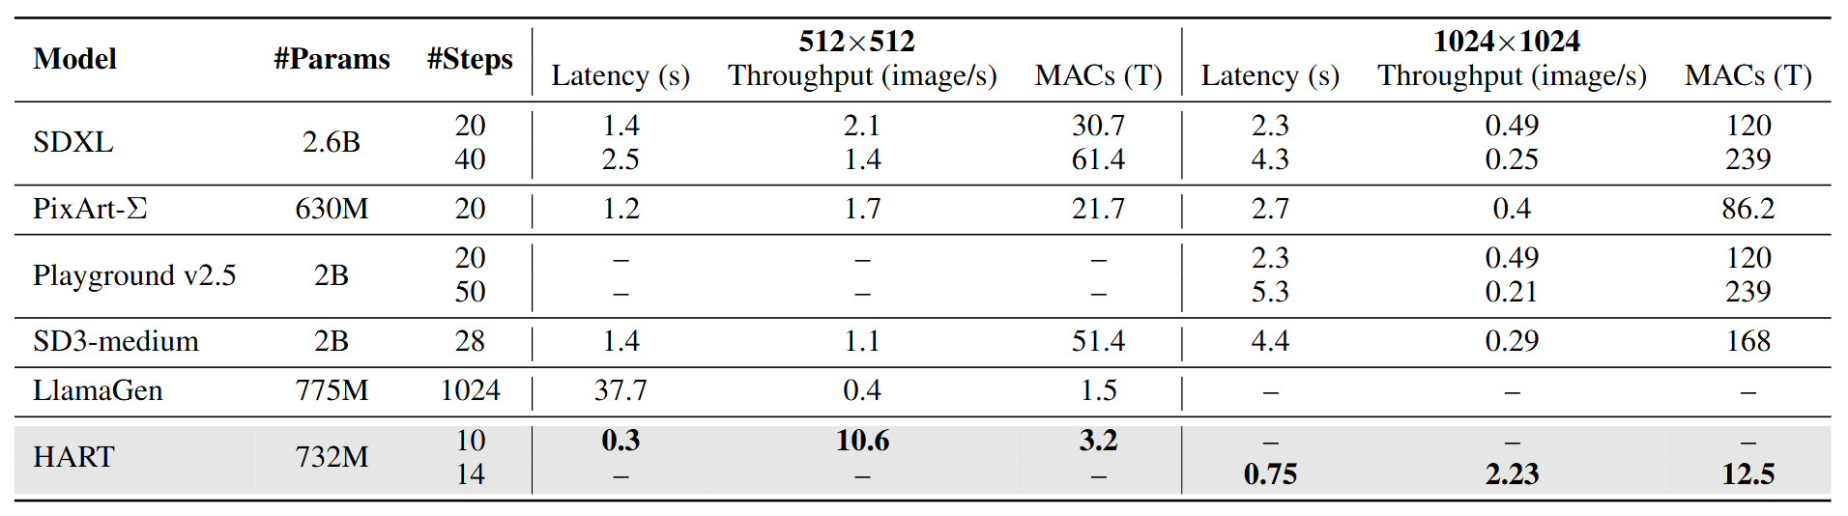
HART – Experiments
Notes:
Compared to state-of-the-art diffusion models, HART achieves 5.0-9.6× higher throughput and 4.0-4.7× lower latency at 512×512 resolution. At 1024×1024 resolution, it demonstrates 4.57.7× higher throughput and 3.1-5.9× lower latency.
We evaluate HART on ImageNet (Deng et al., 2009) for class conditioned image generation, and on MJHQ-30K (Li et al., 2024a), GenEval (Ghosh et al., 2024),and DPG-Bench (Hu et al., 2024) for text-to-image generation. The HART tokenizer is trained on OpenImages (Kuznetsova et al., 2020). For HART transformer training, we utilize ImageNet, JourneyDB (Pan et al., 2023), and internal MidJourney-style synthetic data. All text-to-image generation data are recaptioned using VILA1.5-13B (Lin et al., 2024). We measure all quality and efficiency metrics using open-source models with recommended sampling parameters as released by their authors. Latency and throughput (batch=8) measurements are conducted on NVIDIA A100.

Slide 10
SANA EFFICIENT HIGH-RESOLUTION IMAGE SYNTHESIS WITH LINEAR DIFFUSION TRANSFORMERS
Notes:
I will be presenting two papers today, both published at ICLR 2025

Slide 11
SANA – Overview
We know from earlier slides that diffusion models can produce high-quality outputs with fine detail at a greater computational cost than autoregressive models
Generating high resolution images with diffusion models is extremely costly
SANA seeks to reduce this cost, allowing fast, high-quality, high-resolution image generation on edge devices
Notes:
To address the limitations of diffusion models, the authors propose a few different key components of the model… NEXT SLIDE

Slide 12
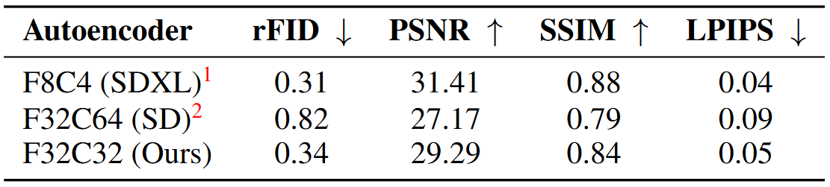
SANA – Method
Deep Compression Autoencoder
Popular Autoencoders used in other models have a spatial compression factor of 8
The SANA authors propose a new Autoencoder that raises the compression factor to 32, significantly reducing the latent tokens
Notes:
Compared with AE-F8, our AE-F32 outputs16 × fewer latent tokens, which is crucial for efficient training and generating ultra-high-resolution images, such as 4K resolution. The motivation is that high-resolution images naturally contain more redundant information. Moreover, efficient training and inference of high-resolution images (e.g., 4K) necessitate a high compression ratio for the autoencoder
Moreover, instead of increasing the patch size P , we argue that the autoencoders should take fullresponsibility for compression, allowing the latent diffusion models to focus solely on denoising.Therefore, we develop an AE with a down-sampling factor of F = 32, Channel C = 32, and run diffusion models in its latent space with a patch size of 1 (AE-F32C32P1). This design reduces thenumber of tokens by 4×, significantly improving training and inference speed while lowering GPUmemory requirements.
Reconstruction capability of different Autoencoders.
rFID (Relative Fréchet Inception Distance); PSNR (Peak Signal-to-Noise Ratio; SSIM (Structural Similarity Index Measure); LPIPS (Learned Perceptual Image Patch Similarity

Slide 13
SANA – Method
Efficient Linear DiT & Mix-FFN
Standard DiT self-attention has computational complexity O(N^2)
The authors propose a linear DiT which lowers this computational complexity to O(N)
Mix-FFN integrates 3×3 depth-wise convolution into MLP to aggregate the local information of tokens
Notes:
To address this issue, we firstproposed linear DiT, which completely replacesthe original self-attention with linear attention,achieving higher computational efficiency inhigh-resolution generation without compromising performance. In addition, we employ MixFFN to replace the original MLP-FFN, incorporating 3×3 depth-wise convolution to betteraggregate token information.
Feed forward network

Slide 14
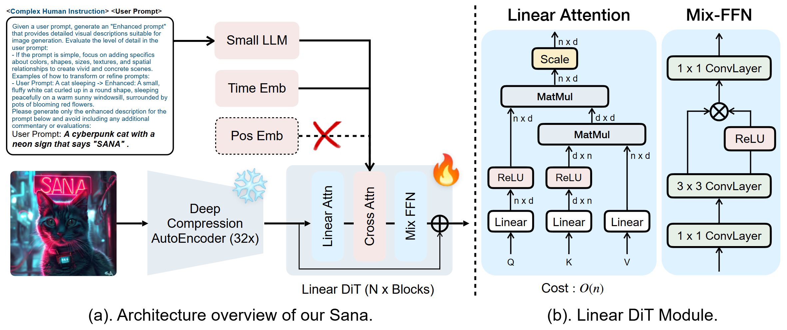
SANA – Method
Notes:
Overview of Sana: Fig. (a) describes the high-level training pipeline, containing our 32×deep compression Autoencoder, Linear DiT, and complex human instruction. Note that Positional embedding is not required in our framework. Fig. (b) describes the detailed design of the LinearAttention and Mix-FFN in Linear DiT

Slide 15
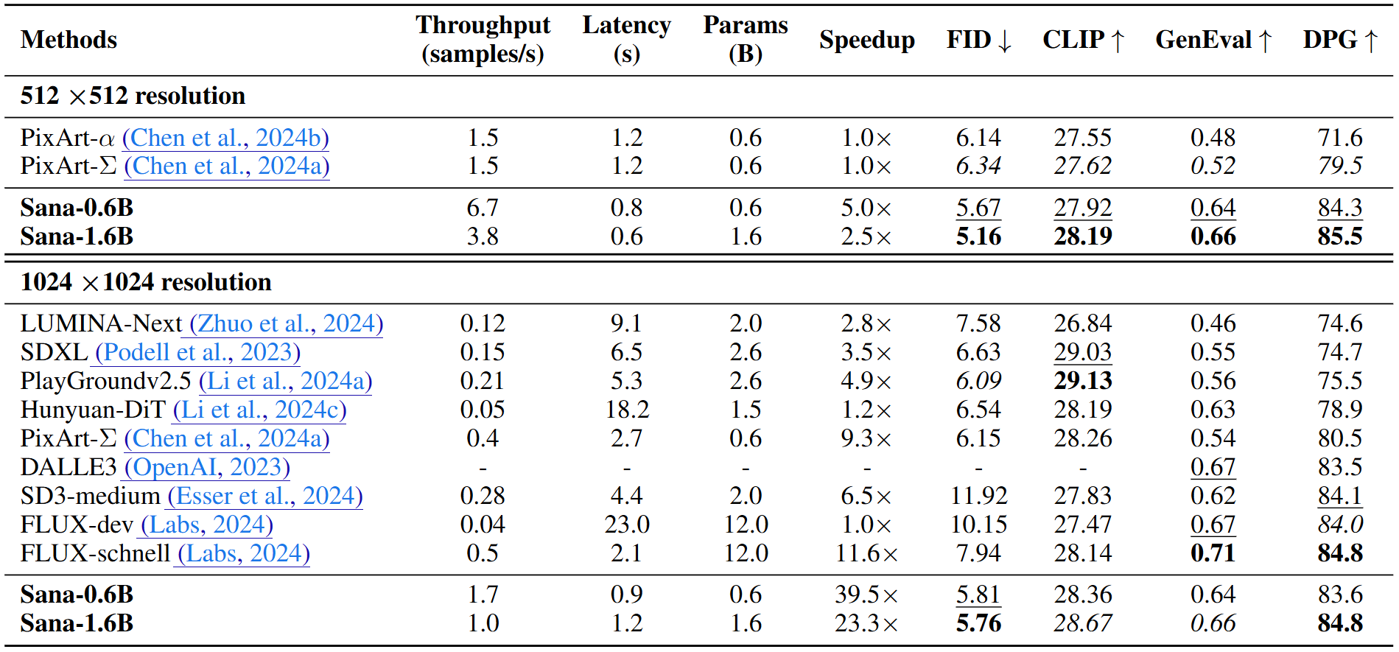
SANA – Experiments
Notes:
Comprehensive comparison of our method with SOTA approaches in efficiency and performance. The speed is tested on one A100 GPU with FP16 Precision. Throughput: Measured with batch=16. Latency: Measured with batch=1 and sampling step=20. We highlight the best,second best, and third best entries.

Slide 16
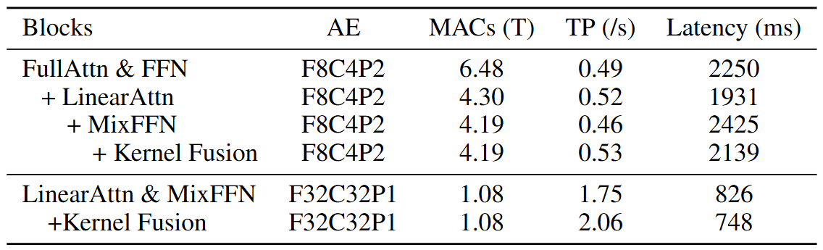
SANA – Experiments
Notes:
Performance of Sana block design space. The speed is tested on one A100 GPU withFP16 Precision with 1024 image size. MACs: Multi-accumulate operations for a single forwardpass. TP (Throughput): Measured with batch=16. Latency: Measured with batch=1.

Slide 17
RECAP
Notes:
I will be presenting two papers today, both published at ICLR 2025

Slide 18
Recap
Autoregressive models have high throughput, but lack the high visual fidelity capabilities of diffusion models
HART improves autoregressive models through hybrid tokenization, allowing for fast image generation with much finer details than before
SANA improves diffusion models by reducing their large computational cost through a more aggressive spatial compression and a linear DiT, allowing high-quality and high-resolution image generation on edge devices
Notes:
HARTachieves quality comparable to diffusion models while being 3.1-5.9× faster and offering 4.5-7.7×higher throughput. Our key insight lies in the decomposition of continuous image latents throughhybrid tokenization, producing discrete tokens that capture the overall structure and residual tokensthat refine image details. We model the discrete tokens using a scalable-resolution AR transformer, while a lightweight residual diffusion module with just 37M parameters and 8 sampling steps learnsthe residual tokens.
e propose a deep compression autoencoder, widely use linear attention to replace self-attention in DiT, utilize decoder-only LLM as text encoder with complex humaninstruction, establish an automatic image caption pipeline, and propose flow-based DPM-Solver toaccelerate sampling. Sana can generate images at a maximum resolution of 4096×4096, deliveringthroughput more than 100× higher than the SOTA methods while maintaining competitive generation results.

Slide 19
Questions?

