Slide 1
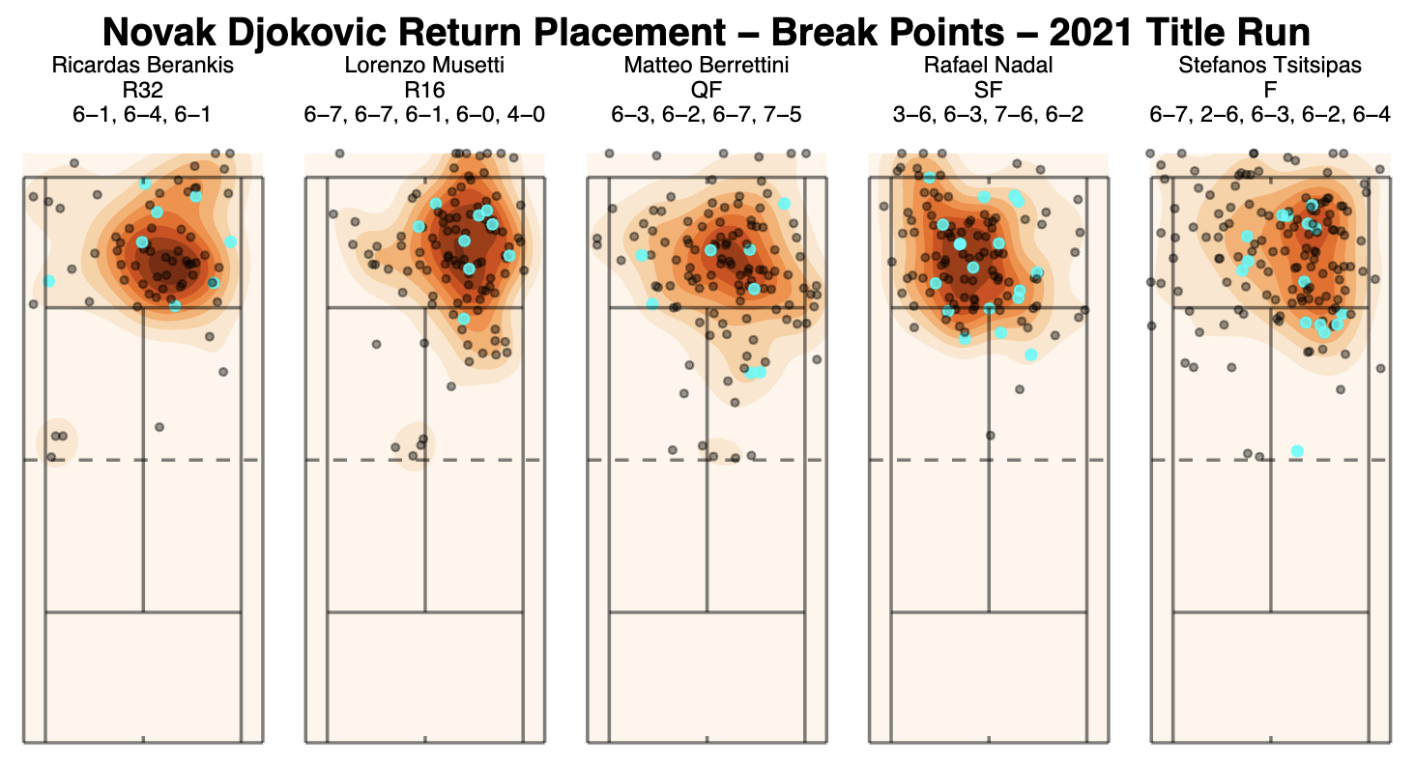
Pressure Point Patterns: A Look Into Tennis Tactics at The French Open
Broderick J. Pinto
Advisor: Dr. Matt Higham
The figure to the right shows Novak Djokovic’s return locations in his run to the 2021 French Open title. Blue dots represent his return placement on break points. On break points – arguably the most pressure-filled moments for a returner – Djokovic did not miss a single return. Across 58 break point chances, he successfully put every return into play, applying immense pressure on his opponents to win the point outright. His returns weren’t just in, they were placed with surgical precision – often deep and toward the backhand side of his opponent.

