Slide 1
Userspace squash filesystem for launching Linux containers on hpc systems
LA-UR-19-24149
by Ronald shane goff

Slide 2
Software in high performance computing
LA-UR-19-24149
Carefully administered and managed
Provides common tools needed by many such as MPI and compilers
Only some versions of some things are installed
Might be missing an older or newer version you need
Can’t install everything under the sun
New software can be requested
Without great enough need the burden of support is too high

Slide 3


Building your own software
LA-UR-19-24149
You can build your own software for most things
Can be a hassle to debug and repeat this
Usually no internet access
Have to rebuild every time on a new platform

Slide 4
The quest for software isolation
LA-UR-19-24149
Many people have specific dependencies that are not supported
Building software can be difficult and can create conflicts with installed software (Priedhorsky & Randles, 2017)
If you change platforms, you have to build everything again
If you change software versions you have to build again
Must get the software to the compute center without the internet

Slide 5
Virtual machines for isolation
LA-UR-19-24149
Uses an entire guest operating system
Separate user libraries and binaries from the host
Separate kernel from the host
Uses a hypervisor to give guest access to host hardware
Almost entirely separate from the host
Usually no access to special hardware used in HPC (Soltesz, Pötzl, Fiuczynski, Bavier, & Peterson, 2007)
Keeps host kernel safe from blunders (Soltesz, Pötzl, Fiuczynski, Bavier, & Peterson, 2007)

Slide 6
Linux containers
LA-UR-19-24149
Separates user binaries and libraries from the host
Uses Linux name spaces to separate resources instead of a hypervisor (Priedhorsky & Randles, 2017)
Shares operating system kernel with the host
Can directly access special hardware with proper configuration (Priedhorsky & Randles, 2017)
Smaller than virtual machines (Jacobsen & Canon, 2015)
Can pose more risk to the host system, but can be mitigated (Jacobsen & Canon, 2015)
Lower overhead than virtual machines(Jacobsen & Canon, 2015)

Slide 7
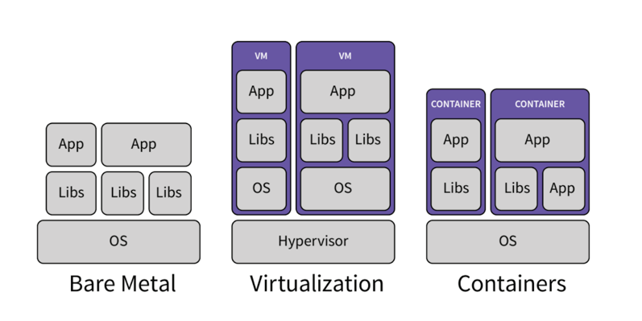
Containers are closer to bare metal
LA-UR-19-24149

Slide 8
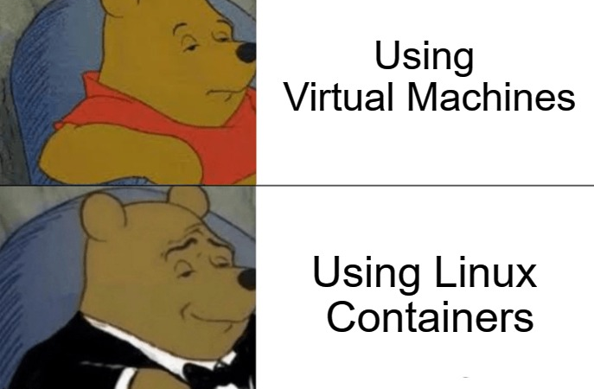
Why containers
LA-UR-19-24149
Fast (Jacobsen & Canon, 2015)
Lightweight (Jacobsen & Canon, 2015)
Unfettered internet access at build time
Reproducible (Priedhorsky & Randles, 2017)
Portable (Priedhorsky & Randles, 2017)

Slide 9
Fitting user needs
Users can use the exact versions of everything they want
Some users require validated software stacks to meet field specifications
Some common software is still important to users, and can be used without having to build it all over again. They still have access to the managed stack
Easy to experiment with new software

Slide 10

We must also ask why not containers
LA-UR-19-24149
User defined software stacks can introduce new attack vectors (Priedhorsky & Randles, 2017)
Some container run time tools require root
Containers can use more system memory than bare metal

Slide 11
Unprivileged workflow
LA-UR-19-24149
Security can be a priority
Linux containers do not need root to execute (Priedhorsky & Randles, 2017)
Some tools provide services to users that need root (Le & Paz, 2017)
Container build time requires root commonly
Uses a root-level process to start user containers without privilege
Parent process also handles root-level things it needs to work
Concerning to most cluster admins, can expose root access to users
Parent process with privilege is more dangerous than one without
Extra services mean extra effort to support

Slide 12
Running containers in hpc
LA-UR-19-24149
Some tools require root-level access in some form for running containers
Docker swarm (Docker Engine)
Singularity (privileged parent process) https://singularity.lbl.gov/faq
Shifter (privileged parent process) https://github.com/NERSC/shifter/blob/master/doc/security.rst
Some do not
Charliecloud

Slide 13
Why Charliecloud
Charliecloud does not require root
Does not use setuid
It is developed at LANL
It is open source
It is light weight
It is only a container run time tool with some helper scripts
It provides tools to assist building containers, but does not build them itself

Slide 14
Using Charliecloud
LA-UR-19-24149
To use containers on HPC resources the container must be made available to all compute nodes within the cluster in some way
Charliecloud only requires a directory tree resembling a Linux filesystem tree
Docker containers are exported to a compressed tar file, then unpacked to memory on each node. This workflow is supported, but not required (which is cool).
Provides tools for using some special HPC hardware (Priedhorsky & Randles, 2017)
Uses host network stack instead of network namespaces (Priedhorsky & Randles, 2017)

Slide 15
Other ways to distribute containers
LA-UR-19-24149
You can run the container from a networked filesystem
No need to distribute containers manually
Job time vs run time
longer run time of containers
Only reads necessary files instead of the whole container, using less memory compared with copying the entire container to memory

Slide 16
Enter The squash filesystem (squashfs)
LA-UR-19-24149
Compressed read only filesystem
Already used by some container tools, like Shifter
Uses a kernel mounted squash filesystem to make container images available over a network filesystem
Kernel mounted is proven to be fast and efficient for containers in HPC (Gerhardt et al., 2017)
Hosted on an existing network filesystem like Lustre (Gerhardt et al., 2017)

Slide 17
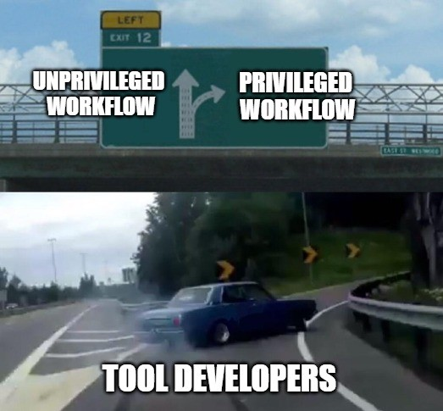
Do we need root for squashfs?
LA-UR-19-24149
Kernel mounted squashfs is fast and great, but needs root
Existing tools can make use of the squashfs without root via Filesystems in userspace (FUSE)
FUSE is generally considered to add overhead (Vangoor, Tarasov, & Zadok, n.d.)

Slide 18
A little about lustre
LA-UR-19-24149
Parallel filesystem that uses object storage
Separates file data and metadata
Uses servers to make bits available
Metadata server
Metadata targets
Object Storage server
Object Storage targets

Slide 19
More about Lustre
Lustre seperates data intro stripes for parallelism
Lustre likes large contiguous parallel operations
Lustre dislikes many small files
Lustre performance suffers under heavy metadata loads

Slide 20
Lustre and squashfs
LA-UR-19-24149
Lustre doesn’t deal well with small file transactions, due to having separate metadata (Gerhardt et al., 2017)
Containers can have many small file transactions, as most binaries and libraries aren’t very large
Squashfs contains and compresses metadata
Keeps everything bundled together
Presented as a single file to Lustre, avoiding lots of metadata transactions (Gerhardt et al., 2017)

Slide 21
FUSE
LA-UR-19-24149
FUSE allows users to mount filesystems without root
User level processes communicate with kernel driver to do work
Users can ONLY start user level processes, kernel driver is separate and handles root stuff
Low-level FUSE API
Faster, harder to develop (Vangoor, Tarasov, & Zadok, n.d.)
High-level FUSE API
Wraps around low-level API, adds more overhead converting paths to inodes (Vangoor, Tarasov, & Zadok, n.d.)

Slide 22


Objectives
LA-UR-19-24149
Find out what amount of overhead is added to squashfs through FUSE
Explore options to minimize overhead, and optimize the squashfs on Lustre
Containers don’t fit well in Lustre best practices
There are options for squashfs block size we can adjust
There are Lustre options we can adjust for squashfs

Slide 23
The pynamic benchmark
LA-UR-19-24149
Developed at Lawrence Livermore National Laboratory
Designed to test a systems ability to handle the Dynamic Linking and Loading requirements of Python-based scientific applications
Creates a number of arbitrary library files
Reports timings for loading these files

Slide 24
Method
LA-UR-19-24149
Factors | Levels
Node Count | 1,128,512,1024
Mount Method | kernel, squashfuse, squashfuse_ll
Squashfs Block size | 128Kib, 1MiB
Lustre Stripe Size | 64KiB, 1MiB
Lustre Stripe Pattern | 1 OST, 2 OSTs, 32 OSTs

Slide 25

misc
LA-UR-19-24149
Some experiment iterations were run on Network Filesystem instead of Lustre, for science.
Not all things will resemble an HPC workflow
A recursive grep will be run on the squashfs which will walk the whole filesystem to test limits. Most scientific applications won’t do such a thing, but someone will.

Slide 26
Results
LA-UR-19-24149
Kernel mounted squashfs is king
Doesn’t care about any attempts or lack of attempts at optimizing
Fastest in all configurations, very stable
High-level FUSE API was slowest
Shows more impact regarding optimization
Low-level FUSE API was in the middle
Shows similar but less obvious benefits from optimizations

Slide 27
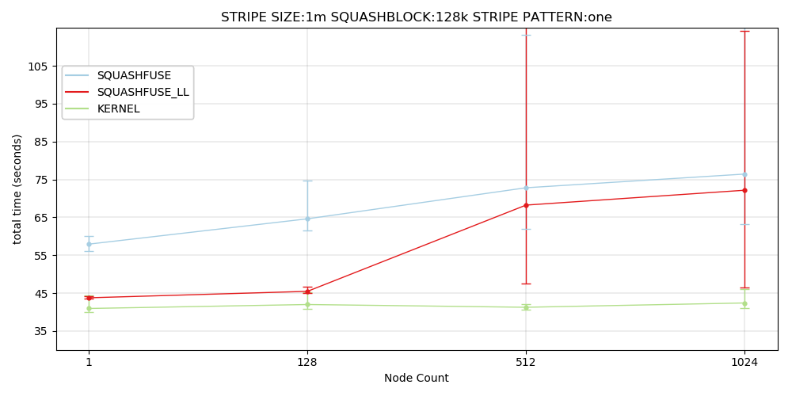
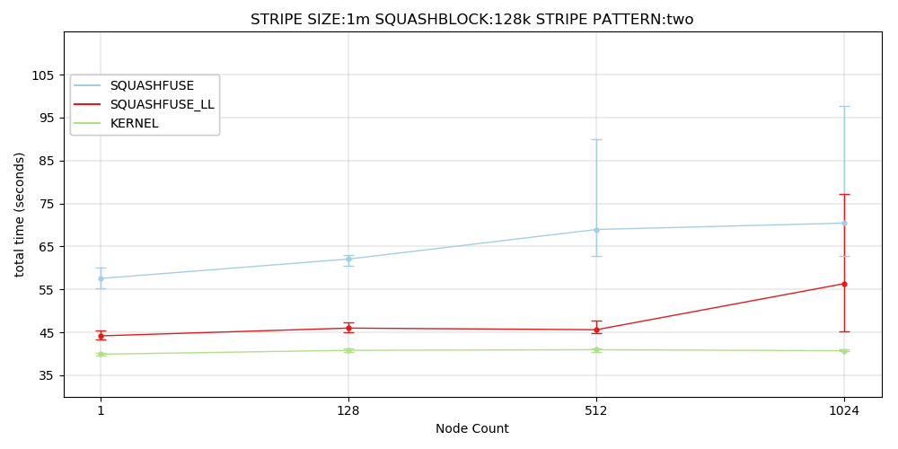
Lustre striping matters
LA-UR-19-24149
Default squashfs block size, Lustre stripe size, and stripe count
Increasing stripe pattern from one stripe, to two greatly improves performance as scale increases

Slide 28
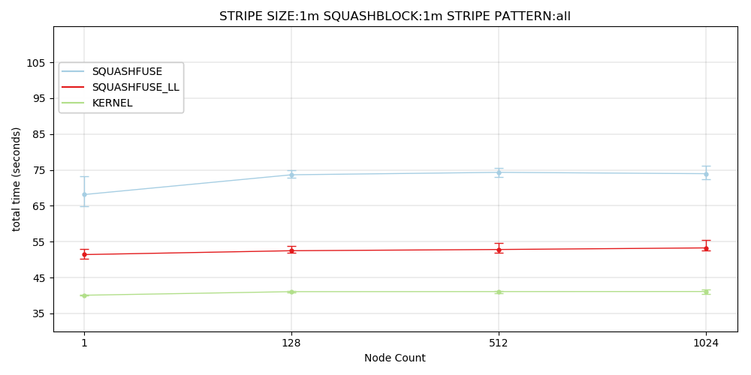
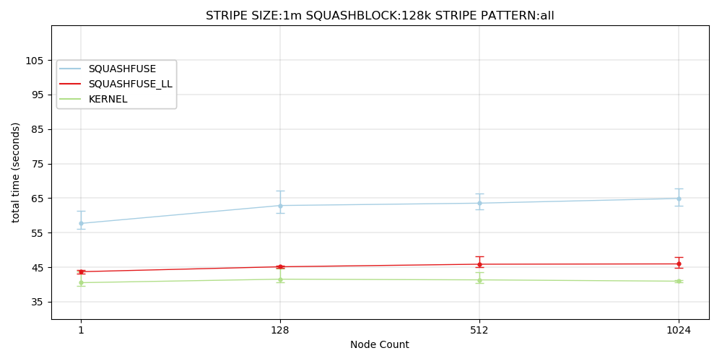
Squashfs block size
LA-UR-19-24149
Smaller squashfs block size is faster than a larger one
Squashfs block size can be smaller than the default 128KiB, but was not tested

Slide 29
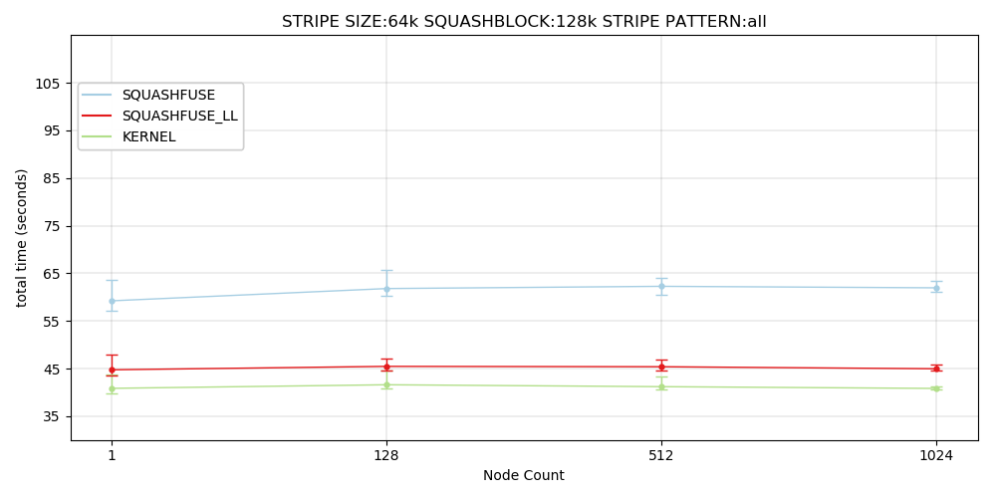
Lustre stripe size
LA-UR-19-24149
Less impactful than the other factors
The curve for the High-level FUSE API is slightly flatter with a smaller stripe size compared to larger
Lustre stripe sizes larger than the default were not tested

Slide 30
FUSE overhead
LA-UR-19-24149
High-level API has more overhead
Low-level API is very close in the reported benchmarks to a kernel mounted squashfs
When optimized performance is maintained as scale increases
FUSE overhead scales very well and is manageable

Slide 31
Misc tests
LA-UR-19-24149
Tests on NFS were short lived, at 64 nodes Pynamic took 10 minutes
Recursive grep had some quirks
Using high-level FUSE API recursive grep was quite slow, but finished even at 256 nodes
Took 370 seconds at 128 nodes
Worked at 256 nodes, gave questionable output after that
The low-level API was fantastically faster, but at higher node counts hangs with no error
Took 100 seconds at 128 nodes
Failed at more than 128 nodes

Slide 32
Caveats
LA-UR-19-24149
FUSE has a default maximum request size of 128KiB
Could explain why larger block sizes appear to hurt performance, instead of help
There were no attempts to optimize FUSE
Sqaushfuse might be improveable
Never figured out why the low-level API hangs on recursive grep
There was no competition for resources through the experiment
This will never happen in the real world
Did not use enough different block and stripe sizes

Slide 33
Future work
LA-UR-19-24149
Testing should be done across a larger scale
More block and stripe sizes should be tested
FUSE can possibly be optimized
New versions support new features
Maximum request size can be increased
Squashfuse has not been updated in 8 years, there may be improvements that have made their way to the kernel code
Lustre monitoring

Slide 34
Lustre job stats
Collects Remote Procedure Calls made during job time
Collects information regarding read sizes, and number of RPCs
Our system does not appear to be bound by block or stripe size for reads
Squashfs Kernel was not checked with Lustre stats
Can’t confirm kernel mounted squashfs is even making RPCs to Lustre

Slide 35
Conclusions
LA-UR-19-24149
Using default squashfs block size and Lustre stripe size is best and easiest
Striping across OSTs becomes more important at scale
FUSE overhead is rather small, and appears to stay that way with the low-level API
Kernel mounted squashfs is fastest, but less secure due to root access

Slide 36
Question time
LA-UR-19-24149

