Slide 1
Frequency Analysis of AI vs. Human Text and Classification Model
Colin Brogan
Dr. Hong Xiao

Slide 2
Problem & Solution
Problem | Solution
Increase of AI generated Content Becoming more difficult to distinguish | Use word frequency to determine patterns to assist in determining origin. Build classification model to identify between the two.

Slide 3
Project Overview
MVP: Learning Model to predict origin of written essay text
What's the goal?
What does it do?

Slide 4
Why This?
Interest in AI
Data Science vs. Game Development
Resume Building

Slide 5


Languages
Python Anaconda Distribution
Well Documented
Common for NLP and Data Science
Previous Experience
Other Considerations:
Java
R
C++

Slide 6

Environment
Jupyter Notebook
Cell Structure
Easy Markdown
Familiarity
Other Considerations
Visual Studio
Pycharm
Google Prolab

Slide 7
Data Collection
Human Essay Text
700 ~ 3000 words
College Level Submissions
From Myself, Friends, and Family
~ 50 Human Essays
AI Essay Text
600 ~ 1300 words
ChatGPT 3.5 & 4.0
Given Popular College Essay Prompts
~ 70 AI Essays

Slide 8
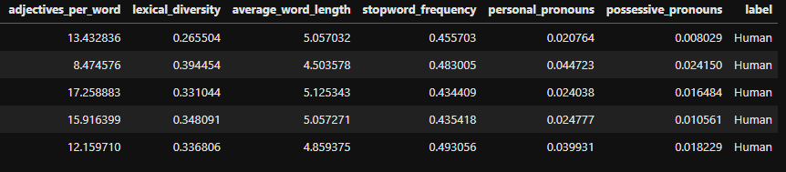
Feature Selection
Based On Three Primary Areas of Focus
Stopword Frequency
POS Tags
Nouns
Adjectives
Pronouns
Punctuation Usage

Slide 9
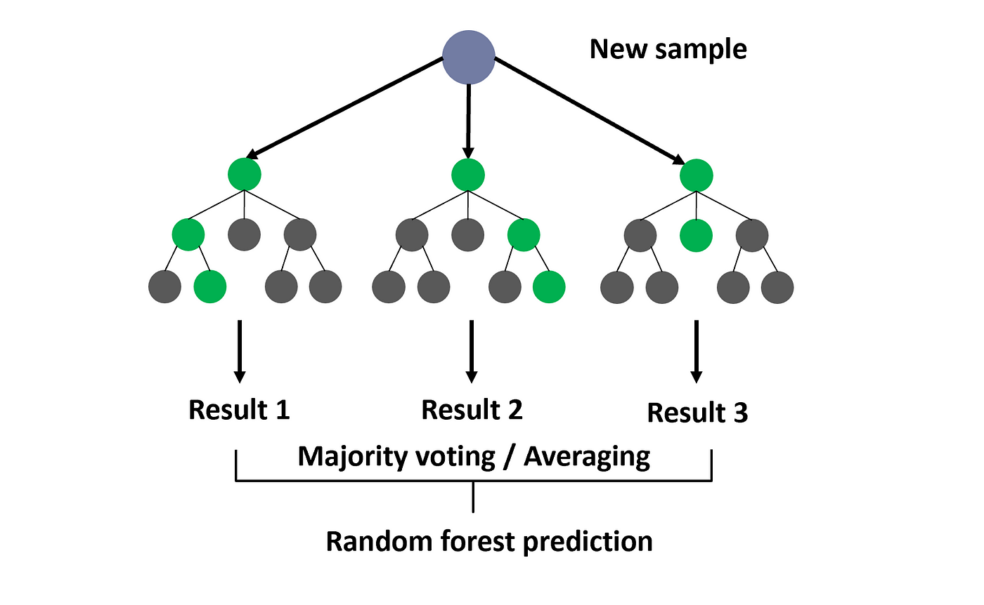
Model Selection
Sci-kit learn Random Forest
Easier implementation with sci-kit
Feature Importance Visualization
Reliable on Relatively Small Datasets
Other considerations
Support Vector Machine (SVM)

Slide 10
Questions?

