Slide 1
Custom Step Sequence

Slide 2
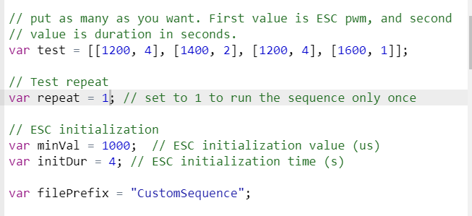
Test 1

