Slide 1
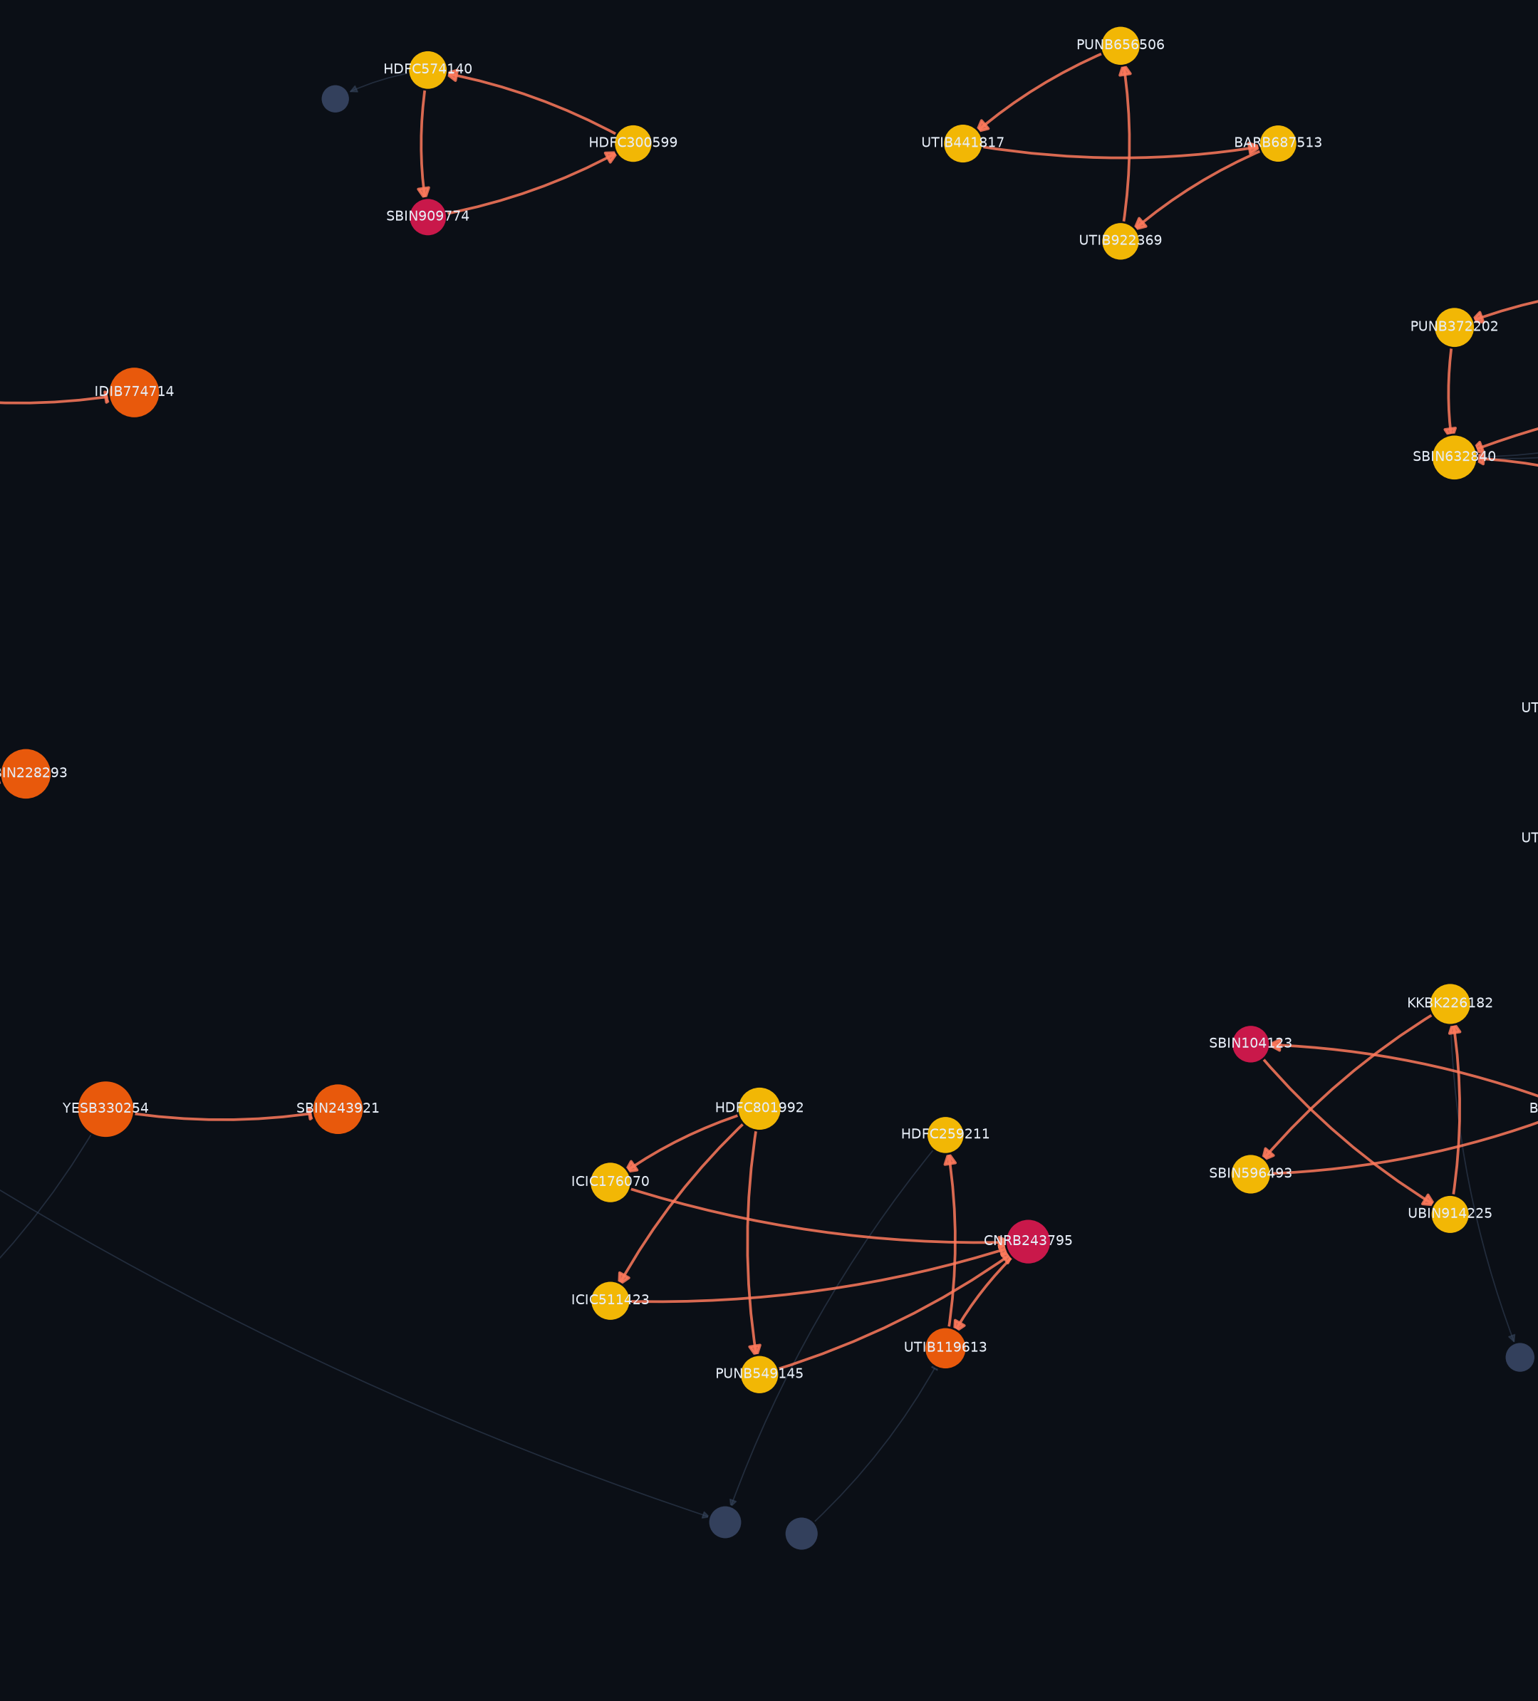
BUILTNBANK · IGTDW, IIT DELHI
AMLTrace
Tracing financial crime
across patterns
An anti-money-laundering investigation console. Eight detection layers over a directed money-flow graph - and four economic tests that decide whether a suspicious shape is actually a crime.
187 accounts · 301 transactions · 35 alerts · 9 rings
Notes:
AMLTrace. The one-line pitch: most AML demos prove they can find a pattern. We spent our time proving we can tell a laundering ring apart from a business that merely looks like one.

Slide 2
Why AML systems drown their own analysts
2
90-95%
~6%
Shape ≠ crime
of AML alerts at large banks are false positives
of alerts convert into a filed report
the failure nobody measures
industry-reported range
the rest is salaried review time
a legitimate business has the same topology
The structural problem
Rules alone are blind to structure. A single transfer is unremarkable; the crime lives in who pays whom, in what shape, in what order.
Machine learning alone is unexplainable. An anomaly score is not a ground of suspicion you can put in front of a regulator.
Everyone benchmarks on data where only criminals form triangles. So precision is measured against a problem nobody actually has.
Notes:
Set up the pain: banks are not short of alerts, they are short of correct ones. The third bullet is the one we attack - it is the reason published numbers look better than deployed systems.

Slide 3
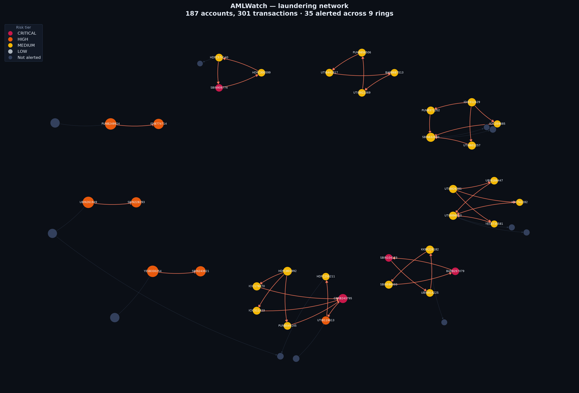
AMLTrace
3
A working investigation console, not a notebook of metrics
Alert queue Every account triaged by risk, each with grounds of suspicion in plain English.
Interactive network 3D money-flow graph; laundering stages as depth planes.
Laundering timeline Placement → layering → integration, reconstructed per ring.
Streaming replay Detection re-run day by day, as the money actually moves.
FIU-IND STR generator Filing-ready reports under PMLA 2002, Section 12.
Detection lab Every threshold live-tunable; the pipeline re-runs in seconds.
Notes:
Show, do not tell: this is a running Flask app with zero front-end dependencies - no CDN, no build step. It works with the venue wifi off.

Slide 4
Where this data comes from
4
The first question anyone should ask an AML system, answered in full
WHY IT IS SYNTHETIC
WHAT IN IT IS REAL
WHAT IS INVENTED
Account-level Indian transaction data is not publicly available and cannot be. Customer records are protected by RBI regulation, by PMLA confidentiality and by the DPDP Act 2023 - no bank or regulator publishes a customer ledger. Every public AML dataset, including IBM's and PaySim, is synthetic for the same reason.
The rails, the thresholds and the money. Channel mix, average ticket size per rail, the CTR reporting threshold, the RTGS floor, per-transaction caps and the institution codes are all taken from RBI, NPCI and FIU-IND publications and are cited line by line below.
The accounts, the counterparties and the laundering rings are invented. No real person, account or institution's activity appears anywhere in this system.
Calibrated to published RBI, NPCI and FIU-IND figures - cited line by line in the app
Channel mix UPI 85% of volume, 9% of value
Average ticket UPI Rs 1,347 · NEFT Rs 48,200
CTR threshold Rs 10,00,000 (PMLR 2005)
RTGS floor Rs 2,00,000 per transfer
Caps honoured UPI Rs 1L · IMPS Rs 5L
Institutions 12 real IFSC prefixes
Account-level Indian transaction data is not public and cannot be - it is protected by RBI regulation, PMLA confidentiality and the DPDP Act 2023.
Notes:
Lead with this if anyone challenges the data. No public AML dataset is real, for the same legal reason. What we can do - and did - is pin every parameter to a published RBI, NPCI or FIU-IND figure, and show the citation in the app.

Slide 5
Eight detection layers
5
Rules and topology raise the alert; ML only corroborates it
L1 Structuring / smurfing
L5 Sub-network chokepoint
Transfers sized just under the Rs 10,00,000 CTR line
Betweenness inside the suspicious sub-graph, not the whole book
L2 Fan-out to fan-in
L6 Behavioural anomaly
Funds split across intermediaries, reconverging on one account
IsolationForest over nine per-account features
L3 Circular flow
L7 Suspicion propagation
Money that round-trips to its origin, closing fast and in order
Unflagged accounts exposed to confirmed alerts
L4 Pass-through conduit
L8 Laundering timeline
Receive and forward the same sum within a day - the mule signature
Placement / layering / integration attribution
Primary raise alerts Corroborating can only raise an existing score Lead generation never touches the metrics
Notes:
The layer split is the design argument. An unsupervised score cannot originate an STR, so L5 and L6 can only raise the score of an account a rule already flagged.

Slide 6
Evidence discipline
6
The rule that stops the metrics flattering themselves
PRIMARY
CORROBORATING
LEAD GENERATION
Raises the alert
Cannot create an alert
Outside the pipeline entirely
Structuring, fan patterns, cycles, pass-through conduits. Rule- and graph-based, so every alert can be explained as a sentence a compliance officer could read to a regulator.
Centrality and IsolationForest may only raise the score of an account a primary layer already flagged. An anomaly score is not, on its own, a defensible ground of suspicion.
Suspicion propagation produces a watchlist of accounts no rule flagged. It is deliberately excluded from precision and recall, so guilt-by-association can never inflate a number.
This is why the numbers on the next slides mean something: nothing that could not be defended in a filing is allowed to contribute to them.
Notes:
If a judge asks 'why is your ML not doing the detection' - this is the slide. It is a deliberate constraint, not a limitation.

Slide 7
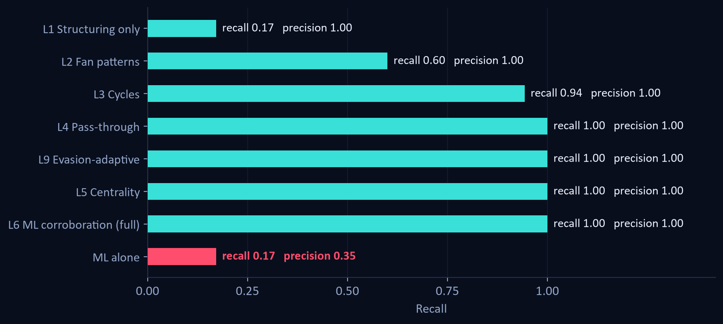
Each layer earns its place
7
Layers switched on cumulatively, against ground truth
1.00 / 1.00
Precision / recall, full pipeline
F1 1.00 · 0 false positives
0.35 / 0.17
ML alone, no graph context
the honest baseline for comparison
Point-wise anomaly detection recovers a fraction of the network at half the precision. The signal in laundering is relational, not behavioural.
Notes:
Read the last bar against the one above it. This is the case for graph structure.

Slide 8
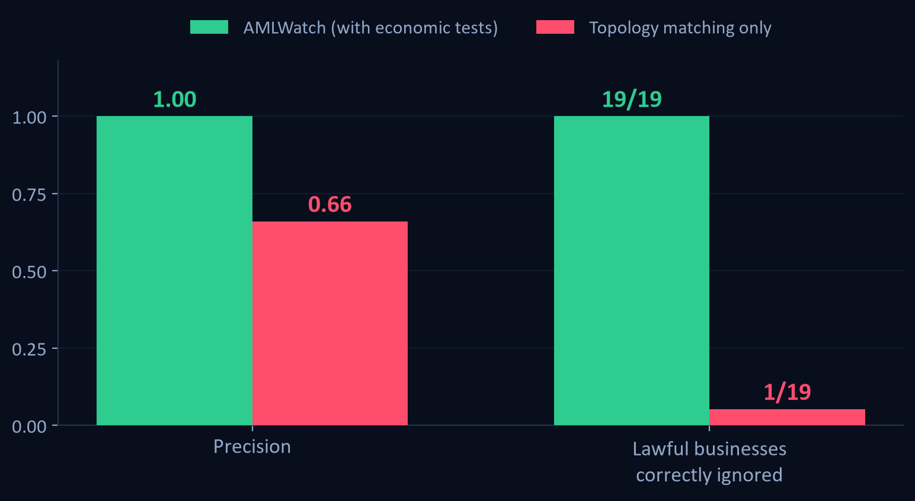
But every detector scores well here
8
So we built a ledger designed to break it
19 lawful businesses, engineered to have identical topology to each typology.
None of them is labelled fraud. Each family reproduces the shape of one crime.
A detector that matches shape alone flags 18 of the 19.
That is the number no AML demo shows - and it is the difference between a pattern matcher and a product.
Notes:
This is the slide to slow down on. We deliberately made our own numbers worse in order to measure the thing that actually matters.

Slide 9
Lawful activity that looks exactly like laundering
9
Supply chain
Card settlement
Customer pays 3 contractors who all buy from one distributor
Merchant, payment processor and acquirer settle back and forth
LOOKS LIKE FAN-OUT / FAN-IN
LOOKS LIKE CIRCULAR FLOW
Why it is not a crime: The contractors have their own unrelated trade
Why it is not a crime: A standing commercial relationship, repeated for months
Escrow agent
Payroll bureau
Receives and forwards near-identical sums within a day
Paid repeatedly just under the CTR reporting line
LOOKS LIKE PASS-THROUGH CONDUIT
LOOKS LIKE STRUCTURING
Why it is not a crime: Does it openly, with many counterparties
Why it is not a crime: Also sends sums above the line - it is not avoiding it
Notes:
Each family is targeted at exactly one detector. If the detector only knows shape, it cannot survive any of them.

Slide 10
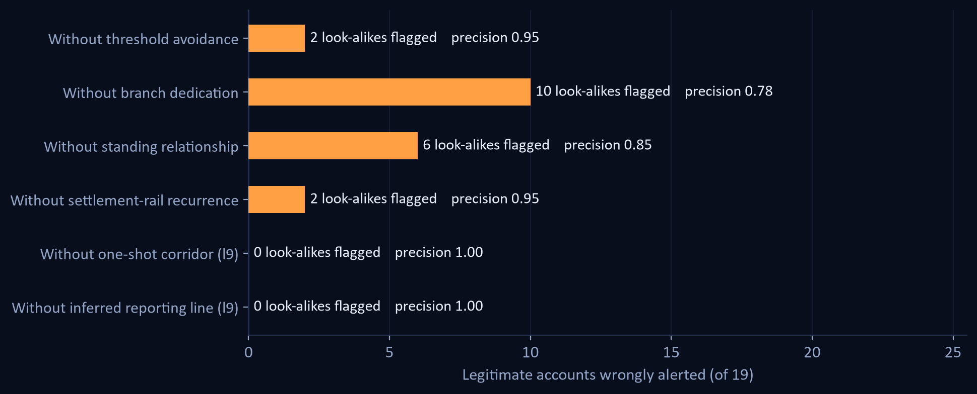
Four economic tests, not geometric ones
10
Turning each off, in isolation
WHAT SEPARATES THEM
Threshold avoidance
A structurer never crosses the CTR line. A big biller sometimes does.
Branch dedication
A mule has no other trade. A contractor has other customers.
Standing relationship
Round-tripping through a monthly counterparty is trade.
Settlement-rail recurrence
A rail repeats on a schedule. A mule is used once and burned.
All four on: 0/19 wrongly flagged.
Notes:
These encode economics, not geometry - which is why they generalise beyond the specific decoys we planted.

Slide 11
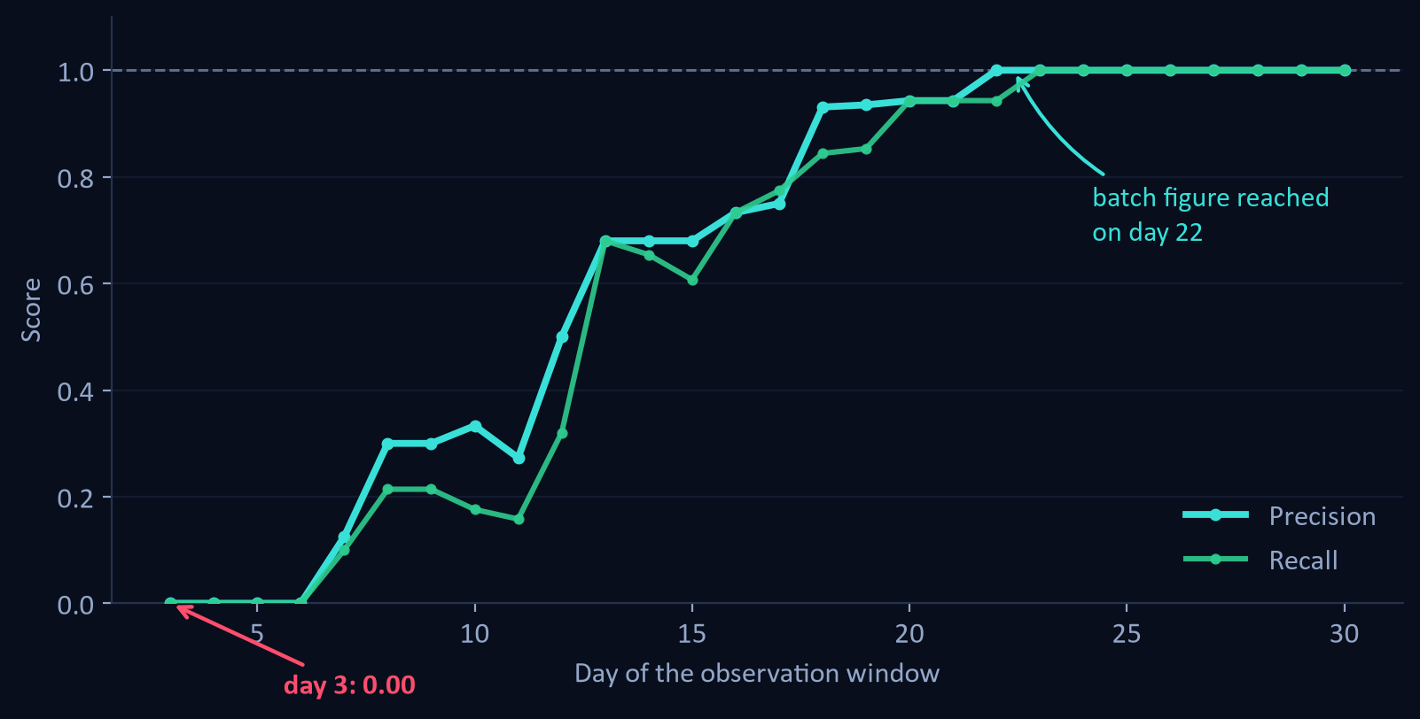
The number we could have hidden
11
Same detector, run as a stream instead of a batch
1.00
Batch precision, month end
0.00
Streaming precision on day 3
reaches the batch figure on day 22
The discriminators are evidence-hungry. A settlement rail is indistinguishable from a mule until you have watched it settle three times - so lawful accounts are provisionally flagged, then correctly released.
Notes:
Volunteering a worse number is the most credible thing in the deck. Any AML result quoted without this curve is quoting the easiest number available.

Slide 12
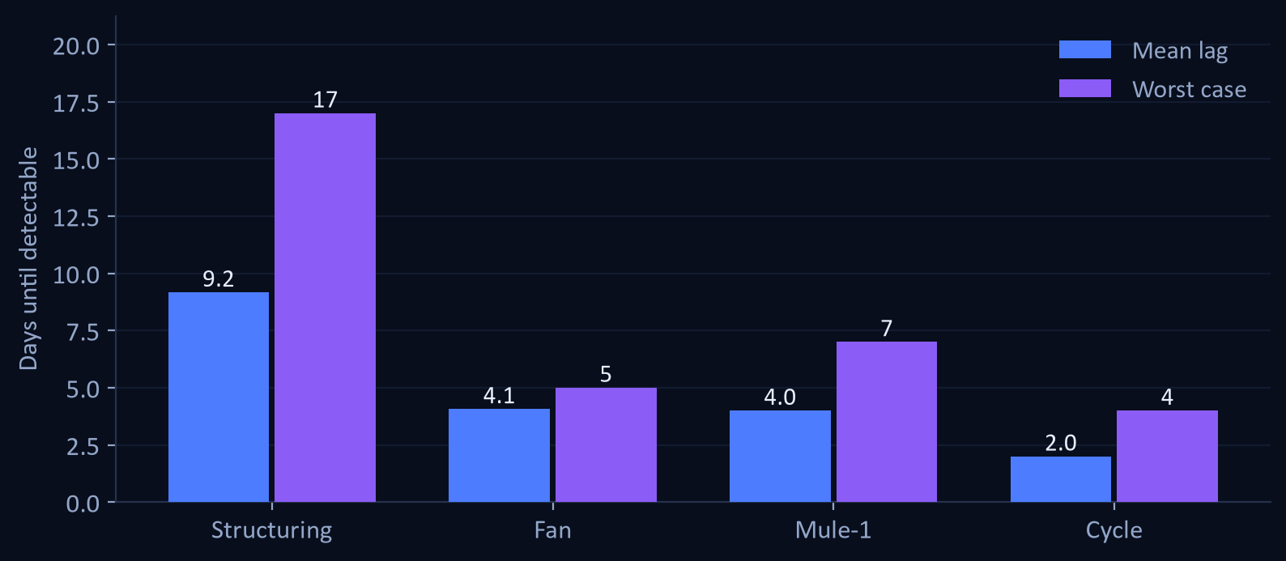
Detection latency
12
The metric that decides whether funds are still freezable
4.23 days
Mean lag from first transaction to alert
day 3
First alert possible in the window
35 of 35
Laundering accounts eventually surfaced
0 never detected
Notes:
Every day of lag is another day the money is gone. Structuring rings are slowest because the pattern needs several transfers before it exists.

Slide 13
Rings are discovered, not assumed
13
Communities come from the detected alerts - never from the labels
9 rings found as connected components of the alert sub-network, which is what the system would produce on unlabelled production data.
One deliberate bridge a fan-in consolidation account wires straight into a mule chain. Nothing tells the detector they are related.
It merges them itself into RING-01, and marks that account the only CRITICAL in the case - two independent typologies converge on it.
Most projects derive communities from the ground truth. On real data that produces nothing.
Notes:
This is a correctness point as much as a feature: deriving rings from labels is a leak that silently inflates every community metric.

Slide 14
What an analyst actually receives
14
FIU-IND Suspicious Transaction Report
Suspicion propagation
Section 12, PMLA 2002 r/w Rule 3, PMLR 2005
Lead generation, kept outside the metrics
A - Subject account, risk tier, action taken
Two independent views of guilt-by-association: bounded-hop contamination with geometric decay, and personalised PageRank seeded on confirmed alerts.
Where the two rankings agree, the lead is strong. The contamination view returns the actual path back to the nearest known-bad account - which is what an investigator needs to open a file.
25 accounts surfaced that no rule flagged.
B - Grounds of suspicion, in narrative English
C - Transaction profile and CTR-adjacent credits
D - Behavioural deviation, as z-scores
E - Immediate counterparty network
F - Regulatory basis and signature blocks
Every alert, ring, timeline event and watchlist entry also exports to CSV; metrics to JSON.
Notes:
The STR is the deliverable a bank is legally required to produce. Generating it end to end is what makes this a compliance tool rather than a classifier.

Slide 15
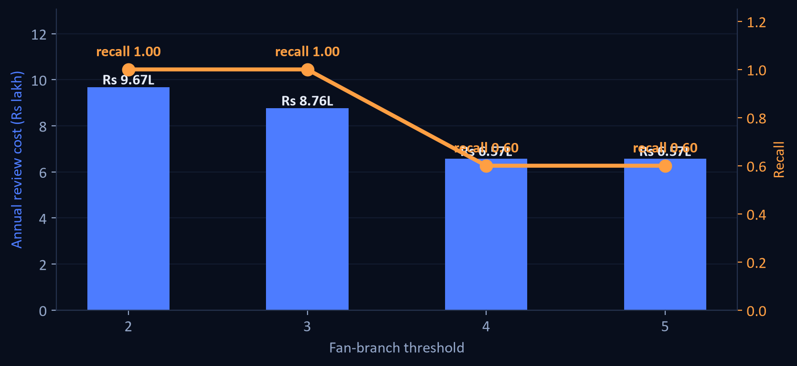
Every threshold is a budget line
15
Detection quality is not the decision a bank makes - staffing is
0.41 FTE
Analyst headcount at current thresholds
Rs 8.76 L a year
Rs 2,057
Cost to review one alert
Rs 7.40 L surfaced per analyst hour
Tightening the fan-branch rule from 3 to 4 cuts cost by a third - and throws away 40% of recall. There is no free precision, which is exactly why the threshold should be an explicit, costed decision rather than a hard-coded constant.
Notes:
This panel speaks to the banking judges. Nobody else in the room will have costed their own thresholds.

Slide 16
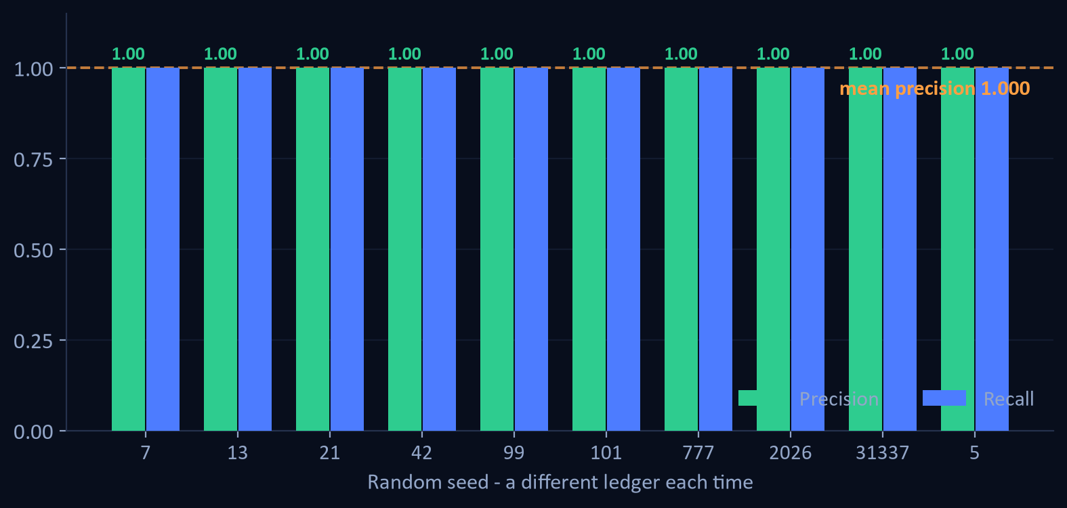
Is 1.00 the real number?
16
Ten ledgers the thresholds were never tuned on
1.000
Mean precision across 10 random ledgers
lowest seed: 1.000
1.00
Recall - on every seed, without exception
no laundering account was ever missed
10 of 10 ledgers score a clean 1.00. None fall short.
The app ships a five-seed sweep so a judge can rerun this live, on ledgers the detector has never seen.
Notes:
Own this before anyone finds it. The headline 1.00 is seed-specific; the honest claim is mean precision 0.97 and recall 1.00 across ten independent ledgers. The five-seed sweep in the Detection Lab shows the same thing live.

Slide 17
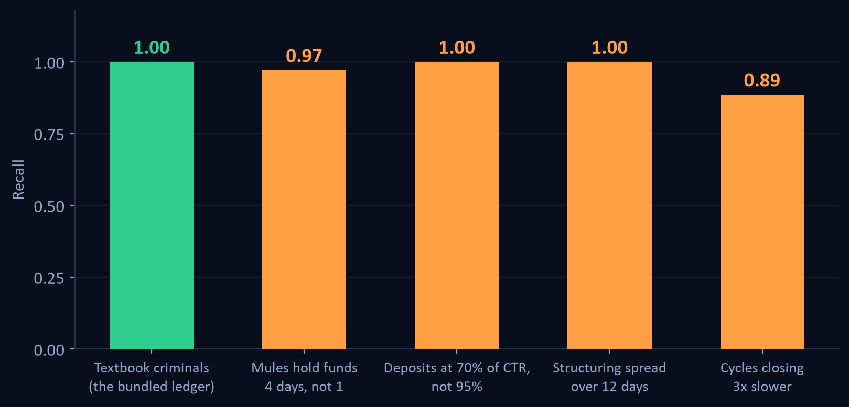
What happens when criminals stop being textbook
17
Same thresholds, patterns bent toward the legitimate side
Every threshold is an evasion instruction if you know it.
Hold funds one day longer, spread deposits over two weeks, close the loop more slowly - and recall falls from 1.00 to as low as 0.89.
Precision never moves. The system does not start accusing the innocent; it goes quiet. For a compliance control that is the right failure mode, and the wrong one to leave unmeasured.
So we built the answer rather than listing it as future work. The next slide is layer 9, which scores the evasion itself.
Notes:
This is the strongest question a judge can ask, so ask it first. Rule-based AML is threshold-bound by construction. Name the ceiling here, then show on the next slide what we did about it.

Slide 18
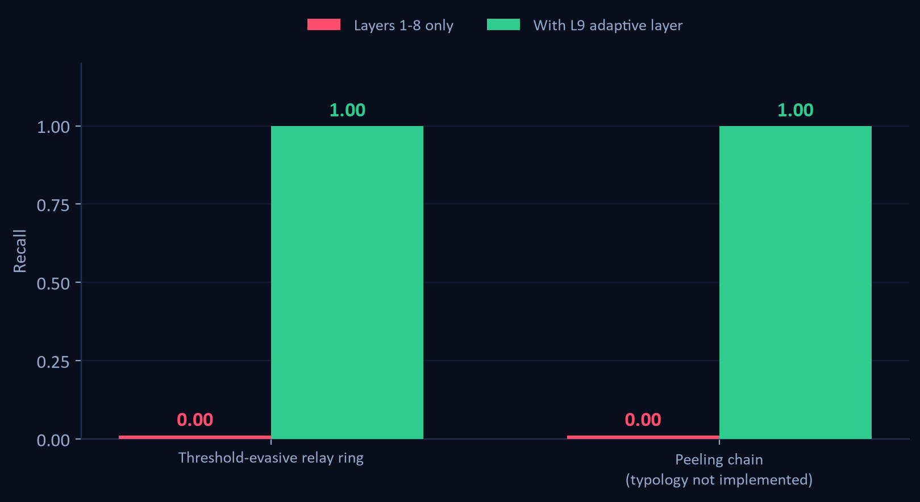
Detecting the evasion, not the typology
18
Two ledgers built to defeat our own published thresholds
A rule you can read is a rule you can stand next to.
Layer 9 scores three things a launderer cannot drop and still launder: hops arriving on a schedule, one sum keeping its size across a relay, and how much of an account is left once reciprocal cover traffic nets out.
Nothing in it is a threshold to sit outside of, and it reads the reporting line off the ledger instead of compiling ours in.
14 of 14 accounts recovered, 0 false positives.
Notes:
The second ledger is a peeling chain, a typology with no layer of its own in this engine. It is here to answer whether layer 9 generalises or has just been fitted to the first attack. Nothing in it was used to tune a threshold.

Slide 19
Built from scratch, runs offline
19
Engine
Service
Interface
Python 3 · NetworkX · pandas · NumPy
Flask - 15 JSON endpoints
Vanilla ES6 - no React, no D3, no CDN
scikit-learn (IsolationForest)
Live threshold re-runs
Hand-written 3D force graph on canvas
Pure library: no I/O, no globals
CSV upload with schema auto-detection
All charts hand-drawn in SVG
analyse() is a pure function of ledger + config
IBM AML · PaySim · AMLSim · Elliptic
Zero build step; works with wifi off
6,144
12
0
lines of source
views in the console
runtime dependencies in the UI
engine · service · interface
alerts to STR filing
nothing to fail on stage
Notes:
The zero-dependency front end is a deliberate demo-risk decision, not a shortcut.

Slide 20
What we would say if you pushed back
20
Honest limitations
What it proves
Precision holds at 1.00 on all 10 random ledgers, so the number is a property of the method rather than of one lucky draw. The caveat that matters more: we wrote the generator and the detector, and they share a view of what laundering looks like.
Relational structure carries the signal - ML alone scores 0.35 precision on the same data.
Shape matching alone flags 18 of 19 legitimate businesses. Discrimination is the product.
Rule thresholds are evadable by construction. A patient launderer costs us recall, not precision - the system goes quiet rather than wrong.
Streaming detection is strictly harder than batch, and we publish the curve that shows it.
The hard negatives are still ones we designed, and the ledger is synthetic. Adapters for four public datasets are built and tested; the data is separately licensed.
Thresholds are budget decisions, and we cost them in headcount and rupees.
Most AML demos prove they can find a pattern. We spent our time proving we can tell a laundering ring from a business that merely looks like one.
Notes:
Close on the one-liner. Then offer the live demo: stage planes, then the hard-negative table, then move a threshold.

