Slide 1
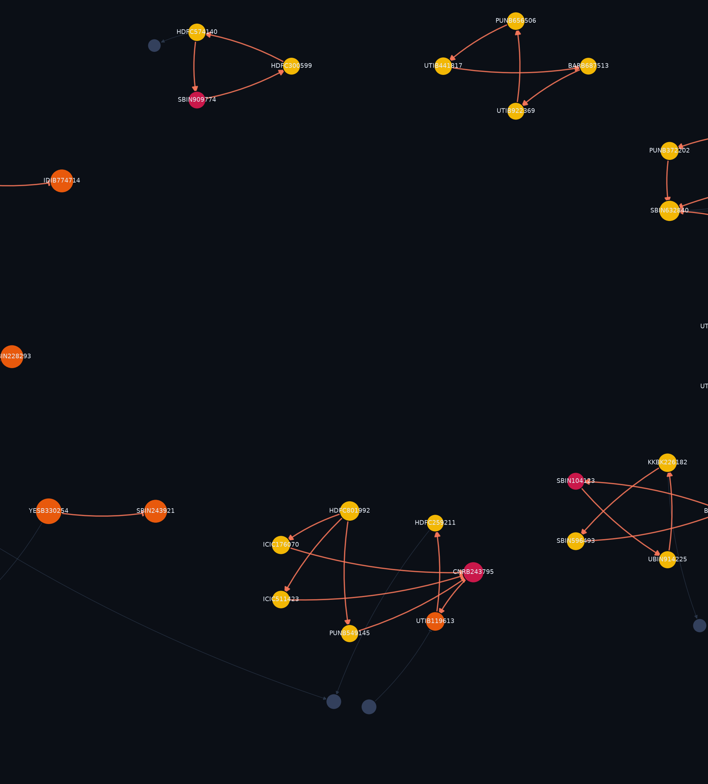
BUILTNBANK · IGTDW, IIT DELHI
AMLTrace
Tracing financial crime
across patterns
An anti-money-laundering investigation console. Eight detection layers over a directed money-flow graph - and four economic tests that decide whether a suspicious shape is actually a crime.
187 accounts · 301 transactions · 35 alerts · 9 rings
Notes:
AMLTrace. The one-line pitch: most AML demos prove they can find a pattern. We spent our time proving we can tell a laundering ring apart from a business that merely looks like one.

Slide 2
Why AML systems drown their own analysts
2
90-95%
~6%
Shape ≠ crime
of AML alerts at large banks are false positives
of alerts convert into a filed report
the failure nobody measures
industry-reported range
the rest is salaried review time
a legitimate business has the same topology
The structural problem
Rules alone are blind to structure. A single transfer is unremarkable; the crime lives in who pays whom, in what shape, in what order.
Machine learning alone is unexplainable. An anomaly score is not a ground of suspicion you can put in front of a regulator.
Everyone benchmarks on data where only criminals form triangles. So precision is measured against a problem nobody actually has.
Notes:
Set up the pain: banks are not short of alerts, they are short of correct ones. The third bullet is the one we attack - it is the reason published numbers look better than deployed systems.

Slide 3
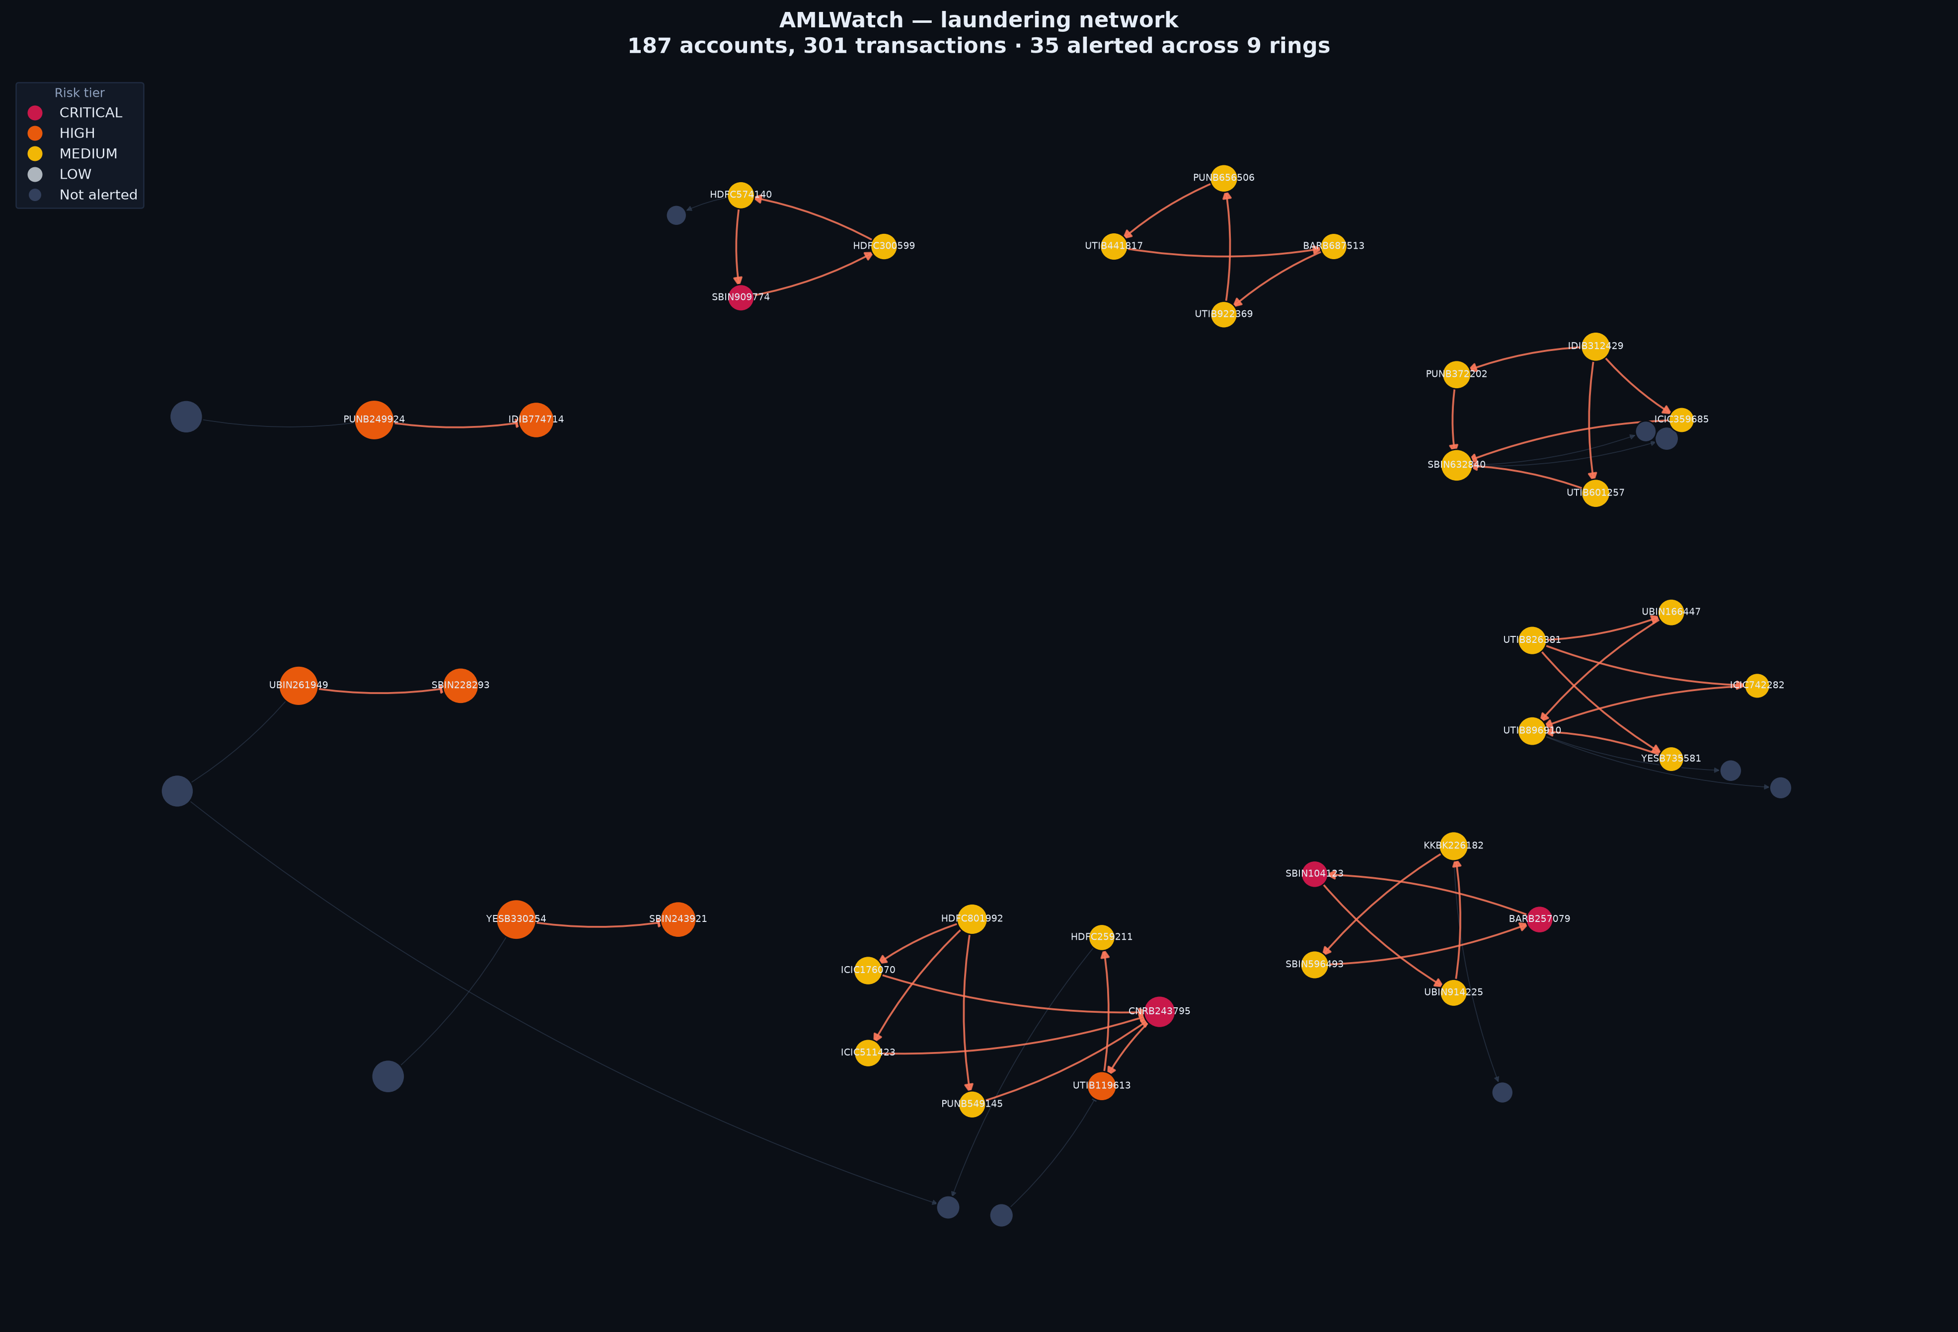
AMLTrace
3
A working investigation console, not a notebook of metrics
Alert queue Every account triaged by risk, each with grounds of suspicion in plain English.
Interactive network 3D money-flow graph; laundering stages as depth planes.
Laundering timeline Placement → layering → integration, reconstructed per ring.
Streaming replay Detection re-run day by day, as the money actually moves.
FIU-IND STR generator Filing-ready reports under PMLA 2002, Section 12.
Detection lab Every threshold live-tunable; the pipeline re-runs in seconds.
Notes:
Show, do not tell: this is a running Flask app with zero front-end dependencies - no CDN, no build step. It works with the venue wifi off.

Slide 4
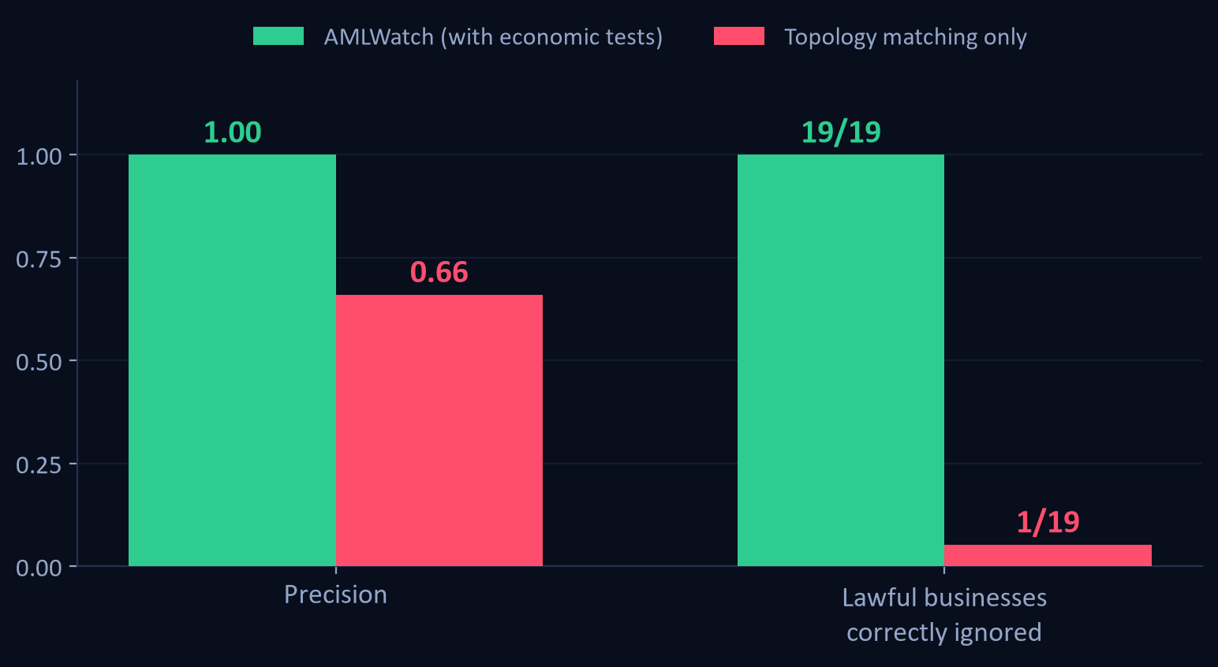
But every detector scores well here
4
So we built a ledger designed to break it
19 lawful businesses, engineered to have identical topology to each typology.
None of them is labelled fraud. Each family reproduces the shape of one crime.
A detector that matches shape alone flags 18 of the 19.
That is the number no AML demo shows - and it is the difference between a pattern matcher and a product.
Notes:
This is the slide to slow down on. We deliberately made our own numbers worse in order to measure the thing that actually matters.

Slide 5
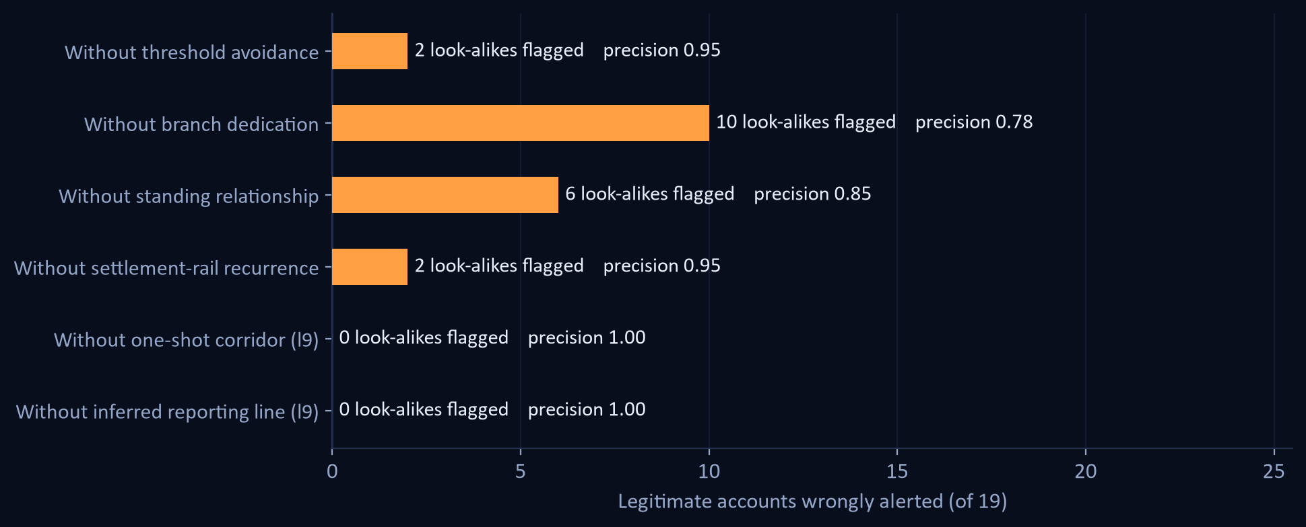
Four economic tests, not geometric ones
5
Turning each off, in isolation
WHAT SEPARATES THEM
Threshold avoidance
A structurer never crosses the CTR line. A big biller sometimes does.
Branch dedication
A mule has no other trade. A contractor has other customers.
Standing relationship
Round-tripping through a monthly counterparty is trade.
Settlement-rail recurrence
A rail repeats on a schedule. A mule is used once and burned.
All four on: 0/19 wrongly flagged.
Notes:
These encode economics, not geometry - which is why they generalise beyond the specific decoys we planted.

Slide 6
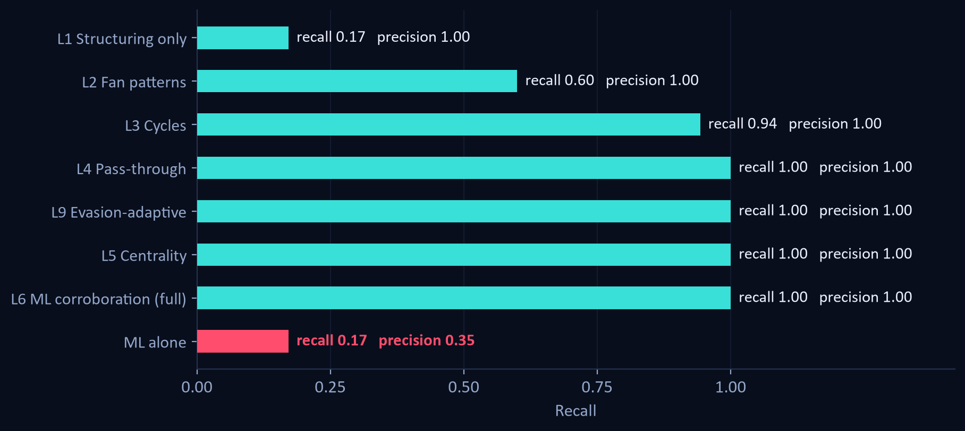
Each layer earns its place
6
Layers switched on cumulatively, against ground truth
1.00 / 1.00
Precision / recall, full pipeline
F1 1.00 · 0 false positives
0.35 / 0.17
ML alone, no graph context
the honest baseline for comparison
Point-wise anomaly detection recovers a fraction of the network at half the precision. The signal in laundering is relational, not behavioural.
Notes:
Read the last bar against the one above it. This is the case for graph structure.

Slide 7
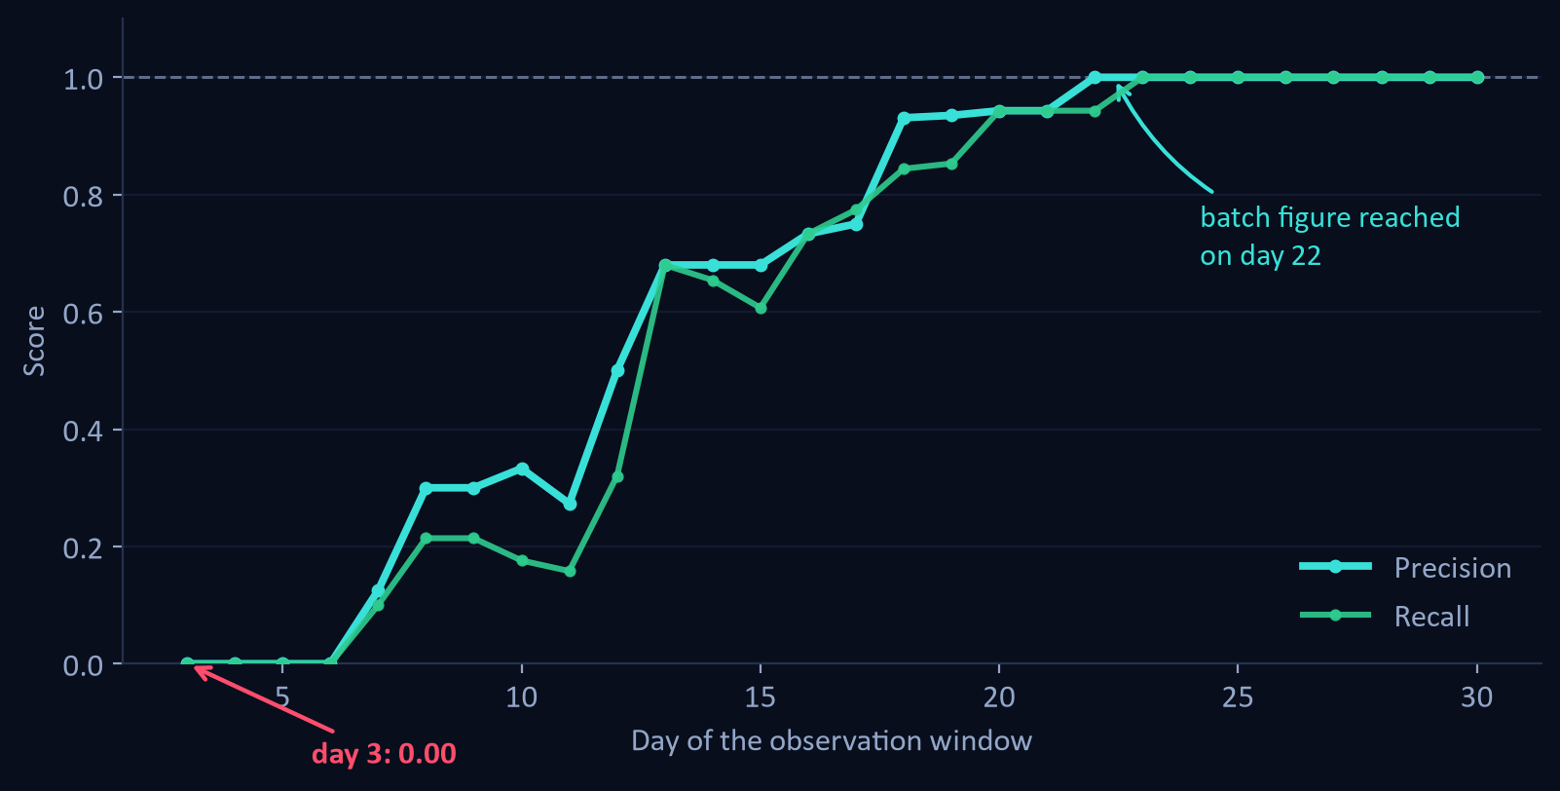
The number we could have hidden
7
Same detector, run as a stream instead of a batch
1.00
Batch precision, month end
0.00
Streaming precision on day 3
reaches the batch figure on day 22
The discriminators are evidence-hungry. A settlement rail is indistinguishable from a mule until you have watched it settle three times - so lawful accounts are provisionally flagged, then correctly released.
Notes:
Volunteering a worse number is the most credible thing in the deck. Any AML result quoted without this curve is quoting the easiest number available.

Slide 8
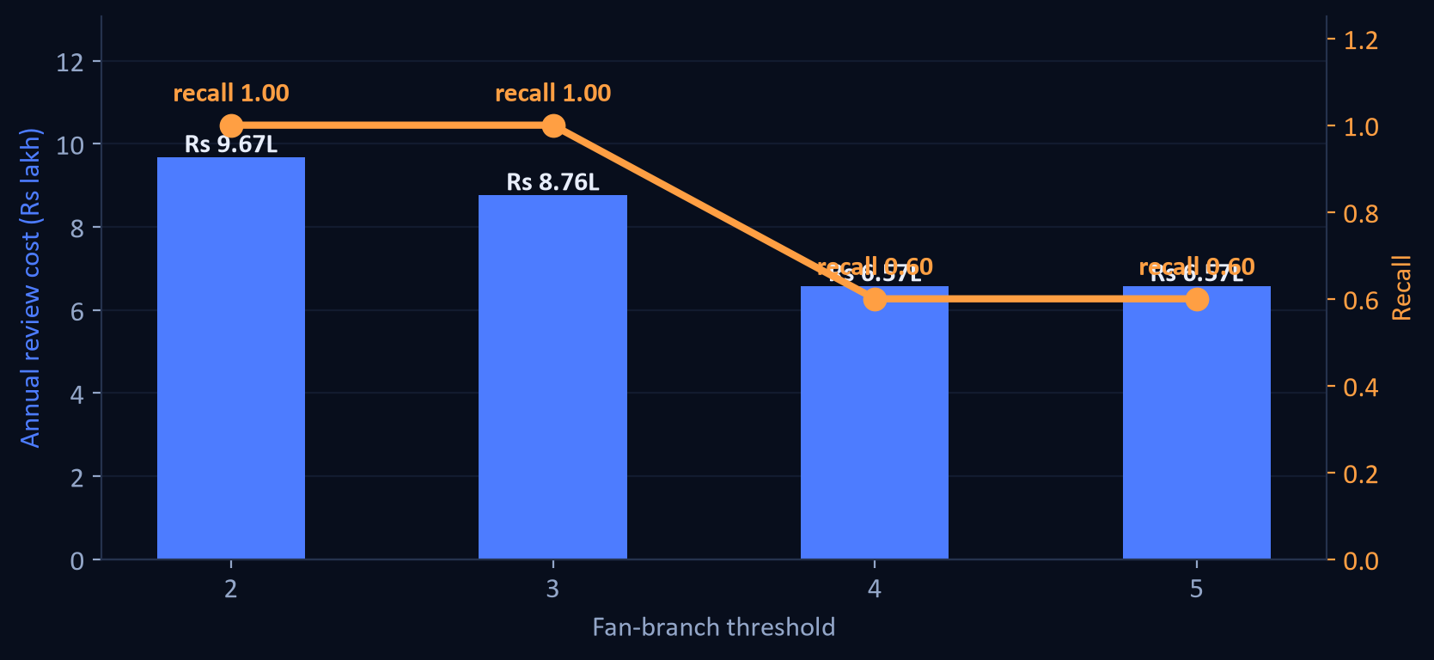
Every threshold is a budget line
8
Detection quality is not the decision a bank makes - staffing is
0.41 FTE
Analyst headcount at current thresholds
Rs 8.76 L a year
Rs 2,057
Cost to review one alert
Rs 7.40 L surfaced per analyst hour
Tightening the fan-branch rule from 3 to 4 cuts cost by a third - and throws away 40% of recall. There is no free precision, which is exactly why the threshold should be an explicit, costed decision rather than a hard-coded constant.
Notes:
This panel speaks to the banking judges. Nobody else in the room will have costed their own thresholds.

Slide 9
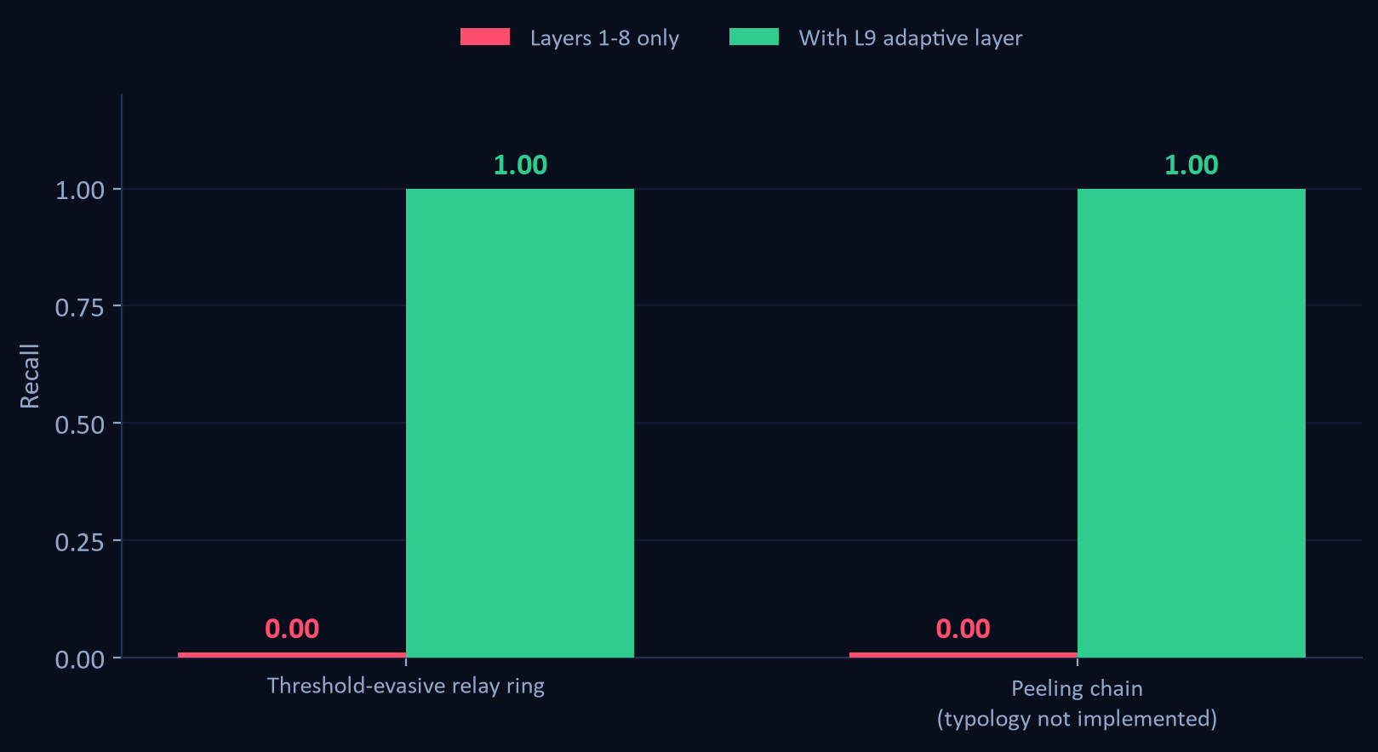
Detecting the evasion, not the typology
9
Two ledgers built to defeat our own published thresholds
A rule you can read is a rule you can stand next to.
Layer 9 scores three things a launderer cannot drop and still launder: hops arriving on a schedule, one sum keeping its size across a relay, and how much of an account is left once reciprocal cover traffic nets out.
Nothing in it is a threshold to sit outside of, and it reads the reporting line off the ledger instead of compiling ours in.
14 of 14 accounts recovered, 0 false positives.
Notes:
The second ledger is a peeling chain, a typology with no layer of its own in this engine. It is here to answer whether layer 9 generalises or has just been fitted to the first attack. Nothing in it was used to tune a threshold.

Slide 10
What we would say if you pushed back
10
Honest limitations
What it proves
Precision holds at 1.00 on all 10 random ledgers, so the number is a property of the method rather than of one lucky draw. The caveat that matters more: we wrote the generator and the detector, and they share a view of what laundering looks like.
Relational structure carries the signal - ML alone scores 0.35 precision on the same data.
Shape matching alone flags 18 of 19 legitimate businesses. Discrimination is the product.
Rule thresholds are evadable by construction. A patient launderer costs us recall, not precision - the system goes quiet rather than wrong.
Streaming detection is strictly harder than batch, and we publish the curve that shows it.
The hard negatives are still ones we designed, and the ledger is synthetic. Adapters for four public datasets are built and tested; the data is separately licensed.
Thresholds are budget decisions, and we cost them in headcount and rupees.
Most AML demos prove they can find a pattern. We spent our time proving we can tell a laundering ring from a business that merely looks like one.
Notes:
Close on the one-liner. Then offer the live demo: stage planes, then the hard-negative table, then move a threshold.

