Slide 1
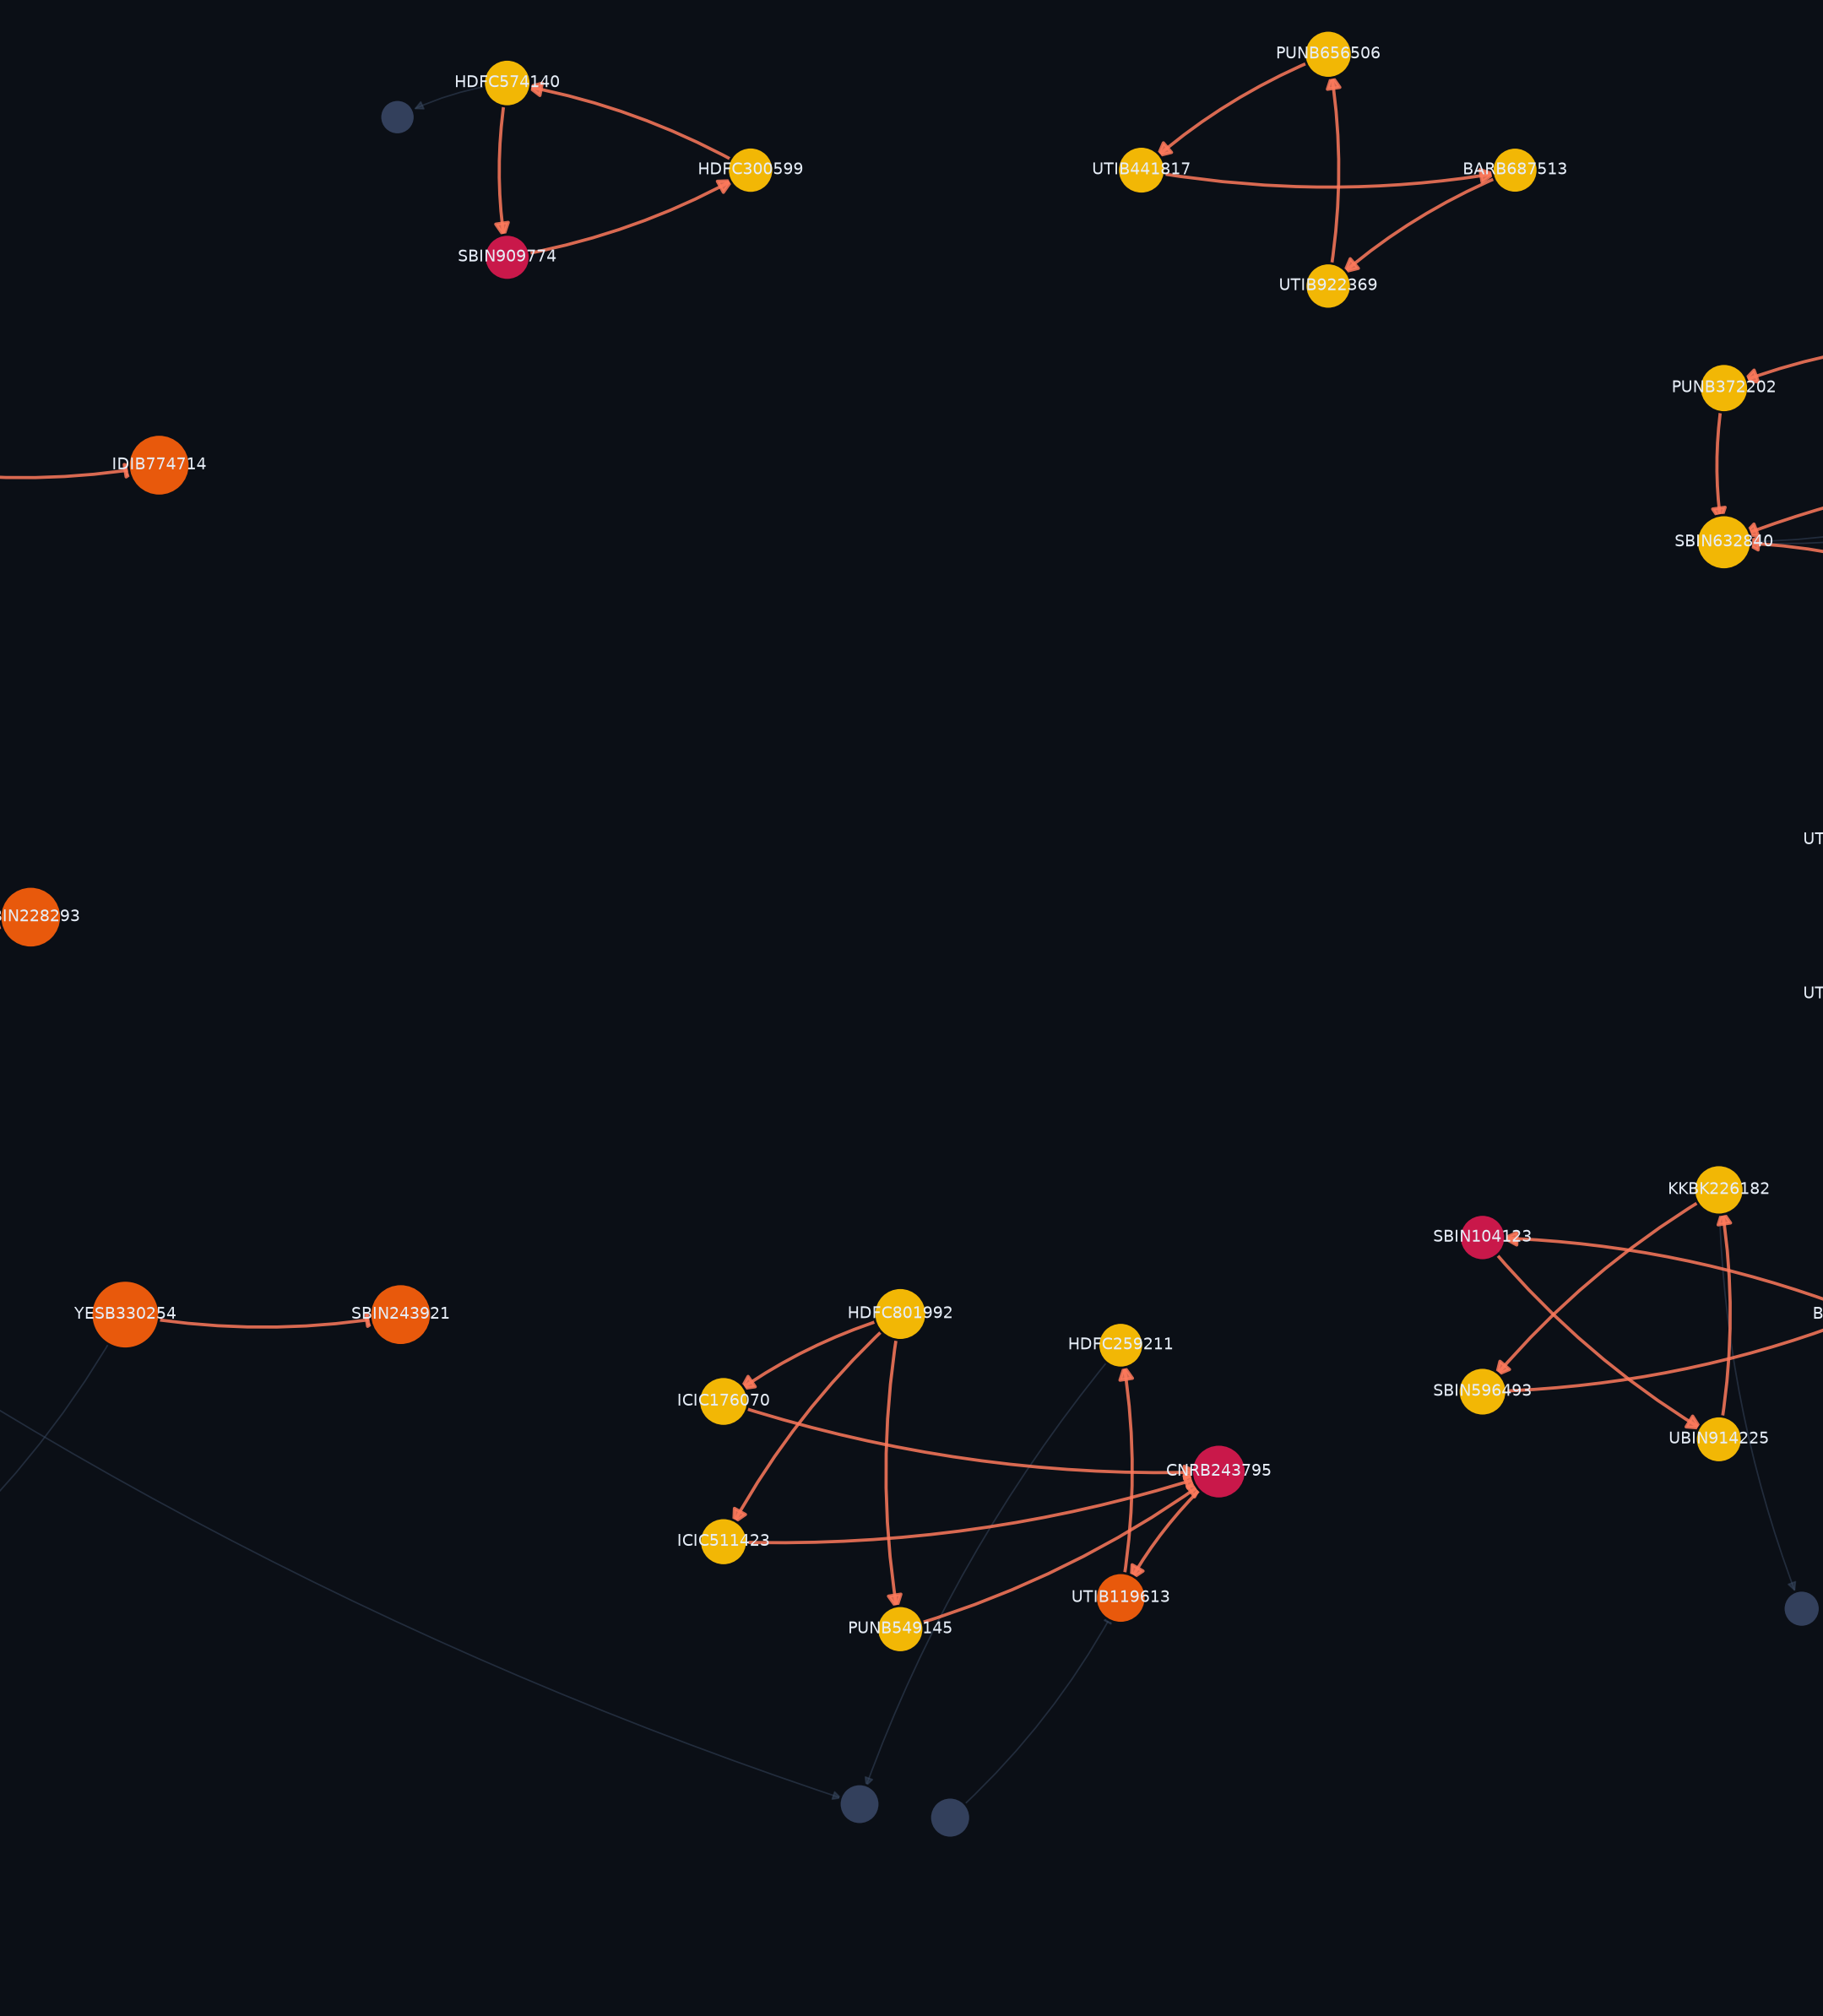
BUILTNBANK · IGTDW, IIT DELHI
AMLTrace
Tracing financial crime
across patterns
An anti-money-laundering investigation console. Eight detection layers over a directed money-flow graph - and four economic tests that decide whether a suspicious shape is actually a crime.
187 accounts · 301 transactions · 35 alerts · 9 rings
Notes:
AMLTrace. The one-line pitch: most AML demos prove they can find a pattern. We spent our time proving we can tell a laundering ring apart from a business that merely looks like one.

Slide 2
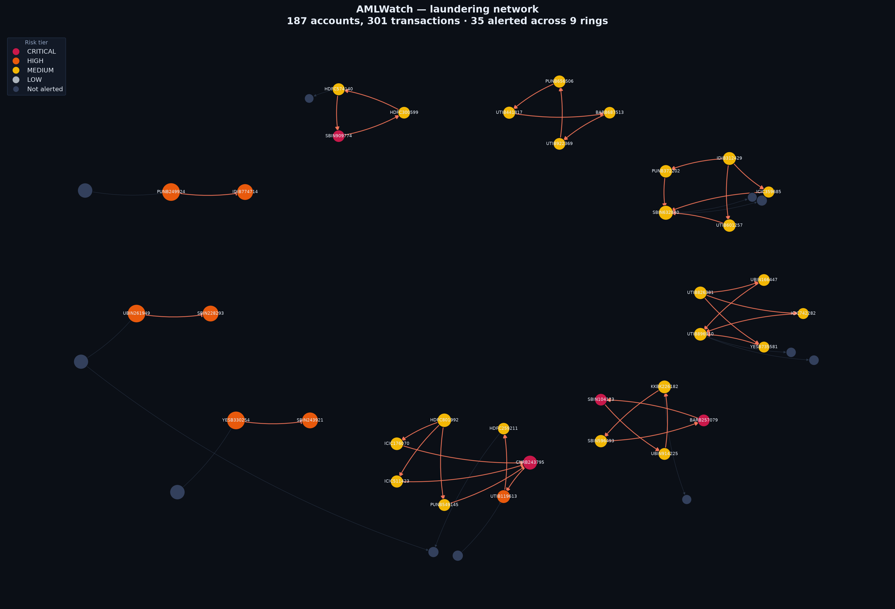
AMLTrace
2
A working investigation console, not a notebook of metrics
Alert queue Every account triaged by risk, each with grounds of suspicion in plain English.
Interactive network 3D money-flow graph; laundering stages as depth planes.
Laundering timeline Placement → layering → integration, reconstructed per ring.
Streaming replay Detection re-run day by day, as the money actually moves.
FIU-IND STR generator Filing-ready reports under PMLA 2002, Section 12.
Detection lab Every threshold live-tunable; the pipeline re-runs in seconds.
Notes:
Show, do not tell: this is a running Flask app with zero front-end dependencies - no CDN, no build step. It works with the venue wifi off.

Slide 3
Where this data comes from
3
The first question anyone should ask an AML system, answered in full
WHY IT IS SYNTHETIC
WHAT IN IT IS REAL
WHAT IS INVENTED
Account-level Indian transaction data is not publicly available and cannot be. Customer records are protected by RBI regulation, by PMLA confidentiality and by the DPDP Act 2023 - no bank or regulator publishes a customer ledger. Every public AML dataset, including IBM's and PaySim, is synthetic for the same reason.
The rails, the thresholds and the money. Channel mix, average ticket size per rail, the CTR reporting threshold, the RTGS floor, per-transaction caps and the institution codes are all taken from RBI, NPCI and FIU-IND publications and are cited line by line below.
The accounts, the counterparties and the laundering rings are invented. No real person, account or institution's activity appears anywhere in this system.
Calibrated to published RBI, NPCI and FIU-IND figures - cited line by line in the app
Channel mix UPI 85% of volume, 9% of value
Average ticket UPI Rs 1,347 · NEFT Rs 48,200
CTR threshold Rs 10,00,000 (PMLR 2005)
RTGS floor Rs 2,00,000 per transfer
Caps honoured UPI Rs 1L · IMPS Rs 5L
Institutions 12 real IFSC prefixes
Account-level Indian transaction data is not public and cannot be - it is protected by RBI regulation, PMLA confidentiality and the DPDP Act 2023.
Notes:
Lead with this if anyone challenges the data. No public AML dataset is real, for the same legal reason. What we can do - and did - is pin every parameter to a published RBI, NPCI or FIU-IND figure, and show the citation in the app.

Slide 4
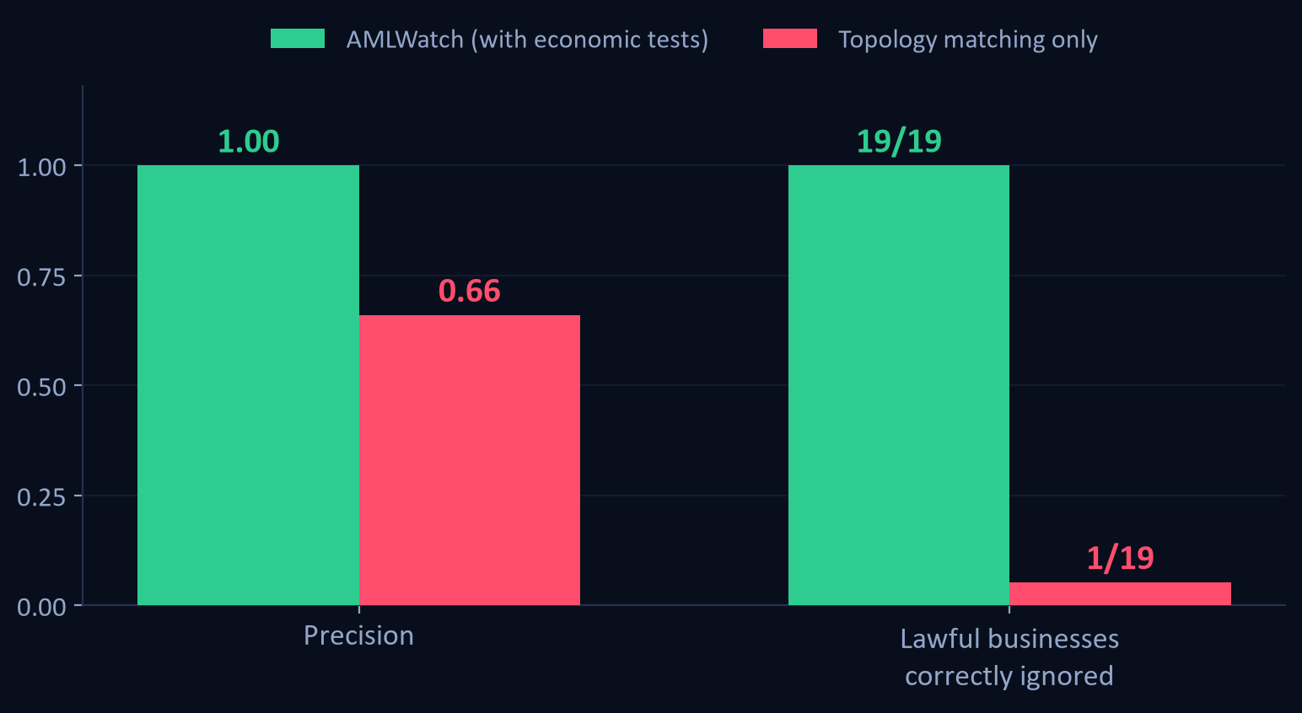
But every detector scores well here
4
So we built a ledger designed to break it
19 lawful businesses, engineered to have identical topology to each typology.
None of them is labelled fraud. Each family reproduces the shape of one crime.
A detector that matches shape alone flags 18 of the 19.
That is the number no AML demo shows - and it is the difference between a pattern matcher and a product.
Notes:
This is the slide to slow down on. We deliberately made our own numbers worse in order to measure the thing that actually matters.

Slide 5
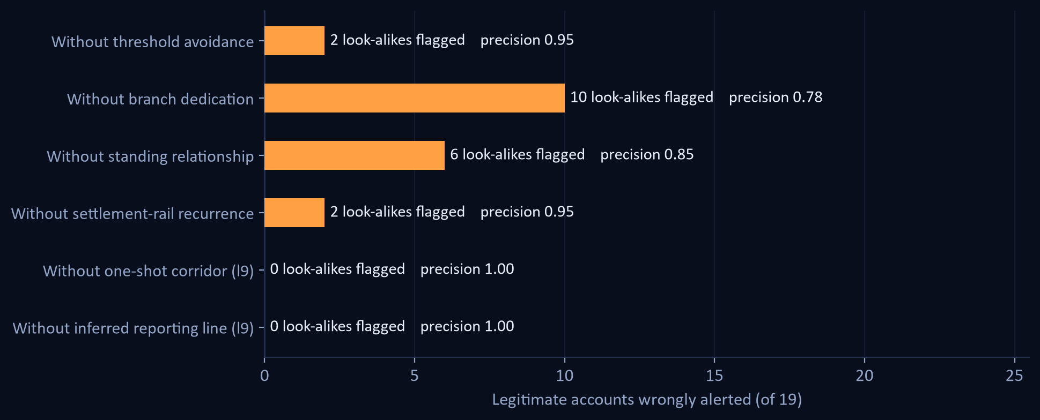
Four economic tests, not geometric ones
5
Turning each off, in isolation
WHAT SEPARATES THEM
Threshold avoidance
A structurer never crosses the CTR line. A big biller sometimes does.
Branch dedication
A mule has no other trade. A contractor has other customers.
Standing relationship
Round-tripping through a monthly counterparty is trade.
Settlement-rail recurrence
A rail repeats on a schedule. A mule is used once and burned.
All four on: 0/19 wrongly flagged.
Notes:
These encode economics, not geometry - which is why they generalise beyond the specific decoys we planted.

Slide 6
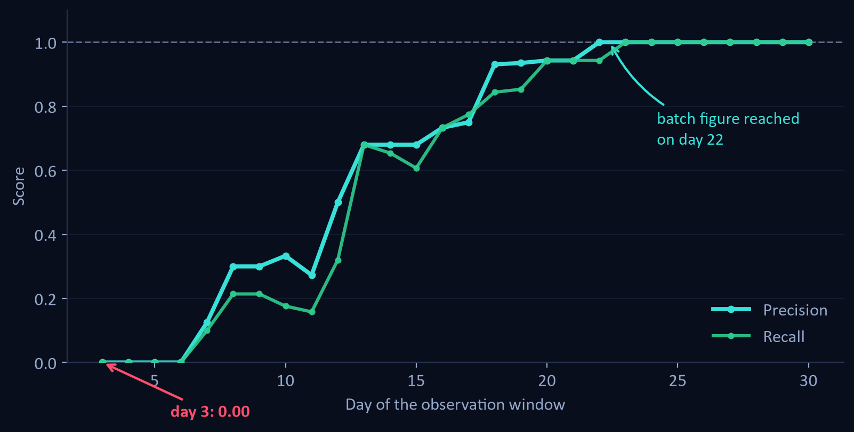
The number we could have hidden
6
Same detector, run as a stream instead of a batch
1.00
Batch precision, month end
0.00
Streaming precision on day 3
reaches the batch figure on day 22
The discriminators are evidence-hungry. A settlement rail is indistinguishable from a mule until you have watched it settle three times - so lawful accounts are provisionally flagged, then correctly released.
Notes:
Volunteering a worse number is the most credible thing in the deck. Any AML result quoted without this curve is quoting the easiest number available.

Slide 7
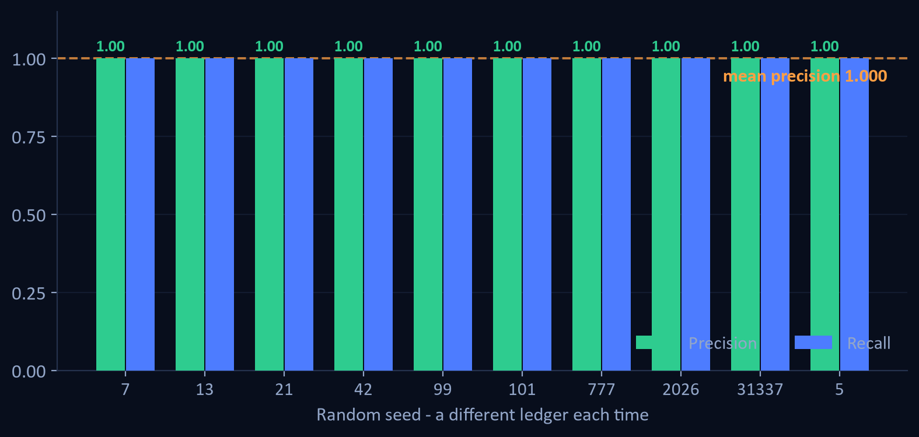
Is 1.00 the real number?
7
Ten ledgers the thresholds were never tuned on
1.000
Mean precision across 10 random ledgers
lowest seed: 1.000
1.00
Recall - on every seed, without exception
no laundering account was ever missed
10 of 10 ledgers score a clean 1.00. None fall short.
The app ships a five-seed sweep so a judge can rerun this live, on ledgers the detector has never seen.
Notes:
Own this before anyone finds it. The headline 1.00 is seed-specific; the honest claim is mean precision 0.97 and recall 1.00 across ten independent ledgers. The five-seed sweep in the Detection Lab shows the same thing live.

Slide 8
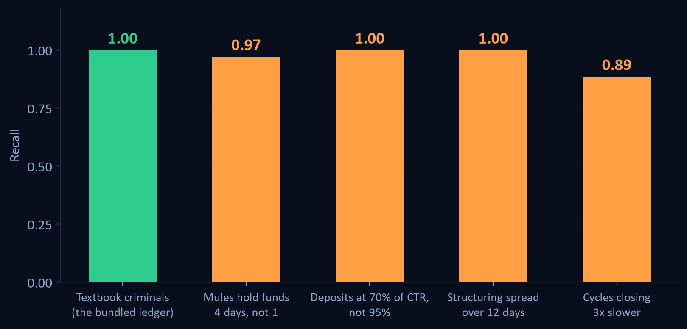
What happens when criminals stop being textbook
8
Same thresholds, patterns bent toward the legitimate side
Every threshold is an evasion instruction if you know it.
Hold funds one day longer, spread deposits over two weeks, close the loop more slowly - and recall falls from 1.00 to as low as 0.89.
Precision never moves. The system does not start accusing the innocent; it goes quiet. For a compliance control that is the right failure mode, and the wrong one to leave unmeasured.
So we built the answer rather than listing it as future work. The next slide is layer 9, which scores the evasion itself.
Notes:
This is the strongest question a judge can ask, so ask it first. Rule-based AML is threshold-bound by construction. Name the ceiling here, then show on the next slide what we did about it.

Slide 9
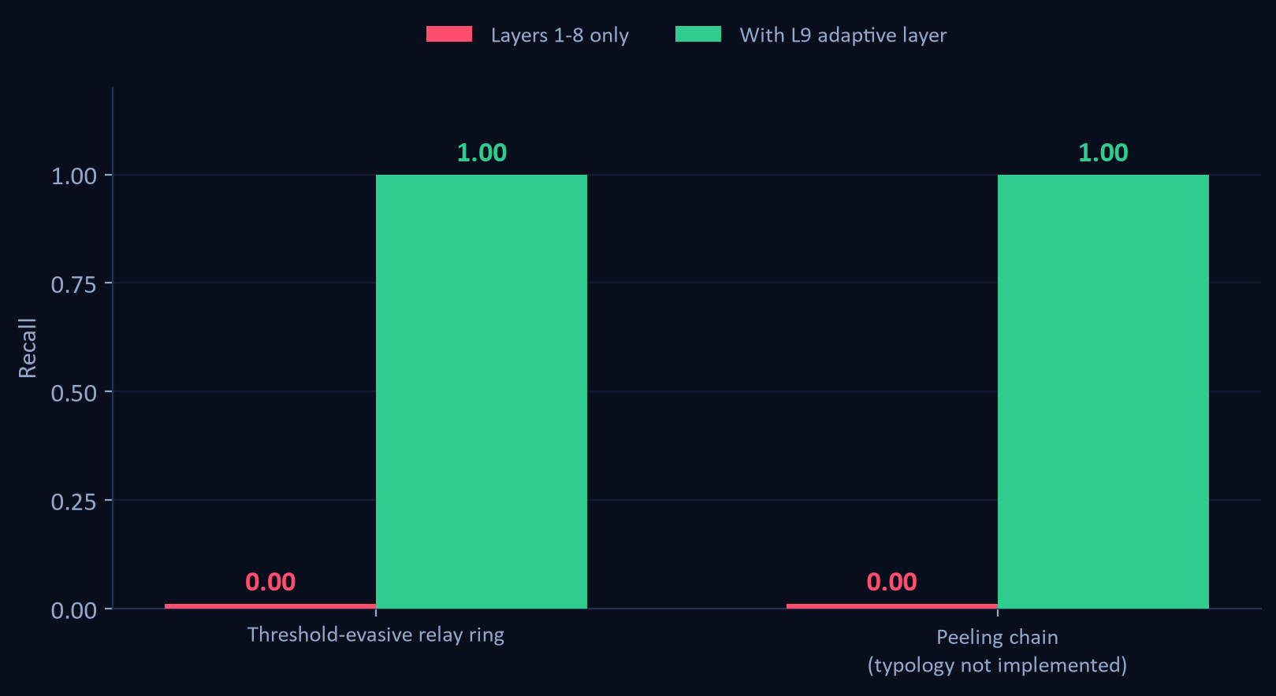
Detecting the evasion, not the typology
9
Two ledgers built to defeat our own published thresholds
A rule you can read is a rule you can stand next to.
Layer 9 scores three things a launderer cannot drop and still launder: hops arriving on a schedule, one sum keeping its size across a relay, and how much of an account is left once reciprocal cover traffic nets out.
Nothing in it is a threshold to sit outside of, and it reads the reporting line off the ledger instead of compiling ours in.
14 of 14 accounts recovered, 0 false positives.
Notes:
The second ledger is a peeling chain, a typology with no layer of its own in this engine. It is here to answer whether layer 9 generalises or has just been fitted to the first attack. Nothing in it was used to tune a threshold.

Slide 10
What we would say if you pushed back
10
Honest limitations
What it proves
Precision holds at 1.00 on all 10 random ledgers, so the number is a property of the method rather than of one lucky draw. The caveat that matters more: we wrote the generator and the detector, and they share a view of what laundering looks like.
Relational structure carries the signal - ML alone scores 0.35 precision on the same data.
Shape matching alone flags 18 of 19 legitimate businesses. Discrimination is the product.
Rule thresholds are evadable by construction. A patient launderer costs us recall, not precision - the system goes quiet rather than wrong.
Streaming detection is strictly harder than batch, and we publish the curve that shows it.
The hard negatives are still ones we designed, and the ledger is synthetic. Adapters for four public datasets are built and tested; the data is separately licensed.
Thresholds are budget decisions, and we cost them in headcount and rupees.
Most AML demos prove they can find a pattern. We spent our time proving we can tell a laundering ring from a business that merely looks like one.
Notes:
Close on the one-liner. Then offer the live demo: stage planes, then the hard-negative table, then move a threshold.

