Slide 1
C++

Slide 2
Outline
Fundamentals of C++
Class & inheritance
Overloading & overriding
Templates, Error handling,…

Slide 3
Reference C/C++
The C Programming Language
Brian Kernighan & Denis Ritchie
The C++ Programming Language
Bjarne Stroustrup

Slide 4
An example
#include<iostream.h>
int main()
{
int i=0;
double x=2.3;
char s[]="Hello";
cout<<i<<endl;
cout<<x<<endl;
cout<<s<<endl;
return 0;
}
1.cpp

Slide 5
Lexical elements
Identifiers: case sensitive
nCount, strName, Strname
Reservered words
if, else, while
Operators
+, ==, &, &&, ‘? :’
Preprocessor Directives
#include, #if,

Slide 6
Primitive Data Types
Name | Size (bytes) | Description | Range
char | 1 | character or eight bit integer | signed: -128..127 unsigned: 0..255
short | 2 | sixteen bit integer | signed: -32768..32767 unsigned: 0..65535
long | 4 | thirty-two bit integer | signed: -2³¹ .. 2³¹-1 unsigned: 0 .. 2³²
int | * (4) | system dependent, likely four bytes or thirty-two bits | signed: -32768..32767 unsigned: 0..65535
float | 4 | floating point number | 3.4e +/- 38 (7 digits)
double | 8 | double precision floating point | 1.7e +/- 308 (15 digits)
long double | 10 | long double precision floating point | 1.2e +/- 4932 (19 digits)
bool | 1 | boolean value false → 0, true → 1 | {0,1}

Slide 7
Variables declaration & assignments
#include<iostream>
using namespace std;
int main()
{
int i,j,k;
int l;
i=10;
j=k=l=20; //j=(k=(i=20))
cout<<"i="<<i<<endl;
cout<<"k="<<k<<endl;
cout<<"l="<<l<<endl;
i+=10; //i = i + 10;
i++; //i = i + 1;
cout << "i="<<i<<endl;
} 2.cpp

Slide 8
Expressions
Boolean expressions
== , != , >, >=, < , <=, …
&& , || …
Arithmetic expression
+ , - , *, / ,% …
&, | …
Assignment
=
? :
Expressions have values

Slide 9
Example of expressions
7 && 8
7 & 8
7 / 8
7 % 8
7 >> 1
(i > 127 ? true : false)
(i > 127 ? i-127 : i)
3.cpp 4.cpp

Slide 10
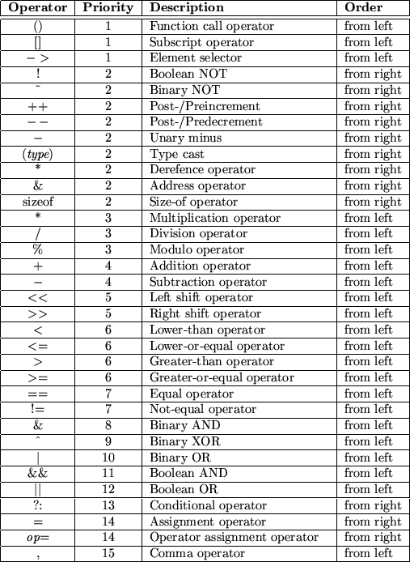

Slide 11
Statements
Assignments
Conditional
Loop
Goto,break,continue
Compound statement

Slide 12
Conditional
if A B ;
if A B else C
If ( I > 10) {cout<<“ > 10”;} else {cout<<“ < 10”;}
5.cpp

Slide 13
Trick
What is the difference?
If (i==1) ……
If (i=1)……
A better way to compare a variable with a constant
if (constant==variable)..
if (10 == i)…..

Slide 14
Trick
If (i) ……
If (1) …….

Slide 15
Loop, for
for (A;B;C) D
1 execute A
2 execute B
3 if the value of B is false(==0), exit to D
4 execute C, goto 2
for(i=0; i<n; i++){cout << A[i]<<endl;}
for(;;) {…}

Slide 16
Loop, while & do while
while A B
While (i>10) { x-=4;i--;}
do A while B
do {x -=4;i--} while (i>10);

Slide 17
Goto,break,continue
For (; ;){
…
If (a==b) break;
…
}
C
-----------------------------------------
-----------------------------------------
For (;;){
{B}
If (a==b) continue;
{A}
}

Slide 18
switch
switch (grade){
case ‘A’:++nACount;break;
case ‘B’:++nBCount;break;
case ‘C’:++nCCount;break;
case ‘D’:++nDCount;break;
default: cout<<“Something wrong\n”;break;
}
Try: write a program using the code segment. Then remove several of the ‘break’s and see the difference

Slide 19
functions
Can not define a function within another function*
Parameters passed by value or reference

Slide 20
Example
#include<iostream>
using namespace std;
int square (int);
int main ()
{
int z = 4;
cout << square(z);
}
int square (int x)
{ x = (x*x); return x; } 6.cpp

Slide 21
Pass by value
void swap1(int x,int y)
{
int temp=x;
x = y;
y=temp;
}

Slide 22
Pass by reference
void swap2(int& x,int& y)
{
int temp=x;
x = y;
y=temp;
} 7.cpp

Slide 23
Array in C/C++
Definition
Int a[10]; //int[10] a;
Char b[12];
No bounds checking
The cause of many problems in C/C++

Slide 24
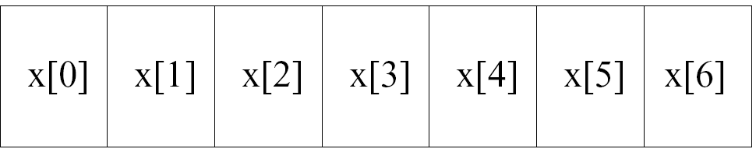
Array
Int x[7];
Int score[3][3]={{1,2,3},{2,3,4}{3,5,6}};

Slide 25
Array: confusing
What is the result of the program.
So, array is passed by reference?
8.cpp

Slide 26
Pointer
Example
int *p, char * s;
The value of a pointer is just an address.
Why pointers?
Dereferencing (*)
Get the content
Referencing (&)
Get the address of

Slide 27
Examples of pointer
int *p;
Int a;
a=10;
p=&a;
*p=7;
Int b=*p;
You must initialize a pointer before you use it
81.cpp 82.cpp

Slide 28
Array and pointer
9.cpp

Slide 29
arithmetic of pointer
Suppose n is an integer and p1 and p2 are pointers
p1+n
p1-n
p1-p2
91.cpp

Slide 30
Strings
C
A string is an array of chars end with ‘\0’
char name[]=“ABC”;
char school_name[]={‘N’,’Y’,’U};
C++ library: string class
10.cpp 101.cpp

Slide 31
Dynamic allocating memory
new , delete
int *p=new int;
int *p=new int [12];
delete p;
delete []p;
malloc,…
11.cpp (difference between different implementations)

Slide 32
Outline
Fundamentals of C++
Class & inheritance
Overloading & overriding
Templates, Error handling,…

Slide 33
Struct:
struct person
{ long nId;
char strName[30];
int nAge;
float fSalary;
char strAddress[100];
char strPhone[20]; };
struct person a , b, c;
struct person *p; 12.cpp

Slide 34
union
union num
{
int x;
float y;
} 13.cpp

Slide 35
More in a stucture: operations
struct box
{
double dLength,dWidth,dHeight;
double dVolume;
double get_vol()
{
return dLength * dWidth * dHeight;
}
} 14.cpp 141.cpp

Slide 36
Class
class box
{
double dLength,dWidth,dHeight;
double dVolume;
public:
double vol(){return dLength * dWidth * dHeight;}
} 15.cpp

Slide 37
Public vs. private
Public functions and variables are accessible from anywhere the object is visible
Private functions and variable are only accessible from the members of the same class and “friend”
Protected

Slide 38
class
class box
{
double dLength,dWidth,dHeight;
double dVolume;
public:
double vol() ;
}
dbouble box::vol()
{
return dLength * dWidth * dHeight;}
} 16.cpp

Slide 39
Constructors
A special member function with the same name of the class
No return type (not void)
Executed when an instance of the class is the created
17.cpp

Slide 40
Deconstructors
A special member function with no parameters
Executed when the class is destroyed
18.cpp

Slide 41
Tricky
What is the result of the program
19.cpp
How many times the constructor executed?
How many times the deconstructor executed
Examples 20.cpp 21.cpp

Slide 42
Empty constructor & Copy constructor
Empty constructor
The default constuctor with no parameters when an object is created
Do nothing: e.g. Examp::Examp(){}
Copy constructor
Copy an object (shallow copy)
The default consturctor when an object is copied (call by value, return an object, initialized to be the copy of another object)
22.cpp {try not to pass an object by value)

Slide 43
Inheritance
Base class
Derived class
23.cpp
Protected members
24.cpp

Slide 44
Having same name?
Use the function/variable in the current class
27.cpp

Slide 45
Constructors
28.cpp

Slide 46
Inheritance
base
derived
Public inheritance
public
public
protected
protected
private
N/A
Private inheritance
public
private
protected
private
private
N/A
Protected
inheritance
public
protected
protected
protected
private
N/A

Slide 47
Static members in class
Static variables
Shared by all objects
Static functions
Have access to static members only
Static members can be accessed by the class name
29.cpp 21.cpp

Slide 48
Friend functions
Have access to the private members of a class.
Must be declared as friend in that class.
Why friend functions?
efficiency
30.cpp 31.cpp 32.cpp

Slide 49
Friend class
A class can be declared as the friend of another class.

Slide 50
Outline
Fundamentals of C++
Class & inheritance
Overloading & overriding
Templates, Error handling,…

Slide 51
Function overloading
Define several functions of the same name, differ by parameters.
void Show()
void Show(char *str)
Void show(int x)
33.cpp

Slide 52
Function overloading
Must have different parameters
int func1(int a, int b);
double func1(int a, int b);
void func(int value);
void func(int &value);
Static binding
The compilers determine which function is called.
(Often used for the multiple constructors)

Slide 53
Operator overloading
Define new operations for operators (enable them to work with class objects).
+ - * / = < > += -= *= /= << >> <<= >>= == != <= >= ++ -- % & ^ ! | ~ &= ^= |= && || %= [] () new delete
Class date x ,y
X+y x-y x>y, x&y

Slide 54
Special member functions
Ret_type class_name::operator<>(arg_list)
34.cpp

Slide 55
Overloading =
this pointer
35.cpp
= & copy constructor

Slide 56
Operator overloading by friend functions
Sometimes it is more convenient to use friend functions to overload a binary operator
36.cpp
37.cpp

Slide 57
Overloading examples
()
++
37-1.cpp 37-2.cpp 37-3.cpp 37-4.cpp

Slide 58
Overloading summary
Same name
Different parameters
Static binding (compile time)
Anywhere

Slide 59
Type conversion between classes
An object of derived class is an object of the base class.
A pointer of the base class can be assigned to an address of the derived class.
38.cpp

Slide 60
Redefine
It is possible to redefine a member of the base class in the derived class
Rule of scoping
40.cpp

Slide 61
What is the result?
41.cpp
The way out
43.cpp

Slide 62
Virtual function & overriding
Define a member function to be virtual
Use pointer/reference/member functions to call virtual functions
Dynamic binding
Time consuming
The constructor cannot be virtual
Must be a member function

Slide 63
Virtual functions examples
By pointers 42.cpp
By reference 43.cpp
By member function of the base class
44.cpp

Slide 64
Overloading & overriding
Polymorphism
Static and dynamic
Compile time and running time
Parameters
Anywhere / between the base and derived class

Slide 65
Pure virtual functions & abstract class
Pure virtual functions
A function declared without definition
virtual ret_type func_name(arg_list)= 0;
Abstract class
A class contains one or more pure functions
Can not be instantiated
Can be used to define pointers

Slide 66
Outline
Fundamentals of C++
Class & inheritance
Overloading & overriding
Templates, Error handling,…

Slide 67
Function Templates
Generic function for different types.
E.g. get the min value of three variables (int, float, char…)
Define function templates 46.cpp
Template<class S, class T…>
func_name(…)
Func_name<type name>(…)
something like macro
More powerful than macro

Slide 68
Using template functions
Func_name<type_name list>(…)
47.cpp
Generic quick sort 47-1.cpp

Slide 69
Class templates
Generic classes
Define class templates
Template<class T>
Class {…}
Template<class T>
ret_type class_name<type_name> :: func_name ( … ){
}
48.cpp

Slide 70
Class template examples
Class_name<type_name..> obj…
Array class 49.cpp
Linked list 50.cpp

Slide 71
overload template functions
It is possible to overload a template function.
51.cpp

Slide 72
Template specialization
An example from www.cplusplus.com
52.cpp
template <> class class_name <type>

Slide 73
Template value parameters
Template can have parameters other than type names
53.cpp

Slide 74
Default value for templates paramters
template <class T = char> // With a default value.
template <int Tfunc (int)> // A function as parameter.
the implementation (definition) of a template class or function must be in the same file as the declaration.

Slide 75
Execptions
try
{ // code to be tried
throw exception; }
catch (type exception)
{ // code to be executed in case of exception }

Slide 76
Examples of exception
54.cpp
throw out an object.
55.cpp

Slide 77
Uncaught exception
Uncaught exceptions will be thrown into outer scope.
If no catch, usually program will terminate.
Void terminate();

Slide 78
I/O system
iostream.h
cin,cout,cerr,clog
iostream,fstream,strstream
Flags 57.cpp 58.cpp
Overload “<<“ 59.cpp
60.cpp 61.cpp 62.cpp 63.cpp 64.cpp

