Slide 1
Programming
Introduction to C++

Slide 2
Introduction to C++
C is a programming language developed in the 1970's alongside the UNIX operating system.
C provides a comprehensive set of features for handling a wide variety of applications, such as systems development and scientific computation.
C++ is an “extension” of the C language, in that most C programs are also C++ programs.
C++, as opposed to C, supports “object-oriented programming.”

Slide 3
C++ was developed by Bjarne Stroustrup at Bell Laboratories
Originally called “C with classes”
The name C++ is based on C’s increment operator (++)
Indicating that C++ is an enhanced version of C
Widely used in many applications and fields
Well-suited to “Programming in the Large”
<iostream>
Must be included for any program that outputs data to the screen or inputs data from the keyboard using C++ style stream input/output.
Replaces <stdio.h> of C
C++ requires you to specify the return type, possibly void, for all functions.
Specifying a parameter list with empty parentheses is equivalent to specifying a void parameter list in C.

Slide 4
what follows after // on the same line is considered comment
indentation is for the convenience of the reader; compiler ignores all spaces and new line ; the delimiter for the compiler is the semicolon
all statements ended by semicolon
Lower vs. upper case matters!!
Void is different than void
Main is different that main

Slide 5
Variable declaration
type variable-name;
Meaning: variable <variable-name> will be a variable of type <type>
Where type can be:
int //integer
double //real number
char //character
Example:
int a, b, c;
double x;
int sum;
char my-character;

Slide 6
C++ Single-Line Comments
In C,
/* This is a single-line comment. */
In C++,
// This is a single-line comment.

Slide 7
C++ Stream Input/Output
In C,
printf(“Enter new tag: “); scanf(“%d”, &tag); printf(“The new tag is: %d\n”, tag);
In C++,
cout << “Enter new tag: “; cin >> tag; cout << “The new tag is : “ << tag << ‘\n’;

Slide 8
Input statements
cin >> variable-name;
Meaning: read the value of the variable called <variable-name> from the user
Example:
cin >> a;
cin >> b >> c;
cin >> x;
cin >> my-character;

Slide 9
Output statements
cout << variable-name;
Meaning: print the value of variable <variable-name> to the user
cout << “any message “;
Meaning: print the message within quotes to the user
cout << endl;
Meaning: print a new line
Example:
cout << a;
cout << b << c;
cout << “This is my character: “ << my-character << “ he he he”
<< endl;

Slide 10
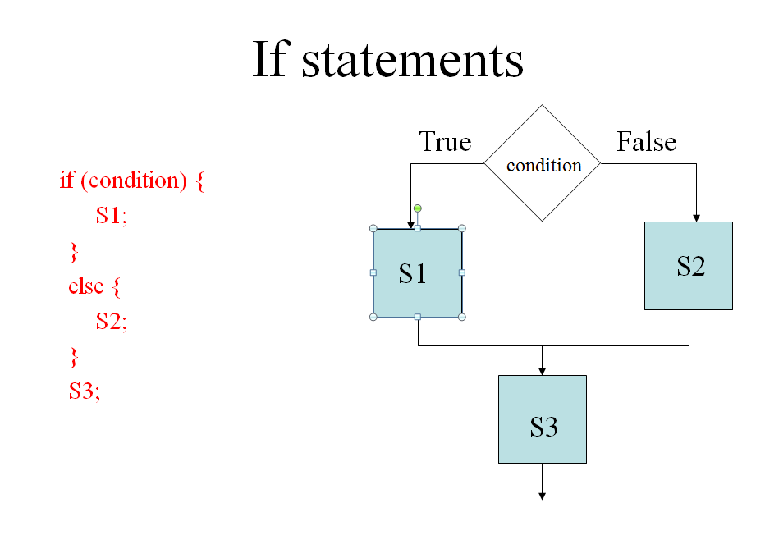

Slide 11
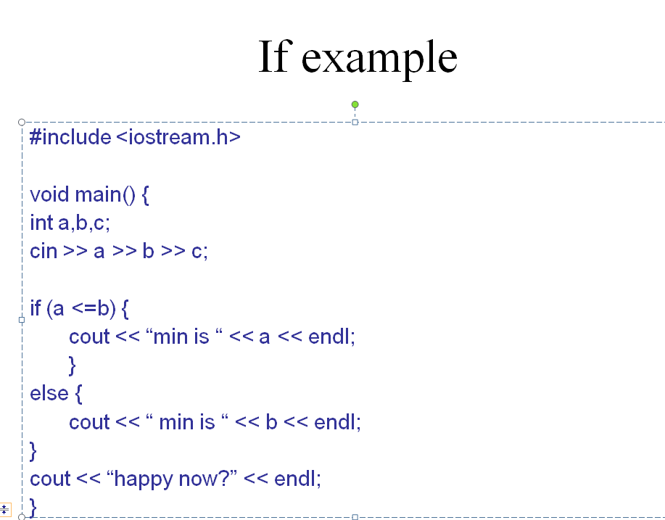

Slide 12
An Example
// Simple stream input/output
#include <iostream.h>
main()
{
cout << "Enter your age: ";
int myAge;
cin >> myAge;
cout << "Enter your friend's age: ";
int friendsAge;
cin >> friendsAge;

Slide 13
if (myAge > friendsAge)
cout << "You are older.\n";
else
if (myAge < friendsAge)
cout << "You are younger.\n";
else
cout << "You and your friend are the same age.\n";
return 0;
}

Slide 14
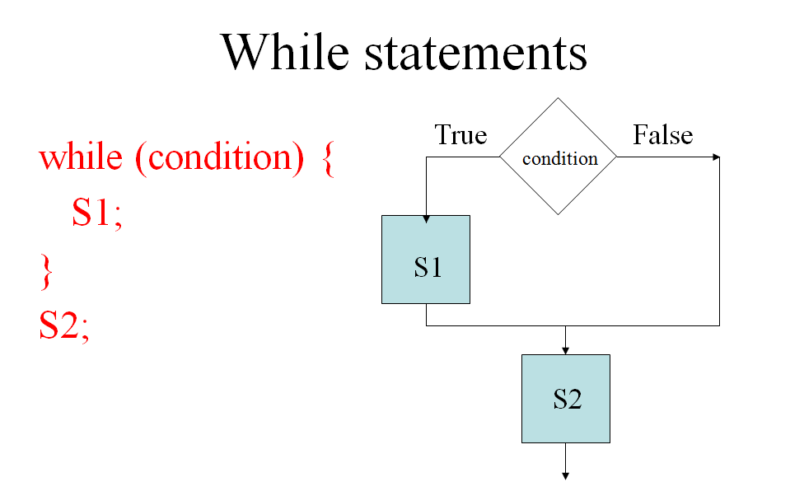

Slide 15
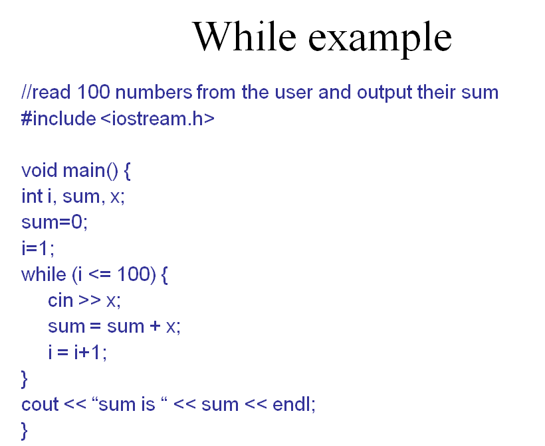

Slide 16
General form of a C++ program
// Program description
#include directives
int main()
{
constant declarations
variable declarations
executable statements
return 0;
}

Slide 17
C++ keywords
Keywords appear in blue in Visual C++.
Each keyword has a predefined purpose in the language.
Do not use keywords as variable and constant names!!
The complete list of keywords is on page 673 of the textbook.
We shall cover the following keywords in this class:
bool, break, case, char, const, continue, do, default, double, else, extern, false, float, for, if, int, long, namespace, return, short, static, struct, switch, typedef, true, unsigned, void, while

Slide 18

Keywords Shared with C
Figure 18.4 in D&D

Slide 19
New Keywords in C++

Slide 20
Hello World
When learning a new language, the first program people usually write is one that salutes the world :)
Here is the Hello world program in C++.
#include <iostream.h>
int main() {
cout << “Hello world!”;
return 0;
}

Slide 21
Example 0 – adding 2 numbers
Peter: Hey Frank, I just learned how to add two numbers together.
Frank: Cool!
Peter : Give me the first number.
Frank: 2.
Peter : Ok, and give me the second number.
Frank: 5.
Peter : Ok, here's the answer: 2 + 5 = 7.
Frank: Wow! You are amazing!
after Frank says “2”, Peter has to keep this number in his mind.
after Frank says “5”, Peter also needs to keep this number in his mind.
First number:
2
Second number:
5
Sum:
7

Slide 22
The Corresponding C++ Program
#include <iostream>
using namespace std;
int main()
{
int first, second, sum;
cout << "Peter: Hey Frank, I just learned how to add”
<< “ two numbers together."<< endl;
cout << "Frank: Cool!" <<endl;
cout << "Peter: Give me the first number."<< endl;
cout << "Frank: ";
cin >> first;
cout << "Peter: Give me the second number."<< endl;
cout << "Frank: ";
cin >> second;
sum = first + second;
cout << "Peter: OK, here is the answer:";
cout << sum << endl;
cout << "Frank: Wow! You are amazing!" << endl;
return 0;
}

Slide 23
C++ identifiers
Identifiers appear in black in Visual C++.
An identifier is a name for a variable, constant, function, etc.
It consists of a letter followed by any sequence of letters, digits, and underscores.
Examples of valid identifiers: First_name, age, y2000, y2k
Examples of invalid identifiers: 2000y
Identifiers cannot have special characters in them. For example: X=Y, J-20, ~Ricky,*Michael are invalid identifiers.
Identifiers are case-sensitive. For example: Hello, hello, WHOAMI, WhoAmI, whoami are unique identifiers.

Slide 24
C++ comments
Comments appear in green in Visual C++.
Comments are explanatory notes; they are ignored by the compiler.
There are two ways to include comments in a program:
// A double slash marks the start of a //single line comment.
/* A slash followed by an asterisk marks the start of a multiple line comment. It ends with an asterisk followed by a slash. */

Slide 25
C++ compiler directives
Compiler directives appear in blue in Visual C++.
The #include directive tells the compiler to include some already existing C++ code in your program.
The included file is then linked with the program.
There are two forms of #include statements:
#include <iostream> //for pre-defined files #include "my_lib.h" //for user-defined files

Slide 26
Programming Style
C++ is a free-format language, which means that:
Extra blanks (spaces) or tabs before or after identifiers/operators are ignored.
Blank lines are ignored by the compiler just like comments.
Code can be indented in any way.
There can be more than one statement on a single line.
A single statement can continue over several lines.

Slide 27
Programming Style (cont. )
In order to improve the readability of your program, use the following conventions:
Start the program with a header that tells what the program does.
Use meaningful variable names.
Document each variable declaration with a comment telling what the variable is used for.
Place each executable statement on a single line.
A segment of code is a sequence of executable statements that belong together.
Use blank lines to separate different segments of code.
Document each segment of code with a comment telling what the segment does.

Slide 28
What makes a bad program?
Bad !!
Writing Code without detailed analysis and design
Repeating trial and error without understanding the problem
Debugging the program line by line, statement by statement
Writing tricky and dirty programs
Bad !!
Bad !!

Slide 29
References in C++
Definition Reference:– An Alternative Name for an Object
BIG difference from Java
References are only created in declarations and parameters
A reference can only appear where the object itself could have appeared

Slide 30
Simple References
void f() { int j = 1; int &r = j; //r and j refer to same int int x = r; // x now is 1 r = 2; // j now is 2
} //f
int k;
int &r1 = k; // okay: r1 is initialized
int &r2; // error; initializer missing
extern int &r3; //okay; r3 defined elsewhere
Sometimes, reference declarations are written as
int& r1 = k

Slide 31
Reference Parameters
An alias for its corresponding argument in a function call.
& placed after the parameter type in the function prototype and function header
Example
int &count in a function header
Pronounced as “count is a reference to an int”
Parameter name in the called function body actually refers to the original variable in the calling function.

Slide 32
Reference Parameter Example
C version
void swap (int *a, int *b) { int temp = *a; *a = *b; *b = temp;
} // void swap(…)
C++ version
void swap (int &a, int &b) { int temp = a; a = b; b = temp;
} // void swap(…)
Hazard: a NULL pointer
Non-hazard: no pointer here

Slide 33
Notes on References and Pointers
Pointers in C do multiple duty
Links, as in linked lists and trees
Parameters, where the function needs to return a value to an argument provided by the caller
Short-hand, a short way of referring to an object that otherwise would need a complex expression
…

Slide 34
Java vs. C++ References
In Java, a reference is a data type.
It can be assigned to, compared, copied, stored, etc.
Same reference can refer to different objects at different times during execution
In C++, a reference is an alias for an object
It cannot be assigned to; assignment is through the reference to the underlying object
Similar to dereferencing a pointer in C
A reference always refers to the same object for the duration of its scope

Slide 35
Repeat Three Times
A reference is not a pointer, …
A reference is not a pointer, …
A reference is not a pointer, …
And neither of them resembles a Java reference

