Slide 1
Team [Team Name] · [Member 1], [Member 2], [Member 3]
VASTAV
Connecting People with the Problems of Our Nation
VASTAV
Report today track tomorrow fix together
Notes:
Introduce the team and the one-line idea: VASTAV connects citizens with the civic problems around them, and makes sure someone acts.

Slide 2



Potholes, leaking pipes, dead streetlights, overflowing drains: reported through scattered, slow, opaque channels, with no way to see what is urgent or what happens next.
Reason for Selection
Target Users
Everyday issue, yet no simple way to report
No priority: urgent risks queue with minor ones
Duplicates pile up, citizens get no updates
Citizens: report fast, track by Receipt ID
Departments: receive routed, scored reports
Authorities: one city-wide priority view
Notes:
Everyone has seen a pothole or a dead streetlight. The gap is not awareness, it is a simple channel, a fair way to rank urgency, and visible follow-up.

Slide 3






VASTAV turns a 2-minute citizen report into a scored, routed, trackable work item for the right department, even when the network drops.
GPS-tagged reports
Transparent priority
Auto routing
Detect location + Maps link in 3 steps
Score 0–100 from 5 weighted factors
Category sent to the right department
Duplicate merging
Live tracking
Works offline
Same issue within ~60 m is flagged
Receipt ID + 5-stage status timeline
Saved on phone, auto-syncs when online
Notes:
Walk the flow: report, score, route, track. The unique part is the transparent score and that it keeps working offline.

Slide 4
Frontend
HTML · CSS · vanilla JS installable PWA (service worker)
Priority score weights (%)
Offline
Reports queue in localStorage, auto-sync when online
Backend
REST API; status updates need an official token
Location
Geolocation API + OpenStreetMap reverse geocoding
Logic
Keyword → department, weighted scorer, 60 m duplicate check
Notes:
Single-file installable PWA on the front; a small REST API behind it. Offline queue + auto-sync is what makes it OFFGRID-ready. The weights on the right are the exact scoring formula in the app.

Slide 5
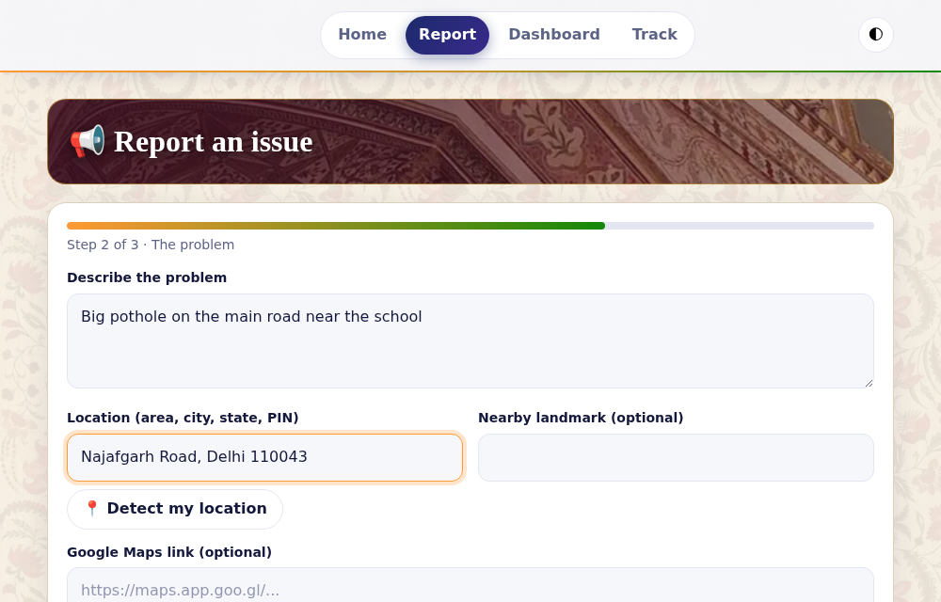
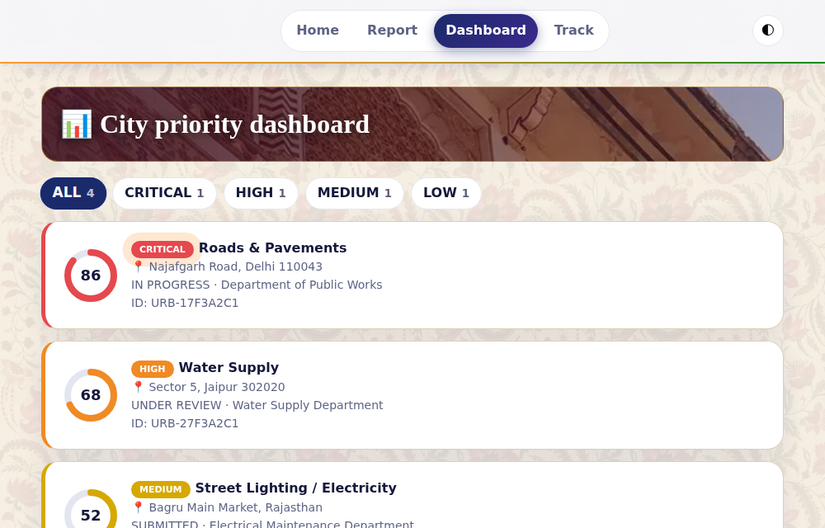
Report in 3 steps: details, location, impact
Dashboard: every report ranked by priority
Notes:
Live screens from the working app. Left: the report flow. Right: the public dashboard, ranked by priority band.

Slide 6
< 2 min
0–100
5 stages
~60 m
to file a report
transparent priority score
Submitted → Resolved
duplicate-matching radius
Real-world impact
Scalability & outcomes
Safety-critical issues surface first
Citizens see progress, not silence
Fewer duplicates, less noise for officials
Same engine scales ward → city → state
Tracks reports, resolved, people affected
New department = new category rule
Notes:
Numbers here come straight from how the product works. Outcomes to measure in a pilot: time-to-resolve, share of reports resolved, duplicates avoided.

Slide 7



BY THE CITIZENS FOR THE CITIZENS
Target market
Revenue streams
Sustainability
Municipal corporations & zone offices
Smart-city missions, local bodies
RWAs, campuses, townships (pilots)
SaaS subscription per ward or zone
Analytics & reporting add-on
CSR / NGO-sponsored deployments
Free citizen app drives adoption
Low-cost PWA: no app-store dependency
Resolution data proves value at renewal
Notes:
Proposed model, to be validated in a pilot: citizens never pay; municipalities and partners fund the platform.

Slide 8
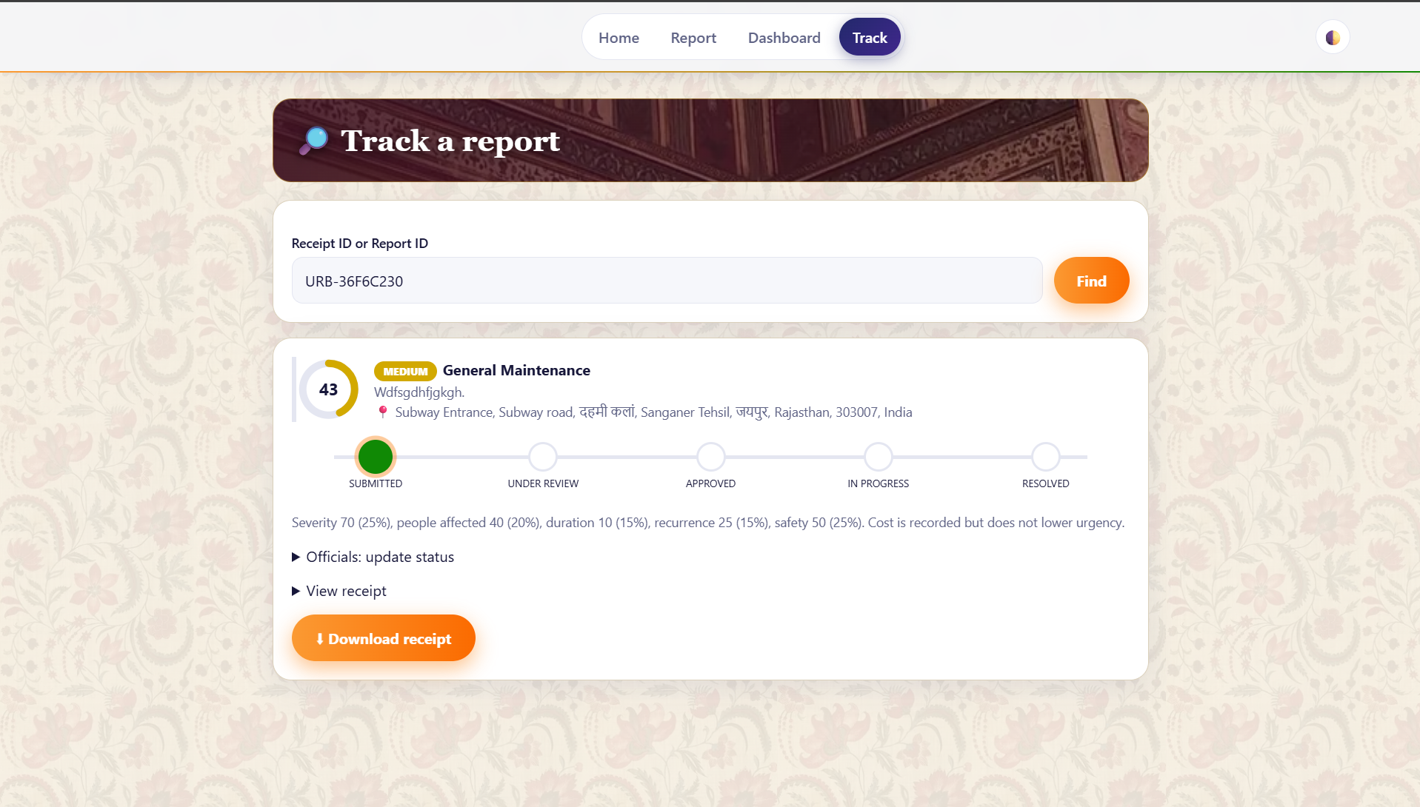
SO JUST LIKE RASTOGI SAID OUR WEBISTE PROVIDES REAL TIME TO TIME TRACKING
UNLIKE MOST GOVT WEBISTES

