Slide 1
Conceptions of student teachers on the limit concept Christoph Ableitinger, Stefan Götz, Roland Steinbauer University of Vienna, Faculty of Mathematics, Austria
Reliable ideas of fundamental mathematical notions are indispensable
Basic ideas (“Grundvorstellungen”) associated with any concept
give meaning to (different aspects of) the notion
are normative or descriptive
Empirical study on student teachers’ written statements
on the notion of the limit of a real sequence

Slide 2
Research focus
Research questions
Three basic ideas of the limit
Approach idea (AI): elements of sequence heading towards a fixed value
Neighbourhood idea (NI): Finally the elements stay in any small nbd.
Object idea (OI): Limits as objects constructed/defined by a sequence
(1) Which ideas on the limit do teacher students express after their subject matter training?
How can these be categorized?
(2) Correlation between the ideas & subject matter performance?
(3) How do ideas change after a didactical course

Slide 3
Setting
Methodology
Course on
first course on one-dimensional analysis
Survey
first survey
Lecture
lecture course “School mathematics Analysis” (winter term 2018/19)
Survey
second survey
„Under the limit of a sequence, I imagine…“
(1) Assign statements to basic ideas
(2) Assess quality in 6 categories (inductively generated from data)
non-specific, misconception, BI clearly recognizable, BI weakly developed, BI strongly devolped/imprecise formulation, BI strongly developed & adequately formulated

Slide 4
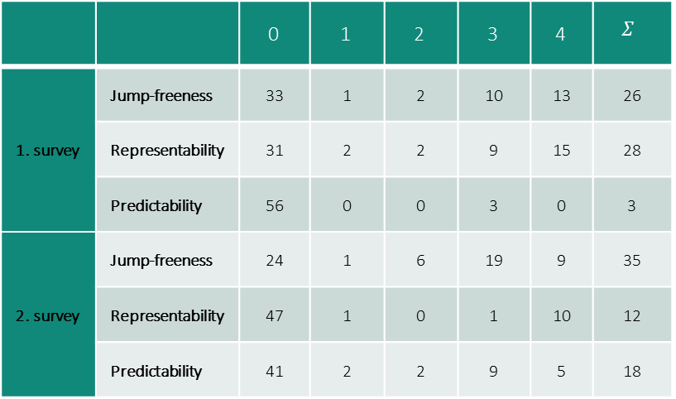
Results
Absolute frequencies of the quality levels depending on basic ideas
significant difference (chi-square test of homogeneity: 𝑝<0.001)
Significant differences and positive (!) correlations
 |  | 0 | 1 | 2 | 3 | 4 | $$Σ$$
1. survey | Jump-freeness | 33 | 1 | 2 | 10 | 13 | 26
 | Representability | 31 | 2 | 2 | 9 | 15 | 28
 | Predictability | 56 | 0 | 0 | 3 | 0 | 3
2. survey | Jump-freeness | 24 | 1 | 6 | 19 | 9 | 35
 | Representability | 47 | 1 | 0 | 1 | 10 | 12
 | Predictability | 41 | 2 | 2 | 9 | 5 | 18
Survey 1-2: Quality of statements belonging to representability decreases (small effect)
Survey 1: statements in general (excluding “0”) & the grade reached at the tutorial
Survey 2: representability (including “0”) & the grade achieved at the subject matter lecture
Survey 1-2: Quality of statements belonging to predictability increases (medium effect)

Slide 5
Discussion
Suggestion: improve ability to cast this first idea of predictability into a proper mathematical formulation
What is missing? - the aspect or basic idea, respectively, of sequential continuity turns out to be gravely underrepresented
Limitation: the formulation “Under a continuous function I imagine …” does not invite the pre-service teachers to mention more than one basic idea.

