Slide 1
NILE UNIVERSITY OF NIGERIA | DEPARTMENT OF COMPUTER SCIENCE
Nigeria Road Management System: A Citizen-Centric Platform for Road Monitoring, Reporting, and Progress Tracking
Undergraduate Software Engineering Group Project Specification & Defense
S/N | Matriculation No. | Full Student Name & Project Role
1 | 241030116 | Chibuzor Clinton AGADA (Group Leader)
2 | 241030026 | Ephraim Ayokunle Tackie OFOLI (Member)
3 | 241030081 | Isaac Akorede-Abayomi ODUJOKO (Member)
4 | 241030123 | Aisha Mohammed RASHEED (Member)
5 | 241030021 | Prince Arinze Wenceslaus OBINABO (Member)
6 | 241030039 | Mubarak Ibrahim AUDU (Member)

Slide 2
NIGERIA ROAD MANAGEMENT SYSTEM (NRMS)
1. Domain Background & National Context
Strategic Scale of Road Arteries
• Nigeria possesses ~193,200 km of roads (largest network in West Africa).
• Accounts for over 90% of inland passenger travel and freight distribution.
• Critical driver for macroeconomic growth and regional commerce.
Pervasive Physical Deterioration
• Chronic pavement distress, asphalt cratering, and collapsed culverts.
• Results in over ₦175 billion annual economic drag (Jaiye & Elisha, 2020).
• High accident rates and premature vehicular depreciation.
Operational & Governance Friction
• Institutional fragmentation across FERMA, State Ministries, and Local Councils.
• Reliance on manual, sporadic physical inspections and paper forms.
• Zero real-time civic participation conduits for road users.

Slide 3
NIGERIA ROAD MANAGEMENT SYSTEM (NRMS)
2. Problem Statement: The 4 Core Domain Flaws
1. Real-Time Defect Reporting Void
Pavement distress relies on reactive paper logging or unverified social media complaints. Defects remain uncatalogued for months until severe structural failures occur (Farouq et al., 2017).
2. Contractor Opacity & Substandard Materials
Road construction projects suffer from substandard materials and abandoned milestones. The absence of photo-verified stage logs enables corruption and delays (Adepoju, 2021).
3. Unchecked Civic Traffic Infractions
Chronic traffic violations (one-way driving, unauthorized parking, waste dumping) occur beyond the physical sight of stationary marshals, lacking civic evidentiary reporting (Umar et al., 2021).
4. Absence of Automated Inspection Alerts
Maintenance agencies lack automated alert engines when road inspections or contractor audit milestones become overdue, creating administrative blind spots (Odinfono & Olawole, 2024).

Slide 4
NIGERIA ROAD MANAGEMENT SYSTEM (NRMS)
3. Literature Audit: Five Key Variables from Consensus AI
Study & Year | Architecture | Core Features | Problem Solved | Identified Gap
Afieroho et al. (2023) | Web E-Gov Portal | Citizen perception survey & project tracking | Identified high citizen willingness to monitor projects | Theoretical model only; no real-time photo/GIS reporting.
Farouq et al. (2017) | Manual & Relational DB | Kano defect cataloging & maintenance logs | Demonstrated severe flaws in manual defect recording | 100% paper-based, zero crowdsourcing capability.
Sese (2020) | Client-Server Distributed | Centralized FRSC traffic offence logging | Multi-state driver offence record sharing | Officer-only system; zero citizen participation or road tracking.
Audu et al. (2021) | Spatial Decision (GIS) | Crash hotspot mapping & Dijkstra ambulance routing | Optimized post-accident emergency dispatch in Ibadan | Post-crash only; no defect prevention or public reporting.

Slide 5
NIGERIA ROAD MANAGEMENT SYSTEM (NRMS)
4. Proposed Improvement: The Value-Add Delta
Functional Dimension | Baseline / Existing Legacy Systems | NRMS Group Value-Add Contribution
Public Defect Reporting | Sporadic paper letters or phone complaints; no GPS or photo verification. | Citizen crowdsourcing web/mobile interface with auto-GPS coordinates and mandatory photo proof.
Contractor Tracking | Internal unverified billing spreadsheets without physical progress audit. | Contractor milestone portal requiring on-site timestamped progress photos prior to inspection sign-off.
Inspection Alerts | Ad-hoc, uncoordinated manual visits; frequent project abandonment. | Automated background scheduler triggering alerts for overdue inspections and maintenance cycles.
Decision Support | Disparate tabular records without spatial intelligence or triage. | Centralized GIS dashboard with road condition severity heatmaps and dynamic KPI indicators.

Slide 6
NIGERIA ROAD MANAGEMENT SYSTEM (NRMS)
5. Overarching Project Aim (The Golden Rule)
THE OVERARCHING PROJECT AIM
"To design, implement, and evaluate a web-based crowdsourced Nigeria Road Management System (NRMS) to enhance road maintenance transparency, defect triage, and civic accountability in Nigeria."
Departmental Golden Rule Enforced: Exactly ONE singular, unified overarching aim is formulated without conflicting secondary aims.

Slide 7
NIGERIA ROAD MANAGEMENT SYSTEM (NRMS)
6. Project Milestones: Exactly Three Objectives
OBJECTIVE 1: DESIGN
Multi-Tier Architecture & Schemas
• Multi-tier software architecture specification
• Relational & spatial schema (PostgreSQL + PostGIS)
• Responsive UI wireframes for citizens & officials
OBJECTIVE 2: IMPLEMENT
Core Functional Software Modules
• Geotagged civic defect & violation reporting
• Contractor milestone progress photo auditing
• Automated background inspection alert scheduler
• Administrative spatial heatmap & KPI dashboard
OBJECTIVE 3: TEST
Empirical System Validation
• Functional integration & regression testing
• Geolocation accuracy & media upload latency
• Notification engine reliability across test cases
• Usability evaluation across stakeholder roles

Slide 8
NIGERIA ROAD MANAGEMENT SYSTEM (NRMS)
7. Proposed System: Functional Module Overview
Citizen Reporting Module
Allows pedestrians and drivers to submit defects (potholes, flooding) and infractions (one-way driving) with GPS & photos.
Contractor Portal
Enables construction contractors to log active milestones and submit dated on-site photographs as proof of work.
Inspection Alert Engine
Executes cron jobs to scan road records and dispatches SMS/email alerts when inspection cycles are overdue.
Administrative Dashboard
Displays road condition KPIs, GIS heatmaps of critical segments, and manages defect assignment workflows.

Slide 9
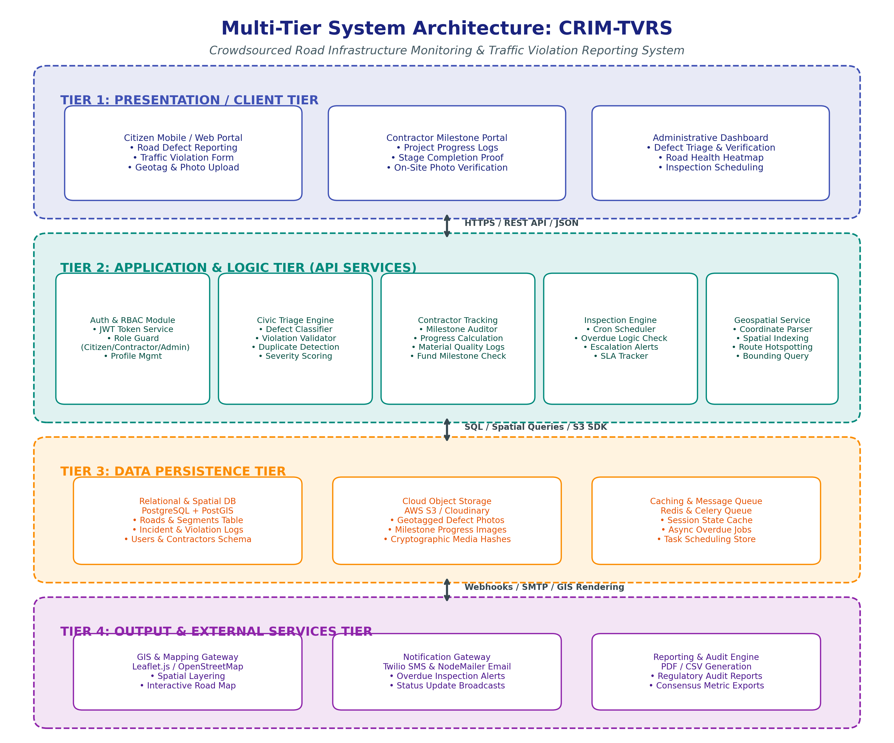
NIGERIA ROAD MANAGEMENT SYSTEM (NRMS)
8. Multi-Tier System Architecture Model

Slide 10
NIGERIA ROAD MANAGEMENT SYSTEM (NRMS)
9. Multi-Tier Technical Decomposition
Tier 1: Presentation Tier
• Citizen Mobile Web (Next.js/React)
• Contractor Milestone Submission UI
• Admin Dashboard & GIS Map View
Tier 2: Logic & API Tier
• JWT Auth & Role-Based Access Control
• Civic Triage & Severity Scorer
• Inspection Cron Scheduler & Task Queue
• PostGIS Geospatial Spatial Query Engine
Tier 3: Persistence Tier
• PostgreSQL + PostGIS (Spatial geometries)
• Cloudinary/AWS S3 (Evidence Media)
• Redis (Session Cache & Queue)
Tier 4: Output & Services Tier
• Leaflet.js & OpenStreetMap
• Twilio SMS & NodeMailer Email
• PDF/CSV Compliance Audit Exporter

Slide 11
NIGERIA ROAD MANAGEMENT SYSTEM (NRMS)
10. Proposed Technology Stack & Justification
System Layer | Technology Selected | Technical Rationale
Frontend Client | Next.js (React) + Tailwind CSS | Server-side rendering, component reusability, responsive mobile layout.
Backend Services | Node.js + Express.js | Asynchronous non-blocking I/O for concurrent multipart report submissions.
Spatial Database | PostgreSQL + PostGIS | Native geospatial geometries (ST_DWithin, ST_Point) and enterprise relational integrity.
Media Storage | Cloudinary / AWS S3 | Secure, CDN-backed image storage preserving geotag metadata.
Mapping & GIS | Leaflet.js + OpenStreetMap | Lightweight, zero-cost open-source mapping with customizable tile markers.

Slide 12
NIGERIA ROAD MANAGEMENT SYSTEM (NRMS)
11. Expected Impact & Defense Conclusion
Civic Empowerment
Enables millions of daily road users to become the 'eyes' of road maintenance agencies via instant geotagged defect and violation logging.
Contractor Transparency
Deters substandard work and milestone abandonment through obligatory photographic proof prior to project stage clearance.
Data-Driven Governance
Equips FERMA, FRSC, and State Ministries with empirical spatial dashboards and automated overdue alerts for timely interventions.
Thank You. Questions & Technical Defense Feedback Welcome.

