Slide 1
NILE UNIVERSITY OF NIGERIA | DEPARTMENT OF COMPUTER SCIENCE
Nigeria Road Management System: A Citizen-Centric Platform for Road Monitoring, Reporting, and Progress Tracking
Undergraduate Software Engineering Project Defense | Academic Session 2025/2026
S/N | Matriculation No. | Full Student Name & Role
1 | 241030116 | Chibuzor Clinton AGADA (Group Leader)
2 | 241030026 | Ephraim Ayokunle Tackie OFOLI (Member)
3 | 241030081 | Isaac Akorede-Abayomi ODUJOKO (Member)
4 | 241030123 | Aisha Mohammed RASHEED (Member)
5 | 241030021 | Prince Arinze Wenceslaus OBINABO (Member)
6 | 241030039 | Mubarak Ibrahim AUDU (Member)

Slide 2
NIGERIA ROAD MANAGEMENT SYSTEM (NRMS)
1. Introduction & Background
Nigeria Road Network
• Over 193,200 km of roads across Nigeria (largest network in West Africa).
• Connects towns, cities, and rural agricultural zones.
• Transports over 90% of national passenger and cargo traffic.
Current Road Conditions
• Widespread potholes, broken bridges, and washed-out shoulders.
• Premature pavement damage from heavy trucks and poor drainage.
• High cost of vehicle maintenance, long transit delays, and frequent accidents.
Management Inefficiencies
• Roads divided among federal (FERMA), state, and local councils.
• Over-reliance on manual inspections and paper complaints.
• Citizens have no direct digital platform to report bad roads with photo proof.

Slide 3
NIGERIA ROAD MANAGEMENT SYSTEM (NRMS)
2. Problem Statement: Key Flaws in the Current System
1. Slow Defect Reporting: Citizens have no direct digital platform to report potholes and road damage with photos and GPS. Complaints take months to reach maintenance teams (Farouq et al., 2017).
2. Contractor Opacity: Road construction progress is not documented in open digital records with photo proof, enabling substandard materials and delayed milestones (Adepoju, 2021).
3. Unchecked Traffic Violations: Violations like driving against traffic ('one-way'), illegal parking, and dumping dirt on roads frequently occur without penalty because officers cannot be everywhere (Umar et al., 2021).
4. Missed Inspection Cycles: Maintenance agencies lack an automated alert system when road inspections or contractor site checks are overdue, leading to forgotten maintenance schedules (Odinfono & Olawole, 2024).

Slide 4
NIGERIA ROAD MANAGEMENT SYSTEM (NRMS)
3. Literature Audit: Findings from Consensus AI
Study & Year | Architecture | Core Features | Problem Solved | Unaddressed Gap
Afieroho et al. (2023) | Web E-Gov Survey | Citizen adoption survey of public project tracking | Showed public willingness to adopt digital monitoring | Survey only; no working software tool with photo reporting.
Farouq et al. (2017) | Database Audit | Kano road defect logs & user satisfaction survey | Demonstrated dissatisfaction with manual defect logging | Paper-based; no citizen-facing web or mobile platform.
Sese (2020) | Client-Server DB | Centralized traffic offence database for FRSC | Shared offence records across state commands | Internal officers only; no citizen reporting or road defect logs.
Audu et al. (2021) | Spatial GIS | Crash hotspot map & shortest ambulance routes | Improved post-crash ambulance response times | Post-crash only; no defect prevention or public reporting.

Slide 5
NIGERIA ROAD MANAGEMENT SYSTEM (NRMS)
4. Proposed Improvement: The Value-Add Delta
Functional Area | Standard / Existing Practice | Proposed NRMS Contribution (Value-Add Delta)
Citizen Defect Reporting | Slow verbal complaints or unverified social media posts without location data. | Simple web and mobile interface where citizens report potholes and violations with photos and GPS.
Contractor Progress Tracking | Contractor-submitted paperwork with little or no public photo verification. | Contractor portal requiring timestamped progress photos for each milestone before inspection sign-off.
Inspection Alerts | Irregular manual visits with no automated reminder system when inspections are overdue. | Automated background engine that checks the database daily and sends email/SMS alerts (> 30 days).
Official Dashboard & Analytics | Disorganized paper files and separate spreadsheets with no interactive map. | Central dashboard showing monitored roads, critical road counts, and overdue inspections on a map.

Slide 6
NIGERIA ROAD MANAGEMENT SYSTEM (NRMS)
5. One Overarching Project Aim (The Golden Rule)
THE OVERARCHING PROJECT AIM
"To design, implement, and test a web-based Nigeria Road Management System (NRMS) that enables citizen defect and violation reporting, tracks construction progress, and alerts officials to overdue inspections."
Strict adherence to departmental guideline: Exactly ONE clear, overarching aim with no competing secondary aims.

Slide 7
NIGERIA ROAD MANAGEMENT SYSTEM (NRMS)
6. Project Milestones: Exactly Three Objectives
OBJECTIVE 1: DESIGN
Architecture, Database & UI Wireframes
• Multi-tier system architecture specification
• PostgreSQL + PostGIS database schema
• Responsive web wireframes for citizens, contractors, and road officials
OBJECTIVE 2: IMPLEMENT
Core Software Modules
• Citizen reporting portal with photo uploads & GPS
• Contractor milestone progress tracker
• Automated overdue inspection alert engine
• Officials' spatial monitoring dashboard
OBJECTIVE 3: TEST
System Testing & Validation
• Functional testing across all modules
• Verification of duplicate report detection
• Testing alert dispatch under simulated delays
• Usability testing across sample user roles

Slide 8
NIGERIA ROAD MANAGEMENT SYSTEM (NRMS)
7. Proposed System Overview
Citizen Reporting Portal
Citizens use a web or mobile browser to report potholes, erosion, or traffic violations, attaching a photo and submitting automatic GPS coordinates.
Contractor Portal
Road contractors log into their portal to view assigned road projects, upload on-site progress photos, and submit milestone completion updates.
Inspection Alert Engine
A background engine scans road records daily and automatically sends SMS/email alerts to engineers when an inspection is overdue (> 30 days).
Officials Dashboard
Officials monitor road conditions on an interactive map, view counts of critical roads and ongoing projects, and assign maintenance teams.

Slide 9
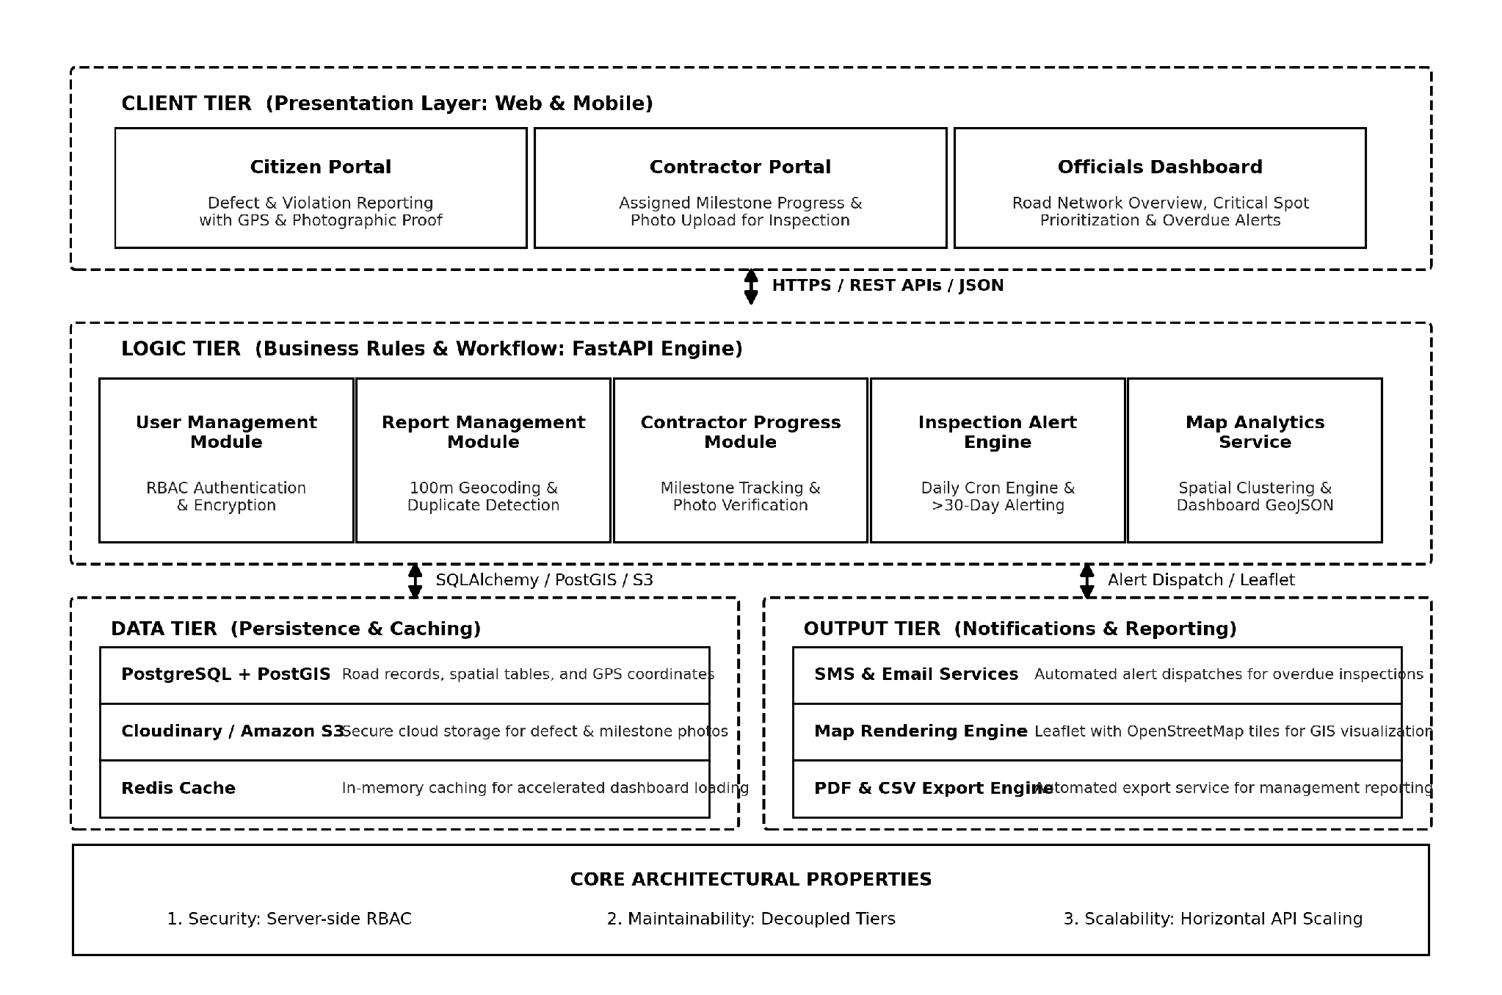
NIGERIA ROAD MANAGEMENT SYSTEM (NRMS)
8. Multi-Tier System Architecture Diagram

Slide 10
NIGERIA ROAD MANAGEMENT SYSTEM (NRMS)
9. Architecture Component Details
Tier 1: Client Tier
• Citizen web & mobile reporting form
• Contractor milestone progress portal
• Officials' interactive map dashboard
Tier 2: Logic Tier
• User authentication & role control
• FastAPI application service endpoints
• Report manager with duplicate checking
• Inspection alert scheduler & map service
Tier 3: Data Tier
• PostgreSQL + PostGIS (or MySQL)
• Cloudinary / AWS S3 (photo storage)
• Redis (caching and task queues)
Tier 4: Output Tier
• Leaflet.js interactive road map
• SMS & email notification gateways
• PDF/CSV report generation for officials

Slide 11
NIGERIA ROAD MANAGEMENT SYSTEM (NRMS)
10. Proposed Technology Stack
Layer | Technology Selected | Practical Reason for Selection
Frontend (Client) | HTML, CSS, JavaScript (React) | Responsive on mobile devices; fast loading and modular UI components.
Backend (Logic) | Python (FastAPI Framework) | Course-designated framework; high-throughput asynchronous API handling with migration path to Express.
Database (Data) | PostgreSQL + PostGIS (or MySQL) | Reliable relational database with spatial indexing for GPS coordinates and geographic clustering.
Media Storage | Cloudinary (or AWS S3) | Stores defect and progress photos safely without overloading the database.
Mapping & Alerts | Leaflet.js + SMS / Email API | Open-source map library without licensing fees; reliable alert delivery.

Slide 12
NIGERIA ROAD MANAGEMENT SYSTEM (NRMS)
11. Conclusion & Expected Impact
Empowering Citizens
• Turns ordinary commuters into 'the eyes of the system'.
• Allows fast reporting of potholes, broken roads, and traffic violations with photos.
• Fosters community participation in public infrastructure.
Contractor Accountability
• Encourages high construction quality across project sites.
• Requires photographic evidence before milestones are approved.
• Reduces project delays and premature road failures.
Better Official Oversight
• Provides road authorities with an up-to-date spatial dashboard.
• Automated alert engine ensures overdue inspections are never missed.
• Enhances data-driven maintenance planning.
Thank you. We welcome your questions and feedback.

