Slide 1
NILE UNIVERSITY OF NIGERIA | DEPARTMENT OF COMPUTER SCIENCE
Nigeria Road Management System: A Citizen-Centric Platform for Road Monitoring, Reporting, and Progress Tracking
Undergraduate Software Engineering Project Defense | Academic Session 2025/2026
S/N | Matriculation No. | Full Student Name & Role
1 | 241030116 | Chibuzor Clinton AGADA (Group Leader)
2 | 241030026 | Ephraim Ayokunle Tackie OFOLI (Member)
3 | 241030081 | Isaac Akorede-Abayomi ODUJOKO (Member)
4 | 241030123 | Aisha Mohammed RASHEED (Member)
5 | 241030021 | Prince Arinze Wenceslaus OBINABO (Member)
6 | 241030039 | Mubarak Ibrahim AUDU (Member)

Slide 2
NIGERIA ROAD MANAGEMENT SYSTEM (NRMS)
1. Introduction & Background
Nigeria Road Network
• Over 193,200 km of roads (largest in West Africa).
• Carries over 90% of passenger and freight traffic.
• Vital for interstate trade and daily commuting.
Current Road Conditions
• Frequent potholes, erosion, and broken bridges.
• Causes severe vehicle damage and travel delays.
• High financial burden on motorists and businesses.
Management Inefficiencies
• Roads managed by separate federal, state, and local agencies.
• Reliance on manual visits and paper records.
• No simple way for citizens to report problems with photos.

Slide 3
NIGERIA ROAD MANAGEMENT SYSTEM (NRMS)
2. Problem Statement: Key Flaws in the Current System
1. Slow Defect Reporting
Citizens have no direct way to report potholes and road damage with photos and GPS locations. Complaints take months to reach maintenance units (Farouq et al., 2017).
2. Contractor Opacity
Construction and repair progress is not tracked using open photo records, allowing substandard materials and delayed milestones to go unverified (Adepoju, 2021).
3. Unchecked Traffic Violations
Driving against one-way traffic, illegal parking, and dumping dirt on roads frequently occur without penalty because officers cannot be everywhere (Umar et al., 2021).
4. Missed Inspection Cycles
Maintenance agencies lack an automated alert system when road inspections or contractor site checks are overdue (Odinfono & Olawole, 2024).

Slide 4
NIGERIA ROAD MANAGEMENT SYSTEM (NRMS)
3. Literature Audit: Findings from Consensus AI
Study & Year | Architecture | Core Features | Problem Solved | Unaddressed Gap
Afieroho et al. (2023) | Web E-Gov Survey | Citizen adoption survey of public project tracking | Showed public willingness to adopt digital monitoring | Survey only; no working software tool with photo reporting.
Farouq et al. (2017) | Database Audit | Kano road defect logs & user satisfaction survey | Demonstrated dissatisfaction with manual defect logging | Paper-based; no citizen-facing web or mobile platform.
Sese (2020) | Client-Server DB | Centralized traffic offence database for FRSC | Shared offence records across state commands | Internal officers only; no citizen reporting or road defect logs.
Audu et al. (2021) | Spatial GIS | Crash hotspot map & shortest ambulance routes | Improved post-crash ambulance response times | Post-crash only; no defect prevention or public reporting.

Slide 5
NIGERIA ROAD MANAGEMENT SYSTEM (NRMS)
4. Proposed Improvement: The Value-Add Delta
Functional Area | Standard / Existing Practice | Proposed NRMS Contribution (Value-Add Delta)
Citizen Defect Reporting | Slow verbal complaints or unverified social media posts without location data. | Simple web and mobile interface where citizens report potholes and violations with photos and GPS.
Contractor Progress Tracking | Contractor-submitted paperwork with little or no public photo verification. | Contractor portal requiring timestamped progress photos for each milestone before inspection sign-off.
Inspection Alerts | Irregular manual visits with no automated reminder system when inspections are overdue. | Automated background engine that checks the database daily and sends email/SMS alerts (> 30 days).
Official Dashboard & Analytics | Disorganized paper files and separate spreadsheets with no interactive map. | Central dashboard showing monitored roads, critical road counts, and overdue inspections on a map.

Slide 6
NIGERIA ROAD MANAGEMENT SYSTEM (NRMS)
5. One Overarching Project Aim (The Golden Rule)
THE OVERARCHING PROJECT AIM
"To design, implement, and test a web-based Nigeria Road Management System (NRMS) that enables citizen defect and violation reporting, tracks construction progress, and alerts officials to overdue inspections."
Strict adherence to departmental guideline: Exactly ONE clear, overarching aim with no competing secondary aims.

Slide 7
NIGERIA ROAD MANAGEMENT SYSTEM (NRMS)
6. Project Milestones: Exactly Three Objectives
OBJECTIVE 1: DESIGN
Architecture, Database & UI
• Multi-tier system architecture
• PostgreSQL + PostGIS database schema
• Responsive web wireframes for citizens, contractors, and officials
OBJECTIVE 2: IMPLEMENT
Core Software Modules
• Citizen reporting with photo uploads
• Contractor milestone progress tracker
• Automated overdue inspection alert engine
• Officials' monitoring dashboard
OBJECTIVE 3: TEST
System Testing & Validation
• Functional testing of all modules
• Verification of duplicate report detection
• Testing of alert dispatch under sample delays
• Usability testing across user roles

Slide 8
NIGERIA ROAD MANAGEMENT SYSTEM (NRMS)
7. Proposed System Overview
Citizen Reporting Portal
Citizens use a web or mobile browser to report potholes, erosion, or traffic violations, attaching a photo and submitting automatic GPS coordinates.
Contractor Portal
Road contractors log into their portal to view assigned road projects, upload on-site progress photos, and submit milestone completion updates.
Inspection Alert Engine
A background engine scans road records daily and automatically sends SMS/email alerts to engineers when an inspection is overdue (> 30 days).
Officials Dashboard
Officials monitor road conditions on an interactive map, view counts of critical roads and ongoing projects, and assign maintenance teams.

Slide 9
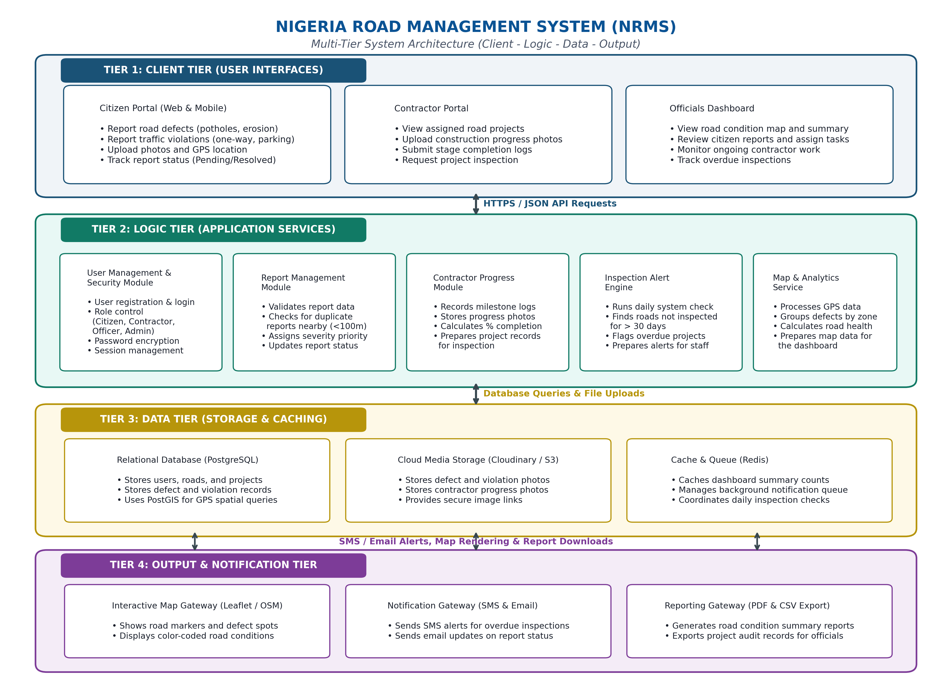
NIGERIA ROAD MANAGEMENT SYSTEM (NRMS)
8. Multi-Tier System Architecture Diagram

Slide 10
NIGERIA ROAD MANAGEMENT SYSTEM (NRMS)
9. Architecture Component Details
Tier 1: Client Tier
• Citizen web & mobile reporting form
• Contractor milestone progress portal
• Officials' interactive map dashboard
Tier 2: Logic Tier
• User authentication & role control
• Report manager with duplicate checking
• Contractor milestone progress module
• Inspection alert scheduler & map service
Tier 3: Data Tier
• PostgreSQL + PostGIS (spatial tables)
• Cloudinary / AWS S3 (photo storage)
• Redis (caching and task queues)
Tier 4: Output Tier
• Leaflet.js interactive road map
• SMS & email notification gateways
• PDF/CSV report generation for officials

Slide 11
NIGERIA ROAD MANAGEMENT SYSTEM (NRMS)
10. Proposed Technology Stack
Layer | Technology Selected | Practical Reason for Selection
Frontend (Client) | Next.js (React) + Tailwind CSS | Responsive on mobile devices; fast loading and modular UI components.
Backend (Logic) | Node.js + Express.js | Asynchronous non-blocking I/O; efficiently handles concurrent photo uploads.
Database (Data) | PostgreSQL + PostGIS | Reliable relational database with native support for GPS latitude and longitude.
Media Storage | Cloudinary (or AWS S3) | Stores defect and progress photos safely without overloading the database.
Mapping & Alerts | Leaflet.js + SMS / Email API | Open-source map library without licensing fees; reliable alert delivery.

Slide 12
NIGERIA ROAD MANAGEMENT SYSTEM (NRMS)
11. Conclusion & Expected Impact
Empowering Citizens
Turns ordinary commuters into 'the eyes of the system' by allowing them to quickly report potholes, broken roads, and traffic violations with photos.
Contractor Accountability
Encourages quality construction by requiring photo evidence of progress before project milestones are signed off.
Better Official Decision-Making
Provides road agencies with an up-to-date map dashboard and automated alerts so overdue inspections are never missed.
Thank you. We welcome your questions and feedback.

