Slide 1
Event handling using different task allocation strategies
Brice Platerrier, Martin Vassor & Arnaud Wald

Slide 2
The problem
Different types of tasks
Mobile agents with limited knowledge of the environment
Communication among agents possible
Objectives :
Optimize the labor division among agents
Maximize the number of tasks processed in a certain time
Notes:
Cheese is good

Slide 3
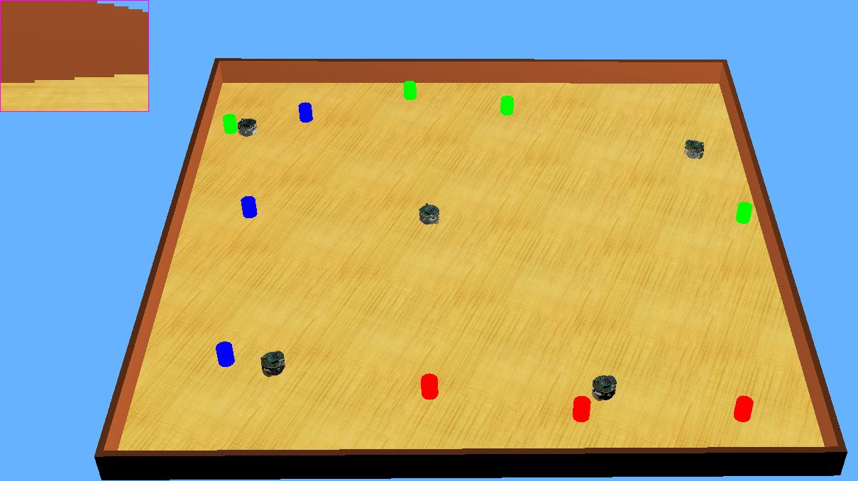
The Webots setup
Agents : e-puck robots
Camera vision
Radio emitter/receiver
Arena
Square 160x160cm
Flat surface
Tasks
Red, green and blue cylinders
Random color
Random position
Notes:
Cheese is good

Slide 4

The metrics used
Objective 1: Maximize the number of events handled / Time period
Objective 2: Minimize the distance traveled / Event handled -> Transformation
Metric 1
$$m_{1}= \frac{N}{T}$$
Metric 2
$$m_{2}=1−\frac{D}{N}$$
Notes:
Cheese is good

Slide 5
The Finite-State Machine used
S1: Search for a task
S2: Go to a task
S3: Stop to perform the task

Slide 6
The different algorithms tested
Private fixed
Private variable
Public
Notes:
Cheese is good

Slide 7
Private fixed
Totot
Totot
Totot
Totot
Totot
tototo
Notes:
Cheese is good

Slide 8
Results
Metric 1
Metric 2
Notes:
Cheese is good

Slide 9
Private adaptive & specialization
Parameters
Notes:
Cheese is good

Slide 10
Results : Adaptive
Metric 1
Metric 2
Notes:
Cheese is good

Slide 11
Results: Specialization
Metric 1
Metric 2
Notes:
Cheese is good

Slide 12

Public case : communication
3 channels, one for each color $i$
Send only the chosen color, and listen on all channels
Signal strength $s=\frac{1}{r^{2}}$
Normalization
Limited communication range: $s=0$ if $r≥r_{max}$
Saturation if under a certain range: $s=\frac{1}{r_{min}^{2}}$ if $r≤r_{min}$
New stimulus:
$$σ_{new}\left(i\right)=σ_{old}\left(i\right)∗\left(1+β\right) −α∗R\left(i\right)∗s$$
Notes:
Cheese is good

Slide 13
Public case
Parameters
Roto
Toto
Toto
toto
Notes:
Cheese is good

Slide 14
Public case
Metric 1
Metric 2
Notes:
Cheese is good

Slide 15
Conclusions
Basic private algorithms achieve good performance if tuned appropriately
Communication among agents adds complexity but yields better results with more robustness
PSO to optimize the weights and communication range in the public case
Notes:
Cheese is good

