Slide 1
Event handling using different task allocation strategies
Brice Platerrier, Martin Vassor & Arnaud Wald
Notes:
<number>

Slide 2
15/12/2015
DIS Project
<number>
The problem
Different types of tasks
Mobile agents with limited knowledge of the environment
Communication among agents possible
Objectives :
Optimize the labor division among agents
Maximize the number of tasks processed in a certain time
Notes:
Cheese is good
<number>

Slide 3
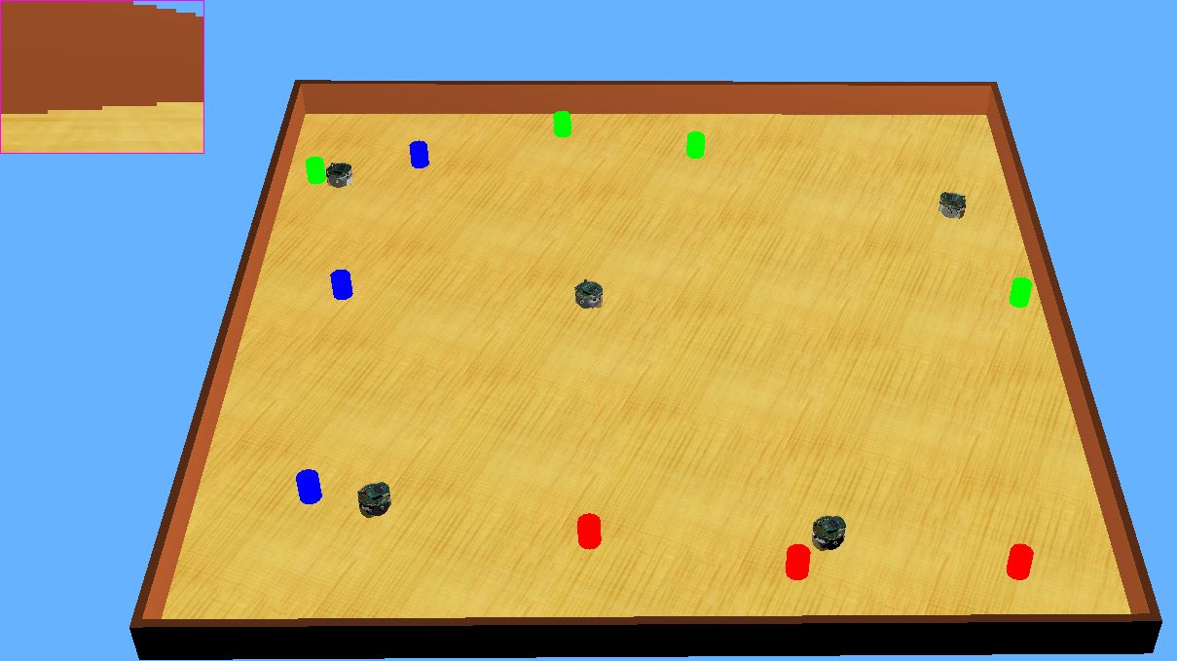
15/12/2015
DIS Project
<number>
The Webots setup
Agents : e-puck robots
Camera vision
Radio emitter/receiver
Arena
Square 160x160cm
Flat surface
Tasks
Red, green and blue cylinders
Random color
Random position
Notes:
Cheese is good
<number>

Slide 4
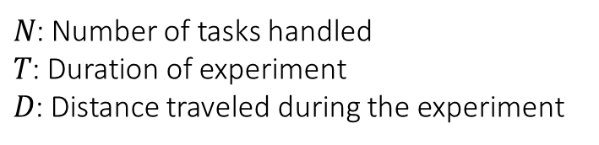
15/12/2015
DIS Project
<number>
The metrics used
Objective 1: Maximize the number of events handled / Time period
Objective 2: Minimize the distance traveled / Event handled -> Transformation
Metric 1
Metric 2
Notes:
<number>

Slide 5
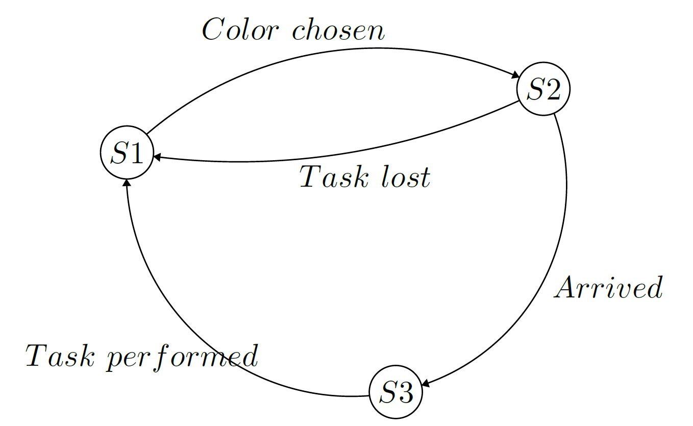
15/12/2015
DIS Project
<number>
The Finite-State Machine used
S1: Search for a task
S2: Go to a task
S3: Stop to perform the task

Slide 6
15/12/2015
DIS Project
<number>
The different algorithms tested
Threshold-based algorithms
Private (no communication, no stimuli adaptation)
Fixed thresholds
Adaptive
Specialization
Combination of both strategies
Public (communication and stimuli adaptation)
Fixed thresholds
Adaptive thresholds
Notes:
<number>

Slide 7
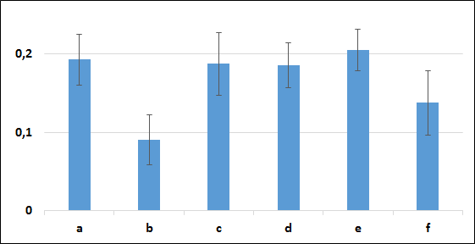
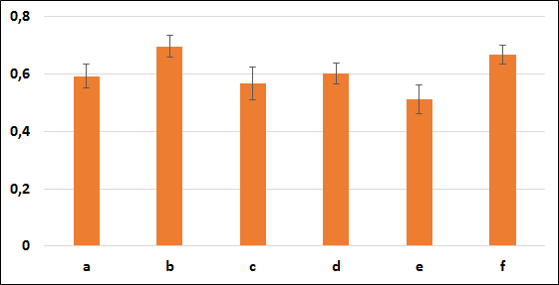
15/12/2015
DIS Project
<number>
Results
Metric 1 (event/time)
Metric 2 (distance/event)
Notes:
Cheese is good
<number>

Slide 8
15/12/2015
DIS Project
<number>
Private adaptive & specialization
Parameters
Notes:
Cheese is good
<number>

Slide 9
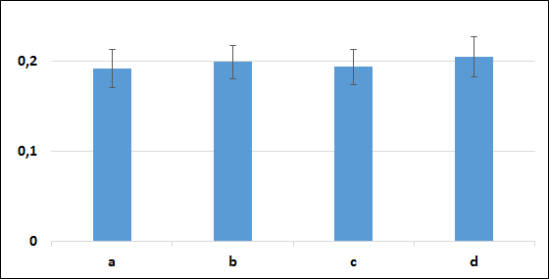
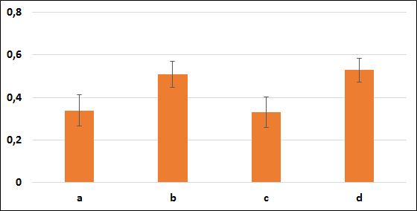
15/12/2015
DIS Project
<number>
Results : Adaptive
Metric 1 (event/time)
Metric 2 (distance/event)
Notes:
Cheese is good
<number>

Slide 10
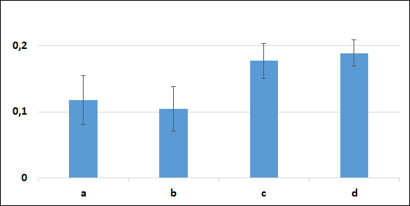
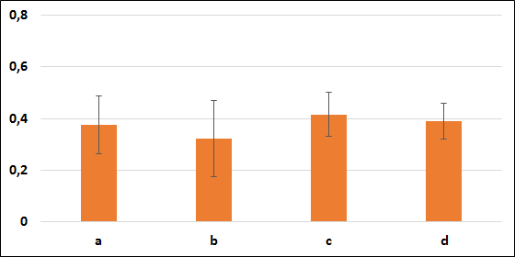
15/12/2015
DIS Project
<number>
Results: Specialization
Metric 1 (event/time)
Metric 2 (distance/event)
Notes:
Cheese is good
<number>

Slide 11
15/12/2015
DIS Project
<number>
Results: Specialization
Metric 1 (event/time)
Metric 2 (distance/event)
Notes:
Cheese is good
<number>

Slide 12
15/12/2015
DIS Project
<number>
Public case : communication
3 channels, one for each color
Send only the chosen color, and listen on all channels
Signal strength
Normalization
Limited communication range: if
Saturation if under a certain range: if
New stimulus:
Notes:
Cheese is good
<number>

Slide 13
15/12/2015
DIS Project
<number>
Public case
Parameters
Roto
Toto
Toto
toto
Notes:
Cheese is good
<number>

Slide 14
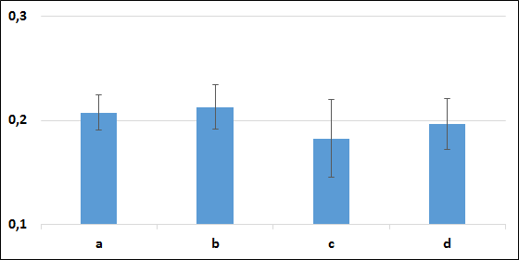
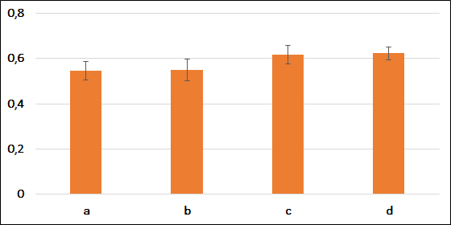
15/12/2015
DIS Project
<number>
Public case
Metric 1 (event/time)
Metric 2 (distance/event)
Notes:
Cheese is good
<number>

Slide 15
15/12/2015
DIS Project
<number>
Conclusions
Basic private algorithms achieve good performance if tuned appropriately
Communication among agents adds complexity but yields better results with higher robustness
Add more randomness in the behavior of the robots
PSO to optimize the weights and communication range in the public case
Notes:
Cheese is good
<number>

