Slide 1
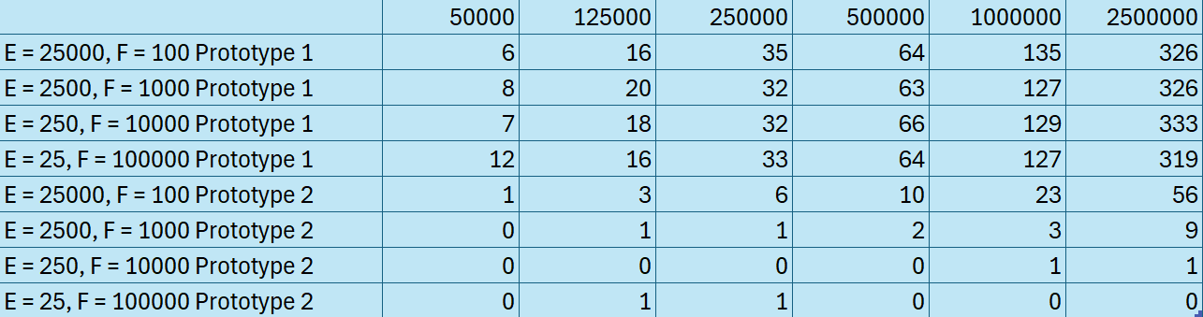
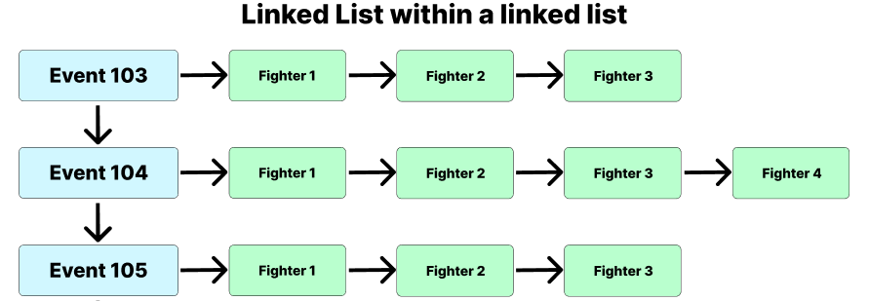
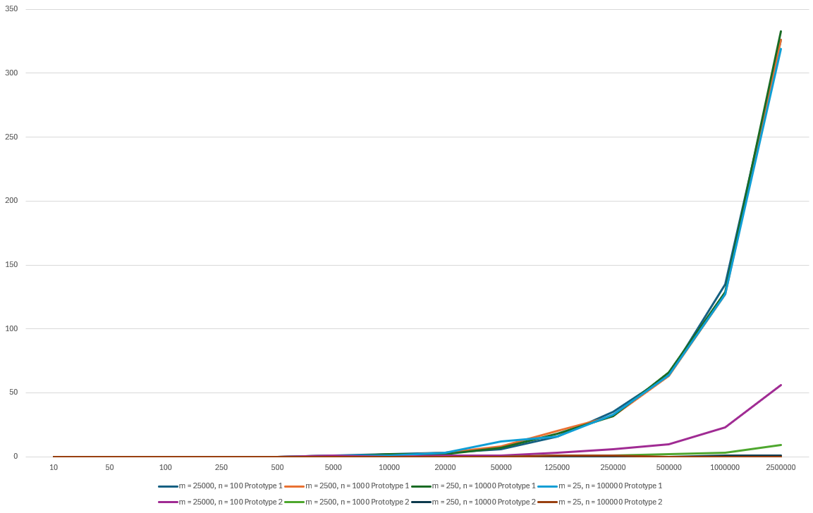
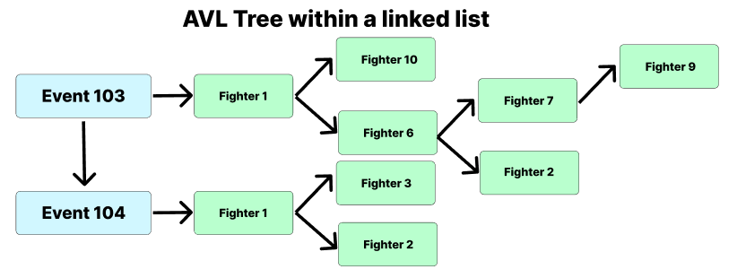
(Sibanda, 2024)
Ollington, R. (2025). Binary Heaps. Utas.edu.au. https://mylo.utas.edu.au/d2l/le/content/704827/viewContent/5960787/View
KIT205 Assignment 1 – Comparing a Data Structures Executing a Many-to-Many Relationship in a UFC Database
Bronson Billing (575952)
https://github.com/BronsonKBilling/KIT205_575952
Introduction
Methodology
Methodology
Results
Results
Professional sports leagues and organisations often make it a point to collect and display data on previous games or events. Mixed Martial Arts (MMA) is no different in this regard, as fighting promotions and fan organisations collect, store, and distribute enormous amounts of data on past events. This is the crux of the problem space for this research project: how can the enormous amount of data generated by MMA events and the fighters that participate in them be stored and accessed most effectively? Efficient storage and access is critical for both lessening running times, and even environmental efficiency (Sibanda, 2024) .
For reasons that will be discussed in the Methodology and Results section, it was decided that the two data structures used to solve this problem would be linked lists and Adelson-Velsky and Landis (AVL) trees. To make meaningful comparisons, both outer data structures were doubly linked lists and the inner structures were either AVL trees or doubly linked lists, depending on the prototype.
With any piece of code or database, there will be certain operations that are more complex than others. In the case of this problem, the most significant operation from a time complexity standpoint was printing a many-to-many relationship, where each event that a fighter had fought needed to be found and printed. This research project focused on comparing how two prototypes, one that contained a linked list and the other that contained an AVL tree, compare to each other when conducting this critical many-to-many operation.
To discuss the choices made for storing events and fighters, it is important to deconstruct these two data fields and what they can contain. Events in this circumstance are simply numerical (int) codes. For simplicity of both data storage and collection, it was decided to limit the problem domain to just UFC events rather than events across all MMA organisations.
Data on UFC events is easy to come by, and as many organisations have a similar event naming system as UFC ([organisation name] [event number]), only using UFC events avoids clashes with numerical codes. Events are ordered in ascending order and only increment by one at a time, and there will never be two events with the same code.
On the other hand, fighters are strings and are stored in ascending alphabetical order. A fighter can fight in many events, and events can have many fighters, however, a fighter cannot be stored more than once in the same event.
While it may have been interesting to compare how two completely different sets of data structures perform against each other (i.e., how a linked list of AVL trees compares to a heap of arrays), using the same outer data structure allowed for a more direct comparison. Additionally, once some data structure options were eliminated from the possibilities due to their incompatibility with the problem space, only linked lists and binary trees remained.
The data structure choices for this project were as follows:
Arrays
Linked lists
Binary Search Trees (BSTs)
Hash tables
Heaps
When considering the traits of an event, an array seemed like a perfect data structure to store them with. An event code could be directly accessed via its index (e.g., event 201 could be in the array at index 201). As there would only ever be one event with the same code, this means that each array index could directly map onto an event. While this part of an array seems perfect, the limited size of an array would have made making this into an actual scalable and usable database impossible. There would be no option to expand the database’s functionality in the future due to arrays being fixed size. Arrays are also inferior when it comes to event insertion. With a linked list, data can be inserted anywhere easily, whereas an array may require shuffling of values. While the testing data is sorted already, using an array limits future extensibility and makes dealing with other potentially unsorted input data much harder.
For these reasons, arrays are simply not suitable for storing events. They are also not suitable for storing fighters for the exact same reason and in the case of fighters, the pro of having direct index mapping is null and void. For the same reasons that an array is unsuitable for both events and fighters, array based data structures such as hash tables are also not suitable. Hash tables require an array to access table indices, so the underlying issues of arrays make hash tables not suitable for this problem.
While a heap almost always uses an array to store data, it can use a BST (Ollington, 2025). Using a BST would solve the previously discussed issues of an array but heaps are unsorted. This makes important operations such as printing in order far more difficult than with an AVL tree or a linked list that ensures that data is sorted on insertion.
Considering the faults of other data structures, the only ones left are linked lists and BSTs. As it is helpful for the data to be sorted when stored, an AVL tree was chosen to be the appropriate BST for this problem. Using doubly linked lists allowed insertion at any point in the list easily, which is perfect for inserting incrementing events as the tail can be replaced to insert a new event. However, the use of a doubly linked list that enforced order allowed insertion to be a quick and easy operation, whether the data is sorted or unsorted.
This is also the case for an AVL tree, which has even better performance characteristics when searching than a doubly linked list. Insertion can have greater constant factors than with a linked list due to balancing, but this trade-off allows for faster search times. When considering the most time complex operation of printing a many-to-many relationship between fighters and events, an obvious fault of doubly linked lists becomes completely nullified. This is searching. All events must be traversed anyway for this operation, so the poorer performance of a doubly linked list when traversing compared to other data structures is irrelevant for the most important function of the problem.
The use of a doubly linked list also allows for faster traversal of incremental events, as if the event being searched for is larger than half of the tail event code, then searching from the tail allows the search algorithm to avoid pointlessly searching over half of the events. This is not the case for names, as they are not alphabetically incremental in the real world.
To compare these two data structures, a doubly linked list containing doubly linked lists, and a doubly linked list containing AVL trees, theoretical analysis was needed as well as practical timings. Four different test datasets with 2.5 million records each were used to get practical timings. The datasets were as follows:
25,000 Events with 100 fighters each (E = 25,000, F = 100)
2,500 Events with 1,000 fighters each (E = 2,500, F = 1000)
250 Events with 10,000 fighters each (E = 250, F = 10,000)
25 Events with 100,000 fighters each (E = 25, F = 100,000)
Data was collected by timing the critical operation’s execution with the different datasets in milliseconds. These timings were then collated for easy analysis and graphing
A comparable operation, the one-to-many function where each fighter from a specific event must be printed also required traversing of both data structures. However, only one list or AVL tree of fighters needed to be printed in the one-to-many function, not all of them, as with the many-to-many function. This gives the one-to-many function a time complexity of O(E + F) for both data structures. This made the many-to-many function the most time complex and critical function of the database program.
The theoretical time complexity of both functions was determined by considering what they must do to achieve their utility. For the many-to-many function, an event must be searched once (thus, E), and in the worst case, the whole inner linked list must be traversed (thus, F). With the second prototype, each event must be searched, and in the worst case, a leaf node may be where the fighter is stored, searching for a leaf has log n complexity, thus log F.
While these theoretical calculations of time complexity mean little when the E and F values are small, as they grow the time to execute the function grows even faster. This can be seen in the below results.
As the proportion of fighters decreased compared to the proportion of events, the time it took for prototype 2 to execute increased. This makes sense when looking at the theoretical time complexity of prototype 2, as the log F section of the equation becomes less significant compared to the E section. As E increased and F decreased, the gap between prototype 1 and prototype 2 decreased. This shows that AVL trees are far more efficient at the critical operation. An example of this is that when E = 25,000 and F = 100, it took prototype 2 56ms to execute, compared to when E = 25 and F = 100,000 it took less than a millisecond to execute.
An interesting result is that no matter how large or small the amount of fighters within an event was compared to the number of events in total, the function time for prototype 1 was approximately the same. This makes sense as theoretically the time complexity of this function is just E x F, as the total amount of records was always 2.5M, the E and F values always made the same product. This was completely different with prototype 2, as its results varied wildly depending on whether the E or F value was larger, despite the product of them together being the same across all tests.
The below table shows the important practical results. All timings for each prototype and dataset were 0 prior to 50,000 records.
Despite the gap becoming narrower as the E value increased and the F value decreased, prototype 2 was far faster than prototype 1. Despite the AVL tree playing such a small part in the more E heavy operations, its presence was still enough to drastically decrease operation times. This shows that more efficient data structures are always worth including.
Conclusion
The data collected from this research project shows clearly the importance of choosing appropriate and efficient data structures for a situation. The results show clearly that doing so helps to decrease the time taken to complete an operation significantly. While the difference between 326ms and 56ms may be minimal in real world terms, once this scales up as a service becomes more used, the time differences between an ideal data structure choice and a poor one become more evident and costly. For this small-scale database, poor data structure choices may have little impact, but for a massive service like YouTube that handles and serves 440,000TB a day (Wiwatowska, 2021) such a choice could destroy the utility of a service. Research like this is important to evidence the importance of sound development decisions.
Results
References and Resources
If events are denoted with the symbol E and fighters are denoted with the symbol F, then the O time complexity of the critical many-to-many operation for both prototypes was as follows:
Doubly linked list of doubly linked lists (prototype 1):
O(E x F)
Doubly linked list of AVL trees (prototype 2)
O(E log F)
The many-to-many operation was the most time complex operation within the database, as it involved in the worst case searching both data structures rather than just one.
Ollington, R. (2025). Binary Heaps. Utas.edu.au. https://mylo.utas.edu.au/d2l/le/content/704827/viewContent/5960787/View
Sibanda, I. (2024). Green Algorithms - The Environmental Cost of Code. [online] IEEE Computer Society. Available at: https://www.computer.org/publications/tech-news/trends/environmental-cost-of-code.
Wiwatowska, A. (2021, November 30). How Much Data Does YouTube Use? WhistleOut. https://www.whistleout.com.au/MobilePhones/Guides/How-Much-Data-Does-YouTube-Use
KIT205 tutorial and weekly content was used heavily in the creation of both this poster and the database program, as well as its underlying data structures
ChatGPT was used extensively in creating the database program.
Methodology

