Slide 1
Pizza Bot
Link to github Repository: GitHub
Links to trello board / project management tools: Trello Board
You MUST provide evidence showing how the problem has been decomposed, how the components have been developed and trialled, and of how they have been assembled and tested to create a final, working outcome.

Slide 2
Relevant Implications
Explain the relevant implications here. Please watch this video to learn how to do this.
Notes:
Explain the relevant implications here. Then as you work, develop your code, discuss how the implications are being met.

Slide 3
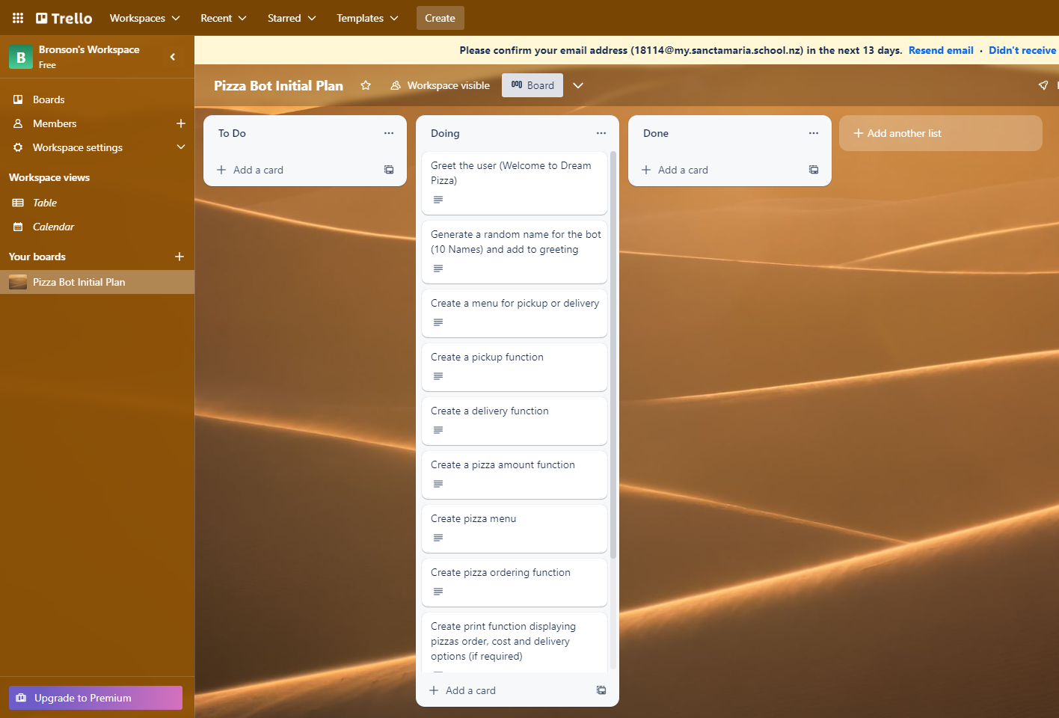
Decomposition
Notes:
Paste screenshots of your initial Trello board / task decomposition on this slide. If you have a long list, you might need to break it up into several columns. Delete this instruction when you are done.

Slide 4
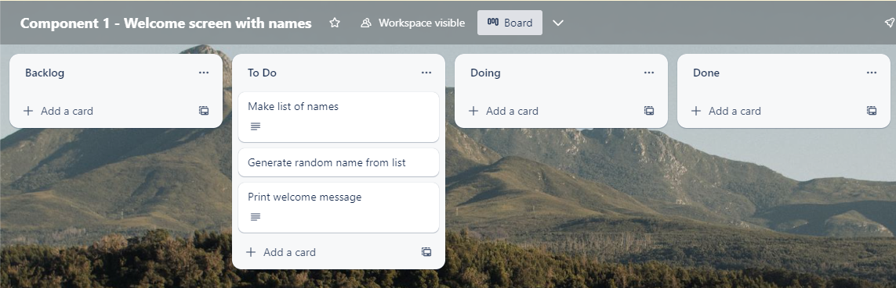
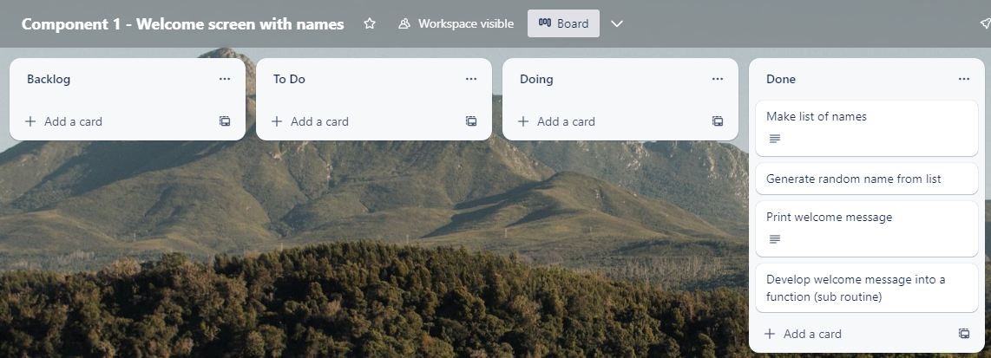
Component 1 (Trello screenshot)
Version 1
Version 2

Slide 5
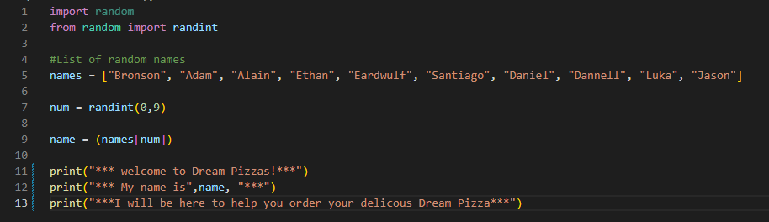
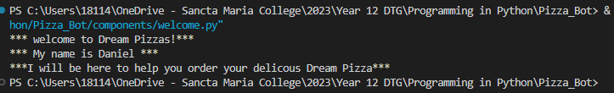
Component 1 Version 1 - Test Plan (?and screenshot)
Test Case | Expected Values
Ran program | Print welcome message with random name from name list – Runs correctly

Slide 6
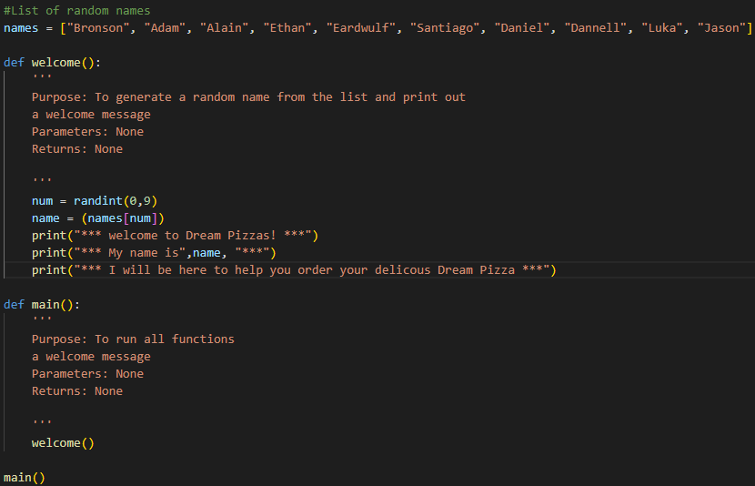
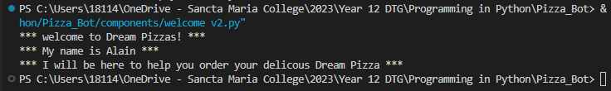
Component 1 Version 2 - Test Plan (?and screenshot)
Test Case | Expected Values
Ran program | Main and welcome run correctly. Welcome message prints with random name

Slide 7
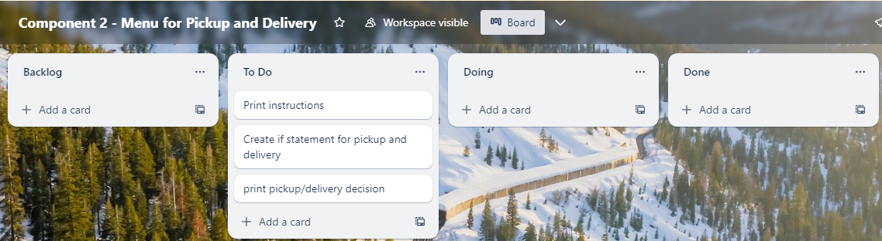
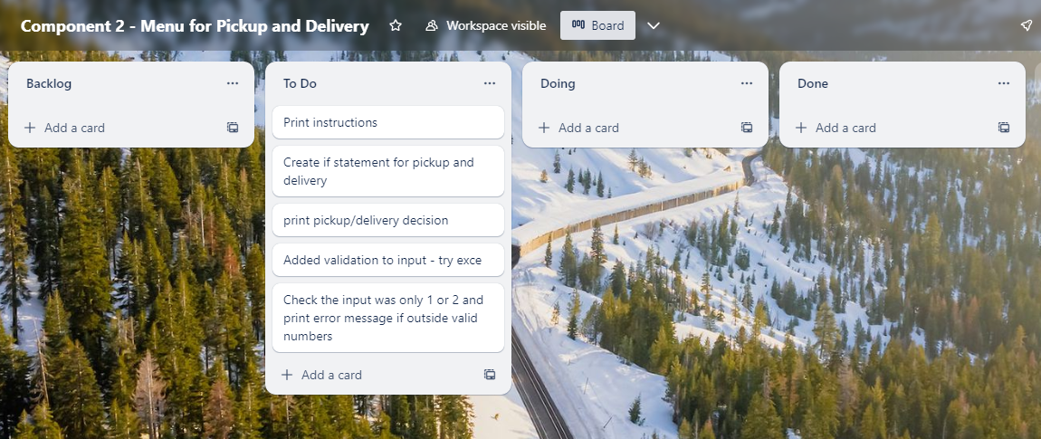
Component 2 (Trello screenshot)
Version 1
Version 2

Slide 8
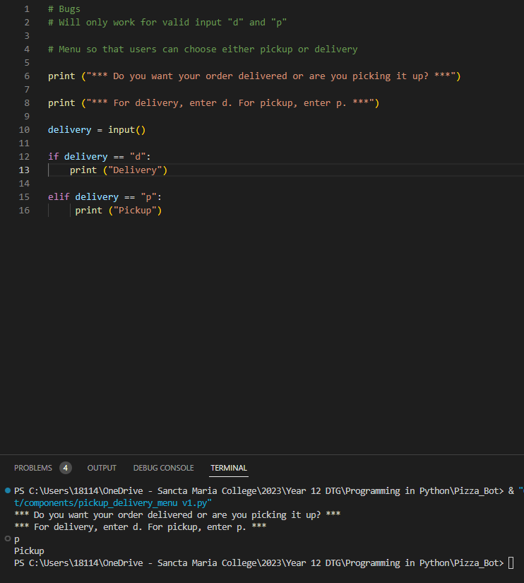
Component 2 Version 1 - Test Plan (?and screenshot)
Test Case | Expected Values
Ran program | Entered p – Program prints pickup Entered d – Program prints delivery Enter invalid – Program stops

Slide 9
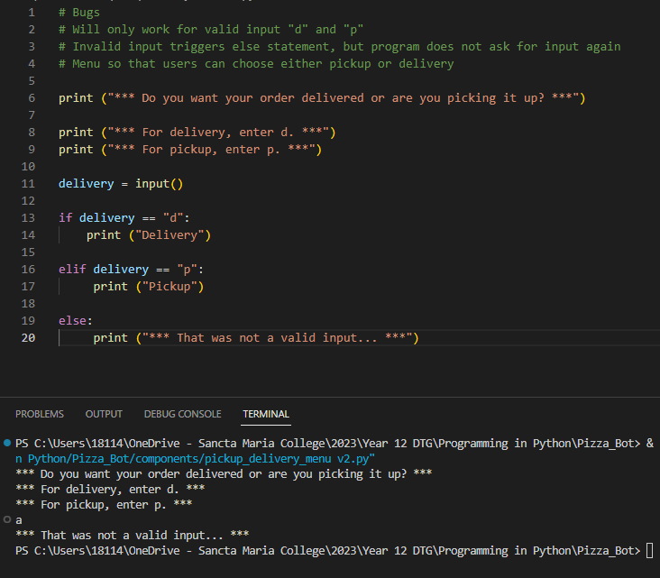
Component 2 Version 2 - Test Plan (?and screenshot)
Test Case | Expected Values
Ran program | Entered p – Program prints pickup Entered d – Program prints delivery Enter invalid – Program prints error message

Slide 10
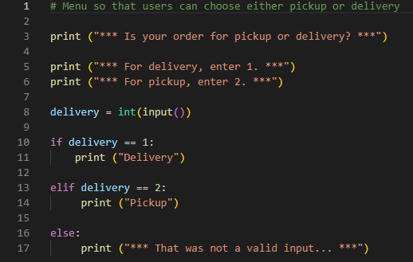
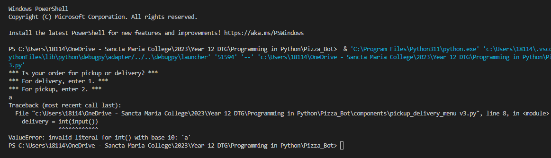
Component 2 Version 3 - Test Plan (?and screenshot)
Test Case | Expected Values
Ran program | Entered 1 – Program prints pickup Entered 2 – Program prints delivery Enter invalid – Program displays value error

Slide 11
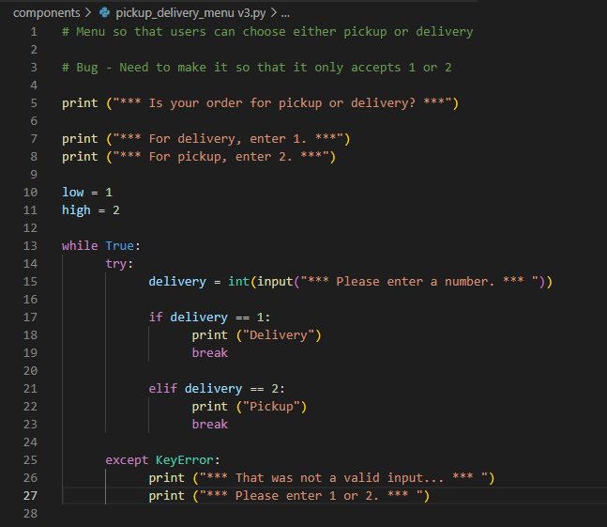
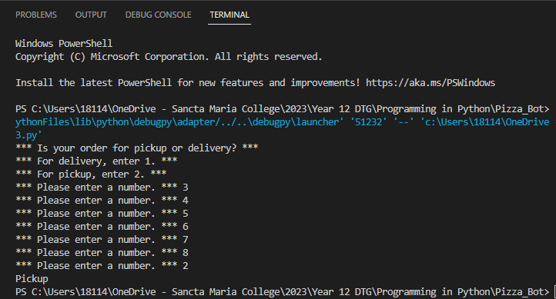
Component 2 Version 4 - Test Plan (?and screenshot)
Test Case | Expected Values
Ran program | Entered 1 – Program prints pickup Entered 2 – Program prints delivery Enter invalid – Program displays value error Enter number other than 1 or 2 does not work

Slide 12
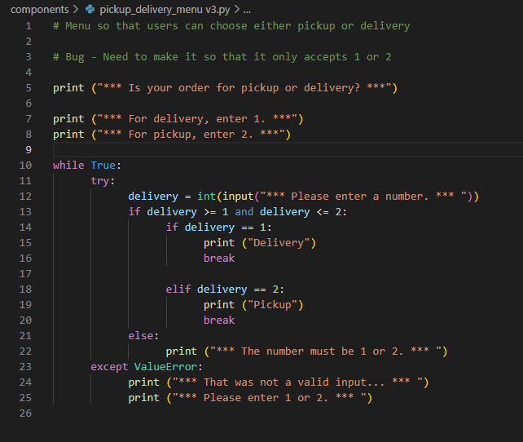
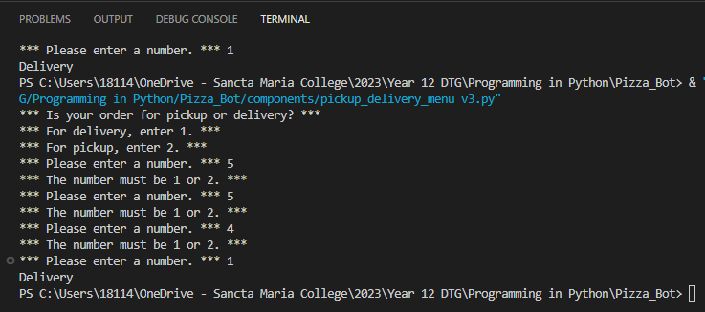
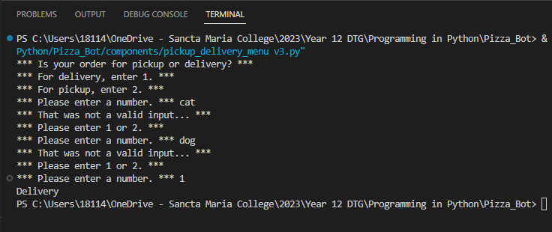
Component 2 Version 5 - Test Plan (?and screenshot)
Test Case | Expected Values
Ran program | Entered 1 – Program prints pickup Entered 2 – Program prints delivery Enter invalid – Error message asks for input again Enter number other than 1 or 2 – Error message asks for entry again

Slide 13
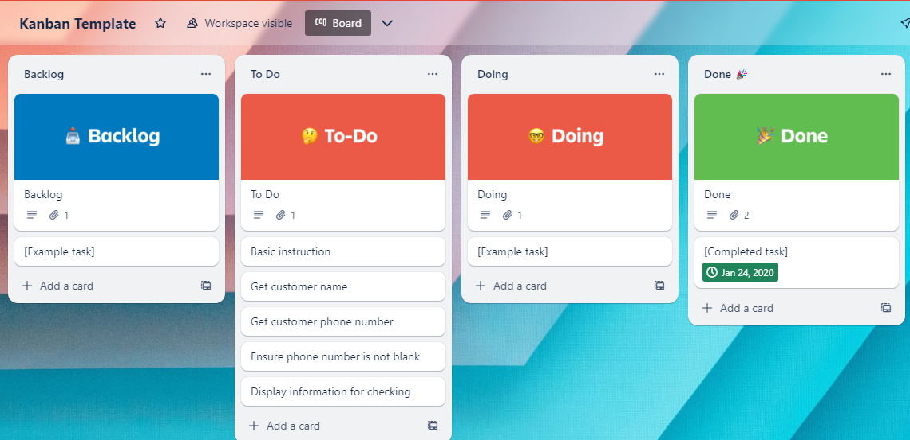
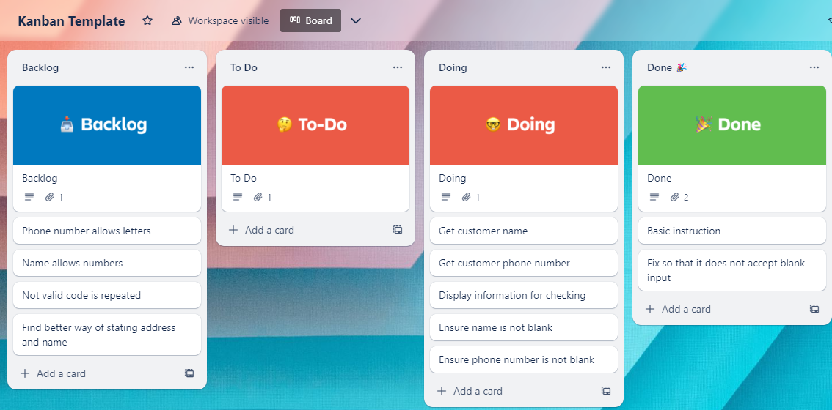
Component 3 – Pickup information (Trello screenshot)
Version 1
Version 2

Slide 14
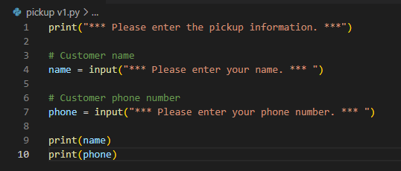
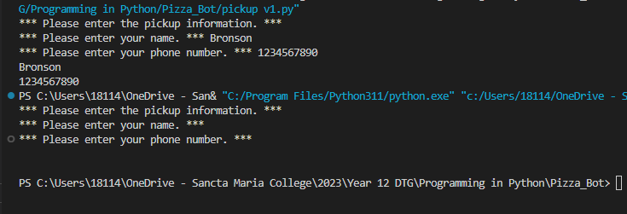
Component 3 Version 1 - Test Plan (?and screenshot)
Test Case | Expected Values
Input name Input phone number Left input blank | Printed name correctly. Printed phone number correctly. Accepted blank and printed blank input.

Slide 15
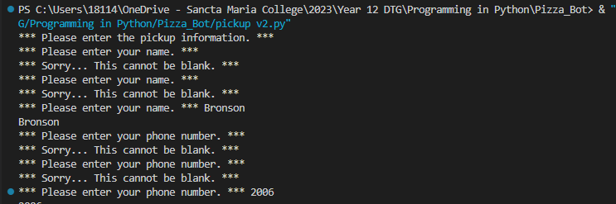
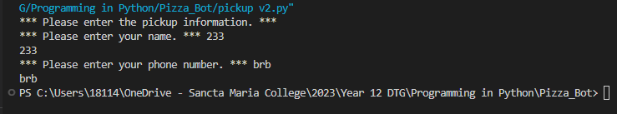
Component 3 Version 2 - Test Plan (?and screenshot)
Test Case | Expected Values
Input name Input phone number Left input blank | Printed name correctly. Printed phone number correctly. Prints "Sorry...and printed blank input.

Slide 16
Version Control Evidence
Your version control evidence should go here. This could be in the form of annotated screenshots which show you you managed this process or you could make a brief screencast explaining how you implemented version control.
Notes:
Your version control evidence should go here. This could be in the form of annotated screenshots which show you you managed this process or you could make a brief screencast explaining how you implemented version control.

Slide 17
Discusses how the information from planning, testing and trialling of components assisted in the development of a high-quality outcome
Notes:
Discusses how the information from planning, testing and trialling of components assisted in the development of a high-quality outcome

