Slide 1
CAPACITI · IT SUPPORT CAPSTONE
IT Infrastructure & Support Solution
25
employees
5
Ubuntu Innovations (Pty) Ltd
departments
The Byte 5
Khanya Gusha · Bronwyn Souls · Emaad Mentor · Siimphiwe Thwabuse · Thapelo Moncho
Notes:
Introduce the team and the client. Ubuntu Innovations is a fast-growing Cape Town technology startup relocating to a new office. Our brief as junior IT support specialists: design and document a complete IT infrastructure and support solution covering hardware, network, access control, backup, security, troubleshooting and documentation that future IT staff can pick up. 25 employees across five departments; Software Development (8) and Sales and Marketing (7) make up more than half the staff.

Slide 2




Business requirements
Connectivity
Resources
Security
Resilience
Wired + Wi-Fi, room to grow
NAS · printers · software
Own accounts · private data
Backups · documentation
Goal: secure, reliable, recoverable
Notes:
We grouped the client's requirements into four themes.
• Connectivity: wired and wireless access with capacity for growth.
• Shared resources: file storage, printers and the right software per department, e.g. accounting tools for Finance, CRM for Sales, IDEs, Git and Docker for Development.
• Access and security: every employee gets their own account and only sees what their department needs; Finance and HR data must never be open to everyone.
• Resilience and support: backups, repeatable troubleshooting steps and documentation.
Main risks we designed around: internet and power outages (including load shedding), hardware failure, malware, accidental deletion and unauthorised access.

Slide 3
Hardware recommendations
Asset | Qty | Key spec
Desktops | 20 | i5 · 16GB · 512GB SSD
Laptops | 5 | i7 · 16GB · 512GB SSD
Router / firewall | 1 | Business-grade
Managed switch | 1 | 24-port Gigabit, VLAN
Wi-Fi access points | 2 | Wi-Fi 6
Network printers | 2 | Laser
NAS | 1 | 8TB RAID
UPS | 2 | 1500VA
Notes:
Twenty desktops cover office-based staff; five i7 laptops give management and mobile staff flexibility. The business-grade router/firewall and managed switch are the core of the network. The managed switch matters because it lets us split traffic into VLANs (next slide). Two Wi-Fi 6 access points cover the office. Two laser printers are shared across departments for lower running costs. The 8TB RAID NAS holds shared folders and on-site backups. Two 1500VA UPS units keep the core network and NAS running through short outages and load shedding.
Software: a standard build for everyone (OS, browser, office suite, endpoint protection, backup client, password manager) plus department-specific tools.
Purpose of each asset: desktops for everyday office work; laptops for management mobility; router/firewall for internet access and perimeter security; managed switch for the wired network, monitoring and VLANs; access points for office-wide Wi-Fi; laser printers for shared printing at lower running cost; NAS for central file sharing and backups; UPS for outage and load-shedding protection. Laptops also have Wi-Fi 6; access points are dual-band.

Slide 4
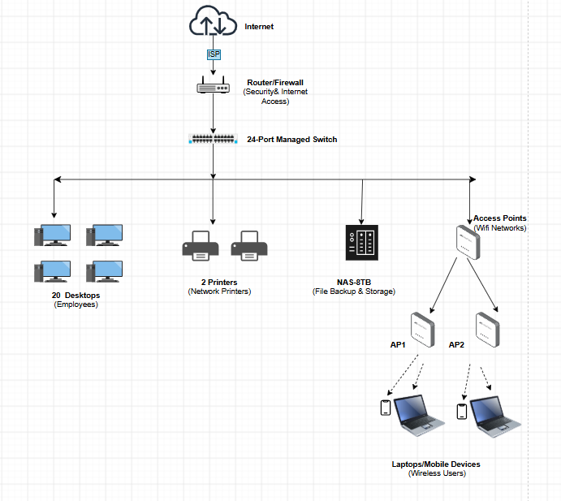
Network architecture
VLAN | Segment | Subnet
10 | Management | 192.168.10.0/24
20 | Servers / NAS | 192.168.20.0/24
30 | User devices | 192.168.30.0/24
40 | Printers | 192.168.40.0/24
50 | Staff Wi-Fi | 192.168.50.0/24
60 | Guest Wi-Fi | 192.168.60.0/24
Static IPs + DHCP
Firewall between VLANs
Guest Wi-Fi isolated · WPA3
Notes:
The ISP connection terminates at the router/firewall, which separates the internet from the internal network. Everything wired connects to the 24-port managed switch: desktops, printers, the NAS and the two access points serving laptops and phones.
We split the private 192.168.0.0/16 range into six VLANs, each a /24 with 254 usable addresses.
Static IPs: router 192.168.10.1, switch 192.168.10.2, access points 192.168.10.3–.4, NAS 192.168.20.10, printers 192.168.40.10–.11. DHCP hands out .100–.240 on the user, staff Wi-Fi and guest Wi-Fi segments.
Only IT administrators can reach the management VLAN, and guest Wi-Fi can never see company devices.
Firewall controls all traffic between VLANs; guests get internet only. Staff Wi-Fi uses WPA3-Enterprise (or WPA2).

Slide 5



User and permissions setup
Department | Group | Access
Management | mgmt_grp | Full access
Finance | finance_grp | Finance + Public
HR | hr_grp | HR + Public
Sales | sales_grp | Sales + Public
Development | dev_grp | Development + Public
Least privilege
Quarterly reviews
No shared accounts
Notes:
Each employee is added to the security group for their department, and folder permissions are set on the groups rather than on individuals. A new hire just joins a group; a mover changes group, with no folder-by-folder edits.
Every department reads and writes its own folder plus Public; Management has full access. IT administrators manage permissions but do not open confidential files without authorisation, and management approval is needed before anyone gets access to a confidential folder.
Access is reviewed every three months, leavers are disabled immediately and there are no shared accounts.
On the Linux side we demonstrated this with mkdir, chown and chmod; the full command-line guide is in our GitHub repository.
Shared folders on the NAS: /UBUNTU with Public, Management, Finance, HR, Sales and Development subfolders. Access is granted to groups, never to individual users.

Slide 6
Backup and recovery plan
3
2
1
copies
media
offsite
Daily incremental
Weekly full
Monthly archive
Encrypted
MFA protected
Tested monthly
Notes:
We follow the 3-2-1 rule. Backups cover departmental shared folders, finance and payroll databases, directory data, Microsoft 365 or Google Workspace data, a nightly mirror of GitHub repositories and network device configurations. Laptops are not backed up centrally; staff save to approved shared folders and laptops are rebuilt from a standard image.
Incrementals run daily, full backups weekly and archives monthly. Restore order: Critical, then Important, then Standard systems.
RTO is the maximum time a system can be down; RPO is the maximum data we can afford to lose.
In a disaster the IT Support Lead and COO declare it, staff are notified by WhatsApp or SMS, critical systems are restored first from the NAS (or from the cloud if the NAS is lost), department heads verify, and we document the actual RTO and RPO achieved. If the office is lost, staff work remotely and services are restored from the Cape Town cloud region.
3-2-1 detail: 3 copies (live data plus two backups), 2 storage media (on-site NAS and cloud), 1 copy offsite, encrypted and immutable so it is safe from fire, theft and ransomware.
Safeguards: AES-256 at rest, TLS in transit, MFA on backup consoles, monthly test restore, full DR test every six months, SA cloud region for POPIA.

Slide 7






Security recommendations
Passwords
MFA
Encryption
EDR
Patching
Awareness
12+ characters
Everywhere it matters
Full-disk
Always on
Monthly
Phishing training
INCIDENT RESPONSE
Detect
Report
Contain
Eradicate
Recover
Learn
Notes:
Top risks: phishing, ransomware and unpatched software. Incidents must be reported within 15 minutes.
Our risk assessment ranked phishing highest, especially fake invoices and payment-change scams aimed at Finance. Ransomware and unpatched software could stop work for all 25 employees; load shedding is a constant local risk handled by the UPS.
Six layered controls:
• Passwords: 12+ characters (16 for admins), stored in a password manager, lockout after 5 failed attempts.
• MFA: authenticator app for email, cloud, VPN and admins; FIDO2 hardware keys for IT, executives and Finance.
• Encryption: BitLocker, FileVault or LUKS on every device; phones enrolled in MDM with remote wipe.
• Endpoint protection: centrally managed EDR users cannot switch off; infected devices isolated automatically.
• Patching: monthly cycle, tested on a pilot group for 48 hours first; firmware reviewed quarterly.
• People: signed acceptable use policy, onboarding training, quarterly phishing simulations. The 2.5-hour awareness programme adds role-specific modules: payment verification for Finance, secure coding and secrets for developers, whaling for executives.
Incidents follow six phases; P1 incidents are escalated to management within an hour, and personal-information breaches are reported to the Information Regulator as required by section 22 of POPIA.

Slide 8



Troubleshooting: simple things first
No power
No internet
Printer offline
1
Power & UPS
1
Cable / Wi-Fi
1
Power · paper
2
Cable
2
IP settings
2
Network cable
3
Lights / fan
3
Router → ISP
3
Clear queue
Fixed in all 3 cases: a loose cable
Notes:
Method every time: check the simple things first, isolate the cause, fix, test, document.
We documented three common support cases with the same structure: problem, symptoms, possible causes, steps and resolution. The lesson across all three: simple physical checks come first.
• Dead desktop: check cable, outlet and UPS before suspecting the power supply.
• No internet: the key question is one user or the whole office. One user points to the cable, adapter or settings; the whole office points to the switch, router or ISP.
• Offline printer: power, paper and toner, then the cable and the print queue.
In all three cases a disconnected or loose cable was the cause, which is very common in practice.
Full steps — Desktop: check cable, outlet and UPS; test the outlet with another device; swap the power cable; look for lights or fan activity. Fixed: loose power cable reconnected. No internet: check Ethernet or Wi-Fi; ask if others are affected; check adapter and IP settings; check switch, router, then ISP. Fixed: Ethernet cable reconnected. Printer: check power, paper and toner; check the network cable; ask if others can print; clear the queue and print a test page. Fixed: network cable reconnected.

Slide 9




Career readiness materials
IT Support CV
Cover letter
LinkedIn summary
Interview prep
Notes:
The final week turned the technical work into career materials. Each of us prepared a one-page IT support CV, a cover letter tailored to a real role, a LinkedIn summary and ten interview questions with sample answers.
This capstone gives us concrete evidence to talk about: we designed a VLAN-based network, built a group-based permissions model, wrote a 3-2-1 backup plan and a full security policy.
We used AI tools to identify transferable skills, tailor applications, plan and track the job search, and rehearse interviews, but every output was reviewed and edited by us so it is accurate and sounds like us.
Details: one-page CV built around skills proven in this capstone; cover letter tailored to a specific IT support role; LinkedIn summary linking to the project portfolio; 10 IT support interview questions with structured sample answers.

Slide 10
Key lessons learned
01
Design security in
02
Groups scale
03
Test your backups
04
Document everything
Thank You
Questions?
Notes:
Four things we are taking away.
1. Security has to be part of the design: segmenting the network, requiring MFA and encrypting devices is simple at the start and painful to add later.
2. Assigning permissions to department groups rather than individuals keeps access simple, auditable and quick to change, and makes onboarding, offboarding and audits far easier.
3. A backup only counts once it restores, which is why monthly test restores and a six-monthly DR test are part of the plan.
4. Good documentation is itself a support tool: our troubleshooting guide and admin guide mean future IT staff are not starting from zero.
Thank the audience and open the floor for Q&A.

