Slide 1
Trans进度汇报 RIS Angular Domain Divide CSI Estimation and Doppler Compensation in mmWave MIMO
郭旭沨

Slide 2
Motivation 1 : Angular domain
Traditional CSI estimation (Theoretical Illustratino)
Higher pilot cost
Not fully implementing the MIMO channel sparsity
Traditional RIS CSI estimation (RIS System Illustration)
LS-based methods
High dimension, which is lethal in high frequency mmWave system
New concept: channel extrapolation
AI-based, need training
Angular domain CSI estimation
Suitable for mmWave channel sparsity
Save pilot cost
Higher estimation accuracy

Slide 3
Motivation 2: single RF antenna design
RIS cascade CSI estimation
Low pilot cost
High computational complexity
Relatively low estimation accuracy, surfer from“Cascade Angular Domain Distortion” (Proved in Lemma 3/Appendix C)
Active & semi-active RIS CSI estimation
High system complexity
High price and power consumption (It contradicts the original intention of RIS)
Impossible in practical
Proposed: RIS with just ONE RF antenna
Huge performance increasement compared with full passive RIS (Cascade CSI)
Much lower price and system complexity

Slide 4
Motivation 3: EM alg. & VB Inf. (Waiting)
Challenge
RIS assisted system introduced high dimension CSI
Advantages in angle-domain design
Opportunity
EM
VBI
RIS vs MIMO
https://v.youku.com/v_show/id_XMTM1Njc5NzkxNg==.html?spm=a2hbt.13141534.1_2.d_1_22&f=51634930&scm=20140719.apircmd.46307.video_XMTM1Njc5NzkxNg==

Slide 5





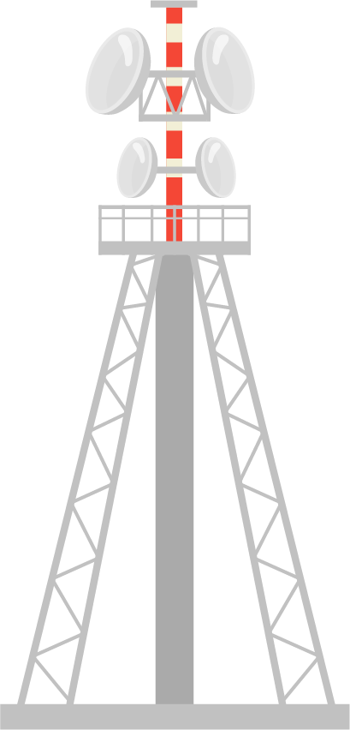









System Model
RIS with a single RF Antenna
（M-ULA）
L multi-paths
multi-paths
AoD
AoA
AoA
Path loss
Path loss
BS
（N-ULA）
AoD
Direct link
Suffer from doppler effect
k-th User
（A-ULA）

Slide 6


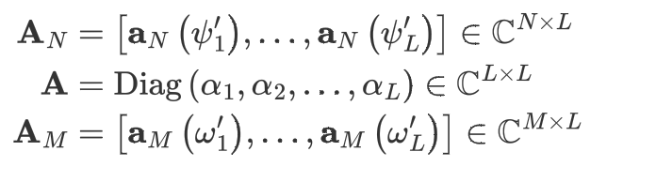
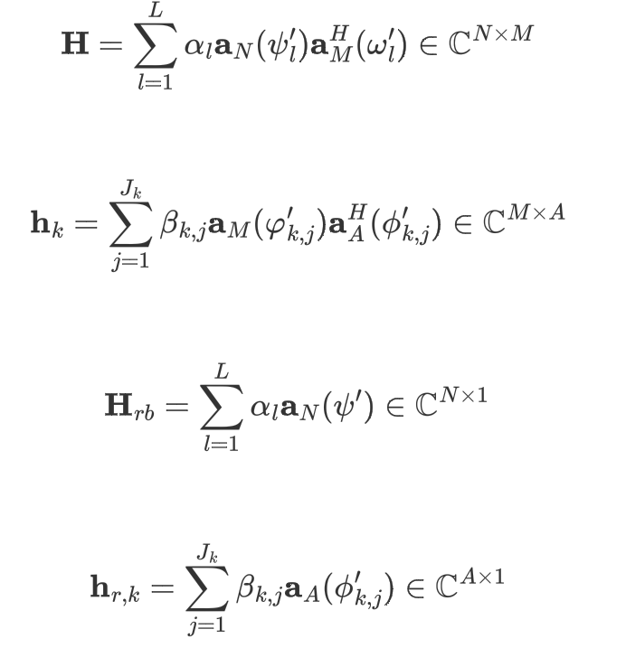
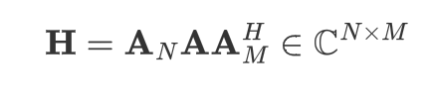
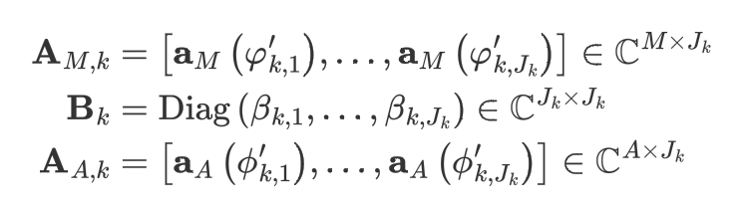





Channel model
Angular Domain Expressions and Components
Estimated with known &
Estimated first

Slide 7



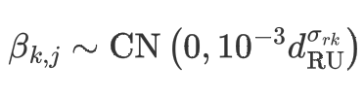


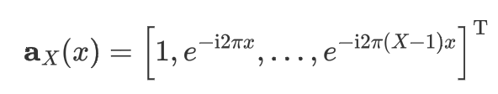

Channel model 2
ULA array response
Path loss generation
Limitation of Nyquist
Best resolution
Lemma 1

Slide 8
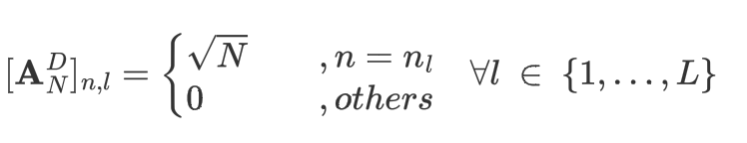


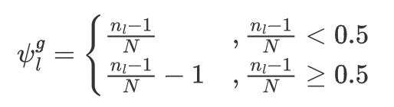

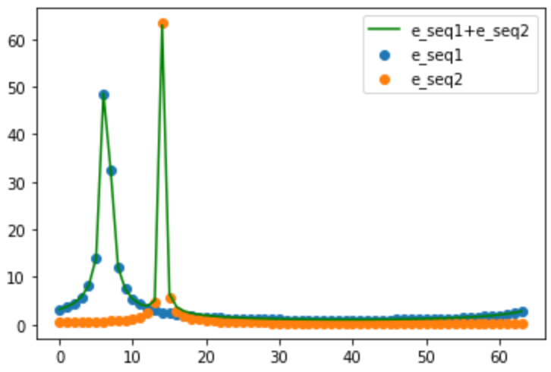
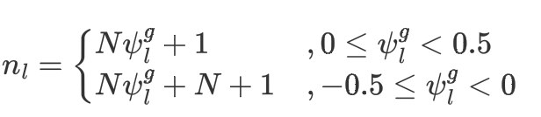
Channel model 3 (Angular Domain)
Essentially an equitization column
let “x” be discrete time index: t
then the FFT of this vector has only one non-zero element
under the condition that:
ULA array response
Incident signal
Then we have
DFT
and
For example
Lemma 2

Slide 9

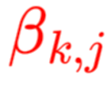

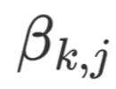










Frame Design 提出完方案，往后放？
Phase 1
One hop estimation
Phase 2
Cascade estimation
Phase 3
Doppler compensation
pilot
pilot
pilot
BS
RIS
user
BS
RIS
user
BS
RIS
user
Red: estimation target
Phase 1
Phase 2
transmission
transmission
transmission
Phase 3

Slide 10

EM alg.

Slide 11
VBI explain

Slide 12
Phase 1

Slide 13
Lemma 3/Appendix C

