Slide 1
进度汇报 RIS Angular Domain Divided CSI Estimation and Doppler Compensation in mmWave MIMO
郭旭沨

Slide 2
Motivation 1 : Angular domain
Traditional CSI estimation (Theoretical Illustratino)
Higher pilot cost
Not fully implementing the MIMO channel sparsity
Traditional RIS CSI estimation (RIS System Illustration)
LS-based methods
High dimension, which is lethal in high frequency mmWave system
New concept: channel extrapolation
AI-based, need training
Angular domain CSI estimation
Suitable for mmWave channel sparsity
Save pilot cost
Higher estimation accuracy

Slide 3
Motivation 2: single RF antenna design
RIS cascade CSI estimation
Low pilot cost
High computational complexity
Relatively low estimation accuracy, surfer from“Cascade Angular Domain Distortion” (Proved in Lemma 3/Appendix C)
Active & semi-active RIS CSI estimation
High system complexity
High price and power consumption (It contradicts the original intention of RIS)
Impossible in practical
Proposed: RIS with just ONE RF antenna
Huge performance increasement compared with full passive RIS (Cascade CSI)
Much lower price and system complexity

Slide 4

Motivation 3: EM alg. & VB Inf. (Waiting)
Challenge
RIS assisted system introduced high dimension CSI
Advantages in angle-domain design
Opportunity
EM
VBI
RIS in MIMO
VS. LASSO、AMP
https://v.youku.com/v_show/id_XMTM1Njc5NzkxNg==.html?spm=a2hbt.13141534.1_2.d_1_22&f=51634930&scm=20140719.apircmd.46307.video_XMTM1Njc5NzkxNg==

Slide 5





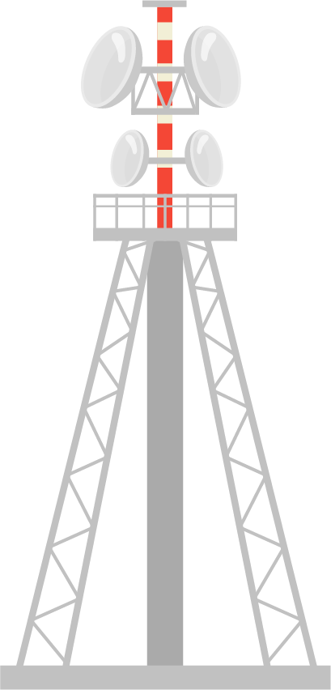





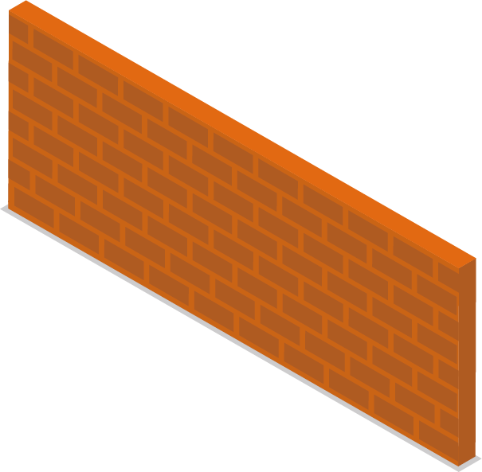



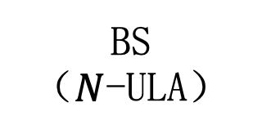
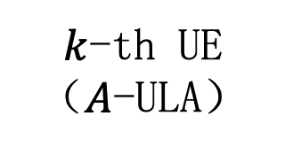


System Model 专利
SA-RIS
（$M$-ULA）
$L$个多径
个多径
AoD
AoA
AoA
路径损耗系数
路径损耗系数
BS
（$N$-ULA）
AoD
直连联路被遮挡
$k$-th UE
（$A$-ULA）

Slide 6
System Model
RIS with a single RF Antenna
（M-ULA）
L multi-paths
multi-paths
AoD
AoA
AoA
Path loss
Path loss
BS
（N-ULA）
AoD
Direct link
Suffer from doppler effect
k-th User
（A-ULA）

Slide 7


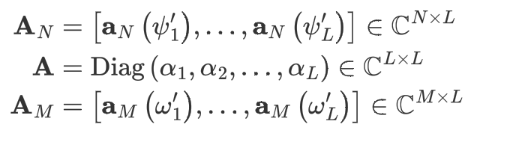
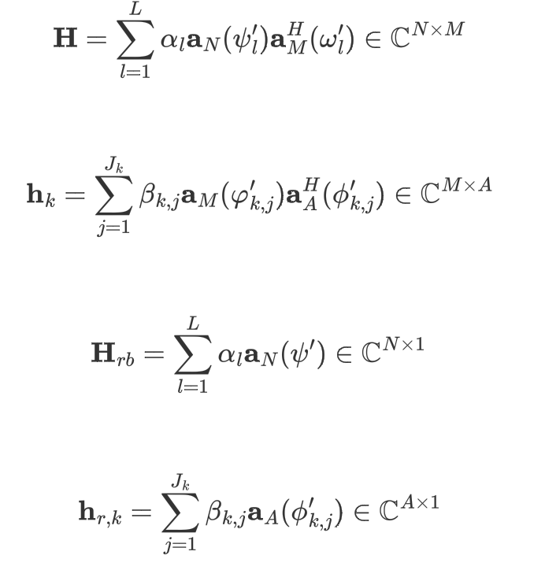
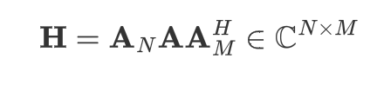
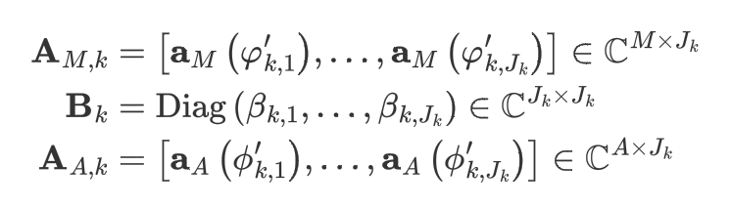





Channel model
Angular Domain Expressions and Components
Estimated with known &
Estimated first

Slide 8



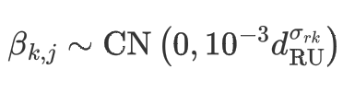


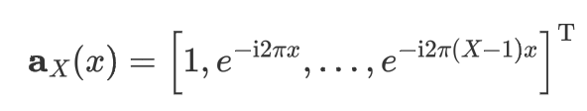

Channel model 2
ULA array response
Path loss generation
Limitation of Nyquist
Best resolution
Lemma 1

Slide 9
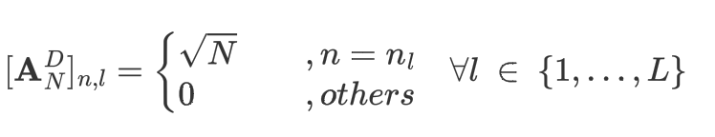


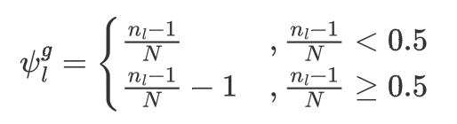

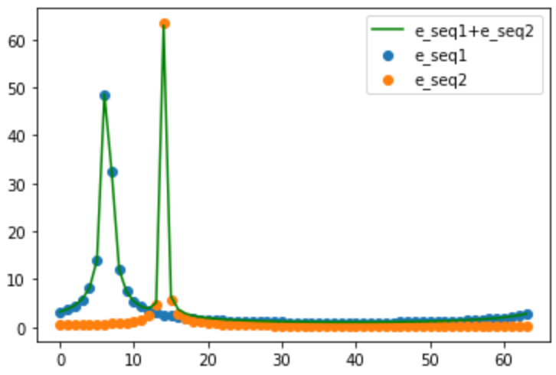
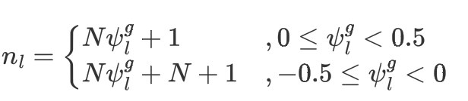
Channel model 3 (Angular Domain)
Essentially an equitization column
let “x” be discrete time index: t
then the FFT of this vector has only one non-zero element
under the condition that:
ULA array response
Incident signal
Then we have
DFT
and
For example
Lemma 2

Slide 10
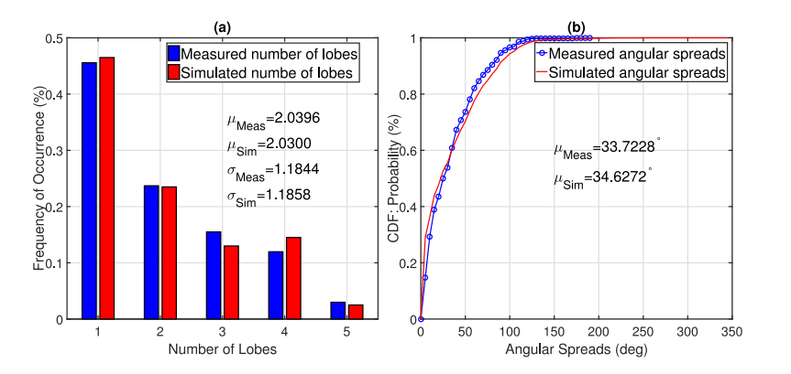
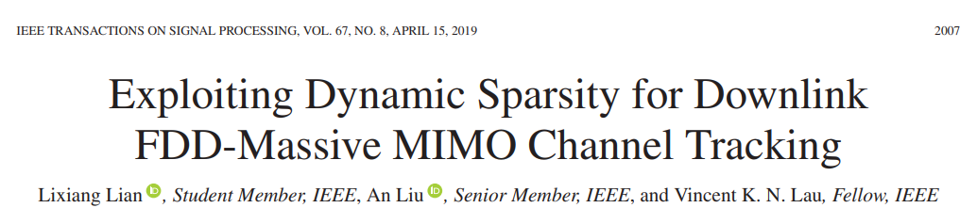
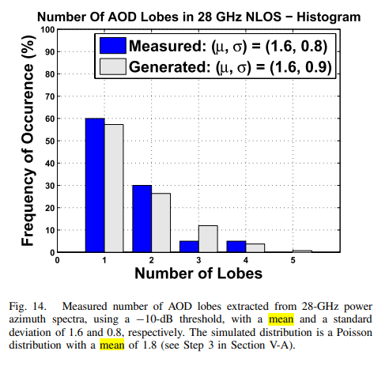
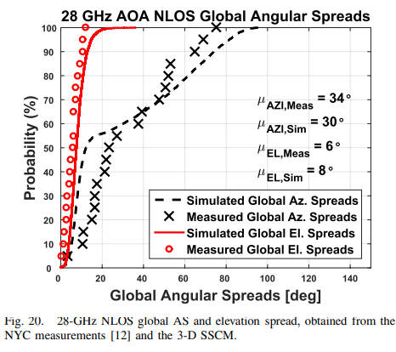
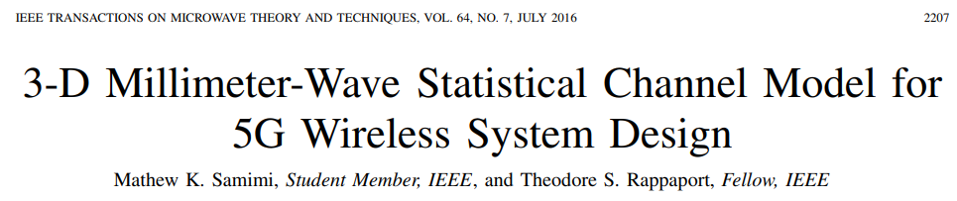
Compare Mea. & Sim.

Slide 11

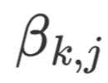

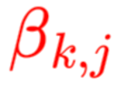












Frame Design
Only in the 1st user estimation
Phase 1
Partial estimation
Phase 2
Cascade estimation
Phase 3
Low cost 2nd hop estimation
pilot
pilot
pilot
BS
RIS
user
BS
RIS
user
BS
RIS
user
Red: estimation target
$t$-th frame
Phase 1
Phase 2
transmission
transmission
transmission
Phase 3
$$φ^{(t−1)}$$

Slide 12




Frame Design 专利 中文版
阶段一：广播
阶段二：级联信道估计
阶段三：信道校准
导频信号
导频信号
导频信号
BS
RIS
UE
BS
RIS
UE
BS
RIS
UE
$$\begin{aligned}& &&\end{aligned}$$
估计目标：$ψ_{l} α_{l} φ_{k,j}$
估计目标：$ω_{l} φ_{k,j} β_{k,j}$
估计目标：$φ_{k,j} β_{k,j} α_{l}$
第$t$个帧
1
阶段一
2
阶段二
3
1
2
数据传输
3
数据传输
3
3
数据传输
3
3
阶段三
$$φ^{(t−1)}$$

Slide 13
Structured Sparse-1 BS-RIS

Slide 14
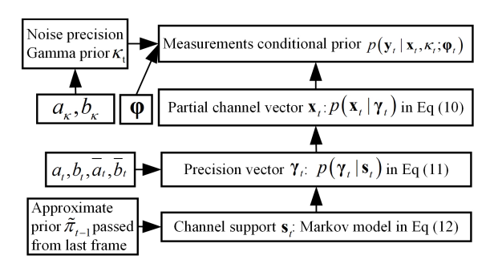

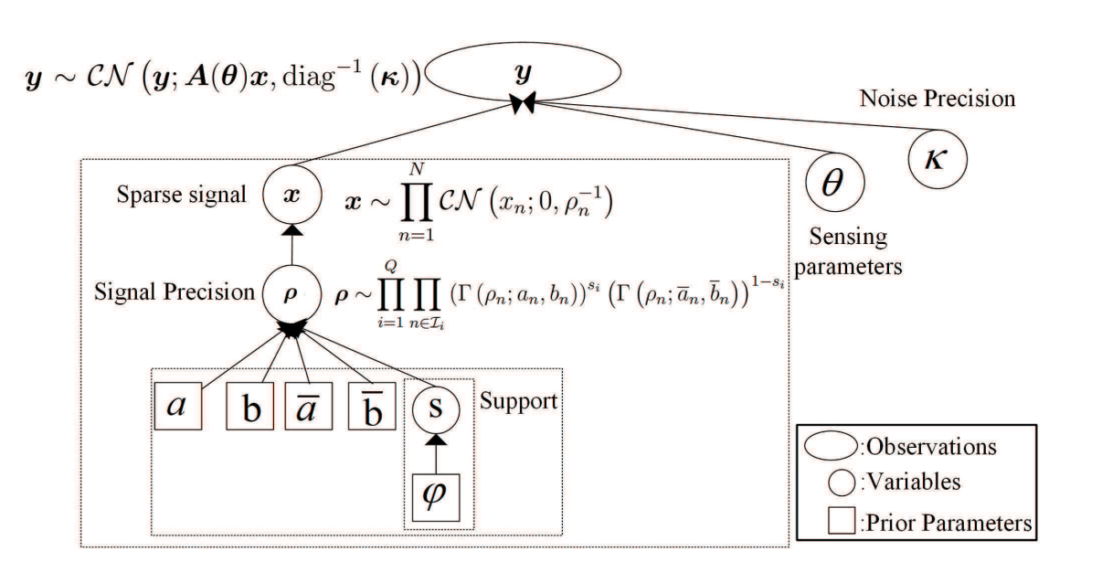


EM alg.
Hidden variables, grid parameters/channel support
(sample belong to which cluster)
Parameters to estimate
Theta rotation with respect to grids
(the distribution parameters
under each cluster)
Samples of received pilot

Slide 15
VBI explain

Slide 16

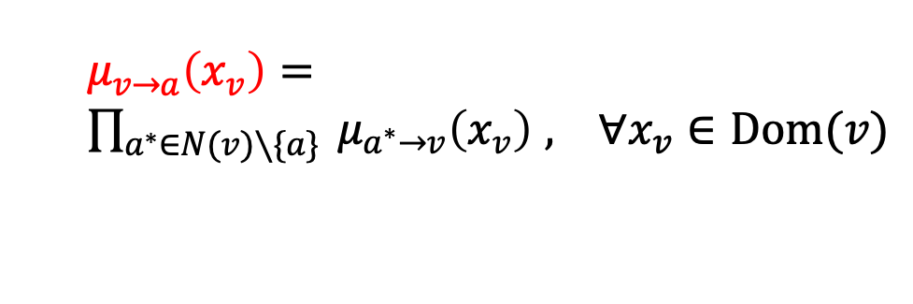







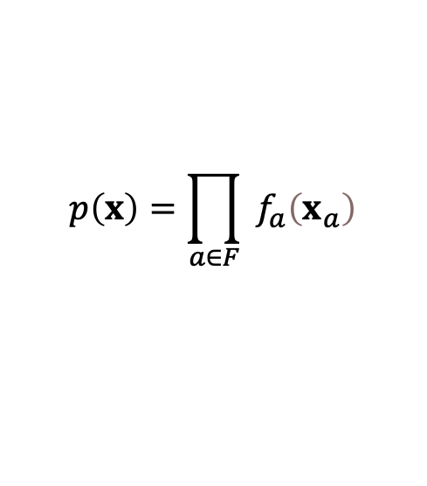

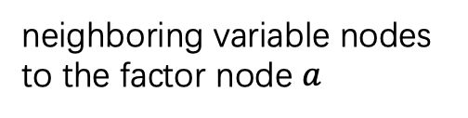
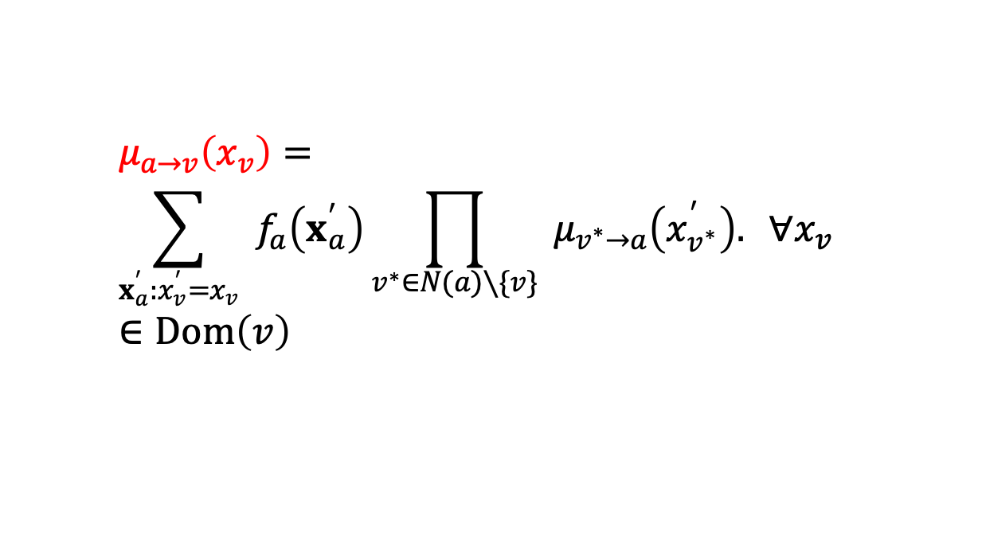
Belief propagation-1
Messages
(real-valued function)
Variables $V$
factors $F$
Variables $V$
$$μ_{f_{a}→a}$$
$$μ_{v→a}\left(x_{v}\right)=$$
$\prod_{a^{∗}∈N(v)∖\{a\}}{ }μ_{a^{∗}→v}\left(x_{v}\right)$ $, ∀x_{v}∈Dom(v)$
$$x_{a}$$
$$f_{a}$$
$$x_{a}$$
$$μ_{a→f_{a}}$$
Factor node $a$
neighboring variable nodes
to the factor node $a$
$$μ_{a→v}\left(x_{v}\right)=$$
$$\sum_{x_{a}^{′}:x_{v}^{′}=x_{v}}{ }f_{a}\left(x_{a}^{′}\right)\prod_{v^{∗}∈N(a)∖\{v\}}{ }μ_{v^{∗}→a}\left(x_{v^{∗}}^{′}\right). ∀x_{v}∈Dom\left(v\right)$$
$$p\left(x\right)=\prod_{a∈F}{ }f_{a}\left(x_{a}\right)$$

Slide 17


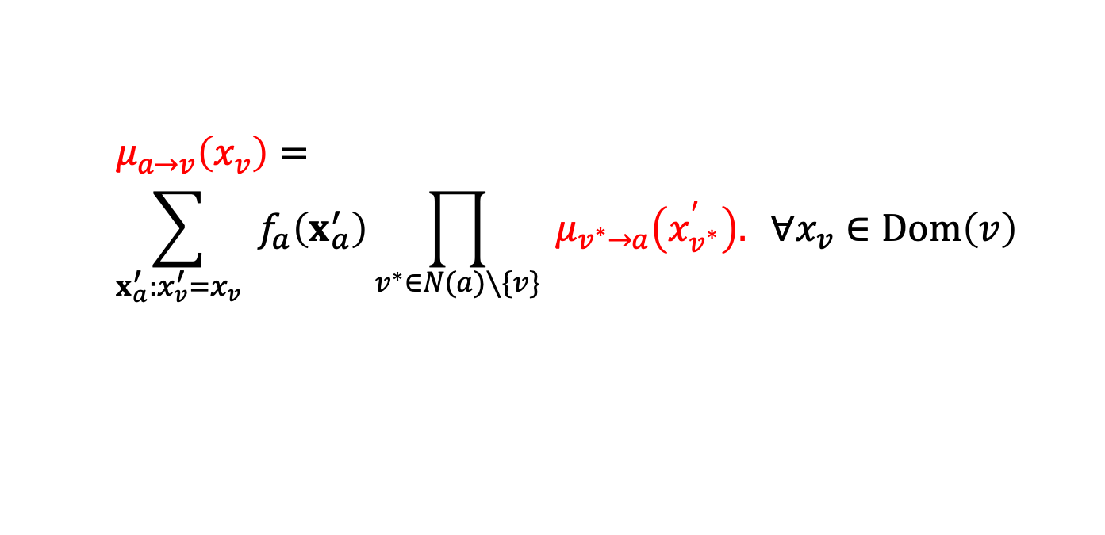


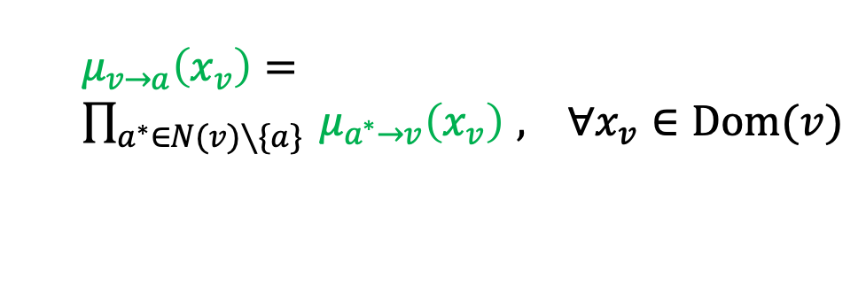







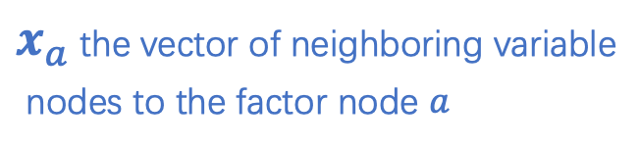
Belief propagation-2
$$μ_{a→v}\left(x_{v}\right)=$$
$$\sum_{x_{a}^{′}:x_{v}^{′}=x_{v}}{ }f_{a}\left(x_{a}^{′}\right)\prod_{v^{∗}∈N(a)∖\{v\}}{ }μ_{v^{∗}→a}\left(x_{v^{∗}}^{′}\right). ∀x_{v}∈Dom\left(v\right)$$
$$v_{n}^{∗}$$
$$v_{1}^{∗}$$
$$μ_{v^{∗}→a}$$
integration
$x_{a}$ the vector of neighboring variable
nodes to the factor node $a$
$$μ_{a→v}$$
variable
$$a$$
$$v$$
$x_{v}$ the vector of variable node $v$
$$μ_{v→a}$$
$$μ_{a^{∗}→v}$$
$$a_{m}^{∗}$$
$$μ_{v→a}\left(x_{v}\right)=$$
$\prod_{a^{∗}∈N(v)∖\{a\}}{ }μ_{a^{∗}→v}\left(x_{v}\right)$ $, ∀x_{v}∈Dom(v)$
$$a_{1}^{∗}$$

Slide 18
Belief propagation-3
$$μ_{a→v}\left(x_{v}\right)=$$
$$\sum_{x_{a}^{′}:x_{v}^{′}=x_{v}}{ }f_{a}\left(x_{a}^{′}\right)\prod_{v^{∗}∈N(a)∖\{v\}}{ }μ_{v^{∗}→a}\left(x_{v^{∗}}^{′}\right). ∀x_{v}∈Dom\left(v\right)$$
$$v_{n}^{∗}$$
$$v_{1}^{∗}$$
$$μ_{v^{∗}→a}$$
integration
$x_{a}$ the vector of neighboring variable
nodes to the factor node $a$
$$μ_{a→v}$$
variable
$$a$$
$$v$$
$x_{v}$ the vector of variable node $v$
$$μ_{v→a}$$
$$μ_{a^{∗}→v}$$
$$a_{m}^{∗}$$
$$μ_{v→a}\left(x_{v}\right)=$$
$\prod_{a^{∗}∈N(v)∖\{a\}}{ }μ_{a^{∗}→v}\left(x_{v}\right)$ $, ∀x_{v}∈Dom(v)$
$$a_{1}^{∗}$$

Slide 19
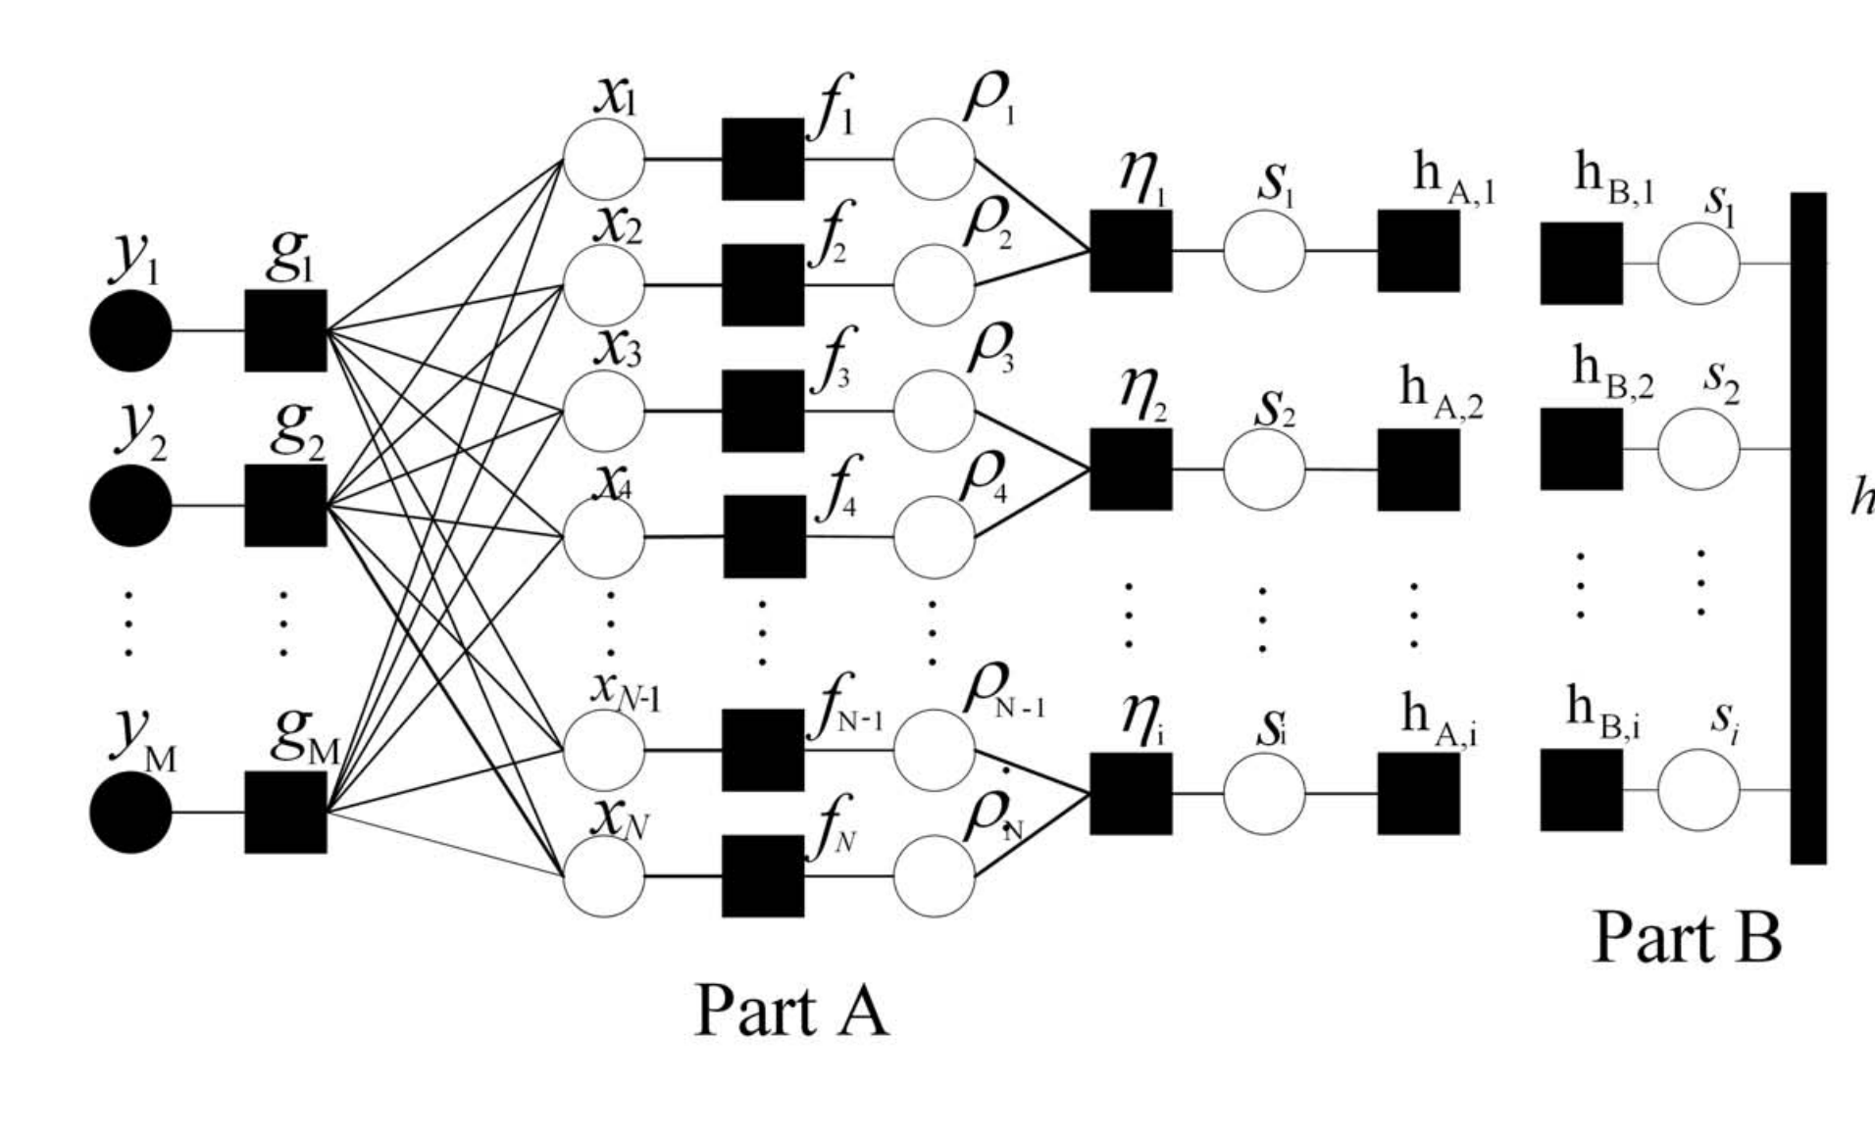
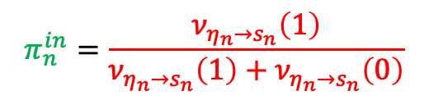
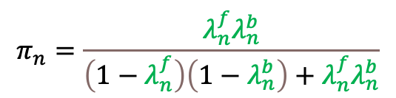

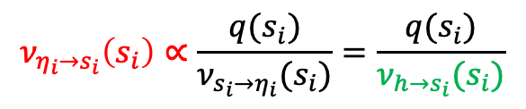


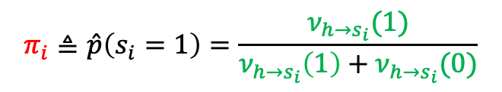
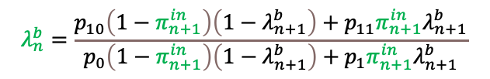
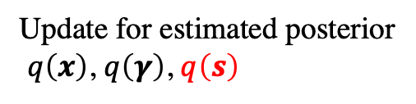

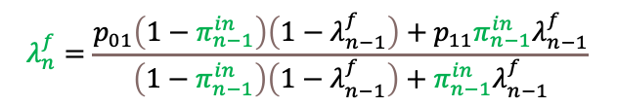



Module A & Module B
$$ν_{h→s_{i}}$$
Part A
Part B
ext
$$ν_{η_{i}→s_{i}}$$
$t$ frame
$t+1$ frame
$$π_{n}=\frac{λ_{n}^{f}λ_{n}^{b}}{\left(1−λ_{n}^{f}\right)\left(1−λ_{n}^{b}\right)+λ_{n}^{f}λ_{n}^{b}}$$
$$ν_{h_{n}→s_{n}}\left(s_{n}\right)={\left(π_{n}\right)}^{s_{n}}{\left(1−π_{n}\right)}^{1−s_{n}}$$
$$π_{i}≜\hat{p}\left(s_{i}=1\right)=\frac{ν_{h→s_{i}}(1)}{ν_{h→s_{i}}\left(1\right)+ν_{h→s_{i}}(0)}$$
$${ν_{h→s_{n}}\left(s_{n}\right)=ν}_{h_{n}→s_{n}}\left(s_{n}\right)$$
Update for estimated posterior
$q\left(x\right)$, $q\left(γ\right)$, $q\left(s\right)$
$$λ_{n}^{f}=\frac{p_{01}\left(1−π_{n−1}^{in}\right)\left(1−λ_{n−1}^{f}\right)+p_{11}π_{n−1}^{in}λ_{n−1}^{f}}{\left(1−π_{n−1}^{in}\right)\left(1−λ_{n−1}^{f}\right)+π_{n−1}^{in}λ_{n−1}^{f}}$$
Why?
$$λ_{n}^{b}=\frac{p_{10}\left(1−π_{n+1}^{in}\right)\left(1−λ_{n+1}^{b}\right)+p_{11}π_{n+1}^{in}λ_{n+1}^{b}}{p_{0}\left(1−π_{n+1}^{in}\right)\left(1−λ_{n+1}^{b}\right)+p_{1}π_{n+1}^{in}λ_{n+1}^{b}}$$
$$ν_{η_{i}→s_{i}}\left(s_{i}\right)∝\frac{q(s_{i})}{ν_{s_{i}→η_{i}}(s_{i})}=\frac{q(s_{i})}{ν_{h→s_{i}}(s_{i})}$$
$$π_{n}^{in}=\frac{ν_{η_{n}→s_{n}}\left(1\right)}{ν_{η_{n}→s_{n}}\left(1\right)+ν_{η_{n}→s_{n}}\left(0\right)}$$
$$h_{B,n}\left(s_{n}\right)∝{\left(π_{n}^{in}\right)}^{s_{n}}{\left(1−π_{n}^{in}\right)}^{1−s_{n}}$$

Slide 20





































Factor graph Part A & B
$$h_{A,i}^{k}(s_{k,i})≜ν_{h^{k}→s_{k,i}}\left(s_{k,i}\right)$$
$$ν_{h^{k}→s_{k,i}}\left(s_{k,i}\right)$$
$$x_{k,1}$$
$$γ_{k,1}$$
$$h^{k}$$
$$f_{k,1}$$
$$η_{k,1}$$
$$s_{k,1}$$
$$h_{A,1}^{k}$$
$$h_{B,1}^{k}$$
$$s_{k,1}$$
$$x_{k,1}$$
$$f_{k,2}$$
$$γ_{k,2}$$
$$η_{k,2}$$
$$s_{k,2}$$
$$h_{A,2}^{k}$$
$$h_{B,2}^{k}$$
$$s_{k,2}$$
$$x_{k,1}$$
$$f_{k,3}$$
$$γ_{k,3}$$
$$η_{k,3}$$
$$s_{k,3}$$
$$h_{A,3}^{k}$$
$$h_{B,3}^{k}$$
$$s_{k,3}$$
$$⋮$$
$$⋮$$
$$⋮$$
$$x_{k,1}$$
$$f_{k,4}$$
$$γ_{k,3}$$
$$η_{k,3}$$
$$s_{k,M}$$
$$h_{A,M}^{k}$$
$$h_{B,M}^{k}$$
$$s_{k,M}$$

Slide 21























Factor graph Part B
$$h_{1}^{c}$$
$$c_{1}$$
$$h_{2}^{c}$$
$$c_{2}$$
$$h_{3}^{c}$$
$$c_{3}$$
$$…$$
$$c_{M}$$
$$p(c_{1})$$
$$p(c_{2}∣c_{1})$$
$$p(c_{3}∣c_{2})$$
$$f_{k,M}$$
$$f_{k,2}$$
$$f_{k,3}$$
$$f_{k,M}$$
$$p(s_{k,1}∣c_{1})$$
$$p(s_{k,2}∣c_{2})$$
$$p(s_{k,3}∣c_{3})$$
$$p(s_{k,M}∣c_{M})$$
$$s_{k,1}$$
$$s_{k,2}$$
$$s_{k,3}$$
$$s_{k,2}$$

Slide 22



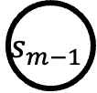
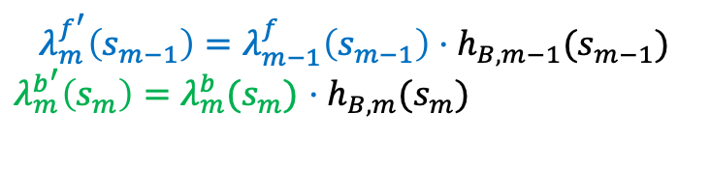



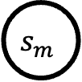

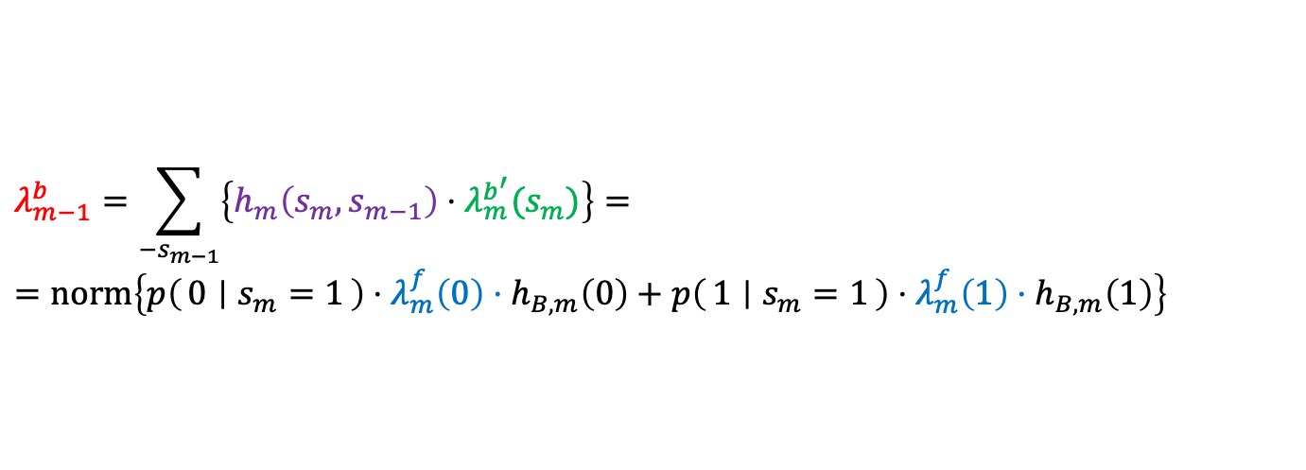





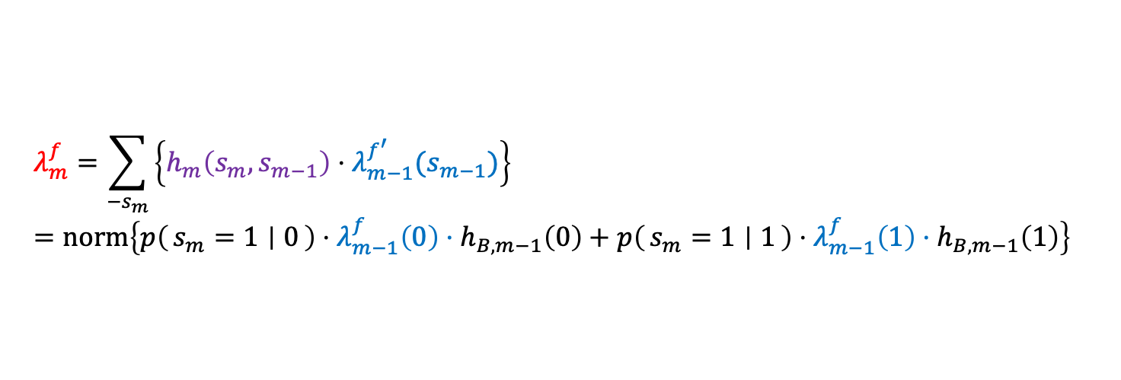



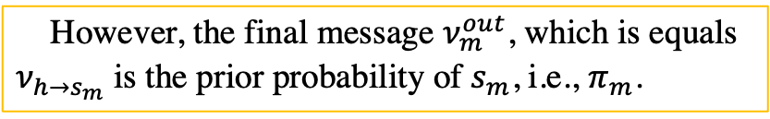
Factor graph Part B (Robust Recovery)
$$λ_{m−1}^{f}$$
$$λ_{m−1}^{b}$$
$$λ_{m}^{f}$$
$$λ_{m}^{b}$$
$$h_{m−1}$$
$$s_{m−1}$$
$$h_{m}$$
$$s_{m}$$
$$h_{m+1}$$
$$λ_{m−1}^{f′}$$
$$λ_{m}^{b′}$$
$$ν_{n}^{out}$$
$$h_{B,m}(s_{m})$$
$$h_{B,m−1}$$
$$h_{B,m}$$
The real value remains unknow
Forward/backward:
However, the final message $ν_{m}^{out}$, which is equals
$ν_{h→s_{m}}$ is the prior probability of $s_{m}$, i.e., $π_{m}$.
$$λ_{m}^{f}=\sum_{−s_{m}}{\left\{h_{m}\left(s_{m},s_{m−1}\right)⋅λ_{m−1}^{f^{′}}(s_{m−1})\right\}}=norm\left\{p\left(s_{m}=1 ∣ 0\right)⋅λ_{m−1}^{f}\left(0\right)⋅h_{B,m−1}\left(0\right)+p\left(s_{m}=1 ∣ 1\right)⋅λ_{m−1}^{f}\left(1\right)⋅h_{B,m−1}\left(1\right)\right\}$$
Calculate $ν_{m}^{out}$:
$$ν_{m}^{out}\left(s_{m}\right)=normal\left\{(λ_{m}^{f}{\left(s_{m}\right)λ}_{m}^{f}(s_{m})\right\}$$
$$λ_{m−1}^{b}=\sum_{−s_{m−1}}{\left\{h_{m}\left(s_{m},s_{m−1}\right)⋅λ_{m}^{b^{′}}(s_{m})\right\}}==norm\left\{p\left(0 ∣ s_{m}=1\right)⋅λ_{m}^{f}\left(0\right)⋅h_{B,m}\left(0\right)+p\left(1 ∣ s_{m}=1\right)⋅λ_{m}^{f}\left(1\right)⋅h_{B,m}\left(1\right)\right\}$$
Where:
$$λ_{m}^{f^{′}}\left(s_{m−1}\right)=λ_{m−1}^{f}\left(s_{m−1}\right)⋅h_{B,m−1}(s_{m−1})$$
$λ_{m}^{b^{′}}\left(s_{m}\right)=λ_{m}^{b}(s_{m})$ $⋅h_{B,m}(s_{m})$

Slide 23














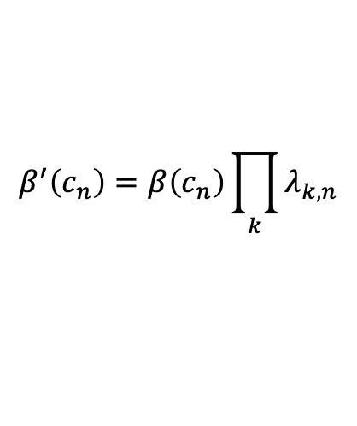









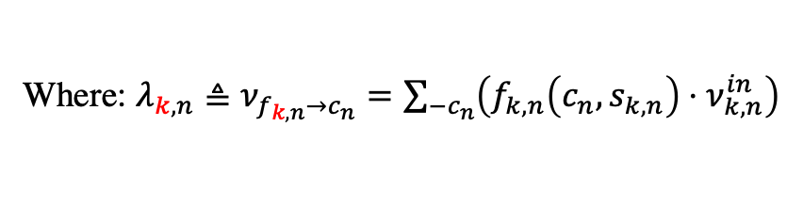





Factor graph Part B (pattern 1)
Only need to solve
$$α(c_{n−1})$$
$$β(c_{n−1})$$
$$α(c_{n})$$
$$β(c_{n})$$
$$h_{n−1}^{c}$$
$$c_{n−1}$$
$$h_{n}^{c}$$
$$c_{n}$$
$$h_{n+1}^{c}$$
$$β^{′}(c_{n−1})$$
$$α^{′}(c_{n−1})$$
$$β^{′}(c_{n})$$
$$α^{′}(c_{n})$$
Forward/backward:
$$p(c_{n}∣c_{n−1})$$
…
…
$$α\left(c_{n}\right)=\sum_{−c_{n}}{h_{n}^{c}\left(c_{n},c_{n−1}\right)⋅α^{′}(c_{n−1})}$$
$$f_{k^{′},n−1}$$
$$f_{k^{′},n}$$
$$f_{k,n−1}$$
$$f_{k,n}$$
$$β\left(c_{n−1}\right)=\sum_{−c_{n−1}}{h_{n}^{c}\left(c_{n},c_{n−1}\right)⋅β^{′}(c_{n})}$$
$$s_{k^{′},n−1}$$
$$s_{k^{′},n}$$
$$α^{′}\left(c_{n−1}\right)=α\left(c_{n−1}\right)\prod_{k}{λ_{k,n−1}}$$
$$s_{k,n−1}$$
$$s_{k,n}$$
$$β^{′}\left(c_{n}\right)=β\left(c_{n}\right)\prod_{k}{λ_{k,n}}$$
Calculate $ν_{k,n}^{out}$:
$$ν_{k,n}^{out}≜\sum_{−s_{k,n}}{\left\{f_{k,n}\left(c_{n},s_{k,n}\right)⋅δ_{k,n}\right\}}$$
Where: $λ_{k,n}≜ν_{f_{k,n}→c_{n}}=\sum_{−c_{n}}{\left(f_{k,n}\left(c_{n},s_{k,n}\right)⋅ν_{k,n}^{in}\right)}$
Where: $δ_{k,n}≜ν_{c_{n}→f_{k,n}}=α\left(c_{n}\right)β\left(c_{n}\right)\prod_{−k}{λ_{k^{′},n}}$

Slide 24























Factor graph Part B
$$h_{k,m}^{B}$$
$$h_{k^{′},m}^{B}$$
$$p\left(c , s , ξ\right)=p\left(c_{1}\right)\prod_{k=1}^{K}{ }p\left(s_{k,1}∣c_{1}\right)\prod_{m=2}^{M}{ }\left[p\left(c_{m}∣c_{m−1}\right)\prod_{k=1}^{K}{ }p\left(s_{k,m}∣c_{m}\right)\right]$$
$$ν_{k,m}^{out}$$
$$ν_{k,m}^{in}$$
$$s_{k,m}$$
$$s_{k^{′},m}$$
$$λ_{k,m}$$
$$δ_{k^{′},m}$$
$$g_{m}\left(c_{m},c_{m−1},s_{1,m},…,s_{K,m}\right)=p\left(c_{m}∣c_{m−1}\right)\prod_{k=1}^{K}{ }p\left(s_{k,m}∣c_{m}\right)$$
…
$$β(c_{m−1})$$
$$α(c_{m})$$
$$c_{m−1}$$
$$g_{m}$$
$$c_{m}$$
Forward/backward:
$$α(c_{m−1})$$
$$β(c_{m})$$
$$α\left(c_{m}\right)=\sum_{−c_{m}}{\left\{g_{m}\left(c_{m},c_{m−1},s_{1,m},…,s_{K,m}\right)⋅α\left(c_{m−1}\right) ⋅\prod_{k}{λ_{k,m}}(s_{k,m})\right\}}$$
$$β\left(c_{m−1}\right)=\sum_{−c_{m−1}}{\left\{g_{m}\left(c_{m},c_{m−1},s_{1,m},…,s_{K,m}\right)⋅β \left(c_{m}\right)⋅\prod_{k}{λ_{k,m}(s_{k,m})}\right\}}$$
Where:
$$λ_{k,m}≜ν_{s_{k,m}→g_{m}}=ν_{k,m}^{in}$$
$$α\left(c_{1}\right)=\sum_{−c_{1}}{\left\{p\left(c_{1}\right)\prod_{k=1}^{K}{ }p\left(s_{k,1}∣c_{1}\right) ⋅\prod_{k}{λ_{k,1}}(s_{k,1})\right\}}$$
Calculate $ν_{k,m}^{out}$:
$$ν_{k,m}^{out}=δ_{k,m}≜ν_{g_{m}→s_{k,m}}$$
$$=\sum_{−s_{k,m}}{\left\{g_{m}\left(c_{m},c_{m−1},s_{1,m},…,s_{K,m}\right)⋅α\left(c_{m−1}\right)β\left(c_{m}\right)\prod_{−k}{λ_{k^{′}}(s_{k^{′},m})}\right\}}$$
$$β\left(c_{M}\right)=\frac{1}{2}$$

Slide 25








E-step: Module A & Module B
Contains information of
Prior probability of $s_{k,m}$
$${\overline{ν}}_{h→s_{k,m}}$$
Input:
Part A
Forward/
Backward
MP
Input:
$$ν_{h→s_{k,m}}$$
Part B
$${\overline{ν}}_{η_{k,m}→s_{k,m}}\left(s_{k,m}\right)$$
$$π_{k,m}=p\left(s_{i}=1\right)=\frac{ν_{h→s_{k,m}}\left(s_{k,m}=1\right)}{\sum_{0,1}{ν_{h→s_{k,m}}\left(s_{k,m}\right)}}$$
calculate
Forward/Backward massage passing:
ext
$${\overline{ν}}_{η_{i}→s_{k,m}}$$
Calculation:
VBI update for $q(s_{k,m})$
$${q\left(s_{k,m}=1\right)=\tilde{π}}_{k,m}=\frac{1}{C}\frac{π_{k,m}b_{k,m}^{a_{k,m}}}{Γ\left(a_{k,m}\right)}e^{\left(a_{k,n}−1\right)\left\langle \ln{γ_{k,m}}\right\rangle −b_{k,m}\left\langle γ_{k,n}\right\rangle }$$
Output according to the Sum-Product rule:
$$ν_{η_{k,m}→s_{k,m}}\left(s_{k,m}\right)∝{\overline{ν}}_{η_{k,m}→s_{k,m}}\left(s_{k,m}\right)=\frac{q(s_{k,m})}{ν_{h→s_{k,m}}\left(s_{k,m}\right)}$$

Slide 26












E-step: Module A
First initialize the estimation of posteriors $q^{0}\left(s\right), q^{0}\left(γ\right), q^{0}\left(x\right)$
(in the first outer-iteration, according to the prior $\hat{p}\left(s_{k,m}=1\right)=π_{k,m}$)
(in the rest outer-iterations, according to $q\left(s\right), q\left(γ\right), q\left(x\right)$) in the last iteration
$$q\left(s_{k,m}\right)={\tilde{π}}_{k,m}^{s_{k,m}}{\left(1−{\tilde{π}}_{k,m}\right)}^{(1−s_{k,m})}$$
The last update
Initialization (first step):
$${\tilde{π}}_{k,m}=\frac{1}{C}\frac{π_{k,m}b_{k,m}^{a_{k,m}}}{Γ\left(a_{k,m}\right)}e^{\left(a_{k,m}−1\right)\left\langle \ln{γ_{k,m}}\right\rangle −b_{k,m}\left\langle γ_{k,m}\right\rangle }$$
$$q^{0}\left(s_{k,m}\right)=π_{k,m}^{s_{k,m}}{\left(1−π_{k,m}\right)}^{1−s_{k,m}}$$
$$q^{0}\left(γ_{k,m}\right)=Γ(γ_{k,m};{\tilde{a}}_{k,m}, {\tilde{b}}_{k,m})$$
$$q\left(γ_{k,m}\right)=Γ(γ_{k,m}, {\tilde{a}}_{k,m}, {\tilde{b}}_{k,m})$$
Second update
${\tilde{a}}_{k,m}=π_{k,m}a_{k,m}+\left(1−π_{k,m}\right){\overline{a}}_{k,m}+$1
${\tilde{a}}_{k,m}={\tilde{π}}_{k,m}a_{k,m}+\left(1−{\tilde{π}}_{k,m}\right){\overline{a}}_{k,m}+$1
$${\tilde{b}}_{k,m}={\left|μ_{k,m}\right|}^{2}+Σ_{k,m}+π_{k,m}b_{k,m}+\left(1−π_{k,m}\right){\overline{b}}_{k,m}$$
$${\tilde{b}}_{k,m}={\left|μ_{k,m}\right|}^{2}+Σ_{k,m}+{\tilde{π}}_{k,m}b_{k,m}+\left(1−{\tilde{π}}_{k,m}\right){\overline{b}}_{k,m}$$
$$q_{x_{k}}\left(x_{k}\right)=𝒞𝒩\left(x_{k};μ_{k},Σ_{k}\right)$$
$$q_{x_{k}}\left(x_{k}\right)=𝒞𝒩\left(x_{k};μ_{k},Σ_{k}\right)$$
First update
$$Σ_{k}={\left(diag\left(\left\langle \frac{{\tilde{a}}_{k,1}}{{\tilde{b}}_{k,1}},…,\frac{{\tilde{a}}_{k,M}}{{\tilde{b}}_{k,M}}\right\rangle \right)+F_{k}^{H}diag(κ)F_{k}\right)}^{−1}$$
$$μ_{k}=Σ_{k}F_{k}^{H}diag(κ)y_{k}$$

Slide 27
































Factor graph Part A&B (pattern 3)(not available)
k
$$γ_{k,1}$$
$$c_{1}$$
$$h$$
k=1
$$x_{1,1}$$
$$γ_{1,1}$$
$$⋮$$
$$η_{1}$$
$$η_{k,1}$$
$$γ_{k,m}$$
$$⋮$$
$$⋮$$
$$⋮$$
$$⋮$$
$$⋮$$
$$⋮$$
$$c_{m}$$
$$x_{1,m}$$
$$γ_{1,m}$$
$$⋮$$
$$η_{m}$$
$$η_{k,m}$$
$$γ_{k,M}$$
$$⋮$$
$$⋮$$
$$⋮$$
$$⋮$$
$$⋮$$
$$⋮$$
$$η_{M}$$
$$c_{M}$$
$$x_{1,M}$$
$$η_{k,M}$$
$$γ_{1,M}$$

Slide 28



Phase 1
Compress Sensing
BS
（N-ULA）
k-th User
（A-ULA）
Scaled path loss

Slide 29







Phase 2
Let be the only variables
Pilot design

Slide 30










Armijo Rule
$$x^{opt}$$
Yes
Conver.?
No
$$m$$
$$c⋅m$$
Safe zoom
$${f(x}^{(t)})$$
$${f(x}^{(t)}+α^{(t)})≥{f(x}^{\left(t\right)})+c⋅m⋅α^{(t)}$$
If safe?
No
$$α^{(t)}=τ⋅α^{(t)}$$
$$α^{(t)}$$
$$x^{(t)}$$
Yes
$$x^{(t+1)}=x^{(t)}+α^{(t)}$$
$$x^{(t+1)}=x^{(t)}+α^{(t)}$$

Slide 31







Overall Alg.
$$Σ_{k}$$
Posterior
Filter
$$μ_{k,m}$$
E-step-VBI
M-step-MM
first
$$φ_{m}$$
Part A
VBI
Part B
Factor-graph
second
$$ω_{l}$$
Initial position
$$ω_{l}$$
$$F_{k}$$
First calculation
$$φ_{m}$$

Slide 32
Overall Alg. 专利
开始
随机生成信道矩阵、

Slide 33


Variables need to be saved
$μ_{k} and Σ_{k}$
$μ_{k}$ contains information about path loss of each activated path: ${\hat{β}}_{k,m}$
$ω_{l} and {Δφ}_{k,m}$
$s_{k,m}$
Plots’ data needs to be saved
$′varphi_after′$

