Slide 1














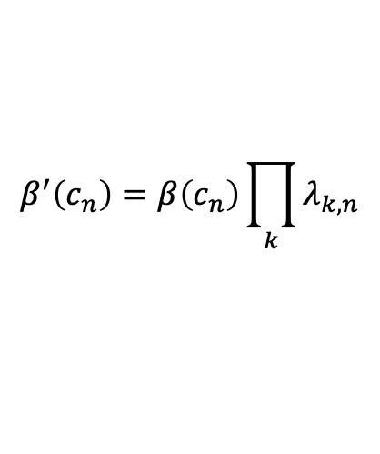









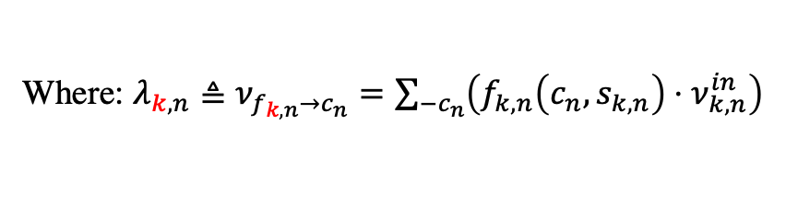
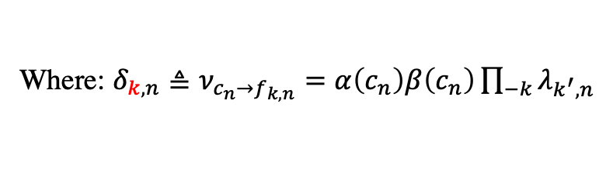




Factor graph Part B
Only need to solve
$$α(c_{n−1})$$
$$β(c_{n−1})$$
$$α(c_{n})$$
$$β(c_{n})$$
$$h_{n−1}^{c}$$
$$c_{n−1}$$
$$h_{n}^{c}$$
$$c_{n}$$
$$h_{n+1}^{c}$$
$$β^{′}(c_{n−1})$$
$$α^{′}(c_{n−1})$$
$$β^{′}(c_{n})$$
$$α^{′}(c_{n})$$
Forward/backward:
$$p(c_{n}∣c_{n−1})$$
…
…
$$α\left(c_{n}\right)=\sum_{−c_{n}}{h_{n}^{c}\left(c_{n},c_{n−1}\right)⋅α^{′}(c_{n−1})}$$
$$f_{k^{′},n−1}$$
$$f_{k^{′},n}$$
$$f_{k,n−1}$$
$$f_{k,n}$$
$$β\left(c_{n−1}\right)=\sum_{−c_{n−1}}{h_{n}^{c}\left(c_{n},c_{n−1}\right)⋅β^{′}(c_{n})}$$
$$s_{k^{′},n−1}$$
$$s_{k^{′},n}$$
$$α^{′}\left(c_{n−1}\right)=α\left(c_{n−1}\right)\prod_{k}{λ_{k,n−1}}$$
$$s_{k,n−1}$$
$$s_{k,n}$$
$$β^{′}\left(c_{n}\right)=β\left(c_{n}\right)\prod_{k}{λ_{k,n}}$$
Calculate $ν_{k,n}^{out}$:
$$ν_{k,n}^{out}≜\sum_{−s_{k,n}}{\left\{f_{k,n}\left(c_{n},s_{k,n}\right)⋅δ_{k,n}\right\}}$$
Where: $λ_{k,n}≜ν_{f_{k,n}→c_{n}}=\sum_{−c_{n}}{\left(f_{k,n}\left(c_{n},s_{k,n}\right)⋅ν_{k,n}^{in}\right)}$
Where: $δ_{k,n}≜ν_{c_{n}→f_{k,n}}=α\left(c_{n}\right)β\left(c_{n}\right)\prod_{−k}{λ_{k^{′},n}}$

Slide 2



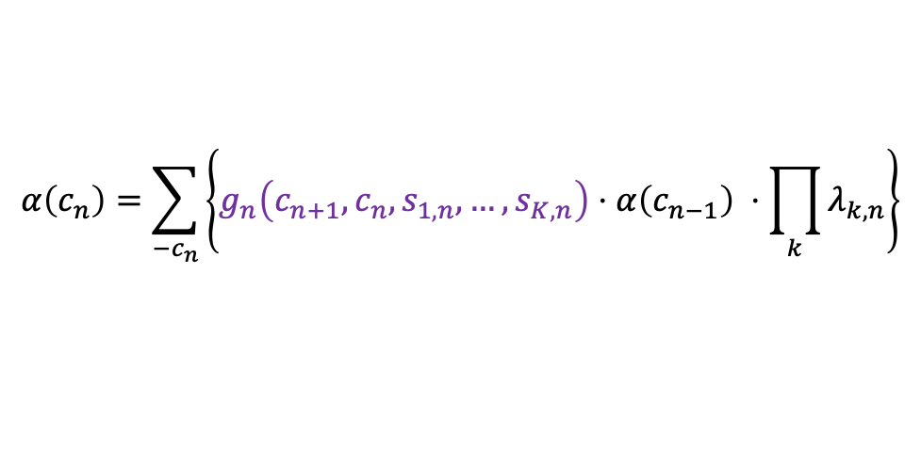
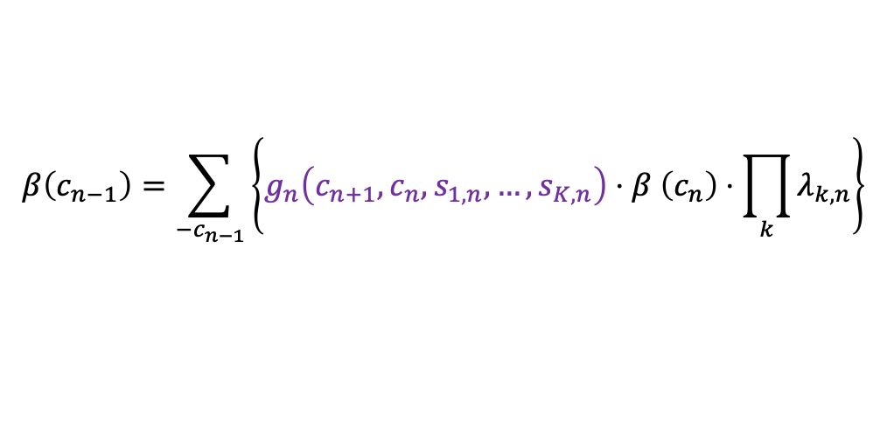



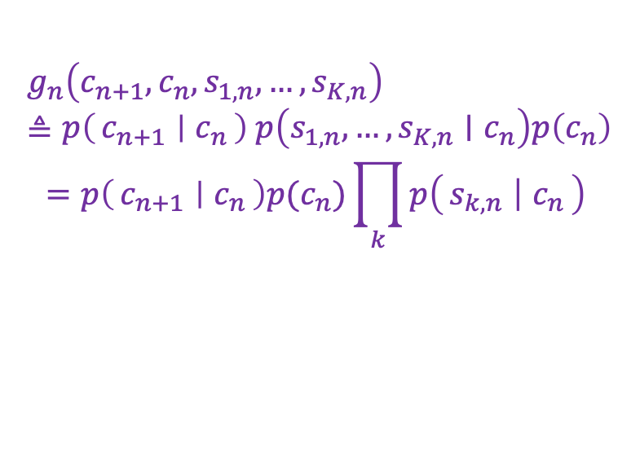













Factor graph Part B
$$h_{k,n}^{B}$$
$$h_{k^{′},n}^{B}$$
$$g_{n}\left(c_{n+1},c_{n},s_{1,n},…,s_{K,n}\right)≜p\left(c_{n+1} ∣ c_{n}\right) p\left(s_{1,n},…, s_{K,n}∣c_{n}\right)p\left(c_{n}\right)$$
$$=p\left(c_{n+1} ∣ c_{n}\right)p(c_{n})\prod_{k}{p\left(s_{k,n} ∣ c_{n}\right) }$$
$$ν_{k,n}^{out}$$
$$ν_{k,n}^{in}$$
$$s_{k,n}$$
$$s_{k^{′},n}$$
$$λ_{k,n}$$
$$δ_{k^{′},n}$$
…
$$β(c_{n−1})$$
$$α(c_{n})$$
$$c_{n−1}$$
$$g_{k,n−1}$$
$$c_{n}$$
$$g_{n}$$
$$c_{n+1}$$
$$α(c_{n−1})$$
$$β(c_{n})$$
Forward/backward:
Where:
$$α\left(c_{n}\right)=\sum_{−c_{n}}{\left\{g_{n}\left(c_{n+1},c_{n},s_{1,n},…,s_{K,n}\right)⋅α\left(c_{n−1}\right) ⋅\prod_{k}{λ_{k,n}}\right\}}$$
$$λ_{k,n}≜ν_{s_{k,n}→g_{n}}=ν_{k,n}^{in}$$
Calculate $ν_{k,n}^{out}$:
$$β\left(c_{n−1}\right)=\sum_{−c_{n−1}}{\left\{g_{n}\left(c_{n+1},c_{n},s_{1,n},…,s_{K,n}\right)⋅β \left(c_{n}\right)⋅\prod_{k}{λ_{k,n}}\right\}}$$
$$ν_{k,n}^{out}=δ_{k,n}≜ν_{g_{n}→s_{k,n}}$$
$$=\sum_{−s_{k,n}}{\left\{g_{n}\left(c_{n+1},c_{n},s_{1,n},…,s_{K,n}\right)⋅α\left(c_{n−1}\right)β\left(c_{n}\right)\prod_{−k}{λ_{k^{′}}}\right\}}$$

