Slide 1
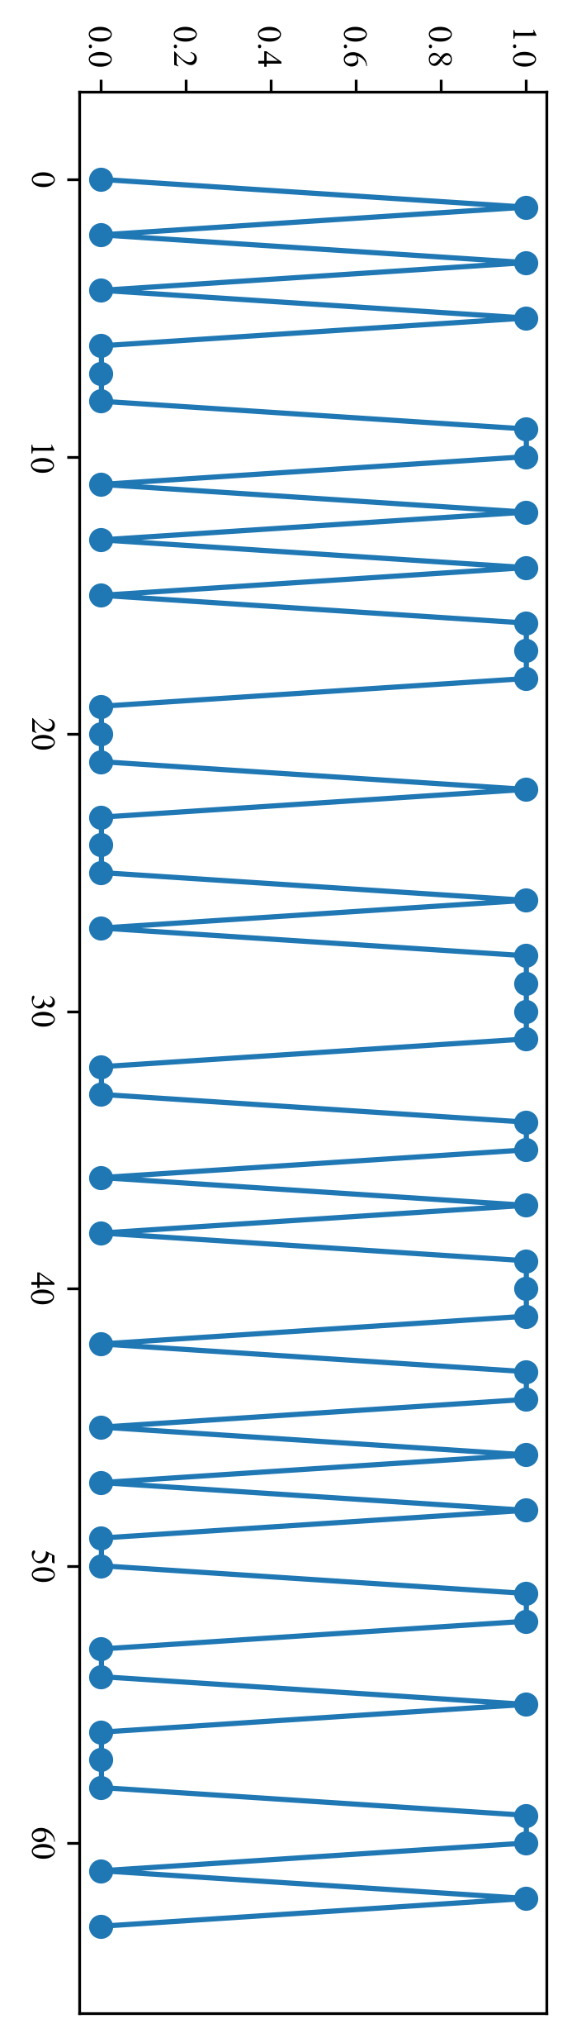
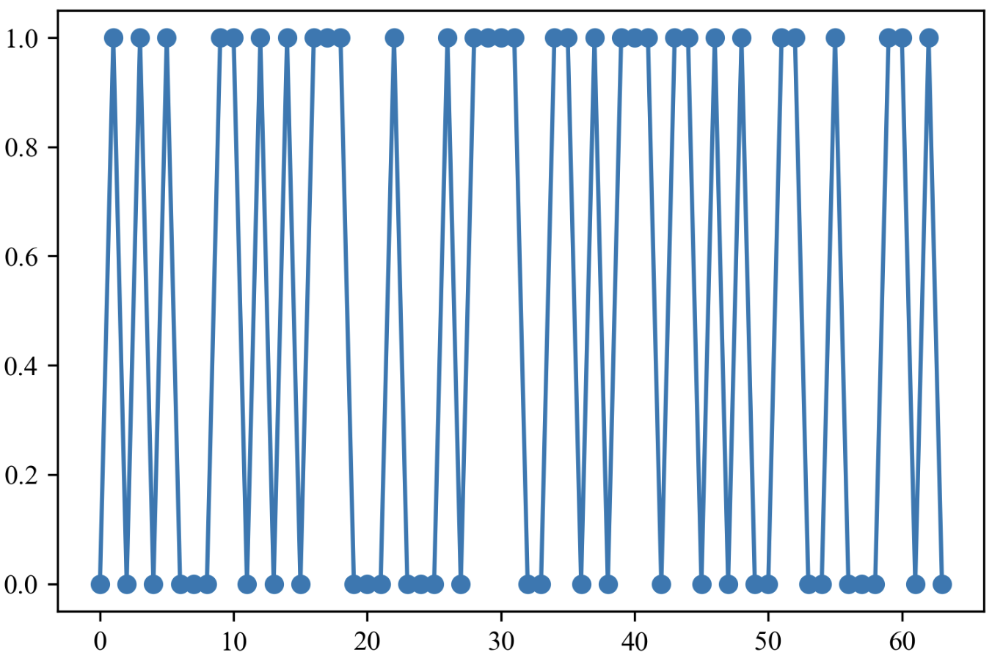
Bottom layer
Middle layer
Parameters:
Markov transition
shape
scale

