Slide 1
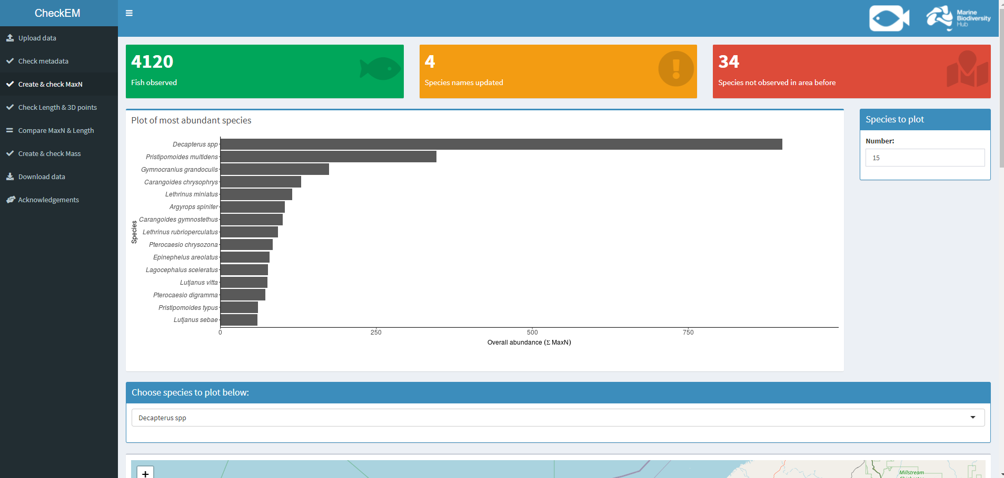
Number of tippers
Total number of tips correct
Average tips per round
Number of weeks on top
INSTITUTION
Number of weeks on bottom

Slide 2
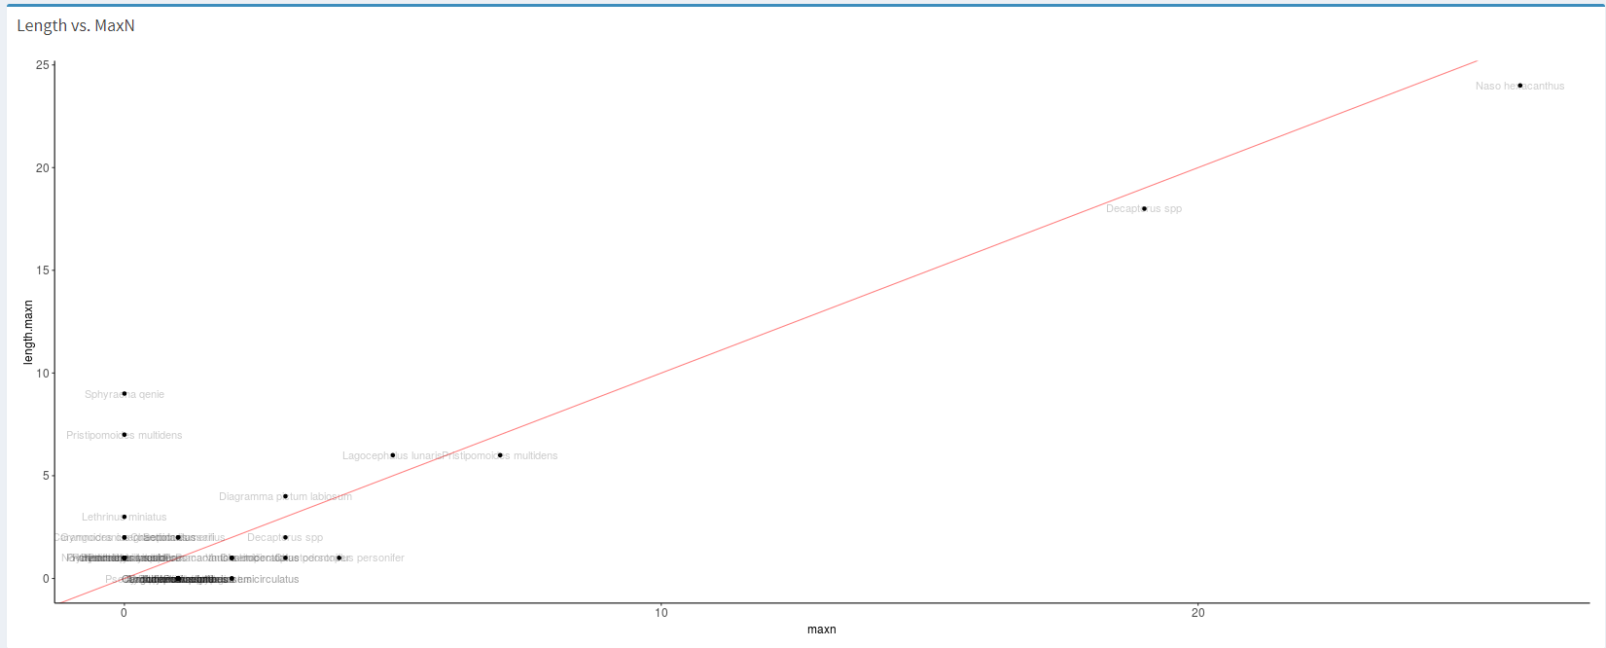
Per person
Choose a tipper
Number of tips correct
Total margin
Average per round
Line graph of tips per week compared to everyone else
Like a snake in the game

