Slide 1
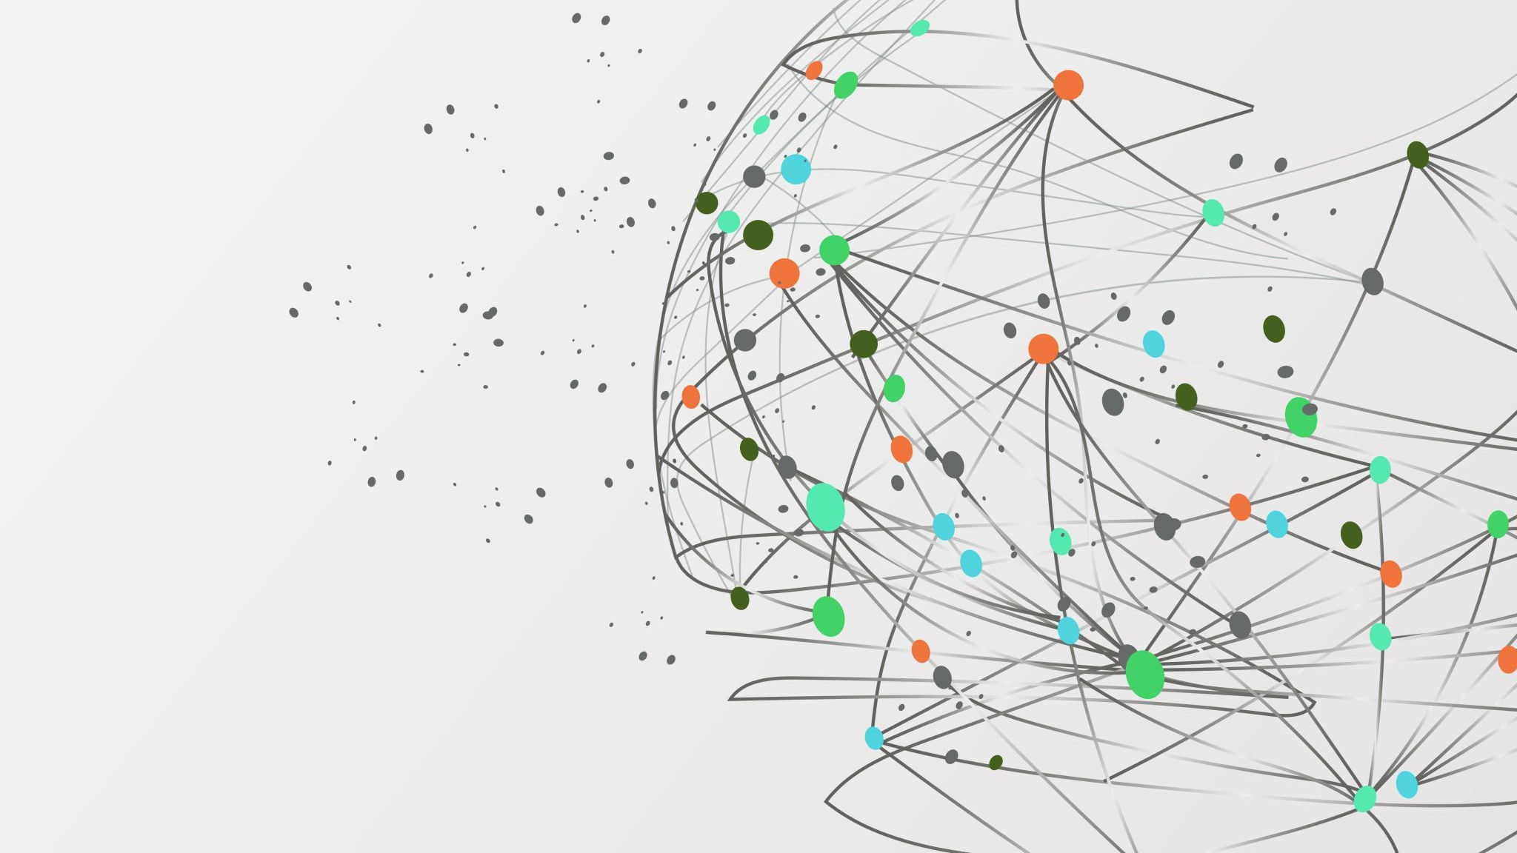
Synthetic Data Generation
By deepthi vettipuzha sukumaran

Slide 2
What is Synthetic patient data?
Synthetic data is artificially generated data that mimics real patient data statistically but does not correspond to real individuals.
It preserves patterns like:
  age distributions
  disease correlations
  treatment pathways
But contains no real patient identities or records
👉 Key idea:
It’s statistically realistic, not literally copied

Slide 3
Ways to generate it?
A. From real patient records (most common)
  Train a model on real data
  Learn distributions + relationships
  Generate new synthetic records
  This produces high-quality, realistic datasets
B. Without real data (less common)
  Use:
      medical knowledge
      public statistics
      clinical guidelines
    This avoids privacy risks but may be less accurate

Slide 4
Why are people doing this?
🔐 1. Privacy & compliance
    Real patient data is protected (GDPR, HIPAA)
    Synthetic data avoids re-identification risks
📊 2. Data access problem
    Healthcare data is hard to access
    Synthetic data enables wider research use
🤖 3. AI & ML training
    Models need large datasets
    Synthetic data helps scale data cheaply
️⚖️4. Bias & rare cases
    You can simulate rare diseases or edge cases
    Improves model robustness

Slide 5
Requirements
Legal & ethical requirements
  GDPR compliance (in UK/EU)
  Data governance approval
  Ethical review boards
  Data access permissions
Technical requirements
  Clean, structured dataset (EHR, claims, etc.)
  Understanding of:
    statistics
    machine learning
    healthcare domain
Validation requirements
  You must prove:
    data is realistic (utility)
    data does NOT leak real patients (privacy)
  👉 This validation step is often harder than generation.

Slide 6
Limitations
Synthetic data is powerful—but not perfect:
  ❌ Can reproduce biases from real data
  ❌ May miss rare correlations
  ❌ Risk of “data leakage” if poorly generated
  ❌ Needs strong validation

Slide 7
Tools and framework
Data Engineering & Preprocessing
  Python
  Pandas & NumPy
  SQL / Apache Spark
Synthetic Data Generation Engine
  SDV (Synthetic Data Vault)
  SDV Metadata API
Machine Learning & Statistical Libraries
  PyTorch
  SciPy
Privacy Validation & Analytics
  Scikit-Learn
  Matplotlib & Seaborn

Slide 8
Approach
  Scalable, Privacy-Preserving Multi-Table Synthesis using Hierarchical Copulas (SDV-HMA)
  Generative Core (SDV HMASynthesizer): Employs the Hierarchical Modeling Algorithm (HMA) designed specifically for relational multi-table schemas.
  Why HMA over Flat GANs? Avoids sparse high-dimensional flattening. It estimates parent distributions first, then conditionally samples child event volumes and characteristics.
  Relational Schema Preservation: Uses the SDV Metadata API to enforce 1-to-many parent-child foreign key integrity (SRPatient - > SRCode, SRPrimaryCareMedication, SRImmunisation).

Slide 9
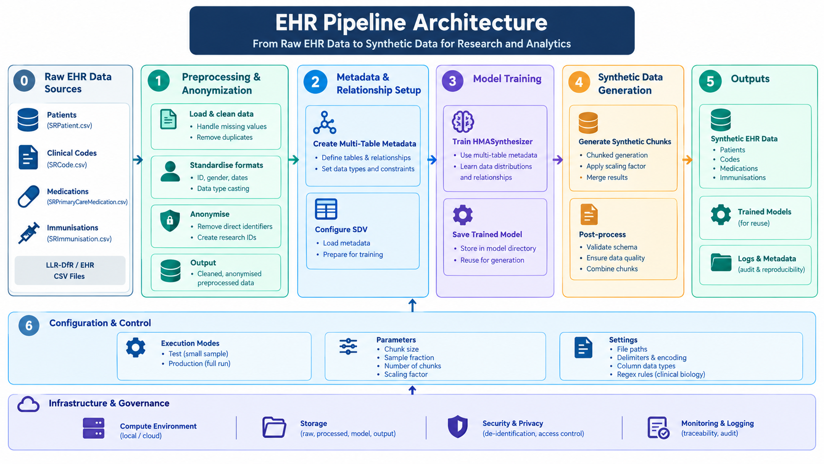
Workflow Architecture –LLR-DfR

Slide 10
The 5-Stage Synthesis Pipeline
1. Out-of-Core Preprocessing
  Streaming Ingestion: 1M row chunk iterators prevent out-of-memory (OOM) failures.
  Temporal Anonymization: Extracts 4-digit years and converts dates to integer ages (AgeIn2026, AgeAtEvent).
  Privacy Protection: Strips raw absolute timestamps to remove exact re-identification vectors.
2. Utilization Features & Stratification
  Utilization Feature: Computes log(1 + count) to engineer the DiseaseMedRatio metric.
  Composite Stratification: Bins by Gender x AgeGroup x UtilGroup to preserve rare cohorts.
  Balanced Cohort: Extracts a representative 3% stratified training fraction (~15k patients).
3. Relational Modeling (SDV HMA)
  Metadata Configuration: Sets MultiTableMetadata with automated primary-foreign key bindings.
  Chronological Constraints: Enforces AgeAtMedicationStart <= AgeAtMedicationEnd.
  Copula Model Fitting: Trains and serializes HMASynthesizer to disk.
4 & 5 . Scaled Generation & Guardrails
  Modular Sampling: Generates batches using sample scaling to achieve the 500k target.
  Sex-Exclusive Rules: Dynamically blocks cross-gender code leaks using learned SNOMED lists.
  Biological Filters: Regex keyword suppression on medication text descriptions.
  Post-Mortem & Tail Filters: Drops records post-AgeAtDeath and suppresses ultra-rare noise codes.

Slide 11
Synthetic Data Evaluation Framework
Evaluating relational synthetic EHR data requires measuring three core pillars: Statistical Fidelity, Clinical & Relational Utility, and Privacy & Disclosure Risk.
1. Statistical Fidelity & Distribution Parity: Evaluates whether generative copulas accurately capture shapes, variances, and correlations of the patient population without distributional distortion.
• Kolmogorov-Smirnov (KS) Complement Tests & Wasserstein Distance
• Spearman Rank Correlation & Covariance Matrix Parity
• Top-K Clinical Code Prevalence & Tail Frequency Parity
2. Relational & Clinical Plausibility (Utility): Audits whether synthetic records adhere to the biological, temporal, and structural realities of healthcare delivery.
• Marginal & Subgroup Query Parity (Gender ratios, Mean Age offset Δ)
• Biological Sex Inconsistency Rate (Sex-exclusive SNOMED & Rx leaks = 0)
• Post-Mortem Event Violation Rate (EventAge > AgeAtDeath = 0)
• Child-to-Parent Event Densities (Prescriptions/diagnoses per patient)
3. Privacy & Re-Identification Risk: Empirically quantifies identity and membership disclosure risks in normalized feature space.
• Distance to Closest Record (DCR) distribution
• Exact Demographic Clone Rate (0-tolerance profile collision check)
• Pipeline-Aligned Membership Inference Attack (MIA) Distance Ratio (Target ≈ 1.0)

Slide 12
DP-HALO
1. Longitudinal Trajectory Modeling: Extends static relational synthesis by capturing temporal clinical visits and multi-label code co-occurrences (SNOMED, medications) via a two-tier autoregressive architecture.
  Inter-Visit Dynamics: Models sequential consultation frequency and disease progression over continuous patient lifetimes.
  Intra-Visit Co-Occurrence: Predicts high-dimensional clinical code combinations within individual care encounters.
2. Formal Mathematical Privacy (DP-SGD): Replaces empirical distance heuristics with provable (Epsilon, Delta)-Differential Privacy bounds embedded directly into model training.
  Per-Sample Gradient Clipping: Enforces L2-norm gradient clipping to strictly bound individual patient influence.
  Calibrated Noise Injection: Adds Gaussian perturbation scaled to predefined privacy loss budgets tracked via Renyi DP.
3. Active Engineering & Optimization Focus: Resolves clinical healthcare data complexities under strict privacy budgets.
  Privacy-Utility Calibration: Fine-tuning Epsilon in range [2.0, 8.0] against downstream mortality and readmission benchmarks.
  Code Embedding Sparsity: Mitigates gradient noise distortion across low-prevalence SNOMED and Multilex vocabularies.
  Hybrid Pipeline Architecture: Integrating DP-HALO for deep temporal trajectories with HMA for broad demographic schemas.

Slide 13
MurMur Evaluation

Slide 14
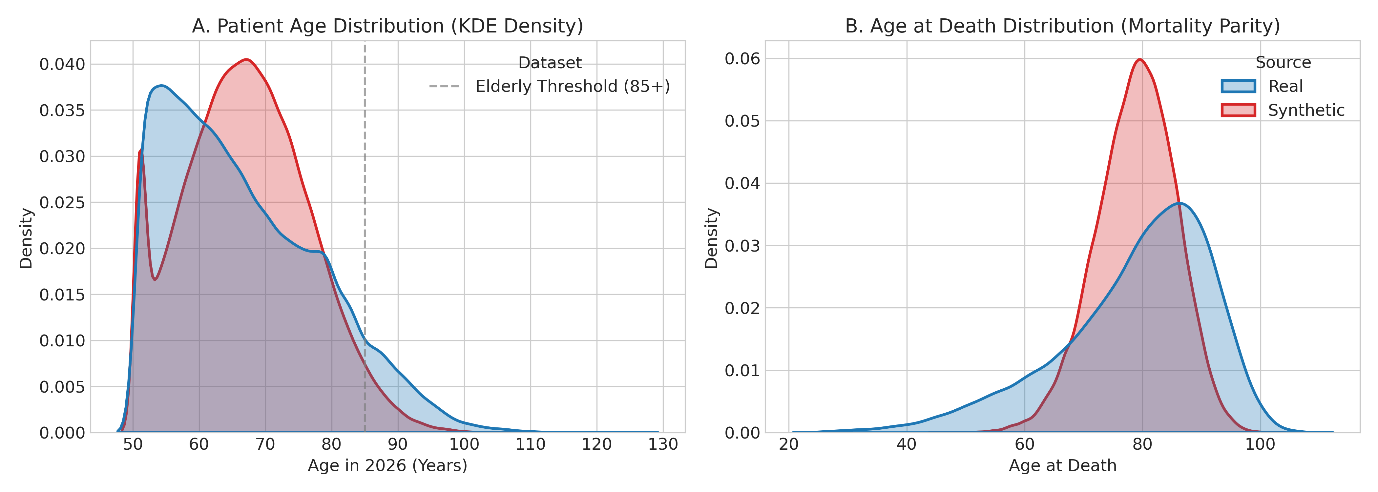
Statistical Fidelity & Demographic Parity
Age Distribution (Wasserstein Distance: 2.34 years): Synthetic demographic curves closely align with real baseline density curves (KS = 0.1059).
Mortality Alignment (Wasserstein Distance: 4.95 years): Replicates life expectancy and age-at-death mortality patterns.
Gender Parity (TVD = 0.0027): Matches real population proportions (50.8% Female vs. 49.2% Male).

Slide 15
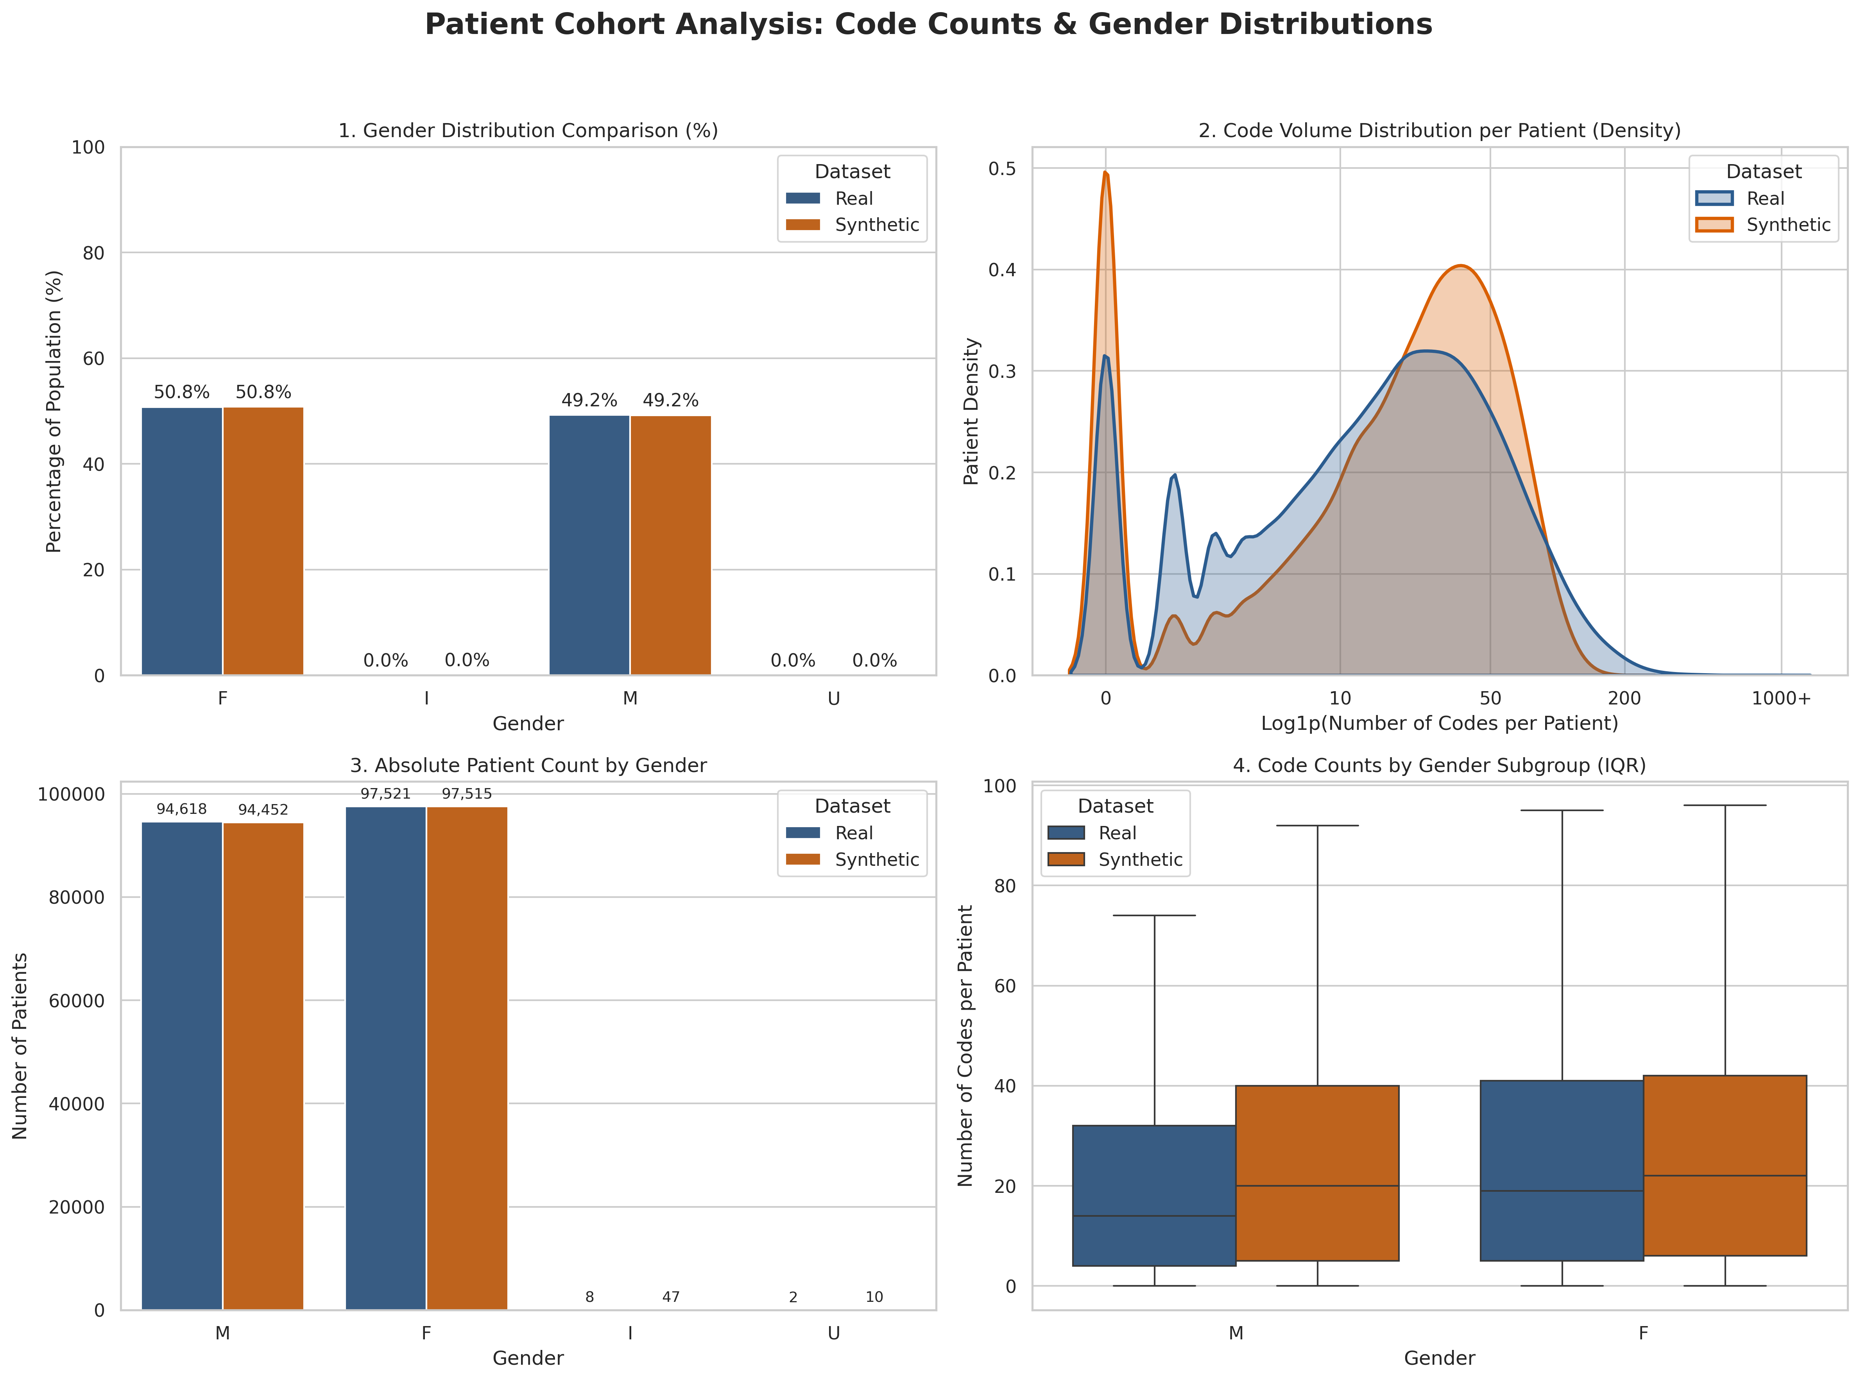

Slide 16
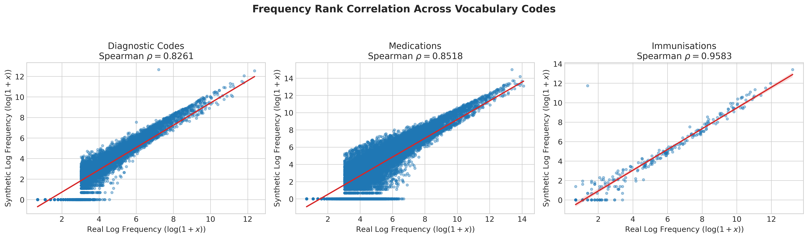
Clinical Vocabulary & Correlation Parity
High Spearman Rank Correlations (p): Confirms that common primary care diagnoses and treatments maintain their exact relative frequency ranks:
Diagnostic Codes (SNOMED): p = 0.8261 (Up to 0.8395)
Medications (MultiLex Product): p = 0.8518
Immunisations: p= 0.9583
Parity Scatter Alignment: Top-100 concept prevalence charts demonstrate tight clustering along the ideal 1:1 parity diagonal.

Slide 17
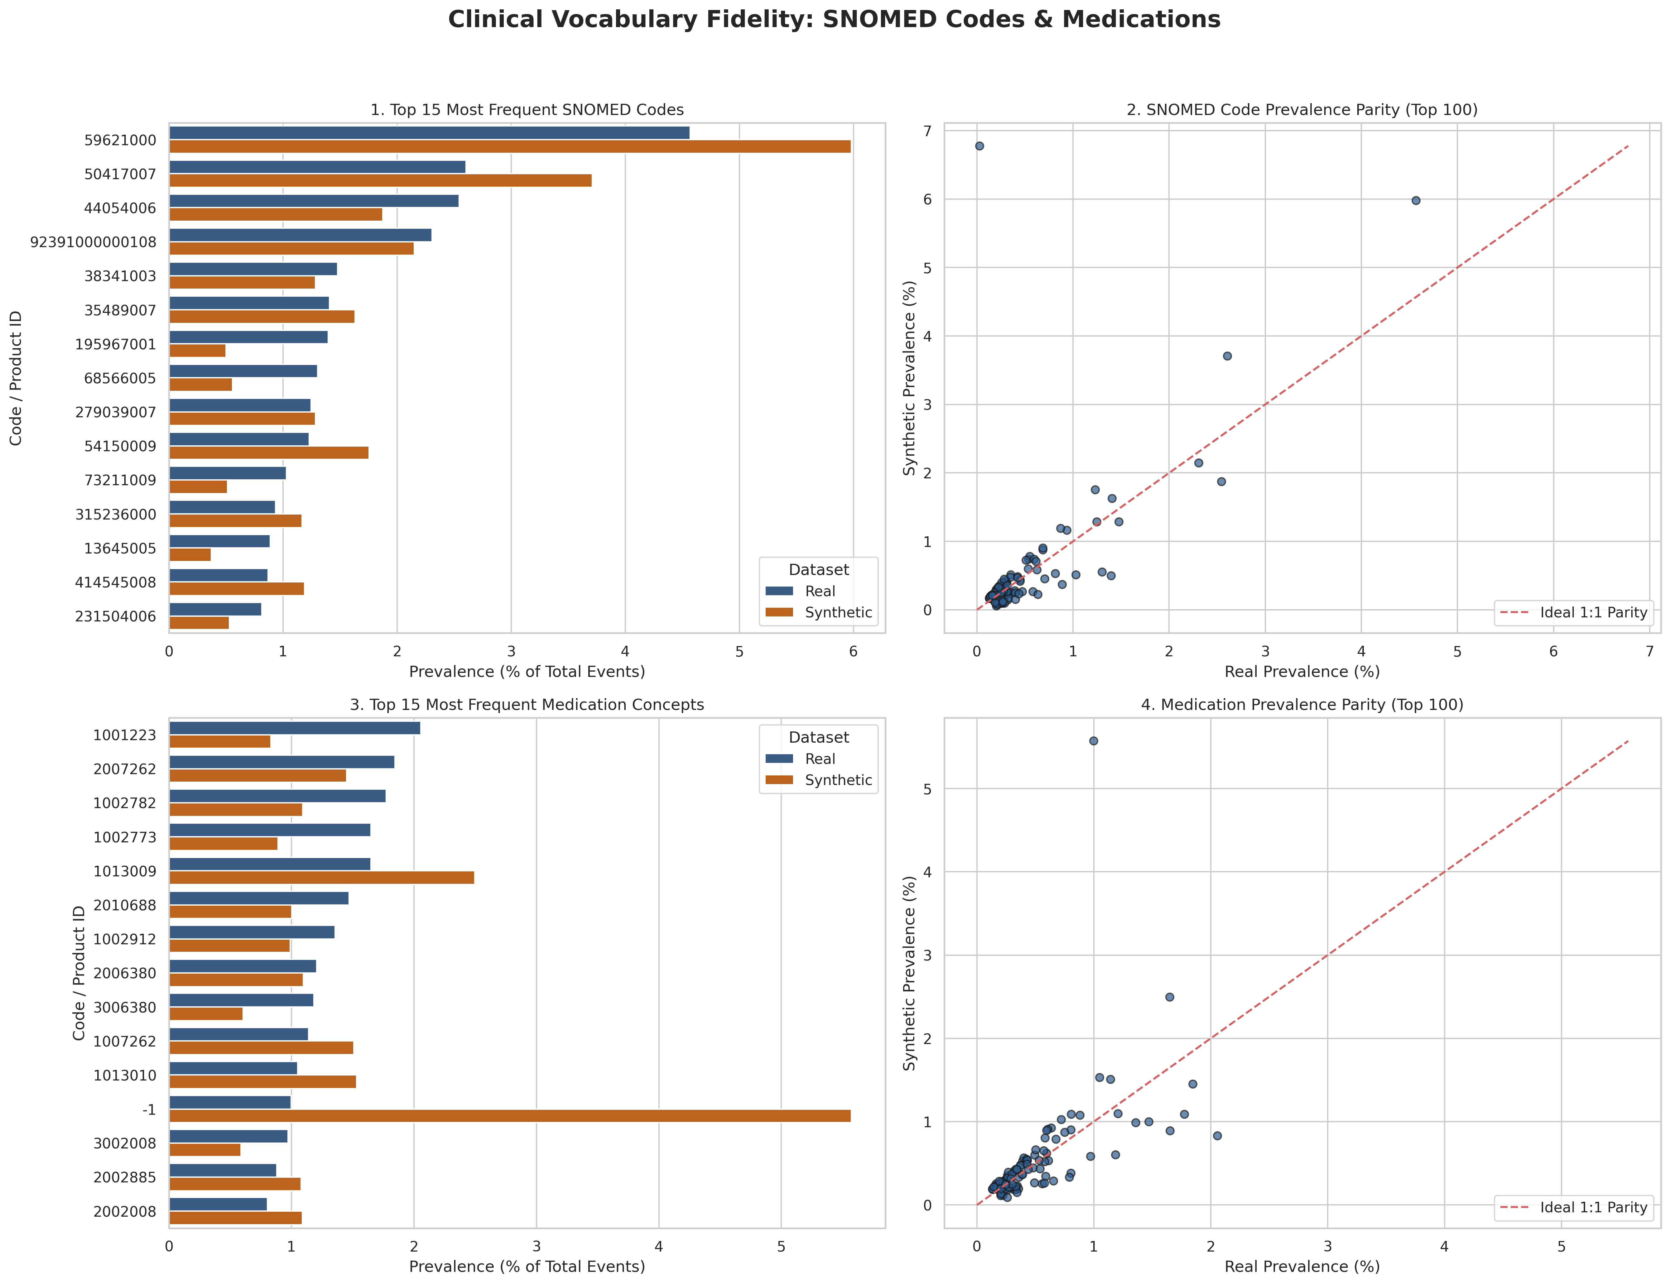

Slide 18
Clinical Integrity & Plausibility Validation
Zero Post-Mortem Events: 100% pass rate (0 violations) where child events occurred after a patient’s recorded death age (AgeAtEvent> AgeAtDeath).
Biological Sex Consistency: Regex filters prevent impossible diagnoses/treatments (e.g., 0 pregnancy codes in males, 0 prostate codes in females).
Noise & Outlier Pruning: Suppressing rare concepts (<20 occurrences) eliminates copula artifacts while preserving high-confidence primary care pathways

Slide 19
Multi-Variable Contingency & Subgroup Query Parity
Queries | Real MurMur Data | Real LLR-DfR data | Synthetic MurMur Data
Total patients | 192149 | 564741 | 192024
Female Patients | 97521 | 291930 | 97515
Male Patients | 94618 | 272776 | 94452
Patients with snomed code= 26929004 | 3564 | 3523 | 5730
Patients with Medication code =chamomile extract 10.5% ointment | 3 | 15 | 0
Patinets with snomed code= 26929004 and Sex= Male | 1394 | 1388 | 2676
Patinets with snomed code= 26929004 and Sex= Female | 2170 | 2136 | 3049
Patient with snomed code =46635009 and Sex = Male | 803 | 1425 | 4240
Patient with snomed code = 46635009 and Sex = Female | 623 | 1156 | 4624

Slide 20
Re-Identification Risk Evaluation
Evaluating patient re-identification risk in synthetic health data relies on three standard statistical and distance-based methodologies:
1. Identity Disclosure & Exact Match Detection (DCR = 0):
  Measures whether any synthetic record identically replicates the exact multidimensional feature vector (e.g., demographics + full clinical event volume) of a real patient.
  Near-zero or zero exact matches confirm that direct replication has been avoided.
2. Distance to Closest Record (DCR) & 5th Percentile Boundary (DCR_5%):
  Computes the Manhattan (L_1) or Euclidean distance from each synthetic patient to their nearest real counterpart in normalized feature space.
  The 5th percentile (DCR_5%) checks the tail: if (DCR_5%) is sufficiently large, the model has generalized rather than overfitted/memorized real outlier profiles.
3. Membership Inference Advantage (MIA):
  Compares the distance from synthetic records to the training cohort (DCR_train) versus an unseen holdout cohort (DCR_holdout).
  If MIA = P(DCR_train < DCR_holdout) approx 50%, an adversary cannot determine whether a real patient's record was part of the generative model's training set.

Slide 21
Pre-Purge Privacy Inferences (Raw Output)
Heuristic Identical Matches: Raw generative copulas produced 12,451 exact feature clones (6.48%), demonstrating that low-granularity healthy profiles with zero recorded clinical events collapsed into identical demographic buckets.
Absence of Outlier Clearance: A 5th percentile Distance to Closest Record (DCR) of 0.0000 indicates that the nearest 5% tail of the synthetic cohort lacked spatial separation from real training individuals.
Evaluation Bias: The initial Membership Inference Advantage (MIA) of 13.81% was artificially skewed by an unbalanced holdout partition (85% holdout vs. 15% train), where higher point density in the holdout set masked true membership risk.
Overall Status: The initial dataset carried an elevated re-identification risk and was unsuitable for external sharing.

Slide 22
Post-Purge Privacy Inferences (Cleaned Output)
Total Identity Protection: Nearest-neighbor clone elimination purged all identical profiles, reducing the exact match rate to 0 .0000% across the remaining 179,557 synthetic patient records.
Established Distance Buffer: Raising the 5th percentile DCR to 0.0138 confirms that even edge-case synthetic outliers maintain a safe metric buffer from real patient feature vectors.
Absence of Membership Leakage: Testing against an equal-sized partition (N_train = N_holdout) normalized the balanced MIA to 48.75%, proving synthetic records are equidistant to training and unseen holdout records (matching the theoretical 50.0% random-guess baseline).
Referential Data Integrity: Deletions cascaded across all linked diagnosis, prescription, and immunisation tables without generating orphaned clinical records.
Overall Status: The post-processed cohort achieved verified Safe to Release status with zero empirical identity disclosure and robust membership defense.

Slide 23
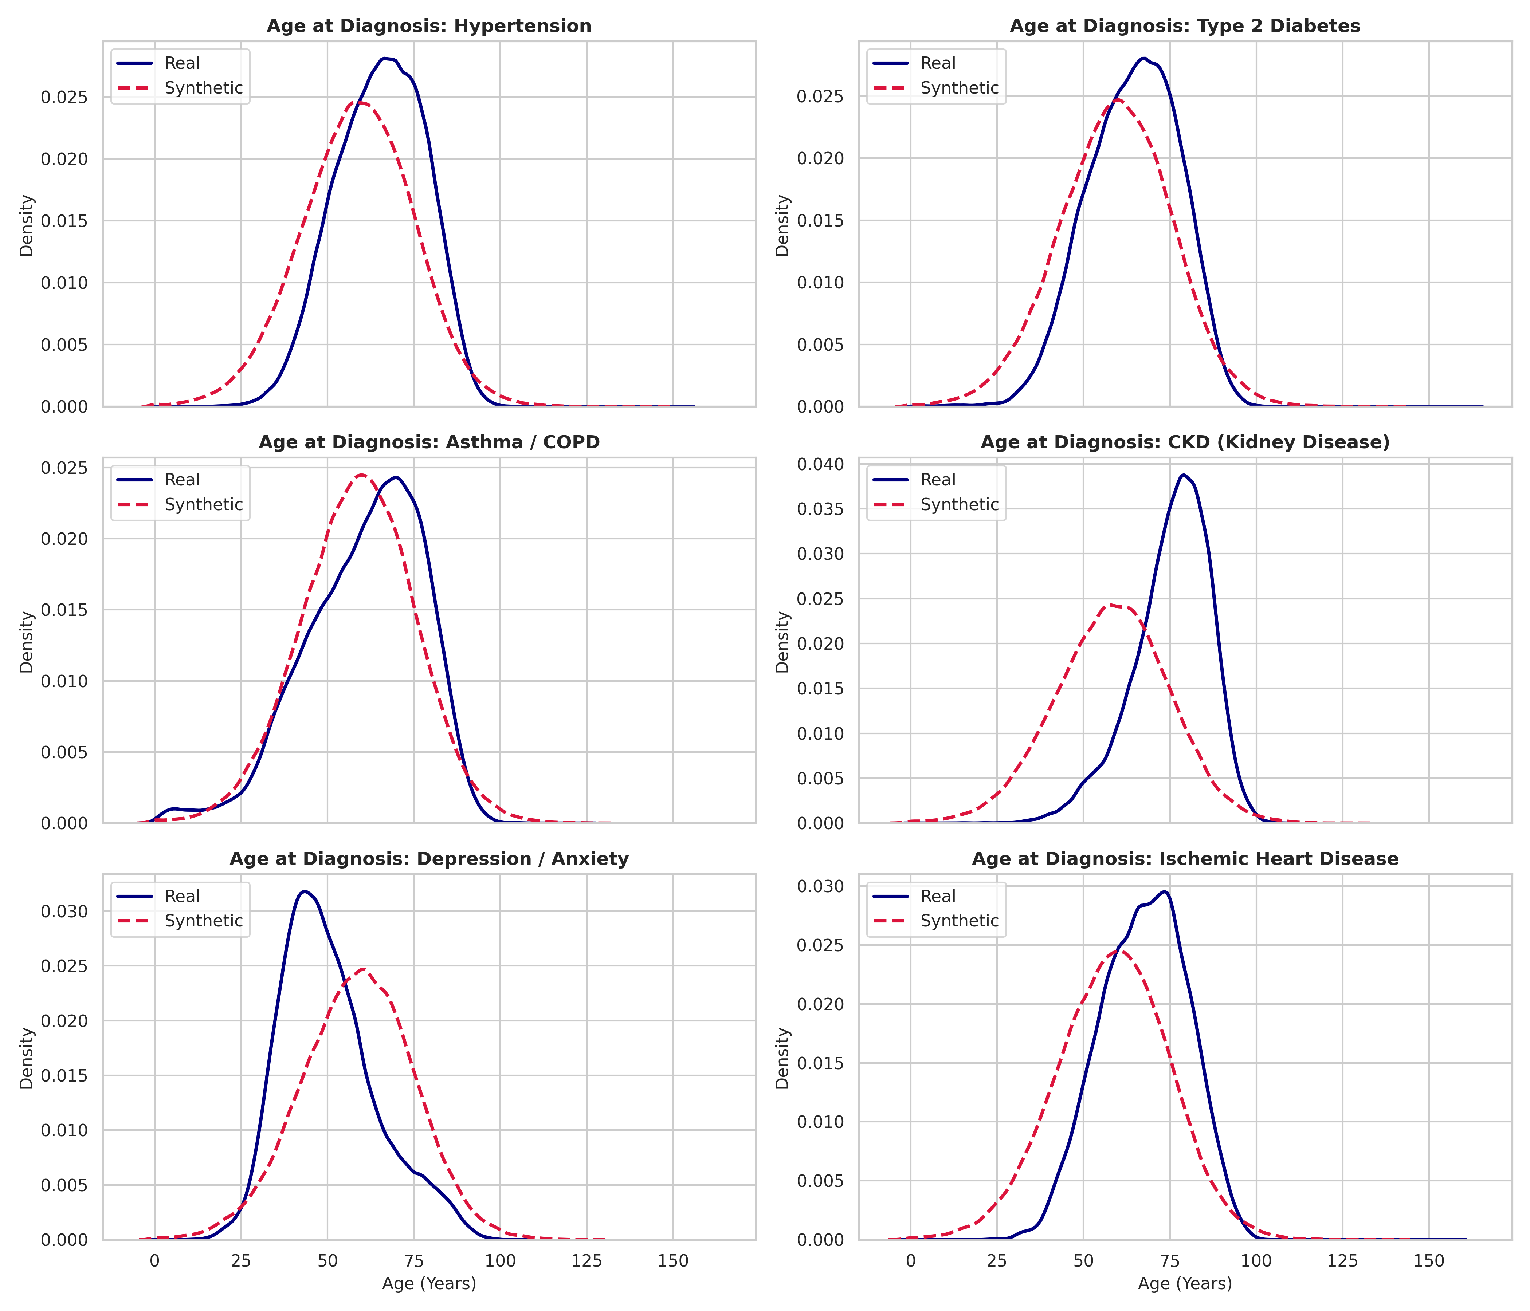

Slide 24
Future Trends
Emerging directions include:
  Federated synthetic data generation
  Differential privacy integration
  Digital twins of patients
  Multimodal synthetic healthcare data
  Synthetic genomic datasets
  Foundation models for EHR generation

