Slide 1


6103 Data Mining
Final Project
How much salary will
we earn in the future?
Team 2 | Brooklyn Chen, Nayaeun Kwon, Manojkumar Yerraguntla

Slide 2

SMART Questions
About Dataset
Features
Exploratory Data Analysis
Modeling
Conclusion
Outline

Slide 3

SMART Questions
Over time, salary by job title is changed?
How large is the wage disparity between gender?
Is there a significant difference between the yearly salary in top 10 companies and the yearly salary in not-top-10 companies?
People working for more years in the same company have higher salary?
In the recent four years, the average salary keeps the same?
How much does the employee’s experience affect his/her salary ?
Notes:
Yoni
This is our smart questions. First one is

Slide 4
About Dataset
From Kaggle
Approximately 62,000 observations, after removing NA values and outliers, it was remained about 35,000 observations
29 variables, but left 8 variables:
Timestamp, company, title, yearsofexperience, yearsatcompany, gender, yearlysalary.
Notes:
As for dataset, we got it from Kaggle. \ Our original dataset has approximately 62,000 observations, but there were a lot of null values in gender variables, so we removed all null values // and then it was remained about 35,000 observations. \ As for features, we had 29 variables in our original dataset, but we left total 7 variables that we wanted to use which are timestamp, company, title, yearsofexperience, yearsatcomapny, gender and yearlysalary. Timestamp means when the data was recorded. Title means job position, years of experience is total experience period, yearsatcompany means years of experience at recorded company.

Slide 5
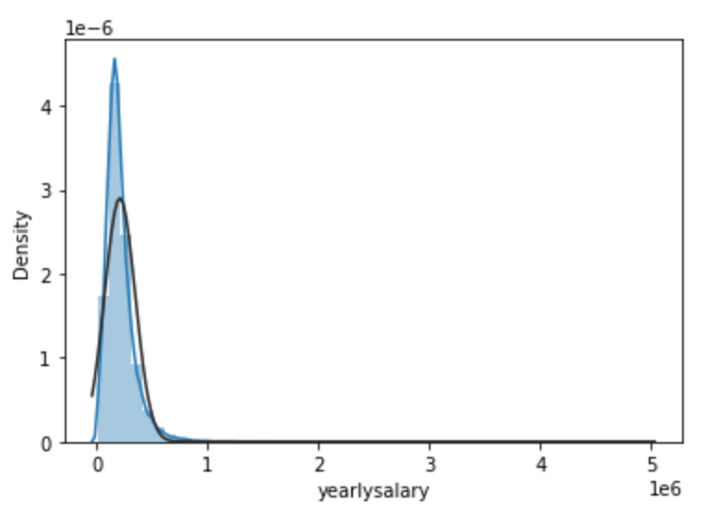
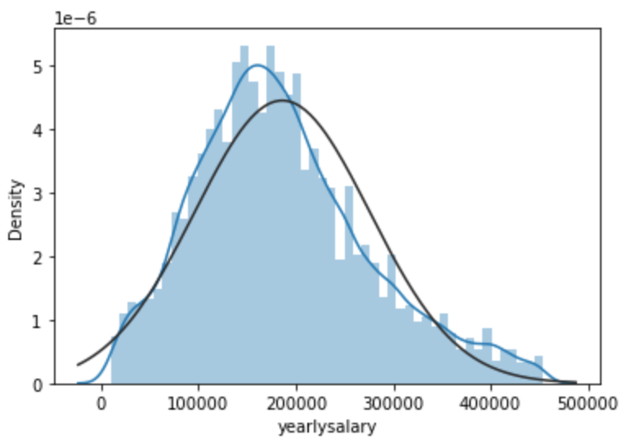
About Dataset
Target Feature: yearlysalary
Notes:
Last feature is yearlysalary which is our independent variable. \ It means total year salary that includes base salary and compensation. But, without dropping outliers, it has highly right-skewed distribution. We tried to make it having normality by removing outliers from yearlysalary, yearsatcompany, yearsofexperience features.

Slide 6
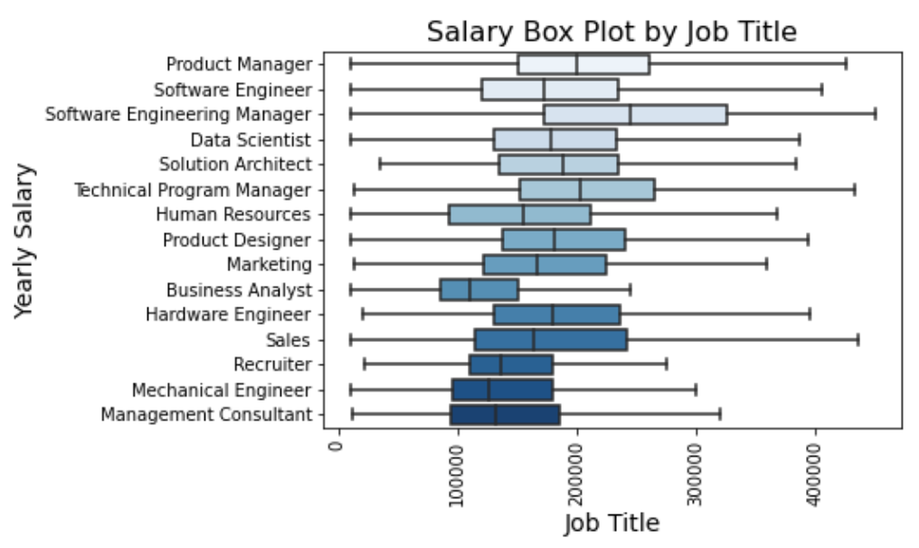
Question 1
Over time, salary by job title is changed?
Notes:
So, this is the first our smart question. Over time, salary by job title is changed? As you guys can see the plot, we have total 15 job positions, and software engineering manager has highest earning average salary compared to other job positions.

Slide 7
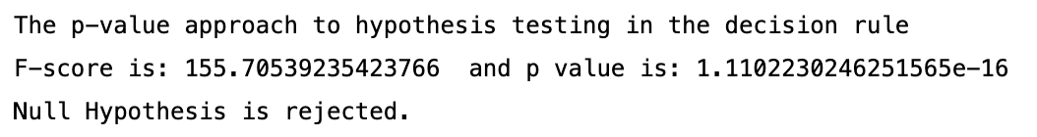
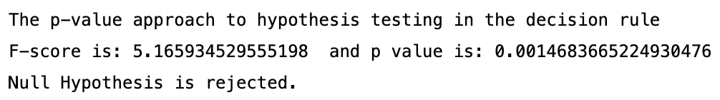
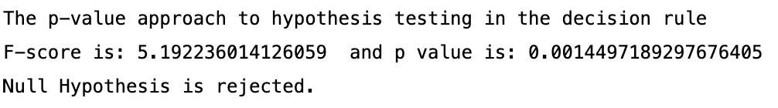
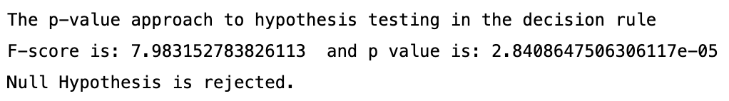
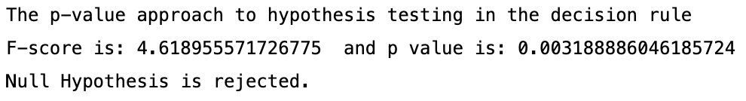
Question 1
Over time, salary by job title is changed?
H₀: Year by year salary means of each job position are equal.
H₁: Year by year salary means of each job position are not equal.
Software Engineer
Product Manager
Software Engineering Manager
Hardware Engineer
Data Scientist
Notes:
But to check whether the average salary by job position is changed over time, we did ANOVA test. The null hypothesis is year by year, salary mean of each job position are equal. As you guys can see the result of ANOVA, all p-value is less than alpha .05, which means salary of all job position for each year is not equal.

Slide 8
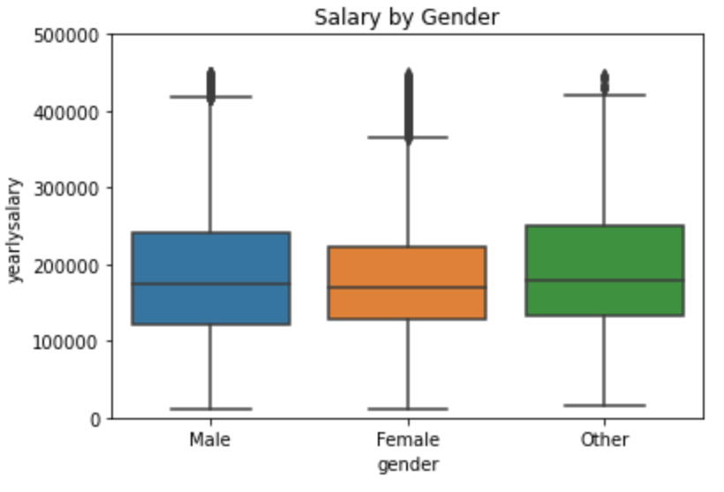
Question 2
Is there the wage disparity between gender?
Notes:
As for second smart question, Is there the wage disparity between gender? This is a box plot for salary by gender. It looks like there are no difference between gender. But, to make sure, we did ANOVA test as well.

Slide 9
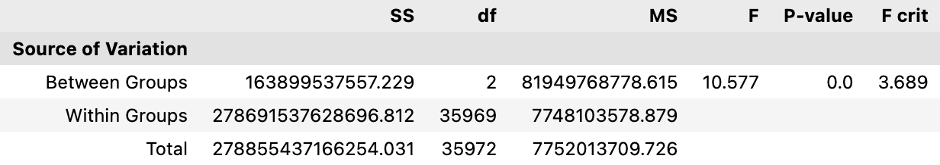
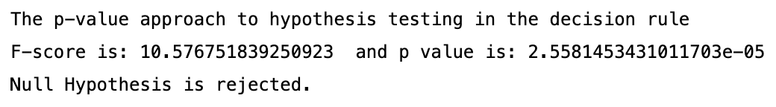
Question 2
Is there the wage disparity between gender?
ANOVA to figure out salary difference by gender difference
H₀: Average salary by gender are equal.
H₁: Average salary by gender are not equal.
α = 0.05
Notes:
Yoni
Our null hypothesis is average salary by gender are equal. As you guys can see the result, the average salary by gender is statistically significant which means it is not equal with highly low p-value.

Slide 10
Question 3
Is there a significant difference between the yearly salary in top 10 companies and the yearly salary in not-top-10 companies?
Notes:
Brooklyn

Slide 11








Question 3
There are 1435 different companies in this dataset
Based on the rank on Fortune 500, we divided the companies into two groups: top 10 vs not-top-10
1 Walmart
2 Amazon
3 Apple
4 CVS Health
5 UnitedHealth Group
6 Exxon Mobil
7 Berkshire Hathaway
8 Alphabet
9 McKesson
10 AmerisourceBergen
1 Yahoo
2 Zillow
3 Airbnb
4 Dell Technologies
5 Uber
6 Netflix
7 Cisco
8 JPMorgan Chase
….
Notes:
Brooklyn

Slide 12
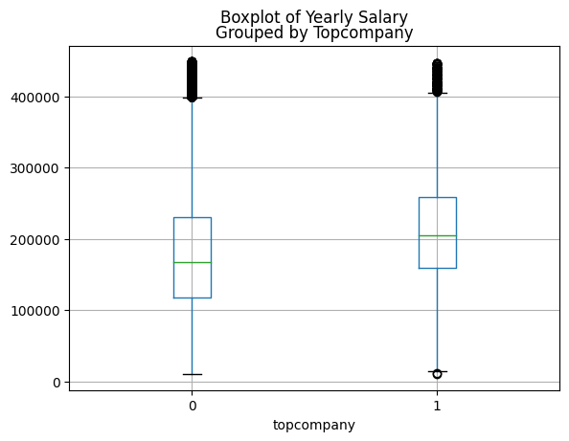
Question 3
Yearly Salary
Not-Top-10
Top 10
Notes:
Brooklyn

Slide 13
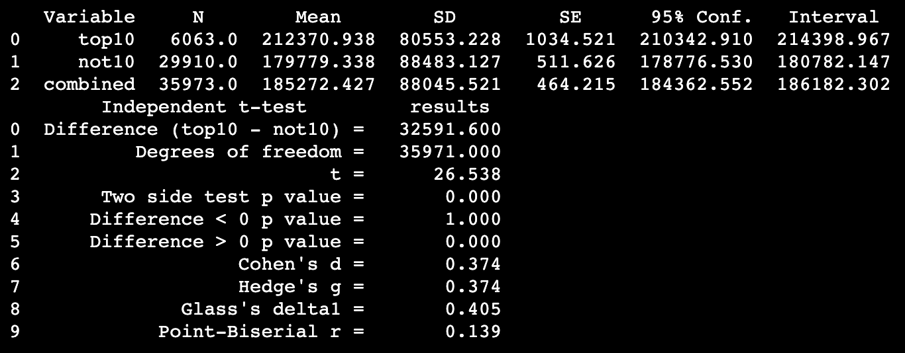
Question 3
Independent-Sample T Test (2 groups)
H0: The means for the two groups are equal.
H1: The means for the two groups are not equal.
Notes:
Brooklyn

Slide 14
Question 4
People working for more years in the same company have higher salary?
Notes:
Brooklyn

Slide 15
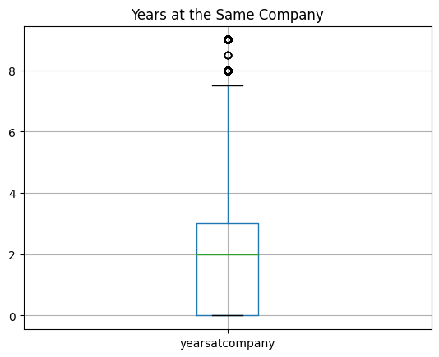
Question 4
Years
Notes:
Brooklyn

Slide 16
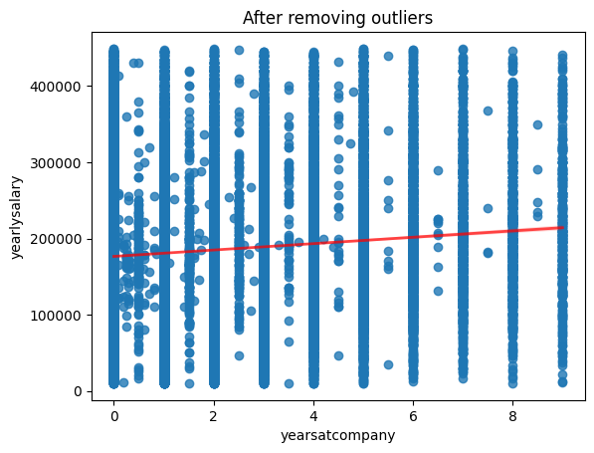
Question 4
Yearly Salary vs Years at Company
Notes:
Brooklyn

Slide 17
Question 5
In the recent four years, the average salary keeps the same?
Notes:
Brooklyn

Slide 18
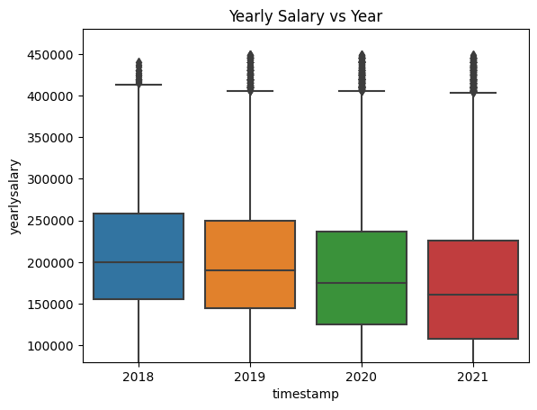
Question 5
Notes:
Brooklyn

Slide 19
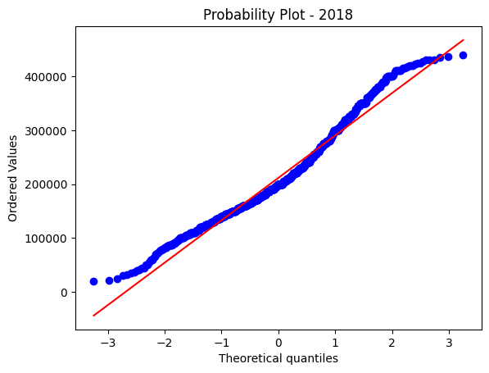
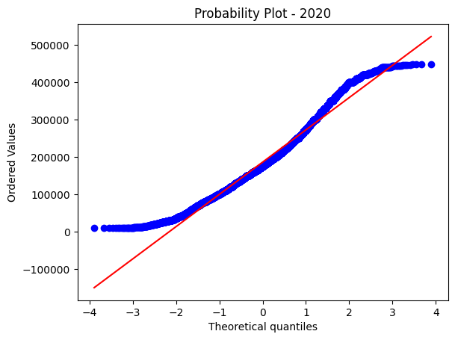
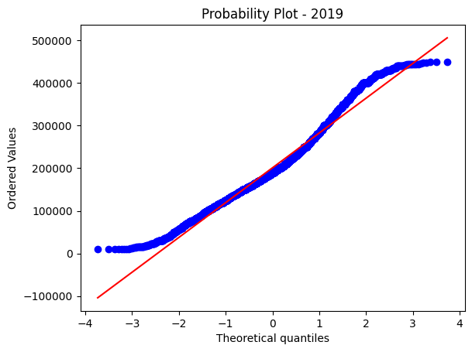
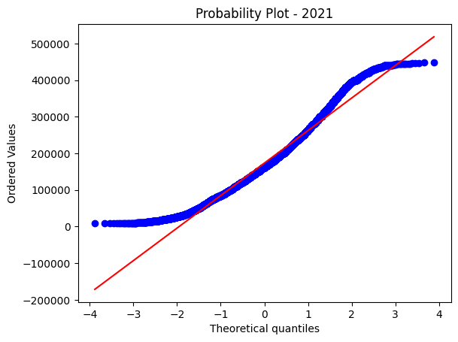
Question 5
Notes:
Brooklyn

Slide 20
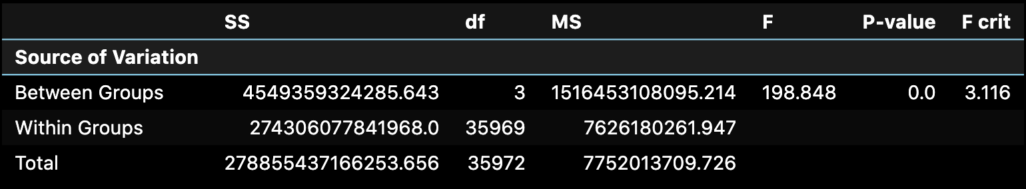
Question 5
ANOVA Test
H₀: μ1= μ2 = μ3 = μ4 = μ5
H₁: Not all yearly salary means are equal
Null Hypothesis is rejected.
Notes:
Brooklyn

Slide 21
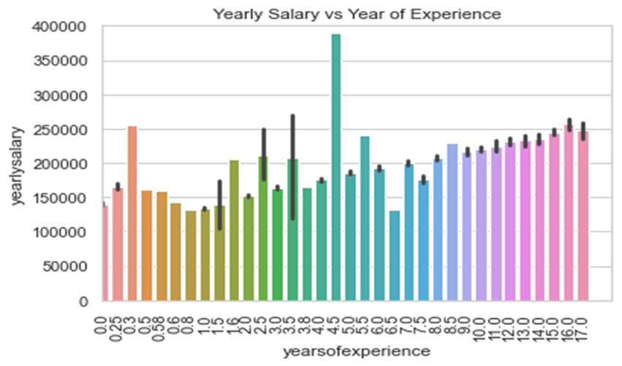
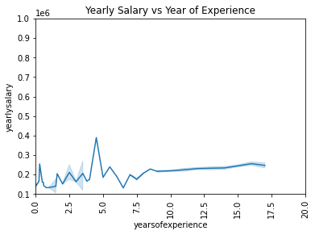
Question 6
How much does the employee’s experience affect his/her salary ?
Notes:
Having some exceptions, there is a constant growth in the salary of the employees until 8-9 years and yearlysalary almost stabilizes after that.

Slide 22
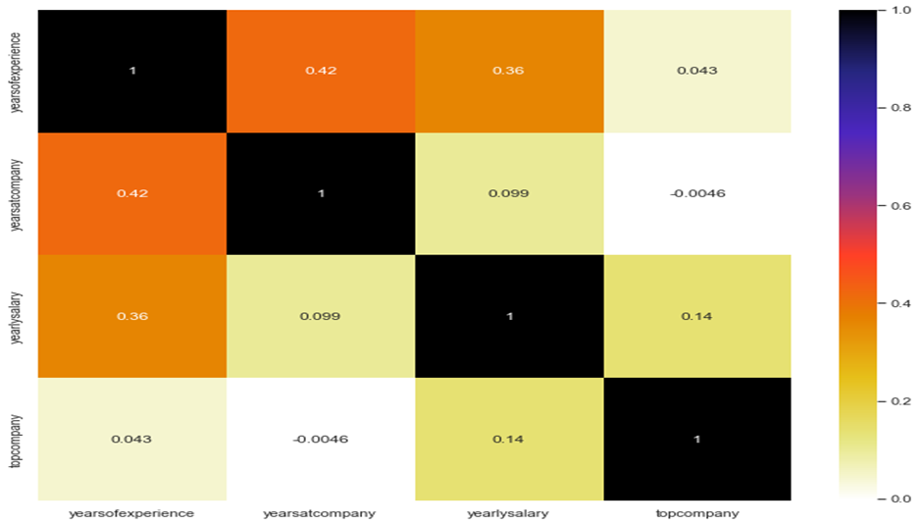
Question 6
Pearson’s Correlation:
Correlation of yearsatcompany is 0.099; Correlation of yearsofexpericence is 0.36

Slide 23
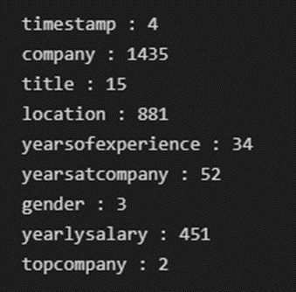

Additional Preprocessing for Modeling
Unique Values in each Variable
Converting Multi Categorical Features into Dummy variables:
get_dummies() Function
One Hot Encoding
Shape of DataFrame after Creating Dummies:
Notes:
Manoj

Slide 24
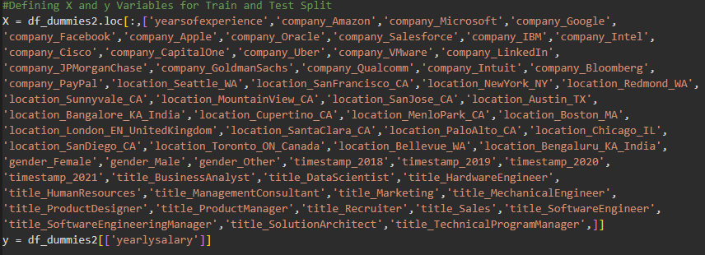
Train Test Split for Modeling
Splitting into Train and Test Subsets: 80:20

Slide 25
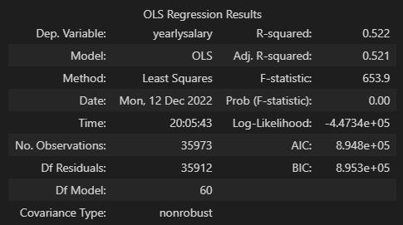

Linear Regression Model Results
Notes:
Manoj

Slide 26
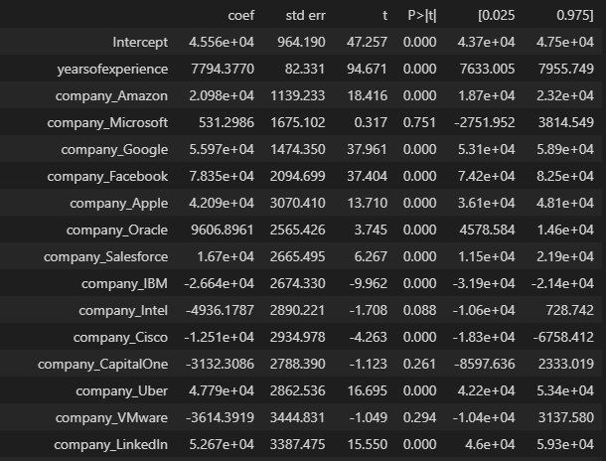
Linear Regression Model Results

Slide 27
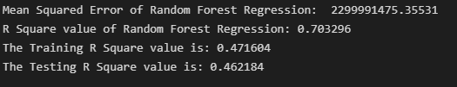
Random Forest Regression Model Results
Can be used for both Regression and classification problems
Implemented using assemble method
N_estimators Used: 100
R Square Values of Model, Training and Testing Datasets:
Notes:
Brooklyn

Slide 28
Comparison of Linear and Random Forest Models
Model Name | MSE Value | R Square Value
Linear Regression | 3720129792.96678 | 0.51675
Random Forest Regression | 2299991457.35531 | 0.70329
Random forest is the better model with 0.70329 R Square value.

Slide 29
Summary
The means salary of each job position is different from each other.
The average salary of gender is not equal
The average yearly salary in the US top 10 companies was higher than not-top-10 companies’ average yearly salary
Working in the same company for more years does not mean those people have higher salaries
The means of yearly salary from 2018 to 2021 are not equal
After a period of time, the salary won’t get affected much by yearsofexperience.
Random Forest Regression is the better model with high R2 Square when compared to the Linear Regression.
Notes:
Brooklyn

Slide 30

Thank You
Team 2 | Brooklyn Chen, Nayaeun Kwon, Manojkumar Yerraguntla

