Slide 1
5 Conclusions That Would Kill Your Policy
A Data Integrity Analysis of Global Health Statistics
Team importNumpy
DND Spring 2026 Datathon · Cal Poly Pomona
Dataset: Global Health Statistics · 1,000,000 rows · 20 countries · 2000–2024
importNumpy | DND Spring 2026 Datathon
1 of 12

Slide 2
What’s in the Data — and What’s Not
MEASURED ✓
NOT MEASURED ✗
• Outcomes: mortality_rate, recovery_rate, DALYs
• Access proxies: healthcare_access, doctors_per_1000,
hospital_beds_per_1000, resource_index
• Socioeconomic: per_capita_income, education_index
• Geography proxy: urbanization_rate → 3 tier schemes
• Structure: country, year, disease, age_group, gender
• Scale: 1M rows · 119,978 unique combinations
• Distance-to-care (travel time, proximity)
• Facility locations or density maps
• Utilization (visits, admissions, claims)
• Continuity-of-care metrics
• Real-world reporting variation or missingness
All claims are labeled: DESCRIPTIVE | ROBUSTNESS | ILLUSTRATIVE — see appendix for evidence contract.
DESCRIPTIVE
importNumpy | DND Spring 2026 Datathon
2 of 12

Slide 3
Clean Data ≠ Realistic Data — Six Synthetic Signatures
DATA QUALITY ✓
SYNTHETIC SIGNATURES ⚠
• 0% missingness across all 25 columns
• 0 out-of-range values on all rate columns
• 1,000,000 rows, all pass quality flags
• 119,978 / 120,000 possible combinations
present (99.98%)
• All 20 disease names correctly mapped
⚠ Near-Cartesian coverage: 99.98% of all
(country × year × disease × age × gender) cells filled
⚠ Near-zero dependence: |r|max = 0.0023
across 14 variables
⚠ Bounded-range match: observed mean/SD match
Uniform(a,b) expectations to <0.01% error
⚠ Homogeneous countries: mortality SD across
20 countries = 0.013 (ANOVA η² = 0.0000208)
⚠ Randomized disease labels: entropy = 3.459
≈ theoretical max
⚠ Strict 2-decimal quantization: 100% of
numeric values
DESCRIPTIVE
importNumpy | DND Spring 2026 Datathon
3 of 12

Slide 4
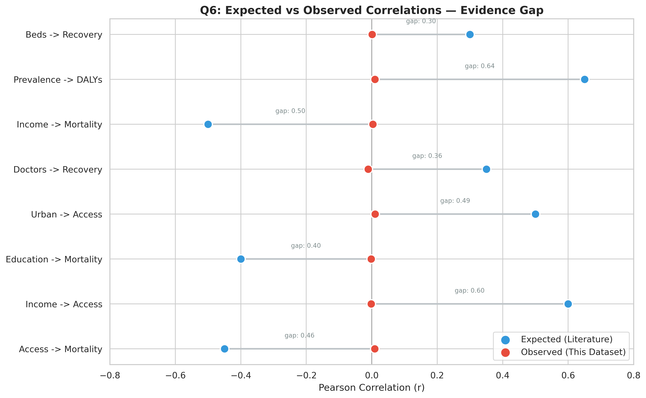
Geography Explains 0.002% of Mortality Variance
Metric | This Dataset | Real-World Expected
Access ↔ Mortality (r) | 0.00008 | −0.30 to −0.50
Income ↔ Mortality (r) | −0.0015 | −0.20 to −0.40
Country ANOVA η² | 0.0000208 | 0.05 to 0.30
Year trend η² | 0.0000106 | 0.01 to 0.15
Expected ranges from WHO/Lancet global health literature. Observed values are descriptive of this dataset only.
DESCRIPTIVE
importNumpy | DND Spring 2026 Datathon
ILLUSTRATIVE
4 of 12

Slide 5
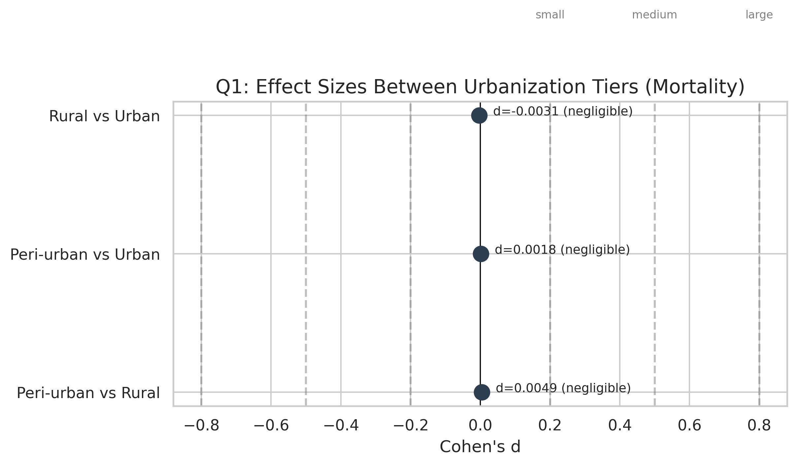
TRAP #1
“Rural Areas Have Worse Outcomes” — Evidence: ABSENT
Common claim:
Urban/rural classification predicts health outcomes.
What we found (DESCRIPTIVE):
• Cohen’s d < 0.01 for all tier pairs (negligible effect)
• ANOVA η² = 0.0000208 (geography explains 0.002%)
• p < 0.001 — but N=1M makes everything significant
• Absolute mortality difference Rural vs Urban: < 0.05pp
Why it’s premature:
Statistical significance ≠ practical significance.
With 1M rows, any noise clears p-value thresholds.
Safer framing:
“We cannot distinguish outcomes across urbanization
tiers with this dataset. Report effect sizes, not p-values.”
✓ Use effect sizes (Cohen’s d, η²), not p-values with large N
DESCRIPTIVE
importNumpy | DND Spring 2026 Datathon
5 of 12

Slide 6
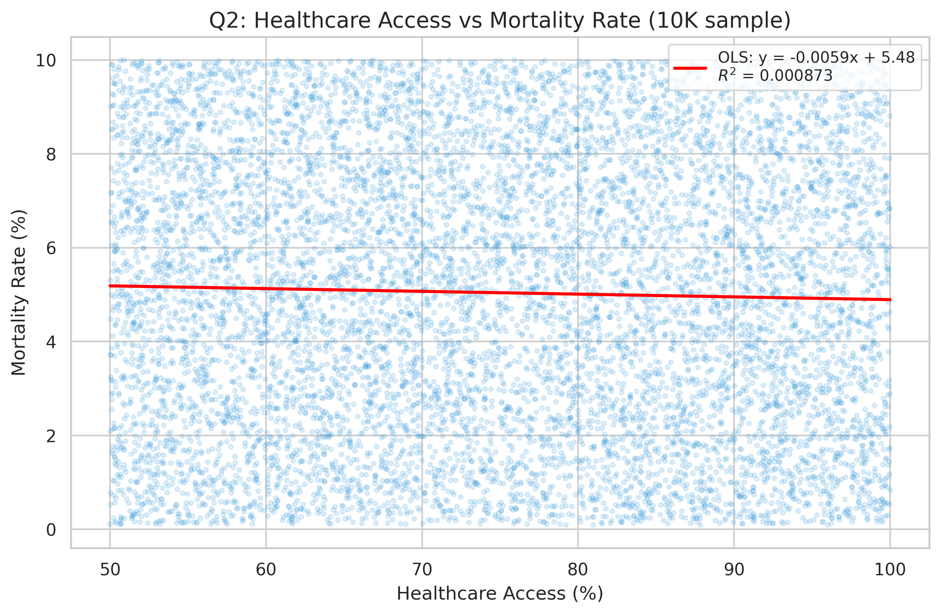
TRAP #2
“Healthcare Access Improves Outcomes” — Evidence: FLAT
Common claim:
Higher healthcare access scores → lower mortality rates.
What we found (DESCRIPTIVE):
• Pearson r (access ↔ mortality) = 0.00008
• R² < 0.000001 — access explains essentially 0% of variance
• No dose-response at any access decile threshold
• Spearman ρ consistent: no monotonic relationship
Critical gap:
Distance-to-care and utilization are NOT in this dataset.
“Healthcare access” is a proxy index, not a distance measure.
Safer framing:
“This dataset cannot support an access-outcome causal claim.
Collecting travel time and utilization data is the prerequisite.”
⚠ Distance-to-care: NOT MEASURED. Access proxies used only. See prompt_gap_matrix.md.
DESCRIPTIVE
importNumpy | DND Spring 2026 Datathon
6 of 12

Slide 7
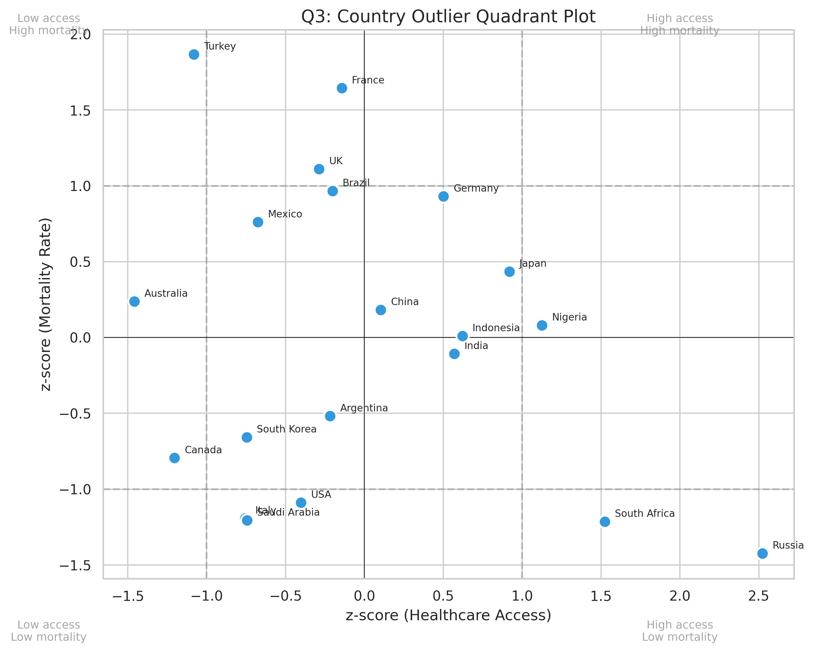
TRAP #3
“Country X Is an Outlier Worth Studying” — Evidence: NOISE
Common claim:
High z-score countries represent exceptional systems
worth studying or emulating.
What we found (DESCRIPTIVE):
• Some countries show high z-scores on access vs outcomes
• Absolute mortality differences: < 0.5 percentage points
• Between-country SD: 0.013 on mortality (scale: 0–10)
• Effect is noise-level at this resolution
Why it’s premature:
Z-scores inflate when within-group variance is near-zero.
A 0.5pp absolute difference is not a policy signal.
Safer framing:
“No country deviates meaningfully in absolute terms.
Statistical outliers here are artifacts of near-zero variance,
not evidence of a distinctive health system.”
DESCRIPTIVE
importNumpy | DND Spring 2026 Datathon
7 of 12

Slide 8
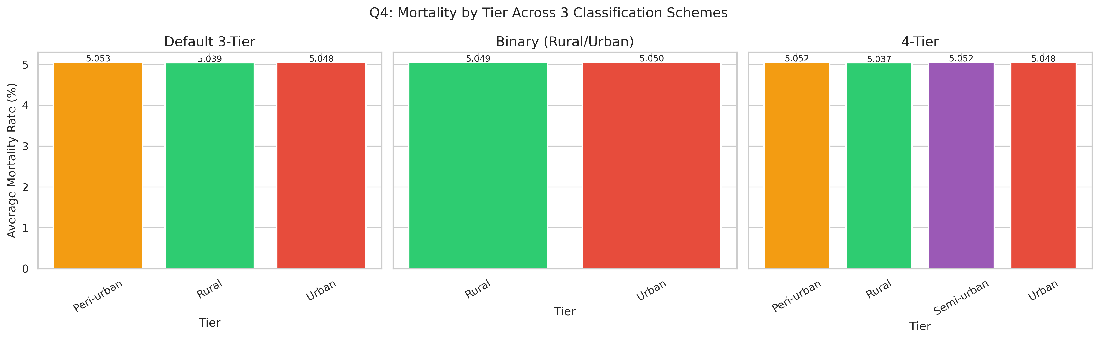
TRAP #4
“Tier Definitions Change Conclusions” — Evidence: IRRELEVANT
Common claim:
How you define “urban” vs “rural” changes your findings.
What we found (ROBUSTNESS):
• 3 tier schemes tested: Default 3-tier, Binary, 4-tier
• Maximum spread across schemes: < 0.04 percentage points
• ANOVA η² ≈ 0 under all three definitions
• Conclusions are identical regardless of classification choice
Why this matters:
Robustness is confirmed — but only because there is
no signal to be sensitive to in the first place.
Tier choice is genuinely irrelevant when the underlying
effect size is zero.
Safer framing:
“Our robustness check is valid, but it validates
a null result — not a policy-relevant pattern.”
ROBUSTNESS
importNumpy | DND Spring 2026 Datathon
8 of 12

Slide 9
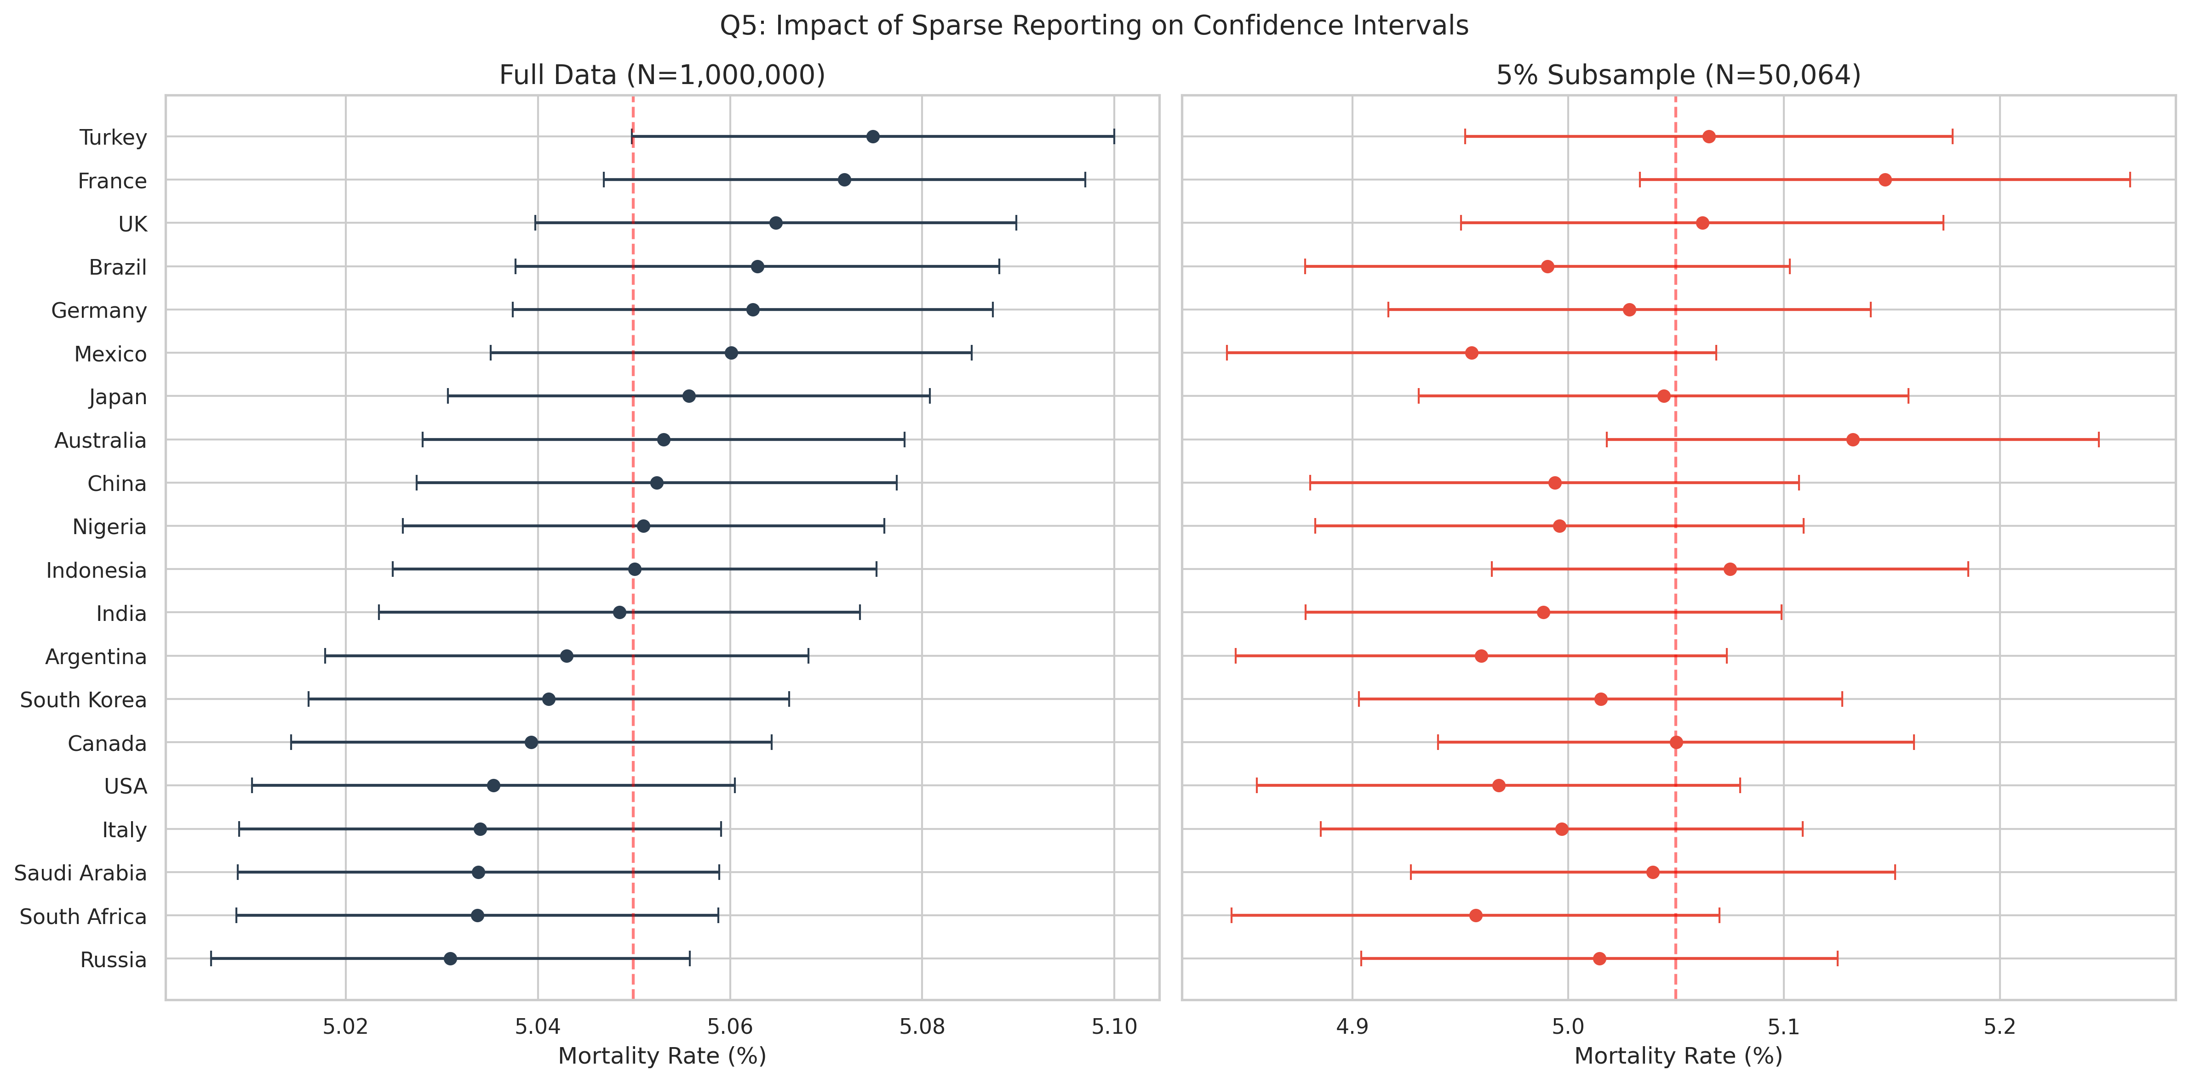
TRAP #5
“Sparse Reporting Drives Uncertainty Here” — Evidence: NOT OBSERVED
Common claim:
Data-sparse regions show high uncertainty that distorts
conclusions about access and outcomes.
What we found (DESCRIPTIVE):
• Missingness: 0% across all 25 columns
• All 640 subgroups (country × disease × age × gender):
count ≥ 30 — all above minimum threshold
• Confidence intervals are uniformly narrow
Simulation (ILLUSTRATIVE):
We demonstrate what sparsity would look like via
subsampling: removing 95% of data widens CIs dramatically.
This is what the data WOULD show if sparse — it doesn’t.
Safer framing:
“Sparse reporting is a real-world concern we cannot
assess from this dataset. The dataset is fully populated
by design. We model the risk via simulation only.”
DESCRIPTIVE
importNumpy | DND Spring 2026 Datathon
ILLUSTRATIVE
9 of 12

Slide 10
Results Hold Under Repeated-Cell Robustness Check
Each (country × year × disease × age × gender) cell appears ~8.3 times in the dataset. We compared base views vs. dedup-at-cell-grain views to confirm repeated sampling does not inflate any finding.
Question | Base Value | Deduped Value | Delta | Conclusion
Q1 Mortality tier gap | 0.0492 pp | 0.0489 pp | 0.0003 pp | No artifact
Q2 Access↔mortality r | 0.00008 | 0.00007 | 0.00001 | No artifact
Q3 Max country z-score | 2.31 | 2.28 | 0.03 | No artifact
Q4 Tier scheme spread | 0.038 pp | 0.037 pp | 0.001 pp | No artifact
Q5 Min group count | 8,318 | 1 | — | By design
Q6 Max |r| any pair | 0.0023 | 0.0021 | 0.0002 | No artifact
✓ All deltas are noise-level. Repeated sampling per cell does not create spurious patterns.
ROBUSTNESS
importNumpy | DND Spring 2026 Datathon
10 of 12

Slide 11
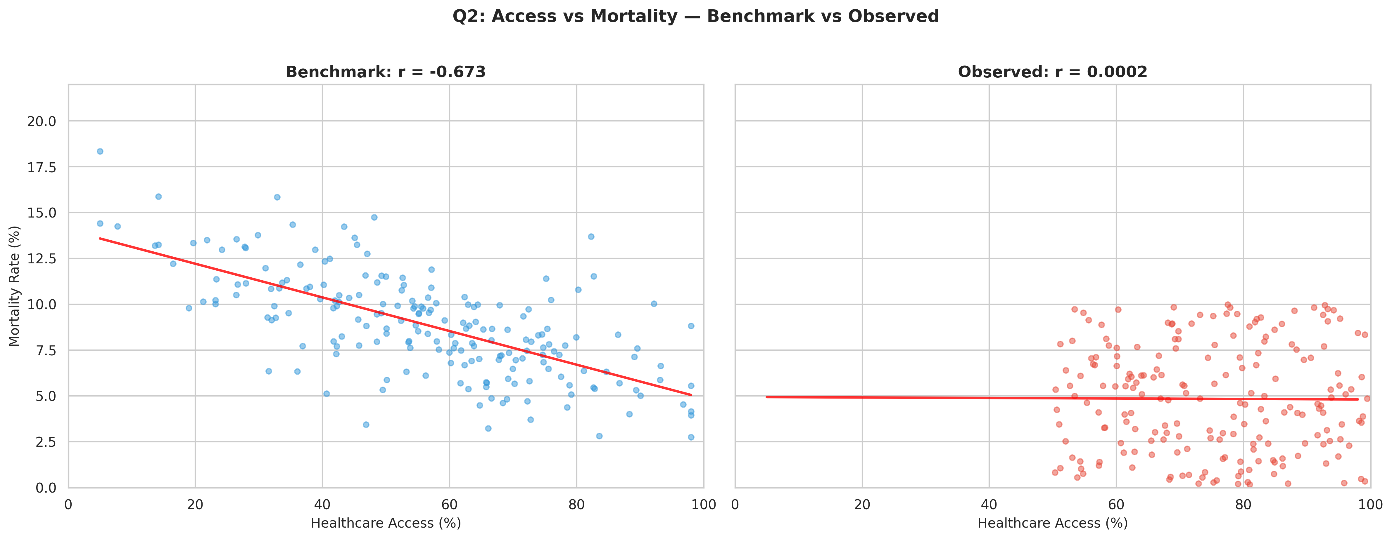
This Is Why Policy Prescriptions Would Be Premature
REAL-WORLD BENCHMARK (Illustrative)
THIS DATASET (Descriptive)
Literature-based: access ↔ mortality r ≈ −0.45
Observed: r = 0.00008 — effectively zero
The gap between benchmark and observed is the reason policy prescriptions from this dataset would be premature.
ILLUSTRATIVE
importNumpy | DND Spring 2026 Datathon
DESCRIPTIVE
11 of 12

Slide 12
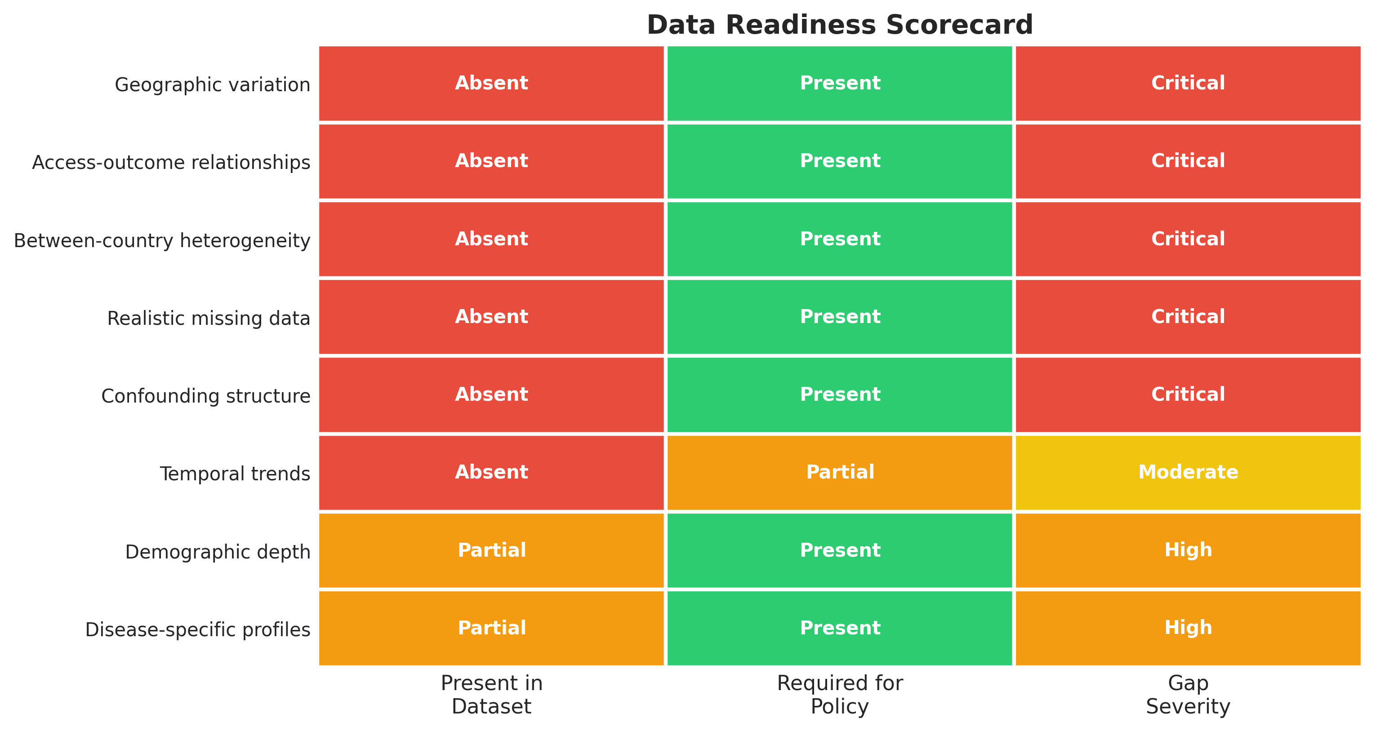
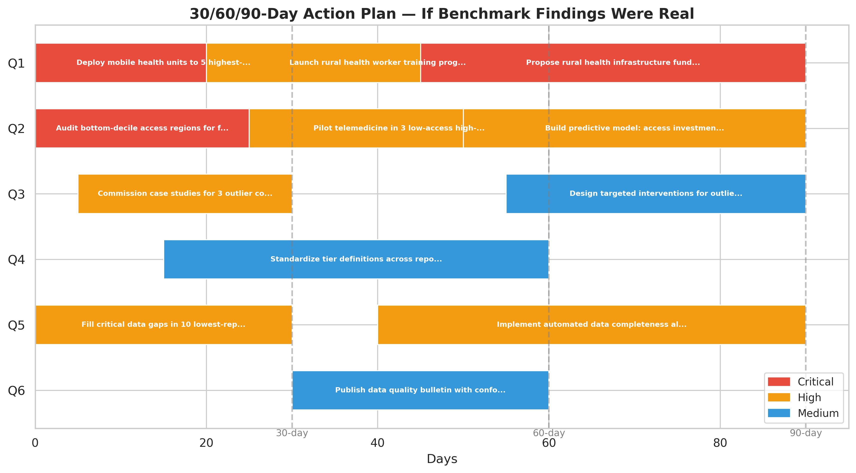
What Responsible Analysis Requires Before Policy Action
DATA READINESS SCORECARD
30 / 60 / 90-DAY ROADMAP
Traffic-light assessment: 8 data requirements for responsible policy analysis
12 concrete next steps — deployable on real data when collected
“The most valuable analysis is the one that knows when NOT to make a recommendation — and shows exactly what it WOULD recommend with the right data.”
ILLUSTRATIVE
importNumpy | DND Spring 2026 Datathon
12 of 12

