Slide 1
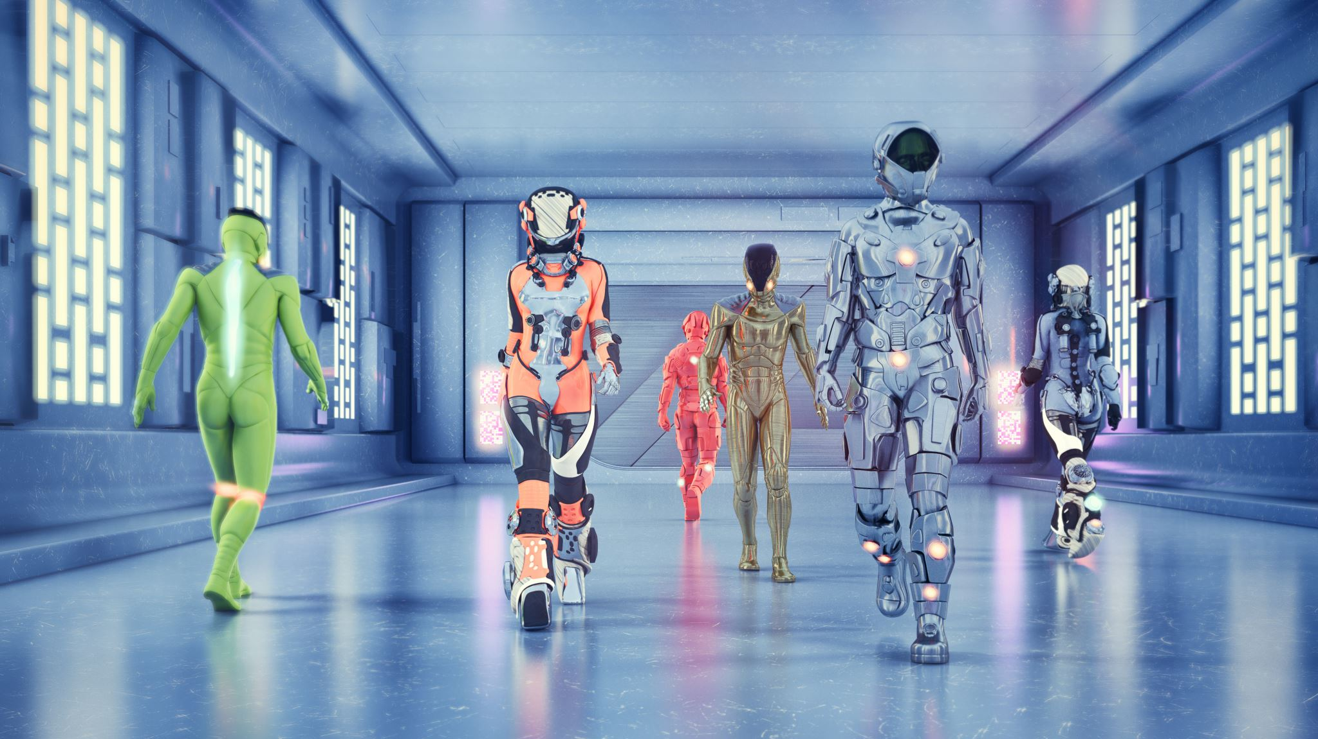
Space Escape Sprint 2 Review
By Phelix Brooks
DMSE SENG 102

Slide 2
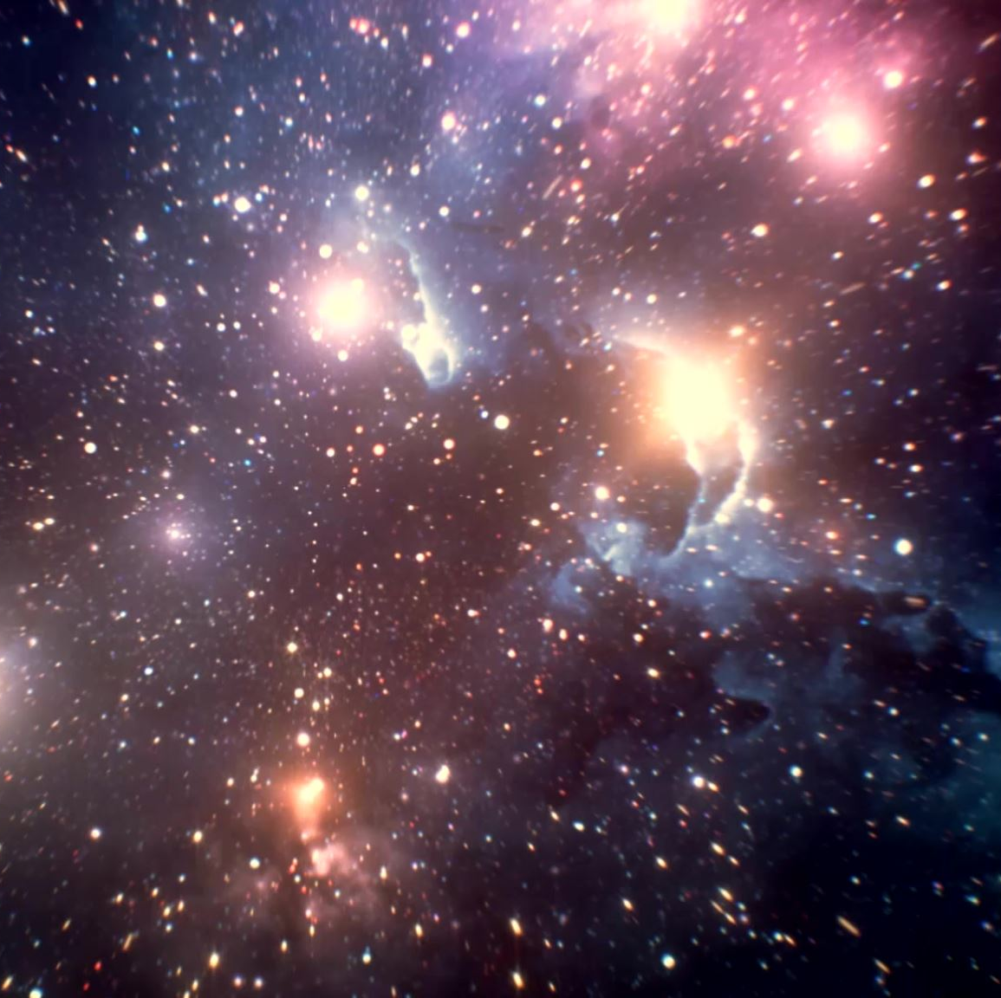
Space Escape Overview
Space Escape is a game similar to Alien Invasion. Space escape shows the game from an Aliens perspective running away from Earthlings. The backstory includes more information like why the Aliens are traveling to Earth and how the Earthlings (who are major environmentalists to the point that they do not agree with anything that relatively harms the Earth) reacted when they got there.

Slide 3

Sprint 1 Review
The main goal of Sprint 1 was to create the base game with most base features and a couple more in-depth features.
Sprint 1 Features:
Main Menu screen
Game screen
Win/Game Over screen
Score displays
Start button
Player ship
Earthling ship
Game over message display

Slide 4
Sprint 2 Review
The goal of Sprint 2 is to refine existing features and add more detailed features as well.
Sprint 2 Features:
Backstory scene
Explosion visuals when an alien ship is defeated
Bullet animation

Slide 5
Additions
Blinking Bullet Image
public void shotTimer() {
int i = 0;
long time = System.currentTimeMillis();
for (i=0;i<=time;i++) {
long newTime = System.currentTimeMillis();
if (newTime >= time+500) {
break;}}
if (shotLabel.isVisible()==true) {
shotLabel.setVisible(false);}
else {
shotLabel.setVisible(true);}}

Slide 6
Sprint 3 Plan
In Sprint 3 I would like to refine all my features as well as work any bugs that are causing my program to work incorrectly.
Sprint 3 Plan:
Check all features
Workout bugs
Clean up code to make it more readable

Slide 7
Sprint 4(Extra Sprint) Plan
Sprint 4 is the sprint where I would like to attempt to add in features I have not mastered yet.
Sprint 4 Plan:
Add a locally recordable highscore that is pulled each time the game starts
Add an option to replay rather than exit the game after playing
Sound effects and music

