Slide 1

Event – Created by AEW on 10/08/2023
ID
Event Type
Overview
Program
13/07/2020
Duration
Engineer
Contact
Contact Method
Notes
Files
<n> Files linked
Mantis Entries
<n> Mantis Entries linked
OK
Apply
Cancel

Slide 2
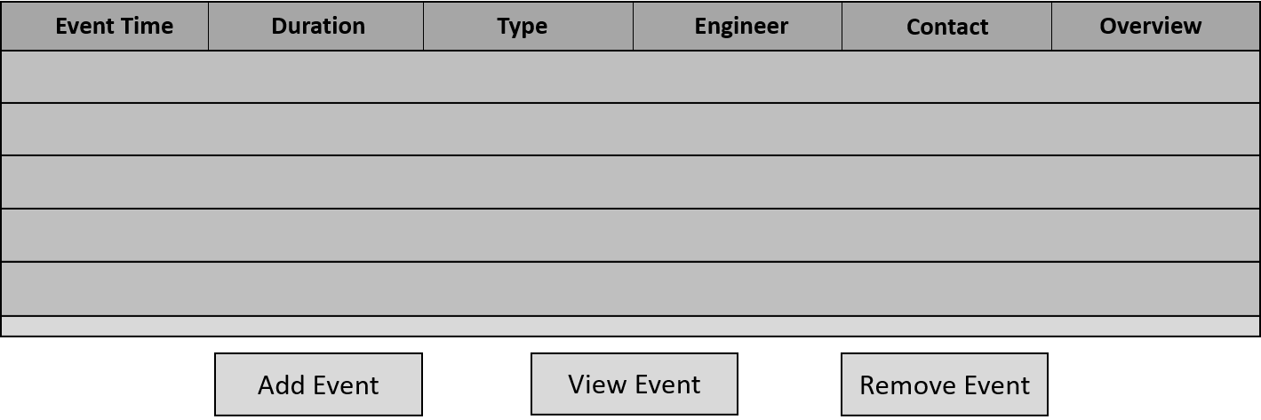
Ticket – Created by CK on 07/08/2023 – Ticket is 3 days and 4 hours old
ID
Version <n> Build <n>
Ticket Status
Overview
Contract Number
Customer
13/07/2020
Duration
Primary Engineer
Primary Contact
Awaiting
Awaiting Engineer
Notes
Awaiting Contact
Awaiting Reason
Event Types
Event Engineers
Event Programs
Files
<n> Files linked
Mantis Entries
<n> Mantis Entries linked
OK
Apply
Cancel

Slide 3

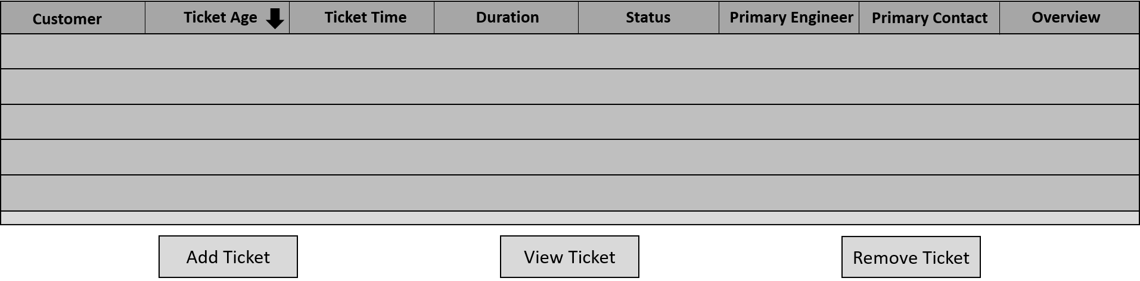
Support Tracker – Version 1.0
ID
Hide Closed Tickets
<n> Total Open Tickets
Ticket Age >
Ticket Status
Customer
Event Type
Primary Engineer
Engineer
Displaying <n> Tickets
OK
Apply
Cancel

Slide 4
Event Time
Duration
Type
Engineer
Contact
Overview
Add Event
View Event
Remove Event
Customer
Ticket Age
Ticket Time
Duration
Status
Primary Engineer
Primary Contact
Overview
Add Ticket
View Ticket
Remove Ticket

Slide 5
