Slide 1
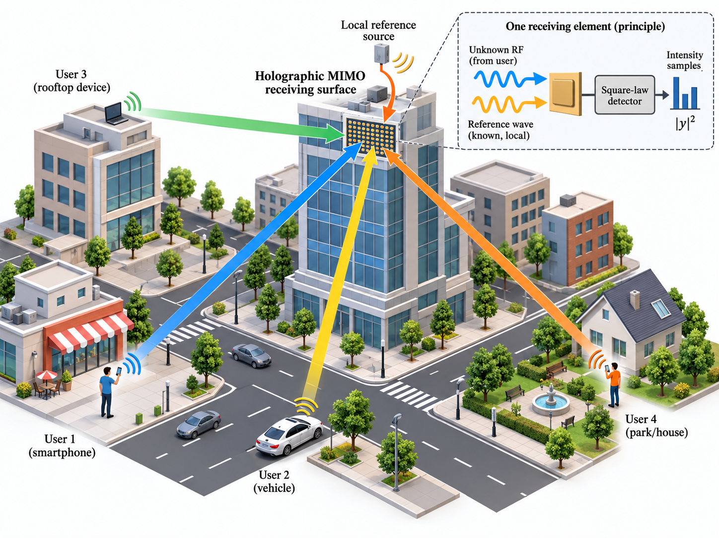
Reference image (raster) for visual comparison
This slide keeps the original PNG for comparison only. The next slide is an editable PowerPoint reconstruction.

Slide 2
Editable scenario reconstruction (all objects are PowerPoint shapes)
You can move / recolor / relabel each element
Multiple users
~
~
~
Holographic MIMO
receiver
~
RF ref.
+
Known reference wave
Multiuser links
Target users / objects
Template note: objects are editable PowerPoint shapes. Ungroup / recolor / relabel as needed for your paper figure.

