Slide 1
Received RF waveform
Reference interference
Detect & integrate
Intensity samples
Amplitude and phase
Spatial interference pattern
Square-law energy sensing
Space × time
Known reference wave
Pilot interval
Data interval
I Learn the channel
II Recover the baseband symbols
Pilot-guided direction and gain estimation
Reference-assisted phase retrieval
Predict intensity
Q
+
I
−
Pilot patterns
Refine directions
Learned channel
Data patterns
Resolved symbols
and path gains
Directions + gains
Refine symbols
Damped Gauss–Newton
Reference-assisted GS
I
Use learned channel
Q
I/Q symbol sequence
Notes:
Source: main.pdf, Section II.B–D and Section IV.A–C, Algorithms 1 and 2. This is a conceptual signal-evolution illustration, not simulation or measured data. RF waveforms, energy envelopes, patterns, gain phasors and constellation points are schematic. The receiver interferes the incoming field with a known reference before element-wise square-law detection and subslot integration. Only intensity samples enter the digital algorithms. Stage I uses known pilots to initialize and refine DOAs and complex channel gains with damped Gauss–Newton; the learned channel is reused by Stage II. Stage II uses reference-assisted Gerchberg–Saxton alternating magnitude and finite-alphabet projections: add the known reference in the forward intensity prediction and remove it before back-projection. The cloud-to-constellation imagery depicts iterative constraint enforcement, not coherent I/Q mixing or an independent measured phase signal. The final I/Q traces represent the time-ordered detected complex symbols. No coherent RF downconversion is implied. QPSK is shown only as an illustrative finite constellation.

Slide 2
A From symbols to RF
B Far-field propagation
C Holographic reception
Complex symbols
Pulse shaping
RF modulation
Different arrival directions
RIS interference
Power detectors
Q
I
I
Q
+
Square-law
Other users
Symbol sequence
Overlapping pulses
I/Q carried by RF
Added before
power detection
Phase across the aperture
Known reference wave
Zoom: one receiving element, one symbol
M = 4 subslots shown
One symbol interval, T_{s}
Retain the full pattern
Subslot 0
Selected subslot m
Subslot 2
Subslot 3
Squared RF
at element i
Elements
Mean power
t
kT_{s}
(k + 1)T_{s}
Δt = T_{s}/M
Integrate this area
Time / subslots
Symbol k
One energy sample per subslot
M N_{r} samples per symbol
Sample indexed at its midpoint t_{k,m}
Intensity-only observations
Notes:
Source: main.pdf, Sections II.A, II.B and II.C, equations (1)–(8). This graphical model follows pulse-shaped complex symbols, RF modulation, far-field propagation, reference addition at the aperture and element-wise square-law energy sensing. Channel loss, shadowing and phase are absorbed into each complex path gain; directional phase varies across the array. The reference adds to the field before the power detector. The detailed lower plot uses a reproducible illustrative two-user raised-cosine waveform and a selected receive element, with a local reference. M=4 is drawn only for clarity. The selected m=1 window lies within symbol k=2. Each normalized integral gives one element/subslot energy sample, indexed by the subslot midpoint. All M samples per element and all Nr elements are retained; general pulse overlap requires block processing. The pale RF-squared ripple and its envelope energy are schematic in carrier scale; effective post-detection noise is omitted from the visualization. Optional transmit-side bias/pilot q(t) is omitted as allowed by xi=0. No coherent receiver I/Q mixing is implied.

Slide 3
A From symbols to RF
B Far-field propagation
C Holographic reception
Complex symbols
Pulse shaping
RF modulation
Different arrival directions
RIS interference
Power detectors
Q
I
I
Q
+
Square-law
Other users
Symbol sequence
Overlapping pulses
I/Q carried by RF
Added before
power detection
Phase across the aperture
Known reference wave
Zoom: one receiving element, one symbol
M = 8 subslots shown
One symbol interval, T_{s}
Retain the full pattern
Subslot 0
Subslot 1
Subslot 2
Subslot 3
Subslot 5
Subslot 4
Subslot 6
Subslot 7
Subslot 8
Squared RF
at element i
Elements
Mean power
t
kT_{s}
(k + 1)T_{s}
Δt = T_{s}/M
Integrate this area
Time / subslots
Symbol k
One energy sample per subslot
M N_{r} samples per symbol
Sample indexed at its midpoint t_{k,m}
Intensity-only observations
Notes:
Source: main.pdf, Sections II.A, II.B and II.C, equations (1)–(8). This graphical model follows pulse-shaped complex symbols, RF modulation, far-field propagation, reference addition at the aperture and element-wise square-law energy sensing. Channel loss, shadowing and phase are absorbed into each complex path gain; directional phase varies across the array. The reference adds to the field before the power detector. The detailed lower plot uses a reproducible illustrative two-user raised-cosine waveform and a selected receive element, with a local reference. M=4 is drawn only for clarity. The selected m=1 window lies within symbol k=2. Each normalized integral gives one element/subslot energy sample, indexed by the subslot midpoint. All M samples per element and all Nr elements are retained; general pulse overlap requires block processing. The pale RF-squared ripple and its envelope energy are schematic in carrier scale; effective post-detection noise is omitted from the visualization. Optional transmit-side bias/pilot q(t) is omitted as allowed by xi=0. No coherent receiver I/Q mixing is implied.

Slide 4
Zoom: one receiving element, one symbol
M = 9 subslots shown
One symbol interval, T_{s}
Retain the full pattern
Subslot 0
Subslot 1
Subslot 2
Subslot 3
Subslot 5
Subslot 4
Subslot 6
Subslot 7
Subslot 8
Squared RF
at element i
Elements
Mean power
t
kT_{s}
(k + 1)T_{s}
Δt = T_{s}/M
Integrate this area
Time / subslots
Symbol k
One energy sample per subslot
M N_{r} samples per symbol
Sample indexed at its midpoint t_{k,m}
Intensity-only observations
Notes:
Source: main.pdf, Sections II.A, II.B and II.C, equations (1)–(8). This graphical model follows pulse-shaped complex symbols, RF modulation, far-field propagation, reference addition at the aperture and element-wise square-law energy sensing. Channel loss, shadowing and phase are absorbed into each complex path gain; directional phase varies across the array. The reference adds to the field before the power detector. The detailed lower plot uses a reproducible illustrative two-user raised-cosine waveform and a selected receive element, with a local reference. M=4 is drawn only for clarity. The selected m=1 window lies within symbol k=2. Each normalized integral gives one element/subslot energy sample, indexed by the subslot midpoint. All M samples per element and all Nr elements are retained; general pulse overlap requires block processing. The pale RF-squared ripple and its envelope energy are schematic in carrier scale; effective post-detection noise is omitted from the visualization. Optional transmit-side bias/pilot q(t) is omitted as allowed by xi=0. No coherent receiver I/Q mixing is implied.

Slide 5
A From symbols to RF
B Far-field propagation
C Holographic reception
Complex symbols
Pulse shaping
RF modulation
Different arrival directions
RIS interference
Power detectors
Q
I
I
Q
+
Square-law
Other users
Symbol sequence
Overlapping pulses
I/Q carried by RF
Added before
power detection
Phase across the aperture
Known reference wave
Zoom: one receiving element, one symbol
M = 9 subslots shown
One symbol interval, T_{s}
Retain the full pattern
Subslot 0
Subslot 1
Subslot 2
Subslot 3
Subslot 5
Subslot 4
Subslot 6
Subslot 7
Subslot 8
Squared RF
at element i
Elements
Mean power
t
kT_{s}
(k + 1)T_{s}
Δt = T_{s}/M
Integrate this area
Time / subslots
Symbol k
One energy sample per subslot
M N_{r} samples per symbol
Sample indexed at its midpoint t_{k,m}
Intensity-only observations
Notes:
Source: main.pdf, Sections II.A, II.B and II.C, equations (1)–(8). This graphical model follows pulse-shaped complex symbols, RF modulation, far-field propagation, reference addition at the aperture and element-wise square-law energy sensing. Channel loss, shadowing and phase are absorbed into each complex path gain; directional phase varies across the array. The reference adds to the field before the power detector. The detailed lower plot uses a reproducible illustrative two-user raised-cosine waveform and a selected receive element, with a local reference. M=4 is drawn only for clarity. The selected m=1 window lies within symbol k=2. Each normalized integral gives one element/subslot energy sample, indexed by the subslot midpoint. All M samples per element and all Nr elements are retained; general pulse overlap requires block processing. The pale RF-squared ripple and its envelope energy are schematic in carrier scale; effective post-detection noise is omitted from the visualization. Optional transmit-side bias/pilot q(t) is omitted as allowed by xi=0. No coherent receiver I/Q mixing is implied.

Slide 6
Subslot 0
Subslot 1
Subslot 2
Subslot 3
Subslot 5
Subslot 4
Subslot 6
Subslot 7
Subslot 8

Slide 9
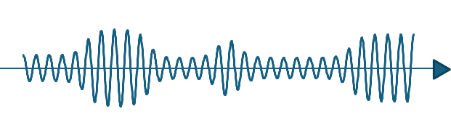
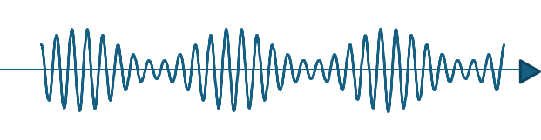
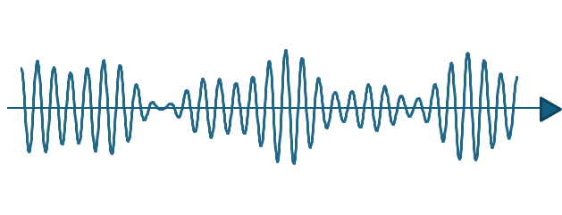
z
RIS
h₁
h_{L}
User 1
y
h₂
User L
x
User 2

Slide 10
z
RIS
h₁
h_{L}
User 1
y
h₂
User L
x
User 2

